Slide 1
CS3103 Operating System 2023/2024 Sem B
Chapter 3: Threads
Dr. Nan Guan
Department of Computer Science
City University of Hong Kong

Slide 2
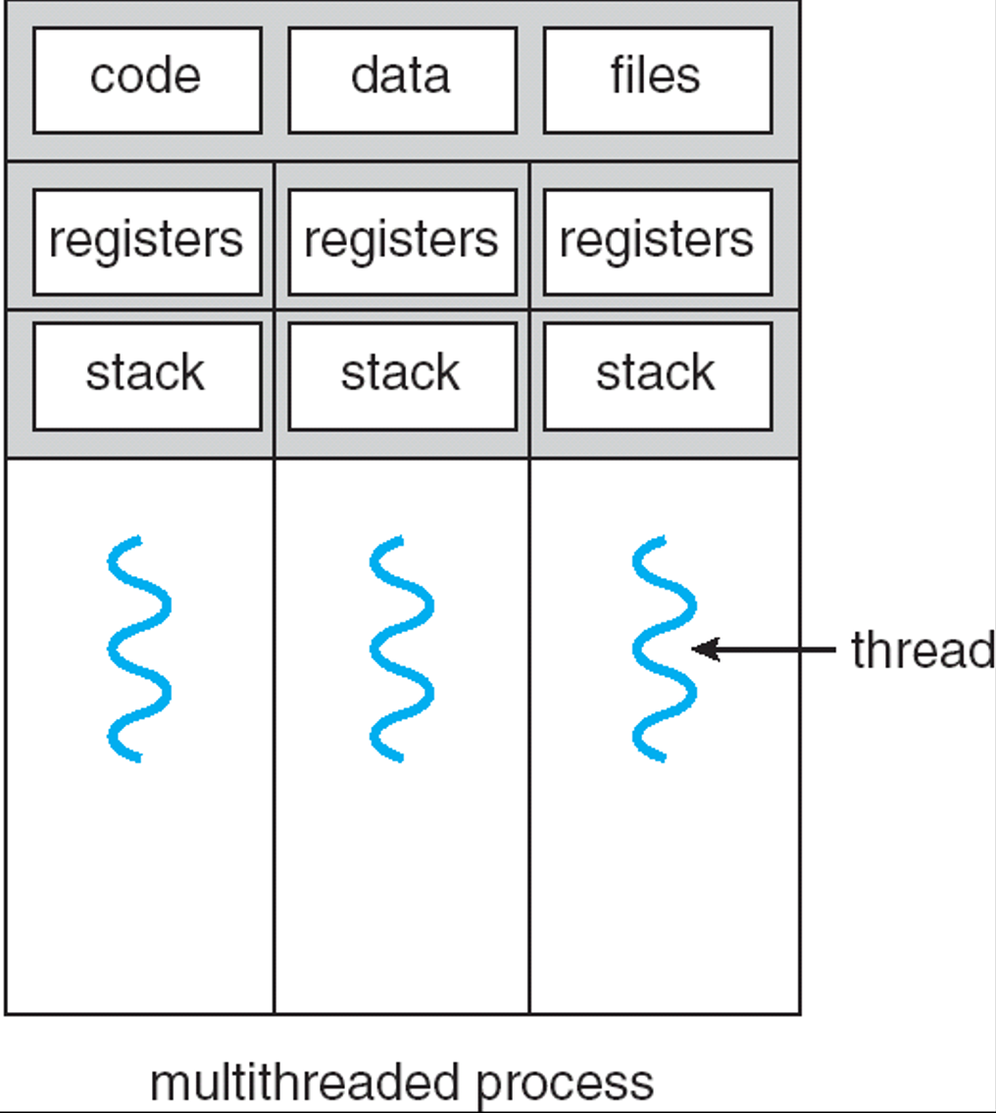
Threads
Thread is an execution unit that is part of a process
A process can have multiple threads, which can execute at the same time
Thread is an execution units managed by OS scheduler
Thread is a “lightweight process”
Threads in a process share the same address space and many resources
While different processes do not share
Typical OS design
Multiple processes
Each process contains multiple threads

Slide 3
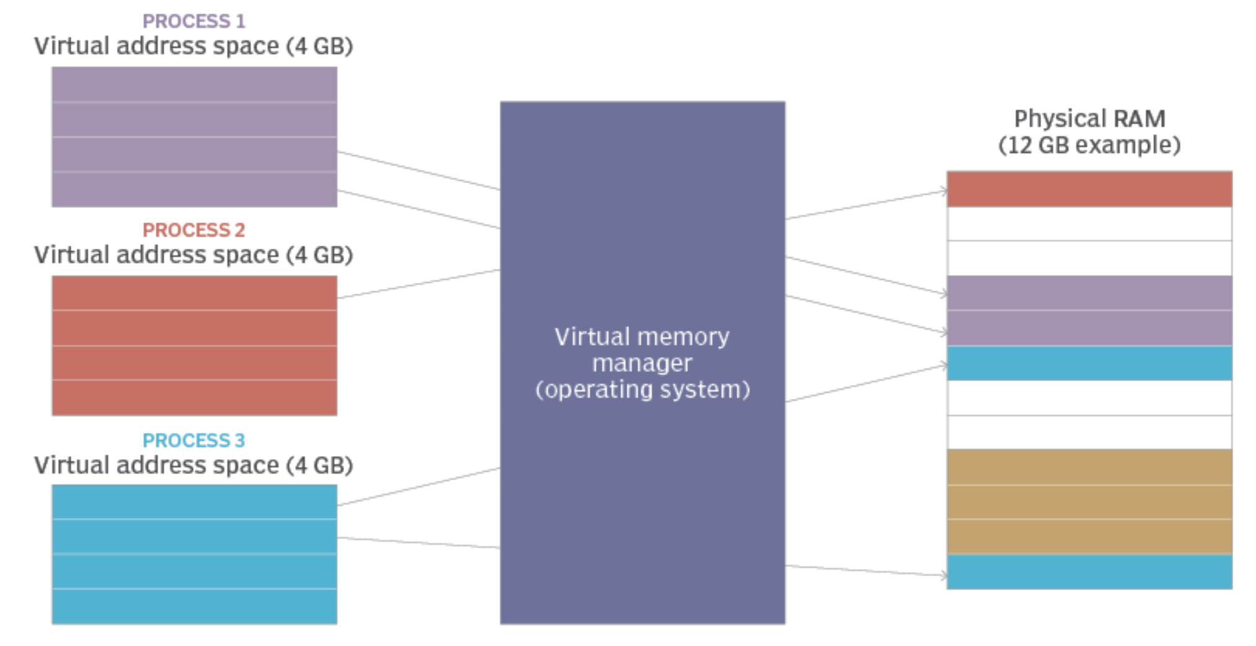
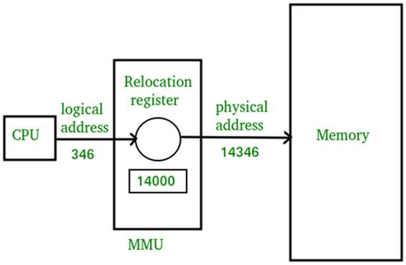
Address Space
Logical address – generated by the CPU; also referred to as virtual address
Physical address – address seen by the memory unit
memory
management
unit

Slide 4
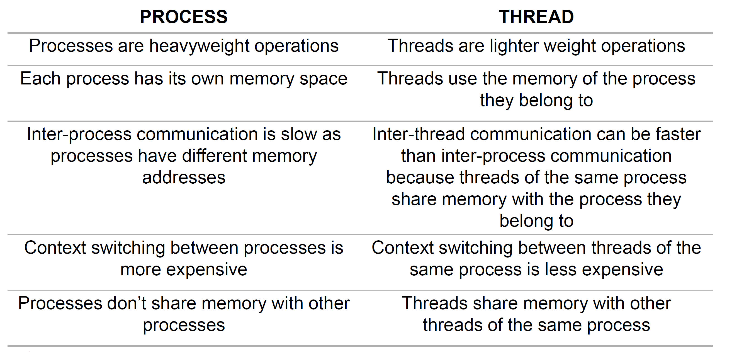
Comparing Process and Thread

Slide 5
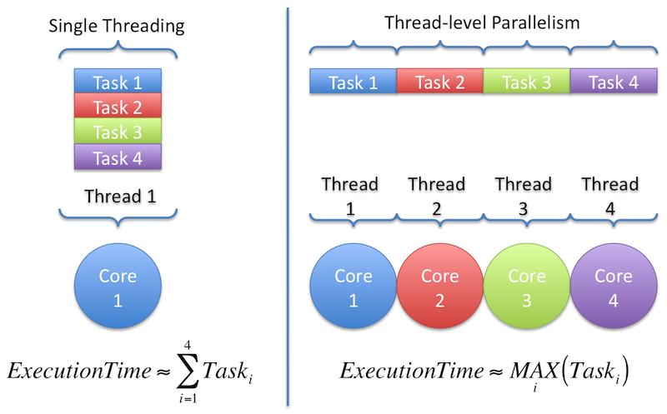
Why Multi-threads in a Process?
For parallel execution
Some program has inherent parallelism
E.g., adding two large arrays, or incrementing the value of each element in the array by some amount
If executed on computer with multiple CPU cores, we can run each thread on a CPU core, to speedup the execution

Slide 6
Why Multi-threads in a Process?
For higher CPU utilization in the presence of I/O blocking
I/O operation is usually slow, CPU wasted when waiting for I/O
Instead of waiting, a program may be able to do something else
utilizing the CPU to perform computation
issuing other I/O requests
Using multiple threads to avoid getting stuck: while one thread waits (i.e., is blocked waiting for I/O), the CPU scheduler can switch to other threads to do something useful
Helpful even if there is only one CPU core

Slide 7
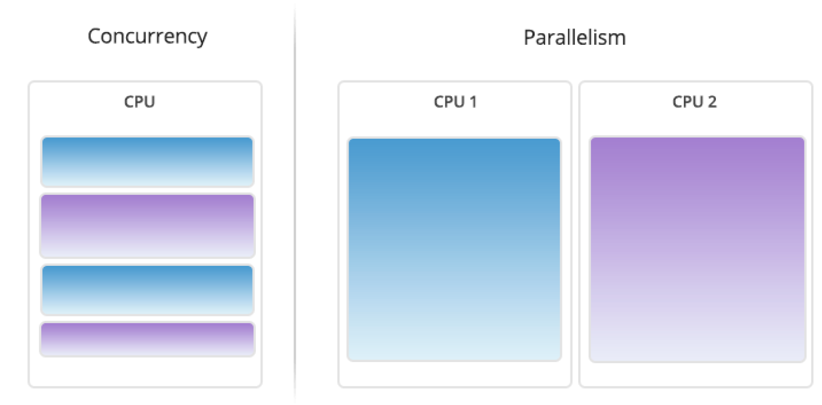
Parallelism vs Concurrency
Parallelism: running multiple threads/processes in parallel over different CPU cores
Concurrency: running multiple threads/processes at the same time, even on single CPU core, by interleaving their executions

Slide 8
User Thread vs Kernel Threads
User Threads
Thread management done by user-level threads library
examples:
POSIX Pthreads
Java threads
Kernel Threads
Managed by the Kernel
User threads are mapped to kernel threads

Slide 9
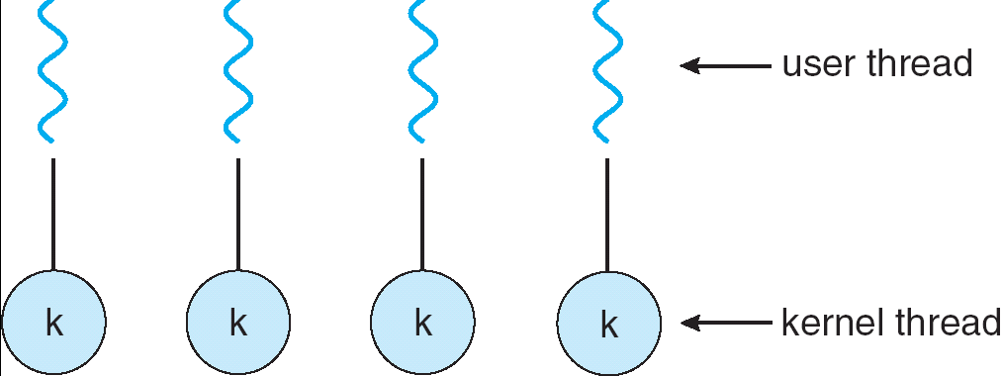
Multithreading Models
One-to-One: Each user-level thread mapped to a kernel thread
Different user threads can execute in parallel simultaneously
Expensive in resource: Creating a user thread requires a kernel thread
Examples: Windows NT/XP/2000, Linux, Solaris 9 and later

Slide 10
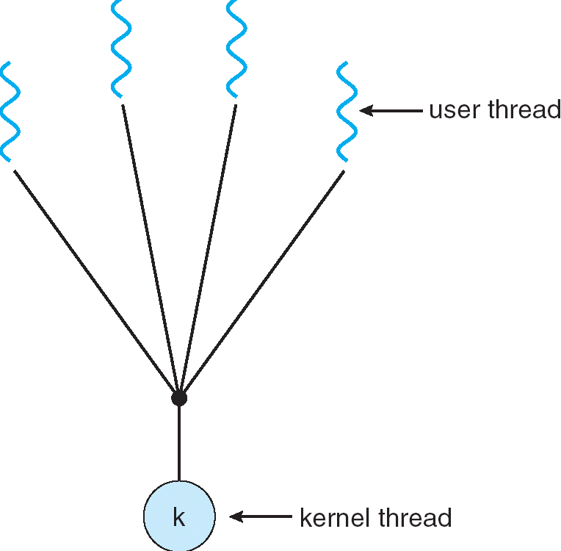
Multithreading Models
Many-to-One: Many user threads mapped to one kernel thread
One thread can access kernel at a time
Multiple thread can not run in parallel
Examples: Solaris Green Threads, GNU Portable Threads

Slide 11
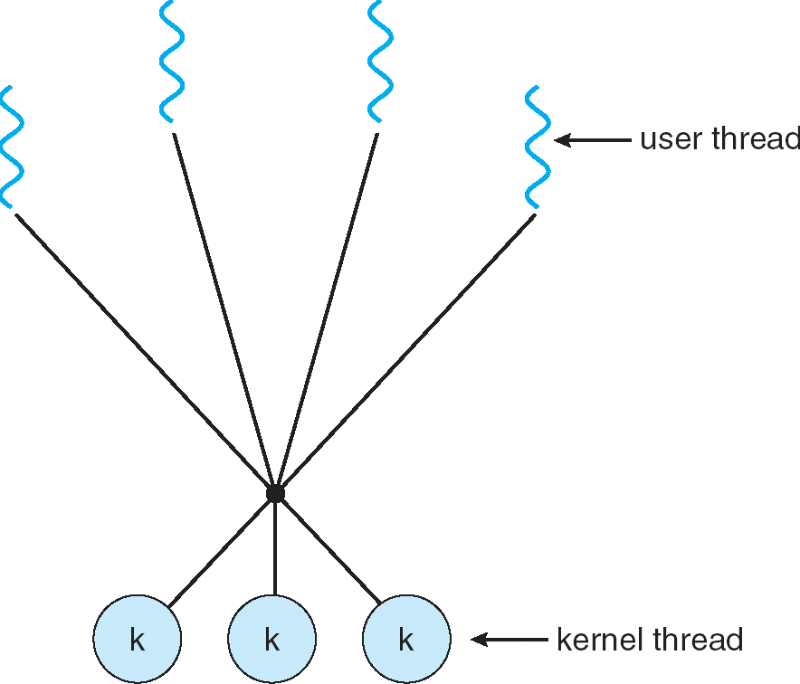
Multithreading Models
Many-to-Many: Allows many user level threads to be mapped to many kernel threads
Allows OS to create a sufficient number of kernel threads
Examples: Solaris prior to version 9, Windows NT/2000 with the ThreadFiber package

Slide 12
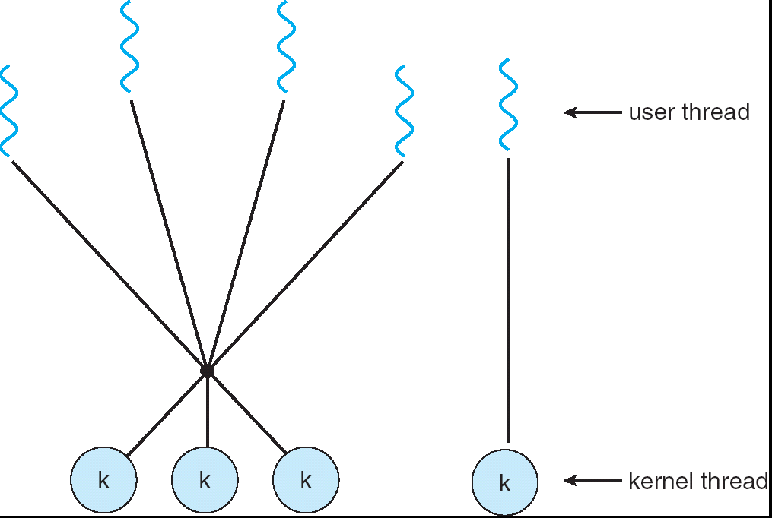
Multithreading Models
Combined Model: Similar to M:M, except that it allows a user thread to be bound to kernel thread
Coexistence of one-one and many-many
Examples: IRIX, HP-UX, Tru64 UNIX, Solaris 8 and earlier

Slide 13
User Thread vs Kernel Threads
User Thread | Kernel Thread
User thread are implemented by users. | kernel threads are implemented inside OS.
Oriented to users; users program with user threads, but do not worry about the implementation details (how they are mapped to kernel threads, and thus managed by the OS kernel) | Oriented to kernel; OS kernel actually manages the threads (e.g., scheduling, preemption, synchronization)
OS doesn’t recognize user level threads. | Kernel threads are recognized by OS.
Possible to schedule the user threads in user level without entering the kernel mode (M:1 mapping); in this case, the scheduling functionality is limited (some actions, e.g., preemption, impossible in user mode) | The OS kernel has full functionality to manage kernel threads
If one user level thread perform blocking operation then entire process will be blocked (in M:1 mapping) | If one kernel thread perform blocking operation then another thread can continue execution.
Context switch overhead is lower | Context switch overhead is higher

Slide 14
Thread Cancellation
Terminating a thread before it has finished
Example: In Pthread, use pthread_cancel() to cancel another thread
Two general approaches
Asynchronous cancellation terminates the target thread at any time
Supposedly terminate immediately, but not guaranteed
Deferred cancellation allows the target thread to be cancelled at certain cancellation point
To avoid improper cancellation, e.g., holding unreleased resource

Slide 15
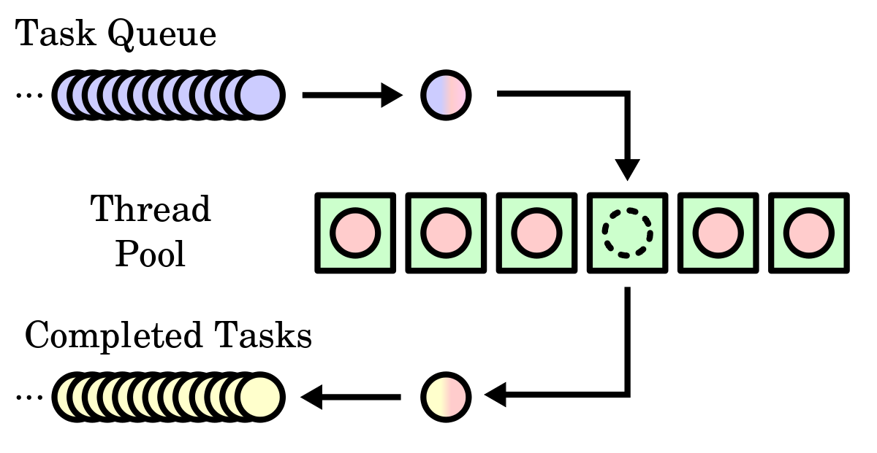
Thread Pools
Thread Pools
Create a number of threads in a pool where they await to do tasks
Advantages:
Usually faster than creating a new thread
Allows to bound the number of threads in the application(s)
Example: Web servers, Oracle DB, OpenMP

Slide 16
Pthreads
POSIX Thread (Pthread)
A POSIX standard (IEEE 1003.1c) API for thread creation and synchronization
API specifies behavior of the thread library, implementation is up to development of the library
Common in UNIX OS
e.g., Solaris, Linux, Mac OS X
these OS provides the Pthread library to user

Slide 17
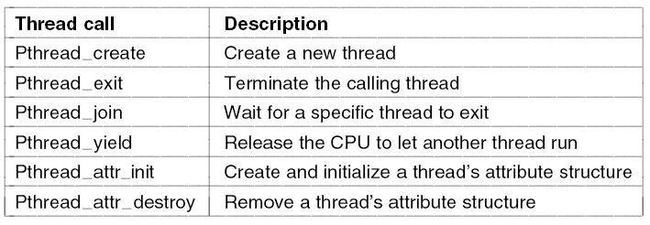
Pthread

Slide 18
Pthread
1 #include <stdio.h>
2 #include <stdlib.h>
3 #include <pthread.h>
4
5 void *mythread(void *arg) {
6 printf("%s\n", (char *) arg);
7 return NULL;
8 }
9
10 int main(int argc, char *argv[]) {
11 if (argc != 1) {
12 fprintf(stderr, "usage: ./t0\n");
13 exit(1);
14 }
15
16 pthread_t p1, p2;
17 printf("main: begin\n");
18 pthread_create(&p1, NULL, mythread, "A");
19 pthread_create(&p2, NULL, mythread, "B");
20 // join waits for the threads to finish
21 pthread_join(p1, NULL);
22 pthread_join(p2, NULL);
23 printf("main: end\n");
24 return 0;
25 }
Thread Creation
Thread Completion
#include <pthread.h>
int
pthread_create(pthread_t * thread,
const pthread_attr_t * attr,
void * ( * start_routine)(void * ),
void * arg);
int pthread_join(pthread_t thread,
void ** value_ptr);

Slide 19
Pthread
Thread Join
"Joining" is one way to accomplish synchronization between threads.
The pthread_join() subroutine blocks the calling (master) thread until the (worker) thread identified by thread identifier terminates.
int pthread_join(pthread_t thread, void **retval);
The worker thread's return value can be obtained by retval if it was specified in the worker thread's call to pthread_exit().
It is a logical error to attempt simultaneous multiple joins on the same worker thread.

Slide 20
Pthread
1 #include <stdio.h>
2 #include <stdlib.h>
3 #include <pthread.h>
4
5 void *mythread(void *arg) {
6 printf("%s\n", (char *) arg);
7 return NULL;
8 }
9
10 int main(int argc, char *argv[]) {
11 if (argc != 1) {
12 fprintf(stderr, "usage: ./t0\n");
13 exit(1);
14 }
15
16 pthread_t p1, p2;
17 printf("main: begin\n");
18 pthread_create(&p1, NULL, mythread, "A");
19 pthread_create(&p2, NULL, mythread, "B");
20 // join waits for the threads to finish
21 pthread_join(p1, NULL);
22 pthread_join(p2, NULL);
23 printf("main: end\n");
24 return 0;
25 }
main
p1
p2

Slide 21
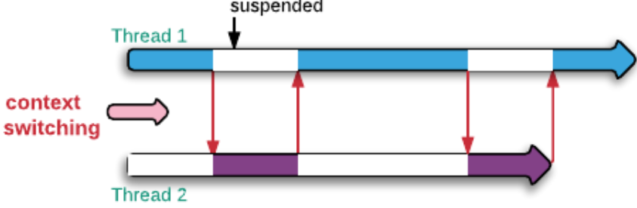
Context Switch
Context of a thread
CPU registers
Stack
Context of a process
CPU registers
Entire address space (code, data, heap, stack …)
Many other resources: kernel resource, I/O, files, …

Slide 22
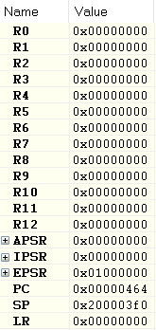
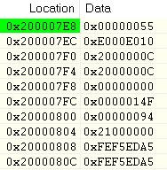
Context Protection for Interrupts
Example: registers in ARM Cortex M4
When an interrupt occurs, before switching to the ISR, registers are saved to the stack
hardware assisted
Include: PC (program counter) SP (stack pointer), …
Why?
Need to protect the registers: ISR needs to use these register
Interrupt is asynchronous, so the compiler does not know which registers to be protected
Different from the function call
Save registers
R0
R1
R2
Stack
R3
R12
LR
PC
xPSR

Slide 23
Context Switch
#include "include/tm4c_cmsis.h"
#include <intrinsics.h>
#define SYS_CLOCK_HZ 16000000U
static uint32_t volatile counter_1=0;
static uint32_t volatile counter_2=0;
static uint32_t volatile counter_3=0;
void SysTick_Handler(void) { // ISR
counter_3++;
}
void task_1() {
while (1) {
counter_1++;
for (int i=0; i<10000; i++); }
}
void task_2() {
while (1) {
counter_2++;
for (int i=0; i<10000; i++); }
}
int main() {
SysTick->LOAD = SYS_CLOCK_HZ - 1;
SysTick->VAL = 0;
SysTick->CTRL = (1U << 2) | (1U << 1) | 1;
__enable_interrupt();
while (1);
}
System Tick (SysTick)
time unit that OS timers and delays are based on
Initialize SysTick
(Trigger interrupt every system tick)
Enable Interrupt

Slide 24


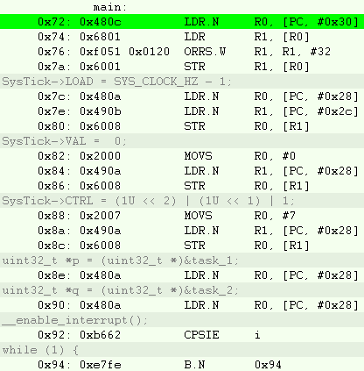
Context Switch
#include "include/tm4c_cmsis.h"
#include <intrinsics.h>
#define SYS_CLOCK_HZ 16000000U
static uint32_t volatile counter_1=0;
static uint32_t volatile counter_2=0;
static uint32_t volatile counter_3=0;
void SysTick_Handler(void) { // ISR
counter_3++;
}
void task_1() {
while (1) {
counter_1++;
for (int i=0; i<10000; i++); }
}
void task_2() {
while (1) {
counter_2++;
for (int i=0; i<10000; i++); }
}
int main() {
SysTick->LOAD = SYS_CLOCK_HZ - 1;
SysTick->VAL = 0;
SysTick->CTRL = (1U << 2) | (1U << 1) | 1;
__enable_interrupt();
while (1);
}
R0
R1
Stack
R2
main
R3
R12
LR
PC
xPSR
SysTick
…
time

Slide 25
Context Switch
#include "include/tm4c_cmsis.h"
#include <intrinsics.h>
#define SYS_CLOCK_HZ 16000000U
static uint32_t volatile counter_1=0;
static uint32_t volatile counter_2=0;
static uint32_t volatile counter_3=0;
void SysTick_Handler(void) { // ISR
counter_3++;
}
void task_1() {
while (1) {
counter_1++;
for (int i=0; i<10000; i++); }
}
void task_2() {
while (1) {
counter_2++;
for (int i=0; i<10000; i++); }
}
int main() {
SysTick->LOAD = SYS_CLOCK_HZ - 1;
SysTick->VAL = 0;
SysTick->CTRL = (1U << 2) | (1U << 1) | 1;
__enable_interrupt();
while (1);
}
R0
R1
Stack
R2
main
R3
R12
0x40
LR
PC
xPSR
task1
SysTick
…
…
time

Slide 26
Context Switch
#include "include/tm4c_cmsis.h"
#include <intrinsics.h>
#define SYS_CLOCK_HZ 16000000U
static uint32_t volatile counter_1=0;
static uint32_t volatile counter_2=0;
static uint32_t volatile counter_3=0;
void SysTick_Handler(void) { // ISR
counter_3++;
}
void task_1() {
while (1) {
counter_1++;
for (int i=0; i<10000; i++); }
}
void task_2() {
while (1) {
counter_2++;
for (int i=0; i<10000; i++); }
}
int main() {
SysTick->LOAD = SYS_CLOCK_HZ - 1;
SysTick->VAL = 0;
SysTick->CTRL = (1U << 2) | (1U << 1) | 1;
__enable_interrupt();
while (1);
}
R0
R1
Stack
R2
main
R3
R12
0x54
LR
PC
xPSR
task1
SysTick
…
task2
SysTick
…
time

Slide 27
Context Switch
#include "include/tm4c_cmsis.h"
#include <intrinsics.h>
#define SYS_CLOCK_HZ 16000000U
static uint32_t volatile counter_1=0;
static uint32_t volatile counter_2=0;
static uint32_t volatile counter_3=0;
void SysTick_Handler(void) { // ISR
counter_3++;
}
void task_1() {
while (1) {
counter_1++;
for (int i=0; i<10000; i++); }
}
void task_2() {
while (1) {
counter_2++;
for (int i=0; i<10000; i++); }
}
int main() {
SysTick->LOAD = SYS_CLOCK_HZ - 1;
SysTick->VAL = 0;
SysTick->CTRL = (1U << 2) | (1U << 1) | 1;
__enable_interrupt();
while (1);
}
R0
R1
Stack
R2
main
R3
xx
R12
0x40
LR
PC
xPSR
task1
SysTick
…
task2
SysTick
…
SysTick
time
We have cheated the processor to switch
between task 1 and task 2!
(but not completely …)

Slide 28
Context Switch
this is actually illegal
task1
save the registers of task1
SysTick
restore the registers of task1
save the registers of task1
task2
SysTick
restore the registers of task1
save the registers of task2
SysTick
time
restore the registers of task2

Slide 29
Context Switch
solutions: use two stacks
one stack per task
stack 1
task1
save the registers of task1 on stack 1
stack 2
SysTick
time

Slide 30
Context Switch
solutions: use two stacks
one stack per task
stack 1
task1
save the registers of task1 on stack 1
stack 2
SysTick
restore the registers of task1 on stack 1
time

Slide 31
Context Switch
solutions: use two stacks
one stack per task
stack 1
task1
save the registers of task1 on stack 1
stack 2
SysTick
restore the registers of task1 on stack 1
save the registers of task1 on stack 1
SysTick
time

Slide 32
Context Switch
solutions: use two stacks
one stack per task
stack 1
task1
save the registers of task1 on stack 1
stack 2
SysTick
restore the registers of task1 on stack 1
save the registers of task1 on stack 1
task2
SysTick
restore the registers of task2 from stack 2
time

Slide 33
Context Switch
solutions: use two stacks
one stack per task
stack 1
task1
save the registers of task1 on stack 1
stack 2
SysTick
restore the registers of task1 on stack 1
?
save the registers of task1 on stack 1
task2
SysTick
restore the registers of task2 from stack 2
time

Slide 34
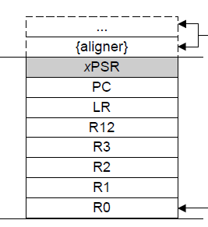
Context Switch
solutions: use two stacks
one stack per task
stack 1
task1
save the registers of task1 on stack 1
stack 2
SysTick
restore the registers of task1 on stack 1
set the initial stack frame of task2
save the registers of task1 on stack 1
task2
SysTick
restore the registers of task2 from stack 2
time

Slide 35
Context Switch
solutions: use two stacks
one stack per task
stack 1
task1
save the registers of task1 on stack 1
stack 2
SysTick
restore the registers of task1 on stack 1
save the registers of task1 on stack 1
task2
SysTick
restore the registers of task2 from stack 2
save the registers of task2 on stack 2
SysTick
time

Slide 36
Context Switch
solutions: use two stacks
one stack per task
stack 1
task1
save the registers of task1 on stack 1
stack 2
SysTick
restore the registers of task1 on stack 1
save the registers of task1 on stack 1
task2
SysTick
restore the registers of task2 from stack 2
save the registers of task2 on stack 2
SysTick
time
save the registers of task1 on stack 1

Slide 37
Context Switch
high address
low address
work to be done (when switching from task 1 to task 2):
save the registers of the task 1 to stack 1
restoring the registers of task 2 from stack 2
using the PC value stored stack 2 to resume task 2
resume from the point where this task was interrupted last time
stack 1
stack 2
save the registers of task1 on stack 1
task2
SysTick
restore the registers of task2 from stack 2
R0
R0
R1
R1
interrupted
R2
R2
R3
R3
R12
R12
LR
LR
PC
PC
time
xPSR
xPSR

Slide 38
The following slides are optional

Slide 39
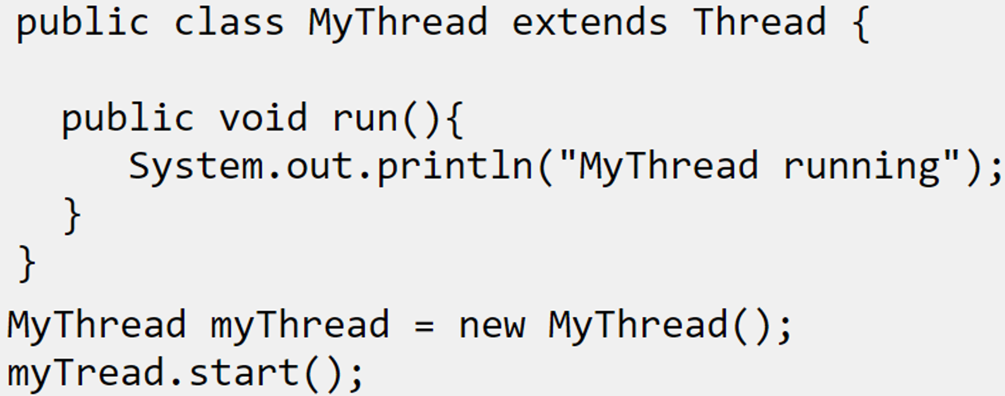
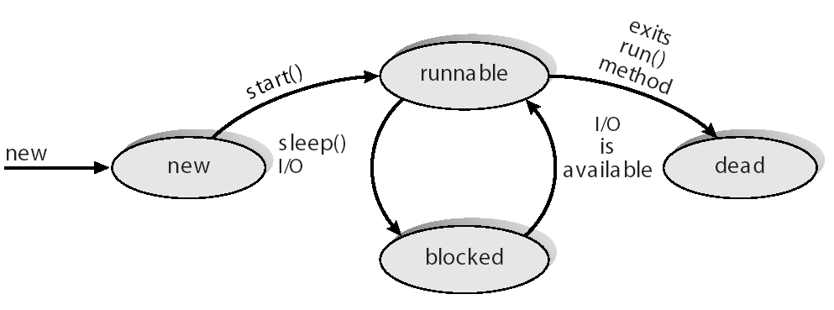
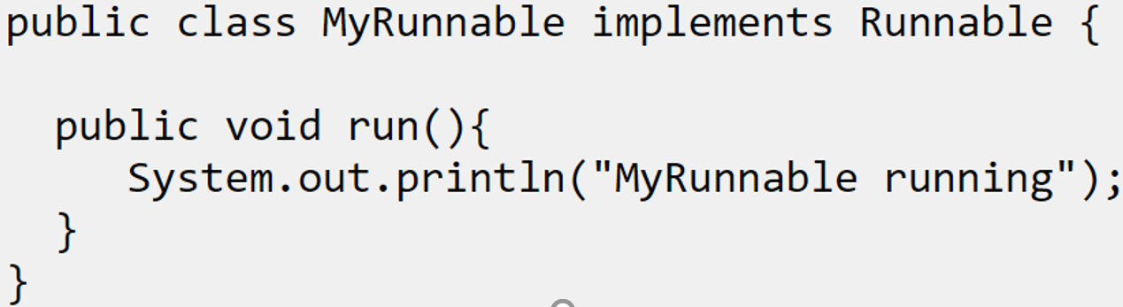
Java Threads
Java threads are managed by the JVM
JVM: Java Virtual Machine
Java threads may be created by:
Extending Thread class
Implementing the Runnable interface
Implemented by many-to-one or many-to-many model
Extending Thread class
Implementing the Runnable interface

Slide 40
Linux Threads
A partial implementation of Pthread on Linux
Linux refers to them as tasks rather than threads
Thread creation is done through clone() system call
clone() allows a child task to share address space of the parent task (process)
Later superseded by Native POSIX Thread Library (NPTL)
One-to-one threads model

Slide 41
Windows XP Threads
Implements the one-to-one model
Each thread contains
id, register set, separate user and kernel stacks, private data storage area
The register set, stacks, and private storage area are known as the context of the threads
The primary data structures of a thread include:
ETHREAD (executive thread block)
KTHREAD (kernel thread block)
TEB (thread environment block)

