Slide 1
CS3103 Operating System 2023/2024 Sem B
Chapter 5: Synchronization
Dr. Nan Guan
Department of Computer Science
City University of Hong Kong

Slide 2
Background
Concurrent access to shared data may result in data inconsistency -- race condition
Maintaining data consistency requires mechanisms to ensure the orderly execution of cooperating processes/threads

Slide 3
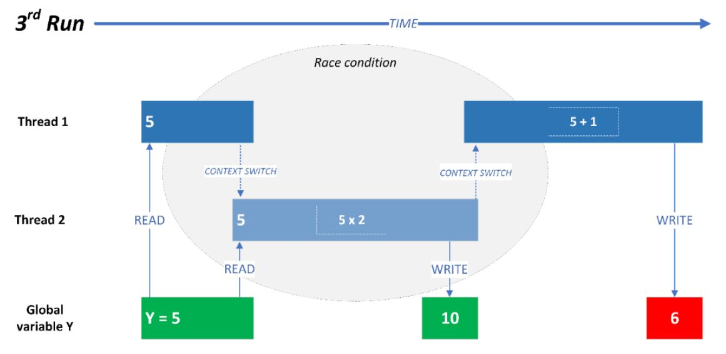
Race Condition
Example: two threads access shared variable Y
Thread 1: Y=Y+1
Thread 2: Y=Y*2

Slide 4
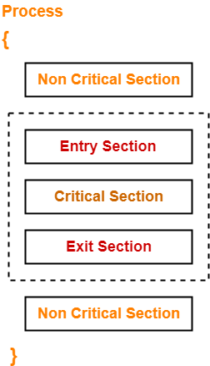
Critical Section
Parts of the program where the shared resource is accessed need to be protected in ways that avoid the concurrent access
This protected section is the critical section or critical region
Use CS to represent Critical Section for short

Slide 5
Critical Section
A good solution of CS satisfies following conditions
Mutual Exclusion: If one process is executing in its CS, then no other processes can be executing in CS
Progress: If no process is executing in CS and some processes wish to enter CS, then the selection of the processes to enter the CS next should not be postponed forever.
Bounded Waiting: A bound must exist on the number of times that other processes are allowed to enter their CS after a process has made a request to enter its CS and before that request is granted

Slide 6
Critical Section
Independence: The solution should not depend on the speed or the number of processors, as well as other factors that can affect the execution of the processes. The solution should be able to handle any number of processes, and any processing speed without being affected by external factors
(not required in this course)

Slide 7
Mutex Lock
A mutex lock (called mutex for short) is a mechanism providing mutual exclusion
Mutex ensures that only one thread has access to a critical section
Using operations like a lock and unlock
Used to protect the critical sections

Slide 8
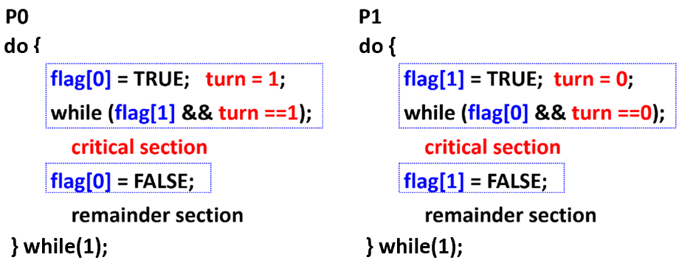
Peterson’s Solution
Two processes running on two cores: index 0 and 1
Assume that the LOAD and STORE instructions are atomic
Atomic: non-interruptable
The processes share two variables: int turn and Boolean flag[n] (n=0 or 1)
turn indicates whose turn it is to enter CS
flag [0] = TRUE implies that process P0 is ready to enter CS (similar for flag [1])
Mutual exclusion?
Progress?
Bounded waiting?

Slide 9
Peterson’s Solution
Mutual exclusive
If one process is in CS, the other process cannot enter CS
Say, P0 is in CS, then flag[0] == TRUE
When P1 tests while condition, turn==0, so P1 is blocked at the while loop until P0 leaves CS and set flag[0] = FALSE
If both processes try to enter the CS
If both of them enters, it must be flag[0]==flag[1]==TRUE
P0 entering CS requires turn==0; P1 enter CS requires turn==1
Both turn==0 and turn==1, which is impossible

Slide 10
Peterson’s Solution
Progress
If only one process wants to enter CS, it can enter
When P0 tests the while condition, P1 does not set flag[1]=TRUE, i.e., flag[1]==FALSE, so P0 can enter CS
If both processes want to enter CS, one of them can enter
If both P0 and P1 have set the flag to be TRUE, then they continue to set turn
Eventually, turn is either 0 or 1 (depending the order for P0 and P1 to set turn), and the corresponding process can enter CS

Slide 11
Peterson’s Solution
Bounded waiting
If both want to repeatedly enter CS, they will do so in turn
When P0 leaves CS, it sets flag[0]==FALSE, so P1 immediately can enter CS
If P0 set flag[0]==TRUE before P1 enters CS, P1 cannot leave the while loop
However, before P0 enters CS again, it has to set turn==1, so P1 still can leave the while loop and enter CS
P0 cannot enter CS again before P1 since currently flag[1]==TRUE and turn == 1

Slide 12
Hardware Support for Synchronization
Many systems provide hardware support for critical section code
Uniprocessors – could disable interrupts
Currently running code would execute without preemption
Generally too inefficient: OS using this not broadly scalable
Modern machines provide special atomic hardware instructions
Two widely used types:
Test memory word and set value
Swap contents of two memory words

Slide 13
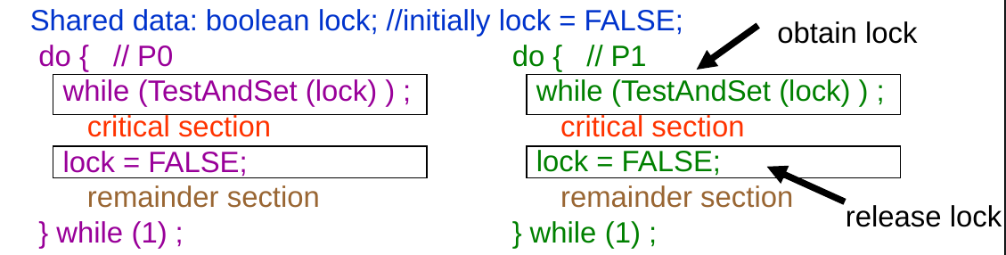
TestAndSet Instruction
boolean TestAndSet (boolean *lock)
{
boolean rv = *lock;
*lock = TRUE;
return rv;
}
If *lock = TRUE - > TestAndSet() = TRUE; *lock = TRUE
If *lock = FALSE - > TestAndSet() = FALSE; *lock = TRUE

Slide 14
Swap Instruction
void Swap (boolean *a, boolean *b)
{
boolean temp = *a;
*a = *b;
*b = temp:
}
Shared lock initialized to FALSE;
Each process has a local boolean key
do {
key = TRUE;
while ( key == TRUE)
Swap (&lock, &key );
// critical section
lock = FALSE;
// remainder section
} while (1);
do {
key = TRUE;
while ( key == TRUE)
Swap (&lock, &key );
// critical section
lock = FALSE;
// remainder section
} while (1);

Slide 15
Semaphore
Semaphore S – integer variable
Two standard operations modify S: wait() and signal()
Originally called P() and V()
Semantics
Counting semaphore – S value can be positive integers
Multiple copies of the shared resource
Binary semaphore – S value can be 0 or 1;
Process:
wait (S);
Critical Section
signal (S);
wait (S) {
while (S <= 0);
S--;
}
signal (S) {
S++;
}
Similar functionality with mutex lock

Slide 16
Semaphore with Busy Waiting
Spinlock:
Implementation is simple
Little busy waiting if critical section rarely occupied
Not a good solution if applications spend lots of time in critical sections
wait (S) {
while (S <= 0);
S--;
}

Slide 17
Semaphore with No Busy Waiting
Each semaphore has an associated waiting queue
Each entry in a waiting queue has two data items
value (integer type)
pointer to next record in the list
Two operations:
block – place the process invoking the operation in the appropriate waiting queue
wakeup – remove one of processes in the waiting queue and place it in the ready queue

Slide 18
Semaphore with No Busy Waiting
semaphore {
int value;
queueType queue
}
P(semaphore S) { // wait operation or "down" operation
S.value–
if (S.value < 0) { add this process/thread to S.queue block() // blocks the process/thread and hands over control to the OS
}
}
V(semaphore S) { // signal operation or "up" operation
S.value++
if (S.value <= 0) {
process/thread T = remove a process/thread from S.queue wakeup(T) // system call that wakes up the blocked process/thread
}
}

Slide 19
Deadlock
Deadlock – is a situation in which no process can proceed because each waits for another to release a lock
Let S and Q be two semaphores initialized to 1
P₀ P₁
wait (S); wait (Q);
wait (Q); wait (S);
. .
. .
. .
signal (S); signal (Q);
signal (Q); signal (S);
Will be elaborated in the next chapter

Slide 20
Classical Synchronization Problems
Producer-Consumer Problem
Readers and Writers Problem
Dining-Philosophers Problem

Slide 21
Producer-Consumer Problem
Multiple producers and consumers share a single buffer of size N
Producers write data to the buffer; must block if the buffer is full
Consumers read data from the buffer; must block if the buffer is empty
A solution: use three semaphores
mutex (boolean, initialized to be 1): protect access to the critical sections
full (initialized to be 0): to count the occupied slots in the buffer
empty (initialized to be N): to count the available slots in the buffer

Slide 22
Producer-Consumer Problem
The structure of the producer process
do { // produce an item
wait (empty);
wait (mutex);
// add the item to the buffer
signal (mutex);
signal (full);
} while (true);
The structure of the consumer process
do {
wait (full);
wait (mutex);
// remove an item from buffer
signal (mutex);
signal (empty);
// consume the removed item
} while (true);

Slide 23
Readers-Writers Problem
A data set is shared among a number of processes
Readers: only read the data set; do not perform any write
Writers: can both read and write
Target:
Multiple readers can access at the same time.
Only one single writer can access at the same time (no reader access)
A solution: two semaphores and a shared variable
Two boolean semaphores
mutex initialized to 1
wrt initialized to 1
Shared integer variable readcount initialized to 0

Slide 24
Readers-Writers Problem
The structure of the writer process
The structure of the reader process
do {
wait (mutex) ;
readcount ++ ;
if (readcount == 1) wait (wrt) ;
signal (mutex)
// reading is performed
wait (mutex) ;
readcount - - ;
if (readcount == 0) signal (wrt) ;
signal (mutex) ;
} while (true)
do {
wait (wrt) ;
// writing is performed
signal (wrt) ;
} while (true)
Need mutex to protect access to readcount

Slide 25
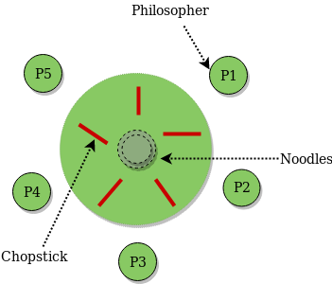
Dining-Philosophers Problem
Five philosophers
Two chopsticks next to each philosopher
A philosopher sometimes thinks, sometimes eats, repeatedly
Need two chopsticks to eat
Hold the chopstick(s) until this time of eating finished
c1
c5
c2
c4
c3

Slide 26
Dining-Philosophers Problem
A solution:
Binary semaphores chopstick [5], all initialized to 1
The process of Philosopher i:
c1
do {
wait ( chopstick[i] );
wait ( chopstick[ (i + 1) % 5]);
// eat
signal ( chopstick[i] );
signal (chopstick[ (i + 1) % 5]);
// think
} while (true) ;
c5
c2
c4
c3
Problems: could cause deadlock!
Possible solution: pick up chopsticks only if both are available

Slide 27
Condition Variables
There are many cases where a thread wishes to check whether a condition is true before continuing its execution.
Example:
A parent thread might wish to check whether a child thread has been completed, before continue to execute
“join”

Slide 28
Condition Variables
A Parent Waiting For Its Child
1 void *child(void *arg) {
2 printf("child\n");
3 // XXX how to indicate we are done?
4 return NULL;
5 }
6
7 int main(int argc, char *argv[]) {
8 printf("parent: begin\n");
9 pthread_t c;
10 Pthread_create(&c, NULL, child, NULL); // create child
11 // XXX how to wait for child?
12 printf("parent: end\n");
13 return 0;
14 }
What we would like to see here is:
parent: begin
child
parent: end

Slide 29
Parent Waiting for Child: Spin-based Approach
1 volatile int done = 0;
2
3 void *child(void *arg) {
4 printf("child\n");
5 done = 1;
6 return NULL;
7 }
8
9 int main(int argc, char *argv[]) {
10 printf("parent: begin\n");
11 pthread_t c;
12 Pthread_create(&c, NULL, child, NULL); // create child
13 while (done == 0)
14 ; // spin
15 printf("parent: end\n");
16 return 0;
17 }
Inefficient as the parent spins and wastes CPU time.
Can we put the parent to sleep until the condition we are waiting for (e.g., the child is done executing) comes true?

Slide 30
Condition Variable
Condition variable
Waiting on the condition
An explicit queue that threads can put themselves on when some state of execution is not as desired.
Signaling on the condition
Some other thread, when it changes said state, can wake one of those waiting threads and allow them to continue.
Notes:
To wait for a condition to become true, a thread can make use of what is known as a condition variable.
The idea goes back to Dijkstra’s use of “private semaphores” [D68]; a similar idea was later named a “condition variable” by Hoare in his work on monitors

Slide 31
Condition Variable
Declare condition variable (in pthread)
Proper initialization is required
Operation (the POSIX calls)
The wait() call takes a mutex as a parameter.
The wait() call release the lock and put the calling thread to sleep.
When the thread wakes up, it must re-acquire the lock.
Pthread_cond_t c;
pthread_cond_wait(pthread_cond_t *c, pthread_mutex_t *m); // wait()
pthread_cond_signal(pthread_cond_t *c); // signal()
Notes:
To declare such a condition variable, one simply writes something like this: pthread cond t c;, which declares c as a condition variable.
A condition variable has two operations associated with it: wait() and signal(). The wait() call is executed when a thread wishes to put itself to sleep; the signal() call is executed when a thread has changed something in the program and thus wants to wake a sleeping thread waiting on this condition. We will often refer to these as wait() and signal() for simplicity
Notice that: the wait() call takes a mutex as a parameter; it assumes that this mutex is locked when wait() is called. Let’s take a look at the solution to the join problem to understand this better.

Slide 32
Parent waiting for Child: Use Condition Variable
Parent:
Create the child thread and continues running itself (L28)
Call into thr_join() to wait for the child thread to complete (L29)
Acquire the lock (L19)
Check if the child is done (L20)
Either put itself to sleep by calling wait()(hence releasing the lock) (L21)
Or returning from wait() with the lock held
Release the lock (L22)
Child:
Print the message “child” (L13)
Call thr_exit() to wake the parent thread (L14)
Grab the lock (L6)
Set the state variable done (L7)
Signal the parent thus waking it (L8)
1 int done = 0;
2 pthread_mutex_t m = PTHREAD_MUTEX_INITIALIZER;
3 pthread_cond_t c = PTHREAD_COND_INITIALIZER;
4
5 void thr_exit() {
6 Pthread_mutex_lock(&m);
7 done = 1;
8 Pthread_cond_signal(&c);
9 Pthread_mutex_unlock(&m);
10 }
11
12 void *child(void *arg) {
13 printf("child\n");
14 thr_exit();
15 return NULL;
16 }
17
18 void thr_join() {
19 Pthread_mutex_lock(&m);
20 if (done == 0)
21 Pthread_cond_wait(&c, &m);
22 Pthread_mutex_unlock(&m);
23 }
24
25 int main(int argc, char *argv[]) {
26 printf("parent: begin\n");
27 pthread_t p;
28 Pthread_create(&p, NULL, child, NULL);
29 thr_join();
30 printf("parent: end\n");
31 return 0;
32 }

Slide 33
The importance of the mutex
If one does not need to hold a lock in order to signal and wait.
There is race condition.
The parent calls thr_join()
The parent checks done, it will see that it is 0 and try to go to sleep.
Just before it calls wait to go to sleep, the parent is interrupted and the child runs.
The child changes the state variable done to 1 and signals.
But no thread is waiting and thus no thread is woken.
When the parent runs again, it sleeps forever.
1 void thr_exit() {
2 done = 1;
3 Pthread_cond_signal(&c);
4 }
5
6 void thr_join() {
7 if (done == 0)
8 Pthread_cond_wait(&c);
9 }
without mutex

Slide 34
The importance of the state variable done
Imagine the case where the child runs immediately.
The child will signal, but there is no thread asleep on the condition.
When the parent runs, it will call wait and be stuck.
No thread will ever wake it.
1 void thr_exit() {
2 Pthread_mutex_lock(&m);
3 Pthread_cond_signal(&c);
4 Pthread_mutex_unlock(&m);
5 }
6
7 void thr_join() {
8 Pthread_mutex_lock(&m);
9 Pthread_cond_wait(&c, &m);
10 Pthread_mutex_unlock(&m);
11 }
without variable done

Slide 35
Producer-Consumer Problem
Suppose the buffer size is 1
Producer
Produce data items
Wish to place data items in a buffer
Consumer
Grab data items out of the buffer and consume them in some way

Slide 36
Producer/Consumer Threads
Producer puts an integer into the shared buffer and loops.
Consumer gets the data out of that shared buffer.
1 void *producer(void *arg) {
2 int i;
3 int loops = (int) arg;
4 for (i = 0; i < loops; i++) {
5 put(i);
6 }
7 }
8
9 void *consumer(void *arg) {
10 int i;
11 while (1) {
12 int tmp = get();
13 printf("%d\n", tmp);
14 }
15 }

Slide 37
The Put and Get Routines
Only put data into the buffer when count is zero.
i.e., when the buffer is empty.
Only get data from the buffer when count is one.
i.e., when the buffer is full.
1 int buffer;
2 int count = 0; // initially, empty
3
4 void put(int value) {
5 assert(count == 0);
6 count = 1;
7 buffer = value;
8 }
9
10 int get() {
11 assert(count == 1);
12 count = 0;
13 return buffer;
14 }
assert(expression)
The expression is evaluated.
If the value returned after evaluation of the expression is FALSE, it quits with an error
If the expression is evaluated TRUE, it does not do anything
Notes:
The put() function assumes the buffer is empty (and checks this with an assertion), and then simply puts a value into the shared buffer and marks it full by setting count to 1. The get() function does the opposite, setting the buffer to empty (i.e., setting count to 0) and returning the value.

Slide 38
Using Condition Variable
1 cond_t cond;
2 mutex_t mutex;
3
4 void *producer(void *arg) {
5 int i;
6 for (i = 0; i < loops; i++) {
7 Pthread_mutex_lock(&mutex); // p1
8 if (count == 1) // p2
9 Pthread_cond_wait(&cond, &mutex); // p3
10 put(i); // p4
11 Pthread_cond_signal(&cond); // p5
12 Pthread_mutex_unlock(&mutex); // p6
13 }
14 }
15
16 void *consumer(void *arg) {
17 int i;
18 for (i = 0; i < loops; i++) {
19 Pthread_mutex_lock(&mutex); // c1
20 if (count == 0) // c2
21 Pthread_cond_wait(&cond, &mutex); // c3
22 int tmp = get(); // c4
23 Pthread_cond_signal(&cond); // c5
24 Pthread_mutex_unlock(&mutex); // c6
25 printf("%d\n", tmp);
26 }
27 }
A condition variable cond and associated lock mutex
p1-p3: A producer waits for the buffer to be empty.
c1-c3: A consumer waits for the buffer to be full.
With just a single producer and a single consumer, the code works.
If we have more than one of producer and consumer?
Notes:
Now we need to write some routines that know when it is OK to access the buffer to either put data into it or get data out of it. This work is going to be done by two types of threads, one set of which we’ll call the producer threads, and the other set which we’ll call consumer threads. Now imagine that we have just a single producer and a single consumer. we have a single condition variable cond and associated lock mutex.

Slide 39
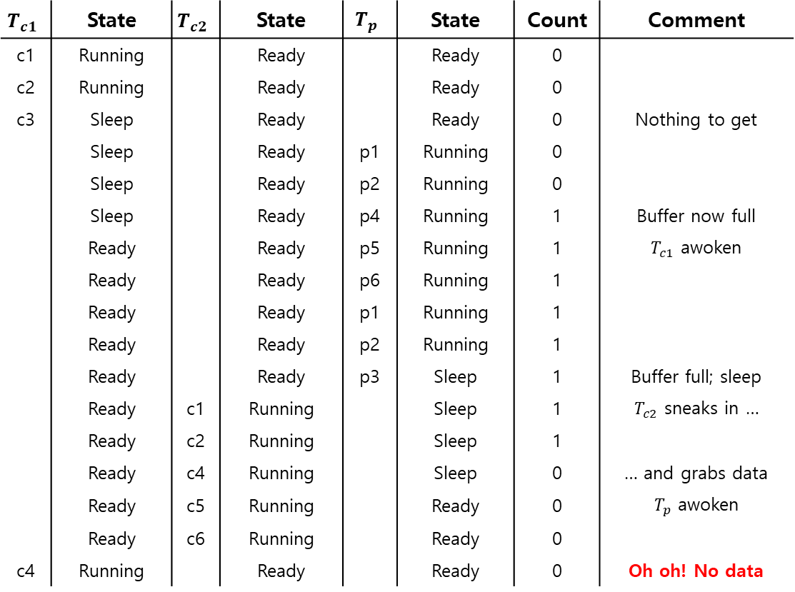
Trace
$$T_{c1}$$ | State | $$T_{c2}$$ | State | $$T_{p}$$ | State | Count | Comment
c1 | Running |  | Ready |  | Ready | 0
c2 | Running |  | Ready |  | Ready | 0
c3 | Sleep |  | Ready |  | Ready | 0 | Nothing to get
 | Sleep |  | Ready | p1 | Running | 0
 | Sleep |  | Ready | p2 | Running | 0
 | Sleep |  | Ready | p4 | Running | 1 | Buffer now full
 | Ready |  | Ready | p5 | Running | 1 | $T_{c1}$ awoken
 | Ready |  | Ready | p6 | Running | 1
 | Ready |  | Ready | p1 | Running | 1
 | Ready |  | Ready | p2 | Running | 1
 | Ready |  | Ready | p3 | Sleep | 1 | Buffer full; sleep
 | Ready | c1 | Running |  | Sleep | 1 | $T_{c2}$ sneaks in …
 | Ready | c2 | Running |  | Sleep | 1
 | Ready | c4 | Running |  | Sleep | 0 | … and grabs data
 | Ready | c5 | Running |  | Ready | 0 | $T_{p}$ awoken
 | Ready | c6 | Running |  | Ready | 0
c4 | Running |  | Ready |  | Ready | 0 | Oh oh! No data
1 cond_t cond;
2 mutex_t mutex;
3
4 void *producer(void *arg) {
5 int i;
6 for (i = 0; i < loops; i++) {
7 Pthread_mutex_lock(&mutex); // p1
8 if (count == 1) // p2
9 Pthread_cond_wait(&cond, &mutex); // p3
10 put(i); // p4
11 Pthread_cond_signal(&cond); // p5
12 Pthread_mutex_unlock(&mutex); // p6
13 }
14 }
15
16 void *consumer(void *arg) {
17 int i;
18 for (i = 0; i < loops; i++) {
19 Pthread_mutex_lock(&mutex); // c1
20 if (count == 0) // c2
21 Pthread_cond_wait(&cond, &mutex); // c3
22 int tmp = get(); // c4
23 Pthread_cond_signal(&cond); // c5
24 Pthread_mutex_unlock(&mutex); // c6
25 printf("%d\n", tmp);
26 }
27 }
Notes:
Assume there are two consumers (Tc1 and Tc2) and one producer (Tp). First, a consumer (Tc1) runs; it acquires the lock (c1), checks if any buffers are ready for consumption (c2), and finding that none are, waits (c3) (which releases the lock).
Then the producer (Tp) runs. It acquires the lock (p1), checks if all buffers are full (p2), and finding that not to be the case, goes ahead and fills the buffer (p4). The producer then signals that a buffer has been filled (p5). Critically, this moves the first consumer (Tc1) from sleeping on a condition variable to the ready queue; Tc1 is now able to run (but not yet running). The producer then continues until realizing the buffer is full, at which point it sleeps (p6, p1–p3).
Here is where the problem occurs: another consumer (Tc2) sneaks in and consumes the one existing value in the buffer (c1, c2, c4, c5, c6, skip- ping the wait at c3 because the buffer is full). Now assume Tc1 runs; just before returning from the wait, it re-acquires the lock and then returns. It then calls get() (c4), but there are no buffers to consume! the code has not functioned as desired.

Slide 40
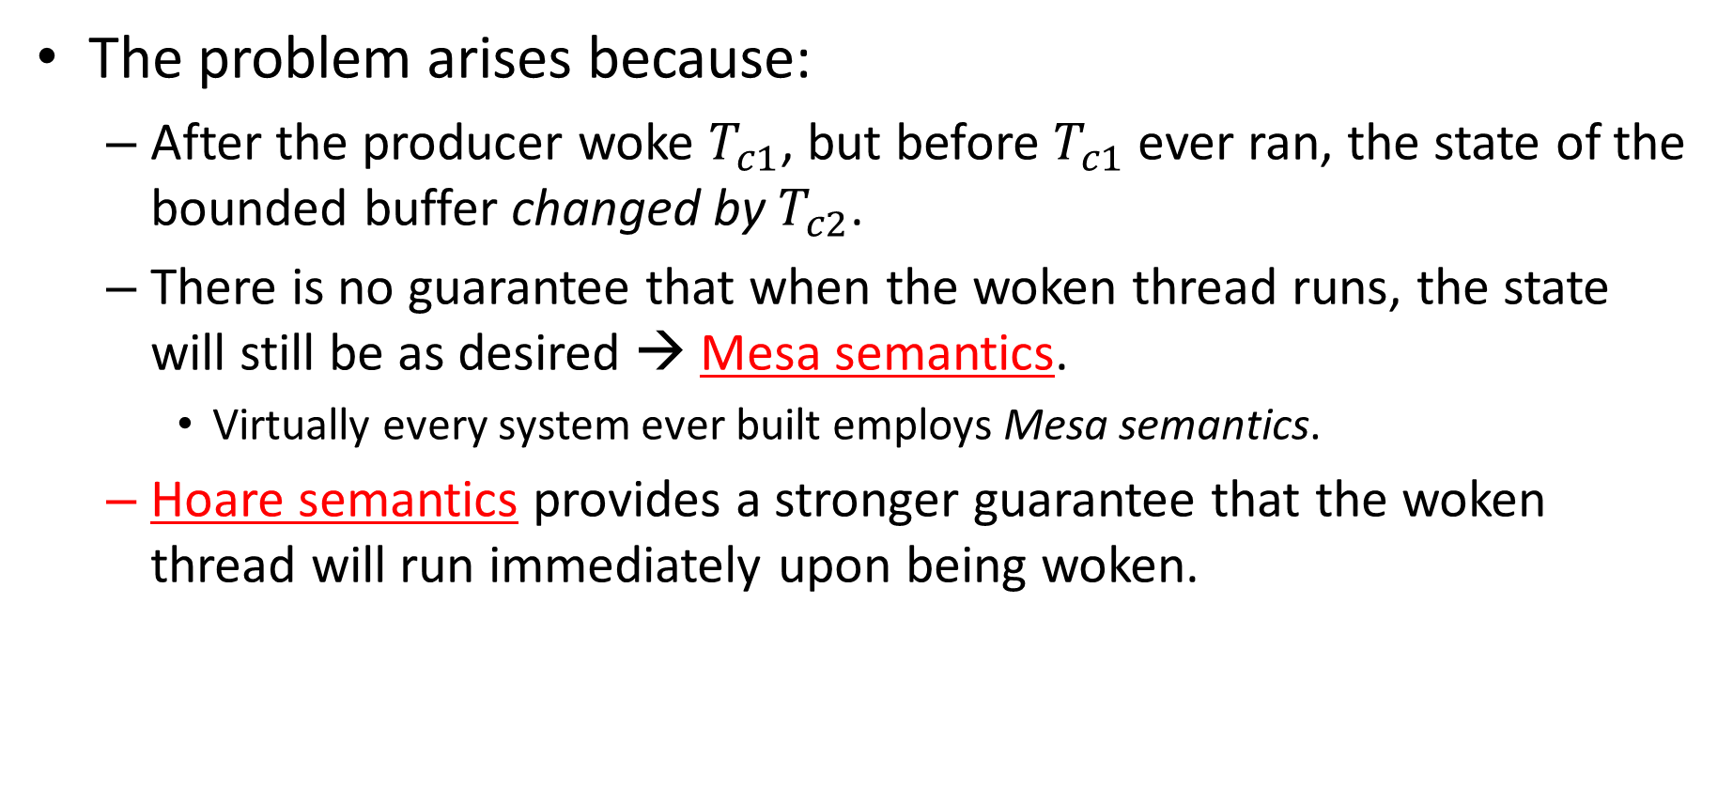
Why the Solution is Broken?
The problem arises because:
After the producer woke $T_{c1}$, but before $T_{c1}$ ever ran, the state of the bounded buffer changed by $T_{c2}$.
There is no guarantee that when the woken thread runs, the state will still be as desired → Mesa semantics.
Virtually every system ever built employs Mesa semantics.
Hoare semantics provides a stronger guarantee that the woken thread will run immediately upon being woken.

Slide 41

Fix the Problem
Consumer $T_{c1}$ wakes up and re-checks the shared variable.
If the buffer is empty, the consumer simply goes back to sleep.
Is it correct now?
1 cond_t cond;
2 mutex_t mutex;
3
4 void *producer(void *arg) {
5 int i;
6 for (i = 0; i < loops; i++) {
7 Pthread_mutex_lock(&mutex); // p1
8 while (count == 1) // p2
9 Pthread_cond_wait(&cond, &mutex); // p3
10 put(i); // p4
11 Pthread_cond_signal(&cond); // p5
12 Pthread_mutex_unlock(&mutex); // p6
13 }
14 }
15
Notes:
Fortunately, this fix is easy: change the if to a while. Think about why this works; now consumer Tc1 wakes up and (with the lock held) immediately re-checks the state of the shared variable (c2). If the buffer is empty at that point, the consumer simply goes back to sleep (c3). The corollary if is also changed to a while in the producer (p2).
A simple rule to remember with condition variables is to always use while loops.

Slide 42
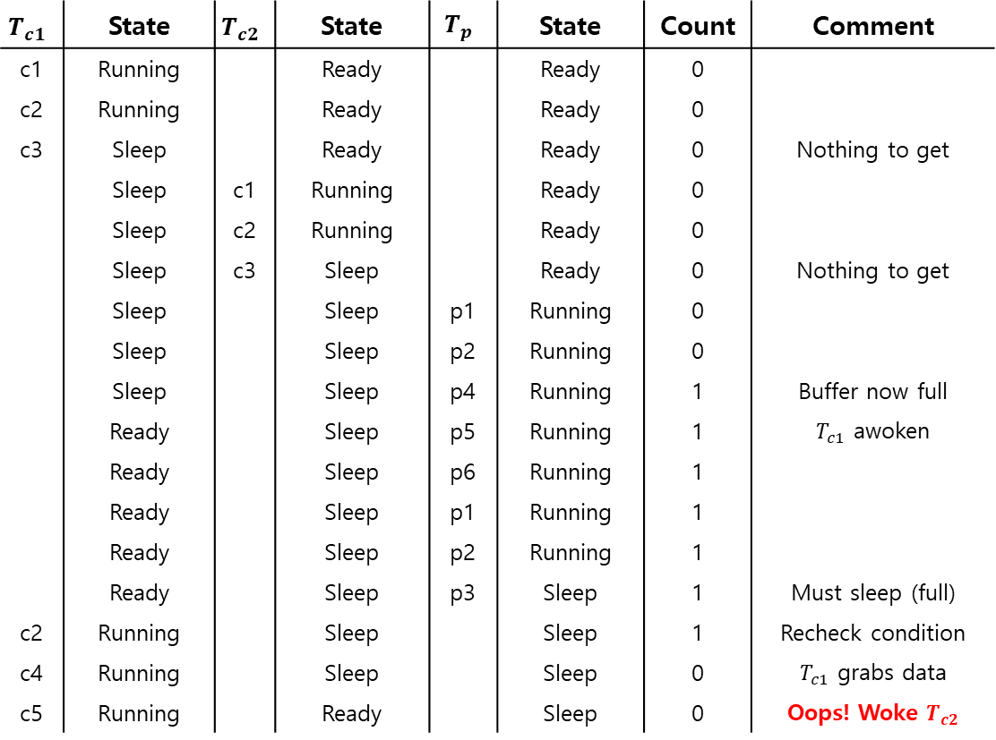
Trace
$$T_{c1}$$ | State | $$T_{c2}$$ | State | $$T_{p}$$ | State | Count | Comment
c1 | Running |  | Ready |  | Ready | 0
c2 | Running |  | Ready |  | Ready | 0
c3 | Sleep |  | Ready |  | Ready | 0 | Nothing to get
 | Sleep | c1 | Running |  | Ready | 0
 | Sleep | c2 | Running |  | Ready | 0
 | Sleep | c3 | Sleep |  | Ready | 0 | Nothing to get
 | Sleep |  | Sleep | p1 | Running | 0
 | Sleep |  | Sleep | p2 | Running | 0
 | Sleep |  | Sleep | p4 | Running | 1 | Buffer now full
 | Ready |  | Sleep | p5 | Running | 1 | $T_{c1}$ awoken
 | Ready |  | Sleep | p6 | Running | 1
 | Ready |  | Sleep | p1 | Running | 1
 | Ready |  | Sleep | p2 | Running | 1
 | Ready |  | Sleep | p3 | Sleep | 1 | Must sleep (full)
c2 | Running |  | Sleep |  | Sleep | 1 | Recheck condition
c4 | Running |  | Sleep |  | Sleep | 0 | $T_{c1}$ grabs data
c5 | Running |  | Ready |  | Sleep | 0 | Oops! Woke $T_{c2}$
1 cond_t cond;
2 mutex_t mutex;
3
4 void *producer(void *arg) {
5 int i;
6 for (i = 0; i < loops; i++) {
7 Pthread_mutex_lock(&mutex); // p1
8 while (count == 1) // p2
9 Pthread_cond_wait(&cond, &mutex); // p3
10 put(i); // p4
11 Pthread_cond_signal(&cond); // p5
12 Pthread_mutex_unlock(&mutex); // p6
13 }
14 }
15
16 void *consumer(void *arg) {
17 int i;
18 for (i = 0; i < loops; i++) {
19 Pthread_mutex_lock(&mutex); // c1
20 while (count == 0) // c2
21 Pthread_cond_wait(&cond, &mutex); // c3
22 int tmp = get(); // c4
23 Pthread_cond_signal(&cond); // c5
24 Pthread_mutex_unlock(&mutex); // c6
25 printf("%d\n", tmp);
26 }
27 }
Notes:
The problem occurs when two consumers run first (Tc1 and Tc2) and both go to sleep (c3). Then, the producer runs, puts a value in the buffer, and wakes one of the consumers (say Tc1). The producer then loops back (releasing and reacquiring the lock along the way) and tries to put more data in the buffer; because the buffer is full, the producer instead waits on the condition (thus sleeping). Now, one consumer is ready to run (Tc1), and two threads are sleeping on a condition (Tc2 and Tp). The consumer Tc1 then wakes by returning from wait() (c3), re-checks the condition (c2), and finding the buffer full, consumes the value (c4). This consumer then, critically, signals on the condition (c5), waking only one thread that is sleeping.
Because the consumer has emptied the buffer, it clearly should wake the producer. However, if it wakes the consumer Tc2, we have a problem.

Slide 43
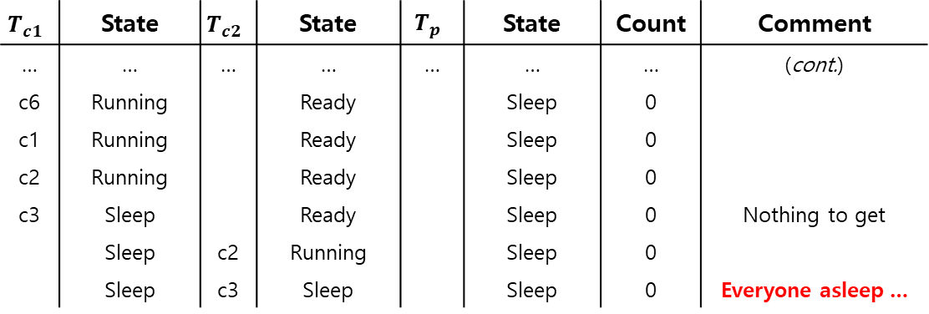
Trace
$$T_{c1}$$ | State | $$T_{c2}$$ | State | $$T_{p}$$ | State | Count | Comment
… | … | … | … | … | … | … | (cont.)
c6 | Running |  | Ready |  | Sleep | 0
c1 | Running |  | Ready |  | Sleep | 0
c2 | Running |  | Ready |  | Sleep | 0
c3 | Sleep |  | Ready |  | Sleep | 0 | Nothing to get
 | Sleep | c2 | Running |  | Sleep | 0
 | Sleep | c3 | Sleep |  | Sleep | 0 | Everyone asleep …
1 cond_t cond;
2 mutex_t mutex;
3
4 void *producer(void *arg) {
5 int i;
6 for (i = 0; i < loops; i++) {
7 Pthread_mutex_lock(&mutex); // p1
8 while (count == 1) // p2
9 Pthread_cond_wait(&cond, &mutex); // p3
10 put(i); // p4
11 Pthread_cond_signal(&cond); // p5
12 Pthread_mutex_unlock(&mutex); // p6
13 }
14 }
15
16 void *consumer(void *arg) {
17 int i;
18 for (i = 0; i < loops; i++) {
19 Pthread_mutex_lock(&mutex); // c1
20 while (count == 0) // c2
21 Pthread_cond_wait(&cond, &mutex); // c3
22 int tmp = get(); // c4
23 Pthread_cond_signal(&cond); // c5
24 Pthread_mutex_unlock(&mutex); // c6
25 printf("%d\n", tmp);
26 }
27 }
A consumer should not wake other consumers, only producers, and vice-versa.
Notes:
Specifically, the consumer Tc2 will wake up and find the buffer empty (c2), and go back to sleep (c3). The producer Tp, which has a value to put into the buffer, is left sleeping. The other consumer thread, Tc1, also goes back to sleep. All three threads are left sleeping, a clear bug。
Signaling is clearly needed, but must be more directed. A consumer should not wake other consumers, only producers, and vice-versa.

Slide 44
Fix the Problem
Use two condition variables and while
Producer threads wait on the condition empty, and signals fill.
Consumer threads wait on fill and signal empty.
1 cond_t empty, fill;
2 mutex_t mutex;
3
4 void *producer(void *arg) {
5 int i;
6 for (i = 0; i < loops; i++) {
7 Pthread_mutex_lock(&mutex);
8 while (count == 1)
9 Pthread_cond_wait(&empty, &mutex);
10 put(i);
11 Pthread_cond_signal(&fill);
12 Pthread_mutex_unlock(&mutex);
13 }
14 }
15
16 void *consumer(void *arg) {
17 int i;
18 for (i = 0; i < loops; i++) {
19 Pthread_mutex_lock(&mutex);
20 while (count == 0)
21 Pthread_cond_wait(&fill, &mutex);
22 int tmp = get();
23 Pthread_cond_signal(&empty);
24 Pthread_mutex_unlock(&mutex);
25 printf("%d\n", tmp);
26 }
27 }
Notes:
The solution here is once again a small one: use two condition variables, instead of one, in order to properly signal which type of thread should wake up when the state of the system changes.
In the code, producer threads wait on the condition empty, and sig- nals fill. Conversely, consumer threads wait on fill and signal empty. By doing so, the second problem above is avoided by design: a consumer can never accidentally wake a consumer, and a producer can never acci- dentally wake a producer.

Slide 45
Multiple Buffer Slots
More concurrency and efficiency → Add more buffer slots.
Allow concurrent production or consuming to take place.
Reduce context switches.
1 int buffer[MAX];
2 int fill = 0;
3 int use = 0;
4 int count = 0;
5
6 void put(int value) {
7 buffer[fill] = value;
8 fill = (fill + 1) % MAX;
9 count++;
10 }
11
12 int get() {
13 int tmp = buffer[use];
14 use = (use + 1) % MAX;
15 count--;
16 return tmp;
17 }
Notes:
We now have a working producer/consumer solution, albeit not a fully general one. The last change we make is to enable more concurrency and efficiency; specifically, we add more buffer slots, so that multiple values can be produced before sleeping, and similarly multiple values can be consumed before sleeping.
With just a single producer and consumer, this approach is more efficient as it reduces context switches; with multiple producers or consumers (or both), it even allows concurrent producing or consuming to take place, thus increasing concurrency.

Slide 46
1 cond_t empty, fill;
2 mutex_t mutex;
3
4 void *producer(void *arg) {
5 int i;
6 for (i = 0; i < loops; i++) {
7 Pthread_mutex_lock(&mutex); // p1
8 while (count == MAX) // p2
9 Pthread_cond_wait(&empty, &mutex); // p3
10 put(i); // p4
11 Pthread_cond_signal(&fill); // p5
12 Pthread_mutex_unlock(&mutex); // p6
13 }
14 }
15
16 void *consumer(void *arg) {
17 int i;
18 for (i = 0; i < loops; i++) {
19 Pthread_mutex_lock(&mutex); // c1
20 while (count == 0) // c2
21 Pthread_cond_wait(&fill, &mutex); // c3
int tmp = get(); // c4
23 Pthread_cond_signal(&empty); // c5
24 Pthread_mutex_unlock(&mutex); // c6
25 printf("%d\n", tmp);
26 }
27 }
p2: A producer only sleeps if all buffers are currently filled.
c2: A consumer only sleeps if all buffers are currently empty.

Slide 47
Midterm
March 14 (Week 8, Thu) in-class
Closed-book, calculator allowed
Scope: Chapter 1-5
Bring your own draft paper
Midterm exam time length: 2 hours
Schedule
2 hours midterm exam
20 mins overhead & break
30 mins Q&A

Slide 48
Tutorial Schedule Revised
Original schedule
Week 4 – 11
Revised schedule:
Week 4 – 9
Week 11 – 12
(i.e., no tutorial on Week 10)

