Slide 1
CS3103 Operating System 2023/2024 Sem B
Chapter 6: Deadlock
Dr. Nan Guan
Department of Computer Science
City University of Hong Kong

Slide 2
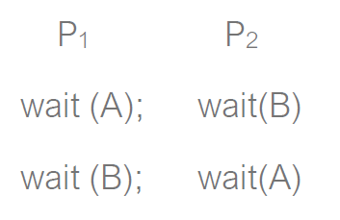
The Deadlock Problem
Deadlock: a set of blocked processes each holding a resource and waiting to acquire a resource held by another process
Examples:
a system has 2 disk drives, P1 and P2 each hold one disk drive and each needs another one
semaphores A and B, initialized to 1

Slide 3
The Deadlock Problem
Deadlock: a set of blocked processes each holding a resource and waiting to acquire a resource held by another process
Examples:
a system has 2 disk drives, P1 and P2 each hold one disk drive and each needs another one
semaphores A and B, initialized to 1

Slide 4
System Model
Resources: R1, R2, . . ., Rm
each represents a different resource type
e.g., share data structure, memory space, I/O devices
each resource type Ri has Wi instances.
Each process utilizes a resource in the following pattern
request
use
release

Slide 5
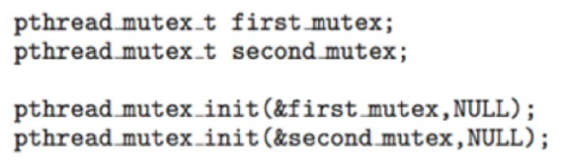
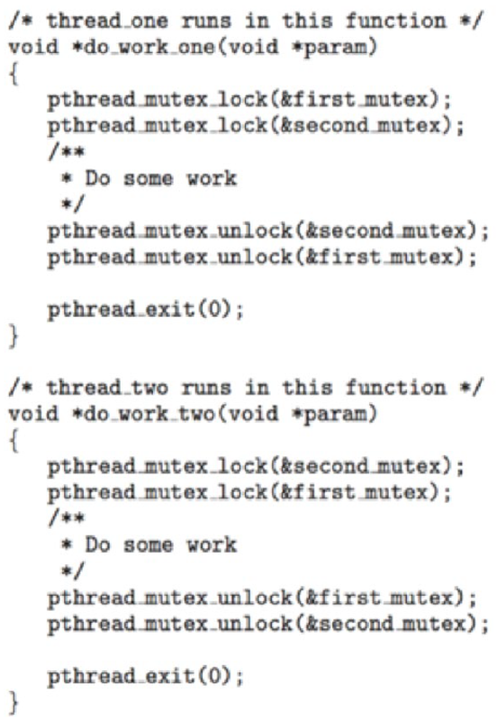
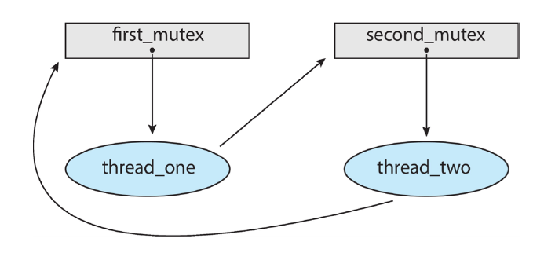
Deadlock program example
Two mutex locks are created and initialized
Deadlock is possible if
Thread 1 requests first_mutex and thread 2 requests second_mutex
Thread 1 then waits for second_mutex and thread 2 waits for first_mutex
illustrated by a resource allocation graph

Slide 6
Why Do Deadlocks Occur?
Reason 1:
In large code bases, complex dependencies arise between components
Reason 2:
Due to the nature of encapsulation
Hide details of implementations and make software easier to build in a modular way
Such modularity does not mesh well with locking

Slide 7
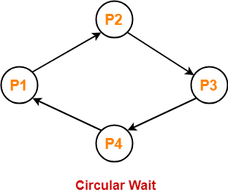
Necessary Conditions of Deadlock
Mutual exclusion: only one process at a time can use a resource
Hold and wait: a process holding at least one resource is waiting to acquire additional resources held by other processes
No resource preemption: a resource can be released only voluntarily by the process holding it, after it has completed its task
Circular wait: there exists a set of waiting processes {P0, P1, …, Pn}
P0 is waiting for a resource that is held by P1
P1 is waiting for a resource that is held by P2 …
Pn–1 is waiting for a resource that is held by Pn
Pn is waiting for a resource that is held by P0

Slide 8




Resource-Allocation Graph
Two types of nodes:
P = {P1, P2, …, Pn}, the set of all the processes in the system
R = {R1, R2, …, Rm}, the set of all resource types in the system
Two types of edges:
request edge: directed edge Pi➞Rj
assignment edge: directed edge Rj➞Pi

Slide 9
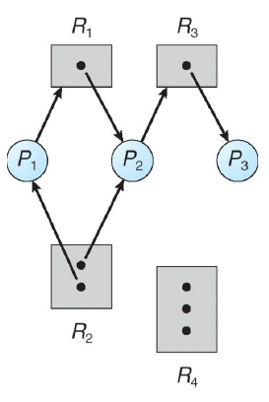
Resource Allocation Graph
Example:
1 instance of R1
2 instances of R2
1 instance of R3
3 instances of R4
P1 holds an instance of R2 and is waiting for an instance of R1
P2 holds an instance of R1, an instance of R2, and is waiting for an instance of R3
P3 holds an instance of R3

Slide 10
Resource Allocation Graph
Is there a deadlock?
No
But will be deadlock if P3 starts to wait for R2

Slide 11
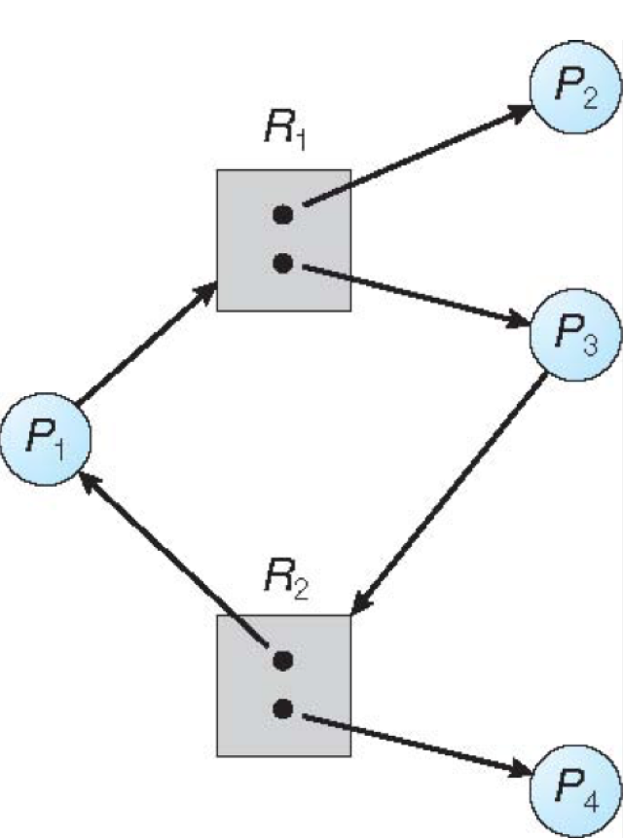
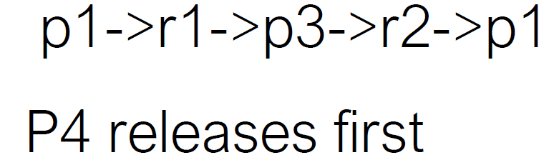
Resource Allocation Graph
Is there a deadlock?
circular wait does not necessarily lead to deadlock

Slide 12
Facts
If graph contains no cycles → no deadlock
If graph contains a cycle
if only one instance per resource type → deadlock
If several instances per resource type → possibility of deadlock

Slide 13
How to Handle Deadlocks
Ensure that the system will never enter a deadlock state
Prevention: ensures that at least one of the necessary conditions to cause a deadlock will never occur
Avoidance: ensures that the system will not enter an unsafe state
Allow the system to enter a deadlock state and then recover
Deadlock detection and recovery: detect the existence of deadlock and recovery to a safe state

Slide 14
Deadlock Prevention - Circular Wait
Provide a total ordering on lock acquisition
This approach requires careful design of global locking strategies.
Example:
There are two locks in the system (L1 and L2)
We can prevent deadlock by always acquiring L1 before L2.

Slide 15
Deadlock Prevention - Hold-and-wait
Process can request a resource only if not hold other resources
require process to request all its resources before it begins execution; allow process to request resources only when the process has none
low resource utilization
possible starvation

Slide 16
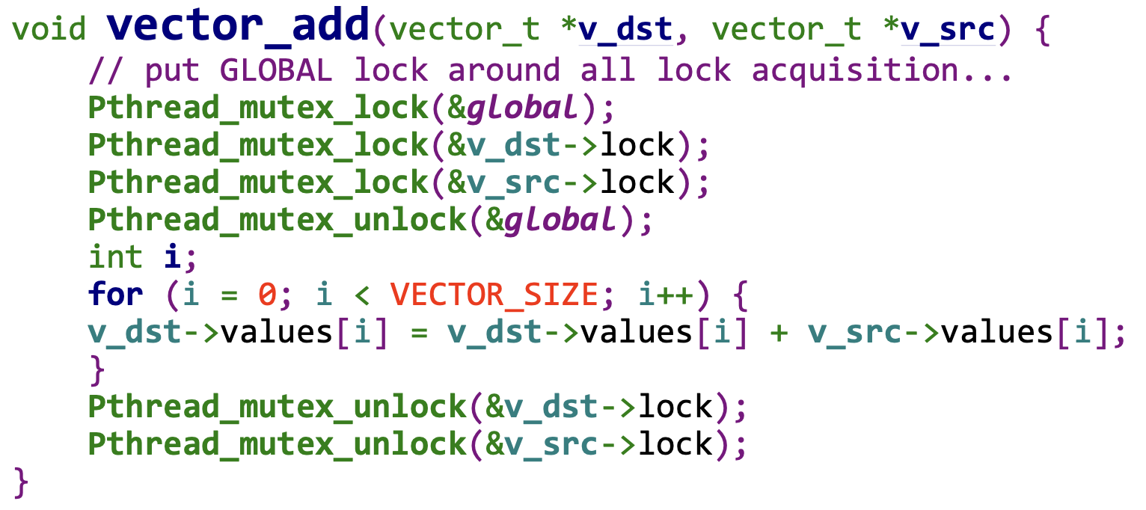
Deadlock Prevention - Hold-and-wait
Acquire all locks at once, atomically
no thread switch can occur in the midst of lock acquisition.
Problem:
Require us to know exactly which locks to acquire in prior
Decrease concurrency

Slide 17
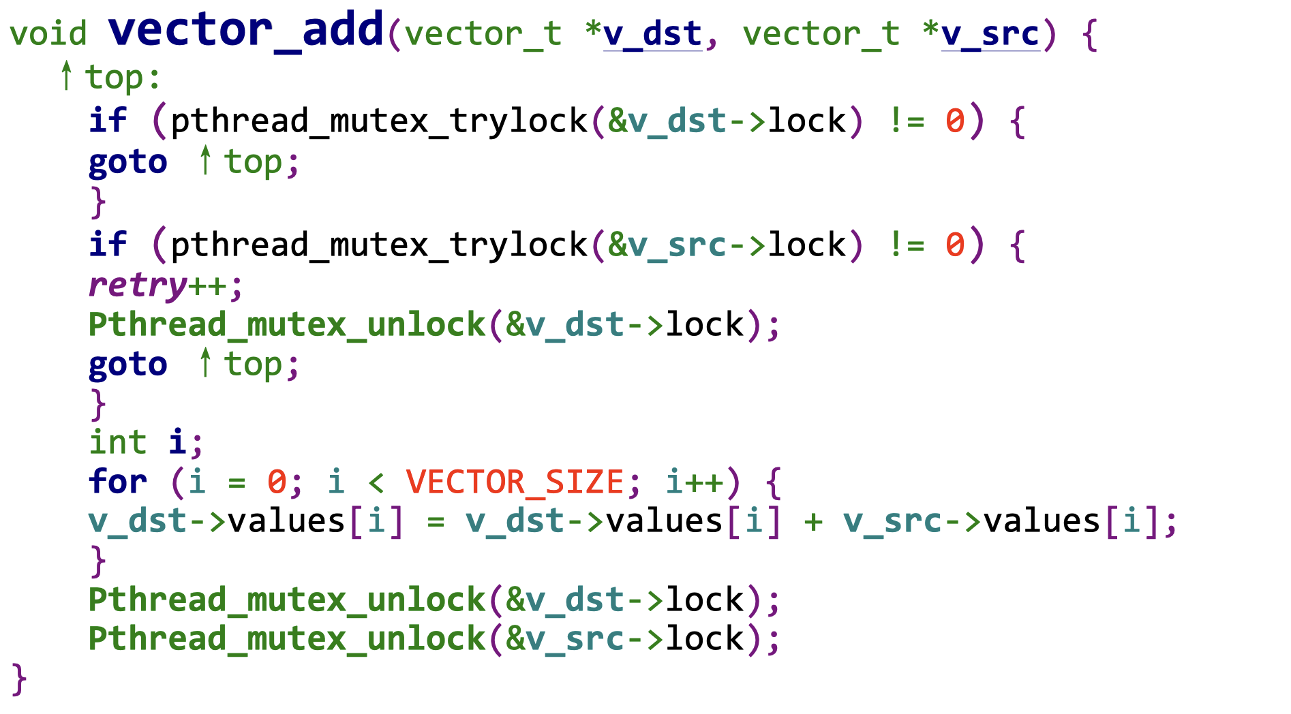
Deadlock Prevention - No Preemption
Multiple lock acquisition often gets us into trouble because when waiting for one lock we are holding another.
trylock()
Used to build a deadlock-free lock acquisition protocol.
Grab the lock (if it is available).
Or, return -1: you should try again later.

Slide 18
Prevention – No Preemption
Problem: livelock
Both systems are running through the code sequence over and over again.
Progress is not being made.
Solution:
Add a random delay before looping back and trying the entire thing over again.

Slide 19
Prevention – Mutual Exclusion
wait-free
Using powerful atomic hardware instruction.
You can build data structures in a manner that does not require explicit locking.
int CompareAndSwap(int *address, int expected, int new){
if(*address == expected){
*address = new;
return 1; // success
}
return 0;
}

Slide 20
Prevention – Mutual Exclusion
We now wanted to atomically increment a value by a certain amount:
Repeatedly tries to update the value to the new amount and uses the compare-and-swap to do so.
No lock is acquired
No deadlock can arise
void AtomicIncrement(int *value, int amount){
do{
int old = *value;
}while( CompareAndSwap(value, old, old+amount)==0));
}

Slide 21
Prevention – Mutual Exclusion
Surrounding this code with a lock acquire and release.
wait-free manner using the compare-and-swap instruction
void insert(int value){
node_t * n = malloc(sizeof(node_t));
assert(n != NULL);
n->value = value;
lock(listlock); // begin critical section
n->next = head;
head = n;
unlock(listlock) ; //end critical section
}
void insert(int value) {
node_t *n = malloc(sizeof(node_t));
assert(n != NULL);
n->value = value;
do {
n->next = head;
} while (CompareAndSwap(&head, n->next, n)== 0);
}

Slide 22
Deadlock Avoidance
Dead avoidance: require extra information about how resources are to be requested
Each process declares a max number of resources it may need
Deadlock-avoidance algorithm ensure there can never be a circular-wait condition
Resource-allocation state:
the number of available and allocated resources
the maximum demands of the processes

Slide 23
Safe State
When a process requests an available resource, system must decide if immediate allocation leaves the system in a safe state
there exists a sequence <P1, P2, …, Pn> of all processes in the system
for each Pi, resources that Pi may still request can be satisfied by currently available resources + resources held by all the Pj, with j < i
Safe state can guarantee no deadlock
if Pi’s resource needs are not immediately available:
wait until all Pj have finished (j < i)
when all Pj (j < i) has finished, Pi can obtain needed resources

Slide 24
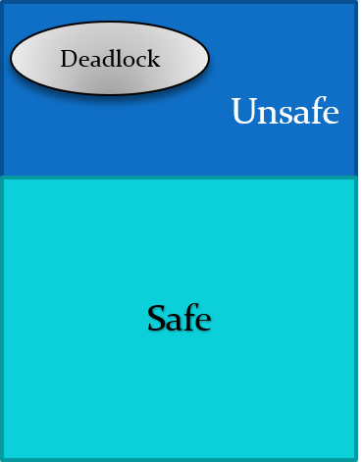
Safe State
System in safe state → no deadlocks
System in unsafe state → possibility of deadlock
Deadlock avoidance: ensure a system never enters an unsafe state
Deadlock Avoidance Algorithms
Single instance of a resource type: resource-allocation graph
Multiple instances of a resource type: banker’s algorithm

Slide 25
Resource-Allocation Graph
Two types of nodes:
P = {P1, P2, …, Pn}, the set of all the processes in the system
R = {R1, R2, …, Rm}, the set of all resource types in the system
Two types of edges:
request edge: directed edge Pi➞Rj
assignment edge: directed edge Rj➞Pi
claim edge: directed edge Pi➞Rj
process Pi may request resource Rj
dash line

Slide 26
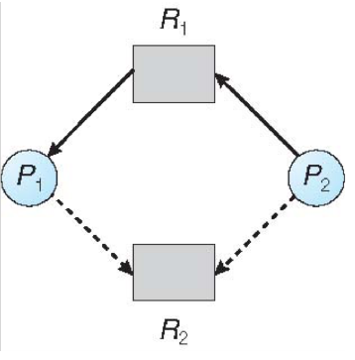
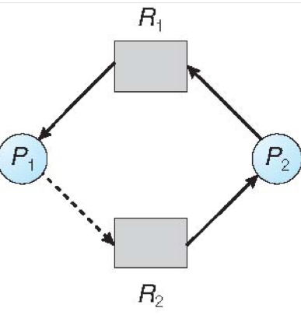
Single-instance Deadlock Avoidance
Using resource-allocation graph
Transitions in between edges
claim edge → request edge when a process requests resource
request edge → assignment edge when resource allocated to process
assignment edge → claim edge when resource released by process

Slide 27
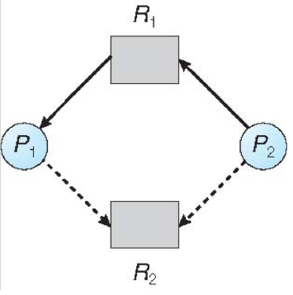
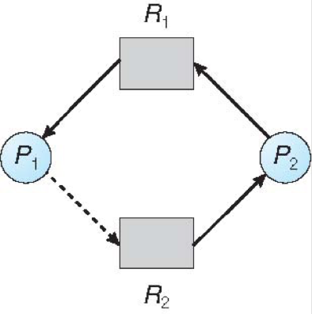
Single-instance Deadlock Avoidance
The request can be granted only if converting a request edge to an assignment edge does not result in a cycle
no cycle → safe state
safe
unsafe

Slide 28
Banker’s Algorithm
For multiple-instance resource deadlock avoidance
Assumptions:
each process must a priori claim maximum use of each resource type
when a process requests a resource, it may have to wait
when a process gets all its resources it must release them in a finite amount of time

Slide 29
Banker’s Algorithm: State Data Structures
n processes, m types of resources
available: an array of length m, instances of available resource
available[j] = k: k instances of resource type Rj available
max: n × m matrix
max [i,j] = k: process Pi may request at most k instances of resource Rj
allocation: n × m matrix
allocation[i,j] = k: Pi is currently allocated k instances of Rj
need: n × m matrix
need[i,j] = k: Pi may need k more instances of Rj to complete its task
need[i,j] = max[i,j] –allocation [i,j]

Slide 30
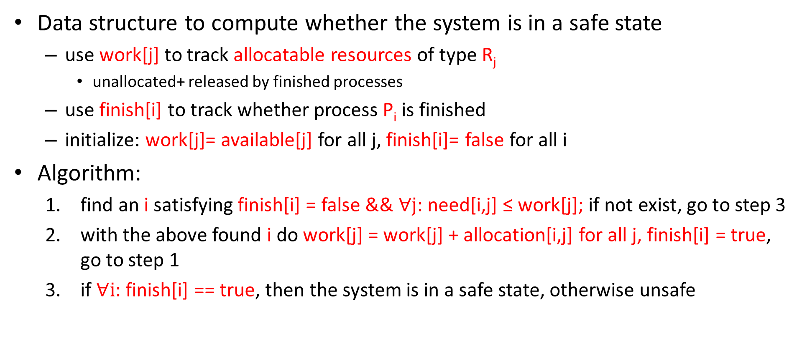
Banker’s Algorithm: Safe State
Data structure to compute whether the system is in a safe state
use work[j] to track allocatable resources of type R_{j}
unallocated+ released by finished processes
use finish[i] to track whether process P_{i} is finished
initialize: work[j]= available[j] for all j, finish[i]= false for all i
Algorithm:
find an i satisfying finish[i] = false && $∀j:$ need[i,j] ≤ work[j]; if not exist, go to step 3
with the above found i do work[j] = work[j] + allocation[i,j] for all j, finish[i] = true, go to step 1
if $∀i:$finish[i] == true, then the system is in a safe state, otherwise unsafe

Slide 31
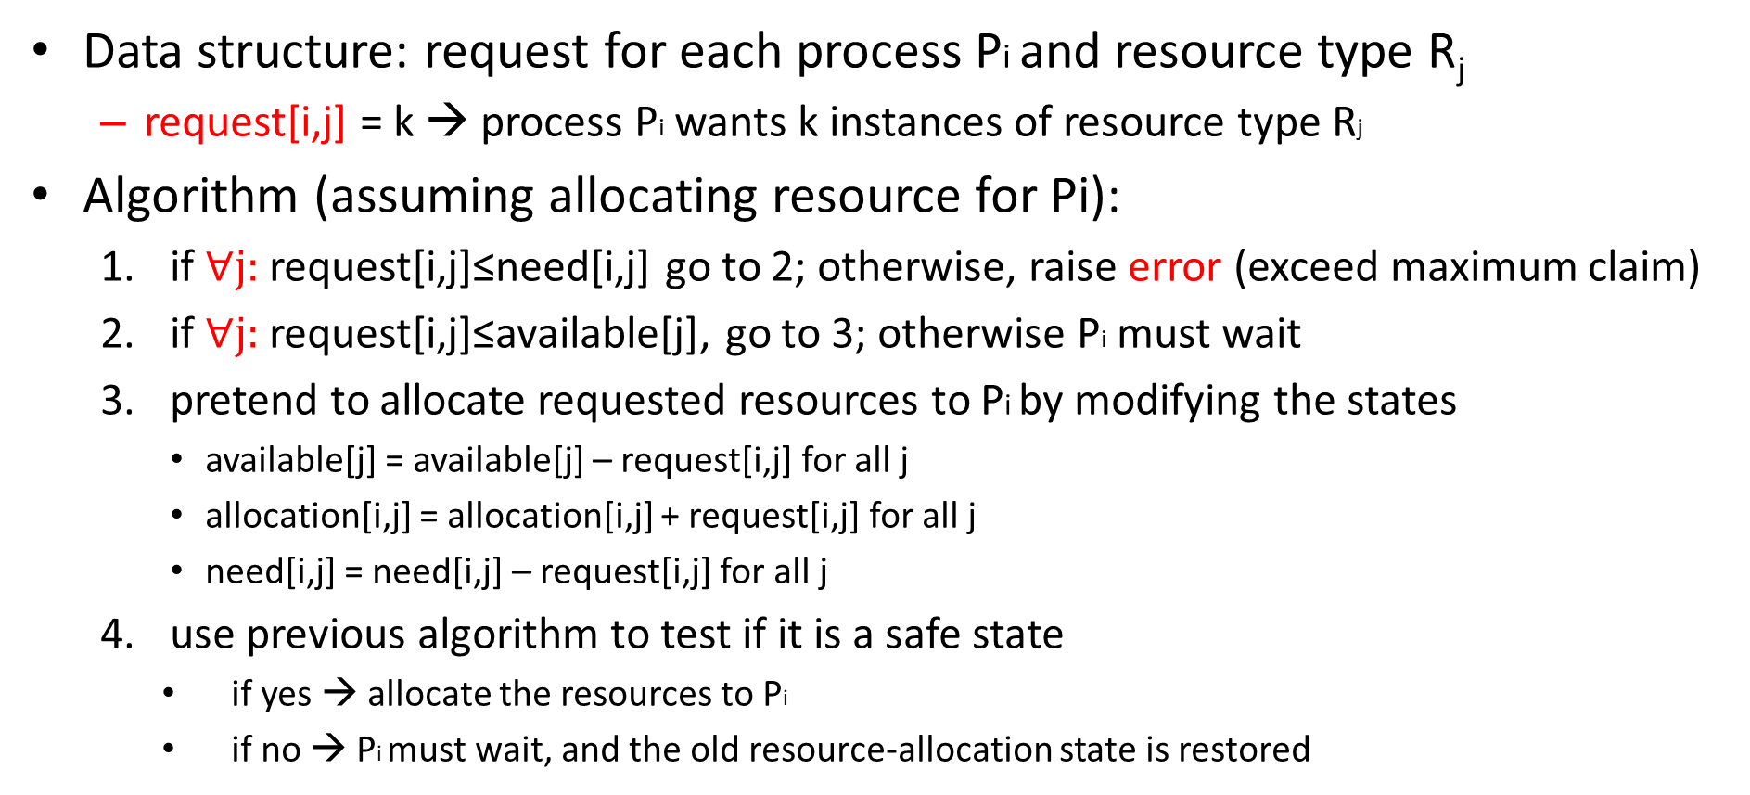
Banker’s Algorithm: Resource Allocation
Data structure: request for each process Pi and resource type R_{j}
request[i,j] = k → process Pi wants k instances of resource type Rj
Algorithm (assuming allocating resource for Pi):
if $∀j:$request[i,j]≤need[i,j] go to 2; otherwise, raise error (exceed maximum claim)
if $∀j:$request[i,j]≤available[j], go to 3; otherwise Pi must wait
pretend to allocate requested resources to Pi by modifying the states
available[j] = available[j] – request[i,j] for all j
allocation[i,j] = allocation[i,j] + request[i,j] for all j
need[i,j] = need[i,j] – request[i,j] for all j
use previous algorithm to test if it is a safe state
if yes → allocate the resources to Pi
if no → Pi must wait, and the old resource-allocation state is restored

Slide 32
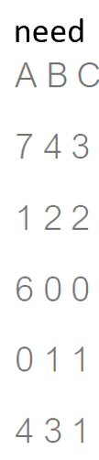
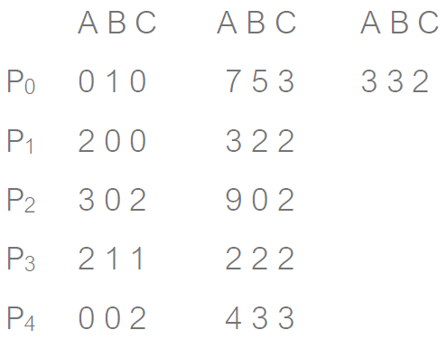
Banker’s Algorithm: Example
System state:
5 processes P₀ through P₄
3 resource types: A (10 instances), B (5 instances) and C (7 instances)
Snapshot at time T0:
allocation
max
available
need= max–allocation
The system is in safe state: sequence < P1, P3, P4, P2, P0>

Slide 33
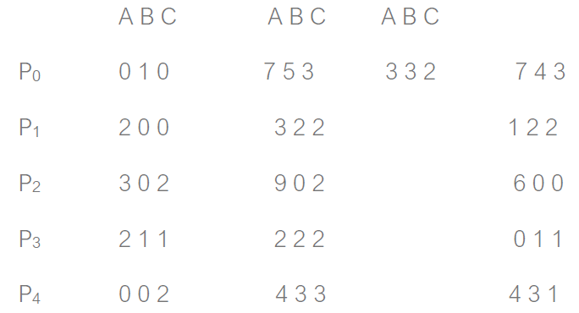
Banker’s Algorithm: Example
Why < P1, P3, P4, P2, P0> is in safe state?
needed[1] <= work
needed[3] <= work
needed[4] <= work
needed[2] <= work
needed[0] <= work
allocation
max
available
need
Initially:
work == available == [3 3 2]
finish[i]==false for all i
→ work = work + allocation = [5 3 2], finish[1] = true
→ work = work + allocation = [7 4 3], finish[3] = true
→ work = work + allocation = [7 4 5], finish[4] = true
→ work = work + allocation = [10 4 7], finish[2] = true
→ work = work + allocation = [10 5 7], finish[0] = true

Slide 34
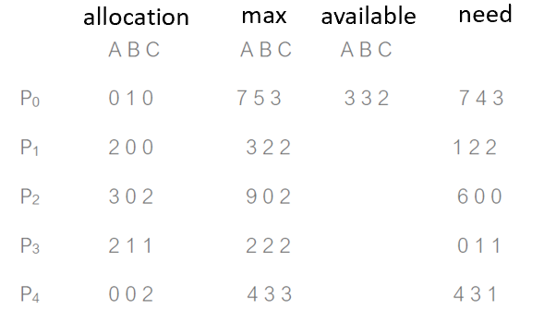
Banker’s Algorithm: Example
P1 requests 1 0 2, still in safe state?
needed[1] < work
needed[3] < work
needed[4] < work
needed[2] < work
needed[0] < work
2 3 0
3 0 2
0 2 0
Initially:
work == available == [2 3 0]
finish[i]==false for all i
→ work = work + allocation = [5 3 2], finish[1] = true
→ work = work + allocation = [7 4 3], finish[3] = true
→ work = work + allocation = [7 4 5], finish[4] = true
→ work = work + allocation = [10 4 7], finish[2] = true
→ work = work + allocation = [10 5 7], finish[0] = true

Slide 35
Banker’s Algorithm: Example
P0 requests 0 2 0, still in safe state?
0 3 0
2 3 0
2 1 0
7 2 3
0 2 0
3 0 2
We cannot find a process that the need[i] < work[i]

Slide 36
Deadlock Avoidance via Scheduling
In some scenarios deadlock avoidance is preferable.
Global knowledge is required:
Which locks various threads might grab during their execution.
Subsequently schedules said threads in a way as to guarantee no deadlock can occur

Slide 37
Deadlock Avoidance via Scheduling
We have two processors and four threads.
Lock acquisition demands of the threads:
A smart scheduler could compute that as long as T1 and T2 are not run at the same time, no deadlock could ever arise.
 | T1 | T2 | T3 | T4
L1 | yes | yes | no | no
L2 | yes | yes | yes | no
CPU 1
T3
T4
CPU 2
T1
T2

Slide 38
Deadlock Avoidance via Scheduling
More contention for the same resources
A possible schedule that guarantees that no deadlock could ever occur.
The total time to complete the jobs is lengthened considerably.
 | T1 | T2 | T3 | T4
L1 | yes | yes | yes | no
L2 | yes | yes | yes | no
CPU 1
T4
CPU 2
T1
T2
T3

Slide 39
Deadlock Detection
System may enter deadlock state, but detect and recover from it
Detection algorithm and recovery scheme

Slide 40
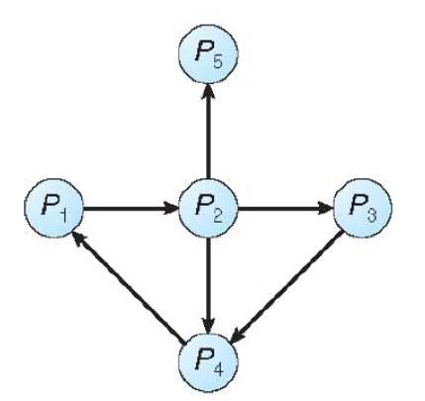
Deadlock Detection: Single Instance Resources
Wait-for graph: nodes are processes
Pi➞Pj if Pi is waiting for Pj
Periodically searches for a cycle in the graph
if there is a cycle, there exists a deadlock
detecting cycles in a graph requires O(n²) operations
n is the number of nodes in the graph
wait-for graph

Slide 41
Deadlock Detection: Multi-instance Resources
Similar to Banker’s algorithm’s safety condition
to prove it is impossible to enter a safe state
Banker’s algorithm is to prove it is impossible to enter an unsafe state
Data structures
available: an array of length m, instances of available resource
allocation: n × m matrix, the current resource allocated to each process
request: n x m matrix, the current resource request of each process.
work: an array of length m, the allocatable instances of resources
finish: a vector of n, whether the process has been “finished”
if allocation[i] ≠0 → finish[i] = false; otherwise, finish[i] = true

Slide 42
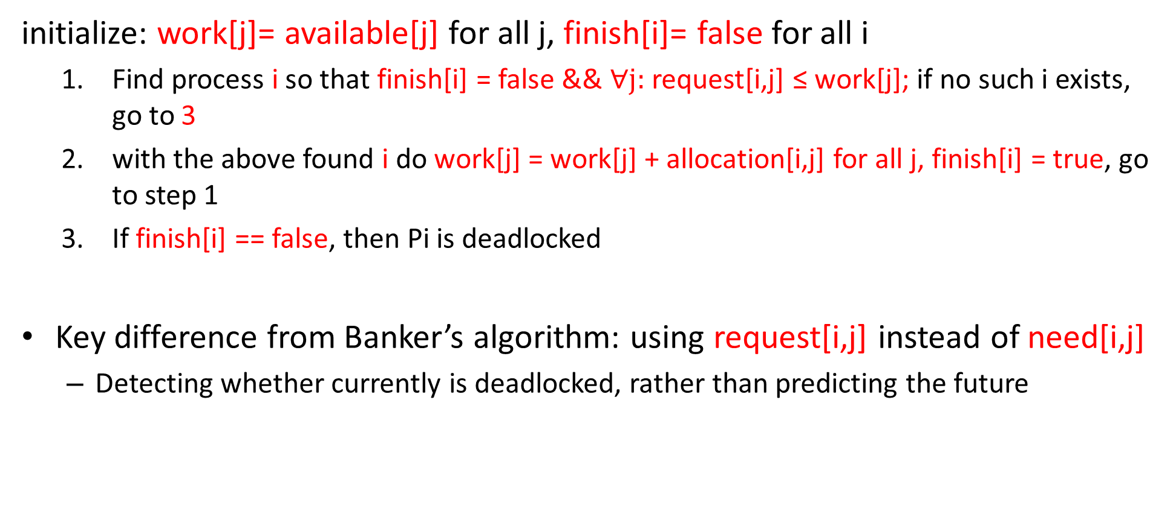
Deadlock Detection: Multi-instance Resources
initialize: work[j]= available[j] for all j, finish[i]= false for all i
Find process i so that finish[i] = false && $∀j:$ request[i,j] ≤ work[j]; if no such i exists, go to 3
with the above found i do work[j] = work[j] + allocation[i,j] for all j, finish[i] = true, go to step 1
If finish[i] == false, then Pi is deadlocked
Key difference from Banker’s algorithm: using request[i,j] instead of need[i,j]
Detecting whether currently is deadlocked, rather than predicting the future

Slide 43
Example
five processes P0 through P4
three resource types: A (7 instances), B (2 instances), and C (6 instances)
allocation
request
available
0 0 0
0 0 0
request[0] <= work
request[2] <= work
request[3] <= work
request[1] <= work
request[4] <= work
→ work = work + allocation = [0 1 0], finish[0] = true
2 0 2
→ work = work + allocation = [3 1 3], finish[2] = true
3 0 3
0 0 0
→ work = work + allocation = [5 2 4], finish[3] = true
→ work = work + allocation = [7 2 4], finish[1] = true
1 0 0
→ work = work + allocation = [7 2 6], finish[4] = true
0 0 2
Sequence <P0, P2, P3, P1, P4> will result in finish[i] = true for all i → no deadlock

Slide 44
Example
P2 requests an additional instance of type C
allocation
request
available
0 0 0
0 0 0
request[0] <= work
→ work = work + allocation = [0 1 0], finish[0] = true
2 0 2
1
3 0 3
0 0 0
Now we cannot find any process with request < work → deadlock
1 0 0
0 0 2

Slide 45
Deadlock Recovery
Option 1: terminate deadlocked processes
abort all deadlocked processes
abort one process at a time until the deadlock cycle is eliminated
In which order should we choose to abort?
Option 2: resource preemption
Select a victim; rollback

