Slide 1
CS3103 Operating System 2023/2024 Sem B
Chapter 7: Memory Management
Dr. Nan Guan
Department of Computer Science
City University of Hong Kong

Slide 2
Background
User programs must be brought into memory and placed within a process for it to run
User programs go through several steps before running

Slide 3
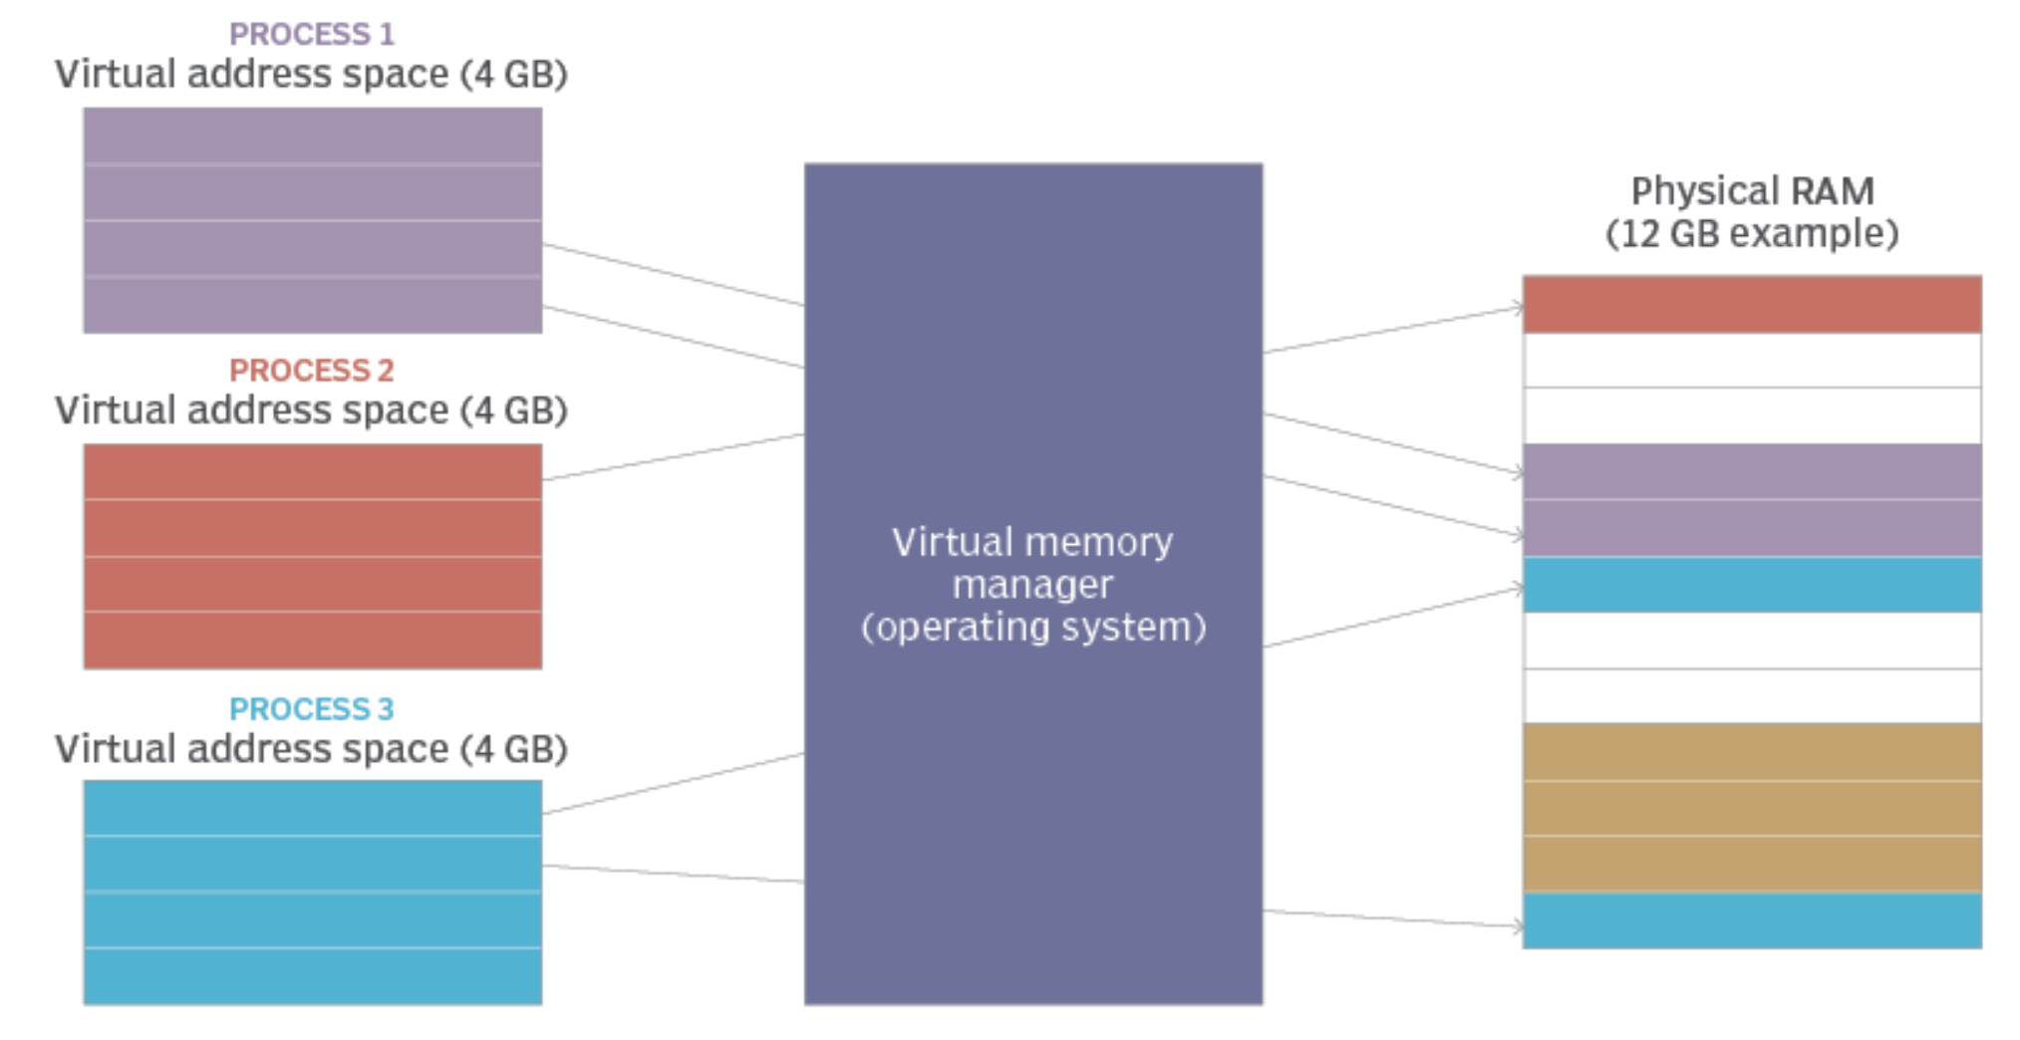
Logical vs. Physical Address Space
The concept of a logical address space that is bound to a separate physical address space is central to memory management
Logical address – generated by the CPU; also called virtual address
Physical address – address seen by the memory unit

Slide 4
Logical vs. Physical Address Space
The concept of a logical address space that is bound to a separate physical address space is central to memory management
Logical address – generated by the CPU; also called virtual address
Physical address – address seen by the memory unit
Logical and physical addresses are the same in compile-time and load-time address-binding schemes
Logical (virtual) and physical addresses differ in execution-time address-binding scheme

Slide 5
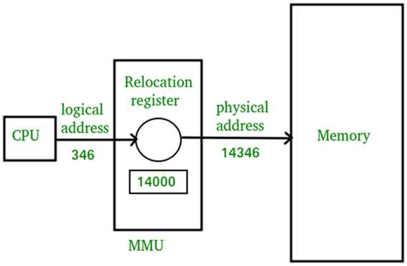
Memory-Management Unit (MMU)
Hardware device that maps virtual to physical address
The value in the relocation register is added to every address generated by a user process when sent to memory
The user program deals with logical addresses; it never sees the real physical addresses

Slide 6
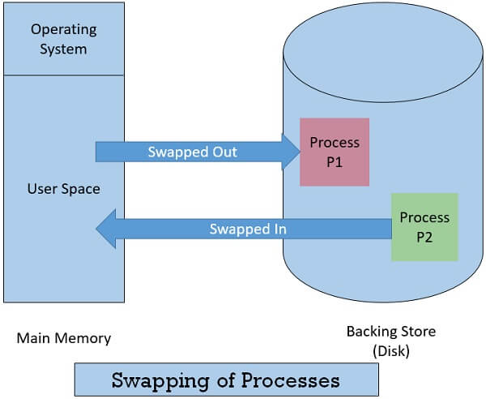
Swapping
Process can be swapped temporarily out of memory, and brought back into memory later
Major part of swap time is transfer time, directly proportional to the amount of memory swapped
Commonly used in many OS (i.e., UNIX, Linux, and Windows)

Slide 7
Dynamic Storage-Allocation Problem
Hole: block of available memory; holes of various size are scattered throughout memory
When a process arrives, it is allocated memory from a hole large enough to accommodate it
OS maintains: allocated partitions and free partitions (hole)
OS
OS
OS
OS
process 5
process 5
process 5
process 5
process 9
process 9
process 8
process 10
process 2
process 2
process 2
process 2

Slide 8
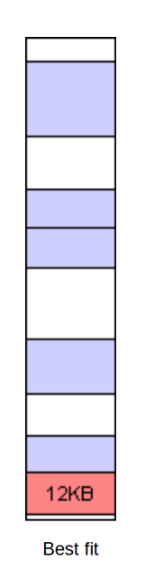
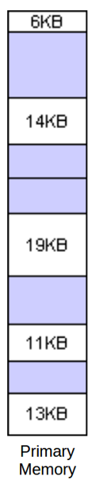
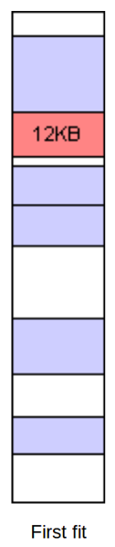
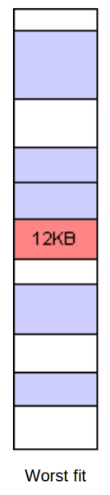
Dynamic Storage-Allocation Problem
How to satisfy a request of a certain size from a list of free holes
First-fit: Allocate the first hole that is big enough. Simple.
Best-fit: Allocate the smallest hole that is big enough; must search entire list, unless ordered by size. Produces the smallest leftover hole
Worst-fit: Allocate the largest hole; must also search entire list. Produces the largest leftover hole

Slide 9
Fragmentation
External Fragmentation: total memory space enough to satisfy a request, but not contiguous
Reduce external fragmentation by compaction
Shuffle memory contents to place all free memory together in one block
Internal Fragmentation: allocated memory may be larger than requested memory

Slide 10
Memory Management Techniques
Two major memory management techniques
Paging
Segmentation

Slide 11
Paging
Divide physical memory into fixed-sized blocks called frames
size is power of 2, typically between 512 bytes and 8192 bytes
Divide logical memory into blocks of same size called pages
Keep track of all free frames
To run a program of n pages, need to find n free frames
Set up a page table to translate logical to physical addresses
External fragmentation eliminated
Internal fragmentation still exists

Slide 12
Advantages of Paging
Flexibility: Supporting the abstraction of address space effectively
Don’t need assumption how heap and stack grow and are used
Simplicity: ease of free-space management
The page in address space and the page frame are the same size.
Easy to allocate and keep a free list

Slide 13
Example: A Simple Paging
128-byte physical memory with 16 bytes page frames
64-byte logical address space with 16 bytes pages
0
reserved for OS
page frame 0 of physical memory
16
(unused)
page frame 1
32
page 3
page frame 2
48
page 0
0
page frame 3
(page 0 of the address space)
64
16
(unused)
page frame 4
(page 1)
80
32
page 2
page frame 5
(page 2)
96
48
(unused)
page frame 6
(page 3)
64
112
page 1
A Simple 64-byte Address Space
page frame 7
128
64-Byte Address Space Placed In Physical Memory

Slide 14
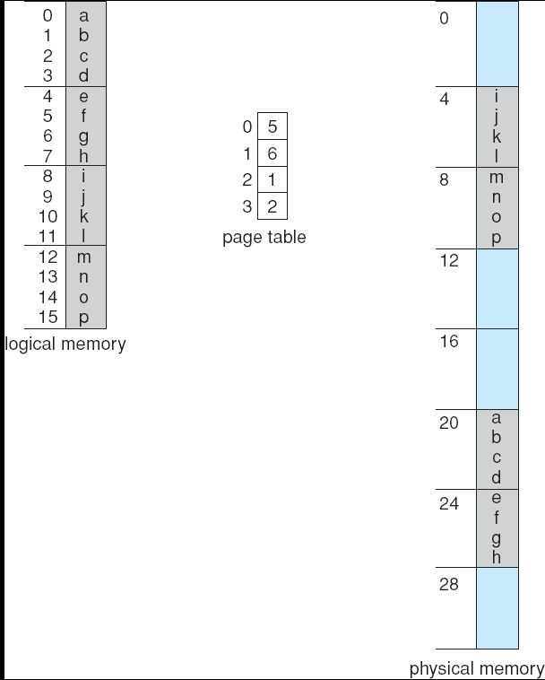
Paging Example
0
1
2
3
4
5
6
Page size = 4 bytes
Physical memory= 32 bytes
7

Slide 15
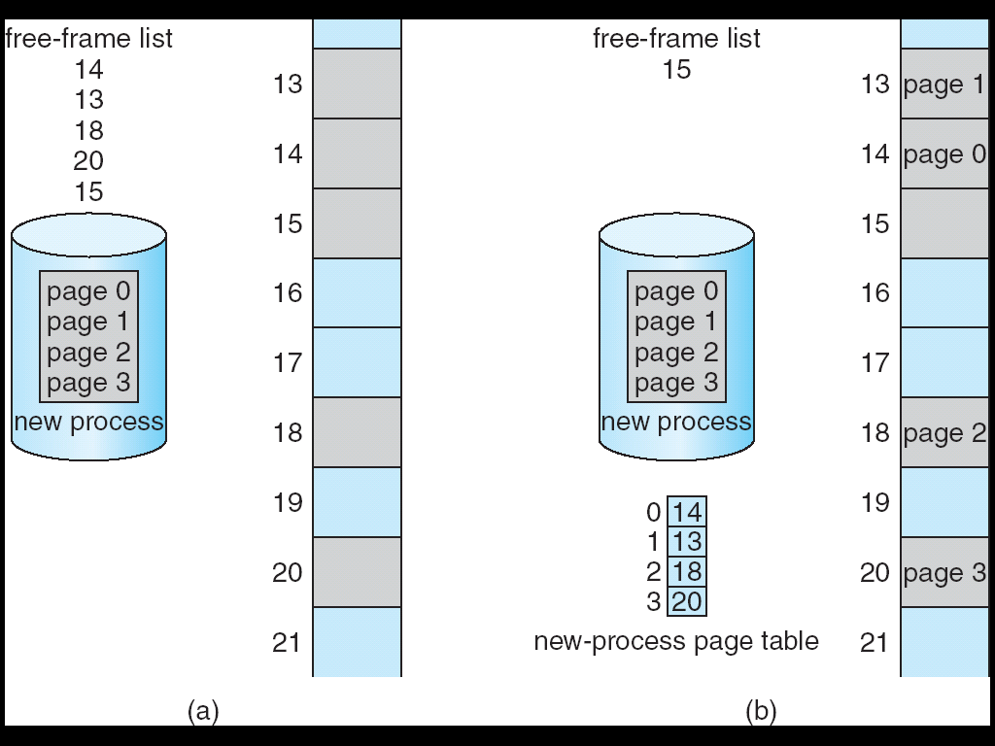
Free Frames
Before Allocation
After Allocation
free
free
free
free
free
Before allocation

Slide 16
Address Translation
Two components in the virtual address
Virtual page number (VPN)
Offset: offset within the page
Example: virtual address 21 in 64-byte address space
VPN
offset
Va5
Va4
Va3
Va2
Va1
Va0
VPN
offset
0
1
0
1
0
1

Slide 17
Address Translation
Example: virtual address 21 in 64-byte address space
The page table would have the following four entries:
VPN
offset
Virtual
Address
0
1
0
1
0
1
Virtual Page No. | Physical Frame No.
VP 0 | PF 3
VP 1 | PF 7
VP 2 | PF 5
VP 3 | PF 2
Address Translation
Physical
Address
1
1
1
0
1
0
1
PFN
offset

Slide 18
What Is In The Page Table?
The page table is just a data structure that is used to map the virtual address to physical address.
Simplest form: a linear page table, an array
The OS indexes the array by VPN, and looks up the page-table entry.

Slide 19
Common Flags Of Page Table Entry
Valid Bit: Indicating whether the particular translation is valid.
Protection Bit: Indicating whether the page could be read from, written to, or executed from
Present Bit: Indicating whether this page is in physical memory or on disk (swapped out)
Dirty Bit: Indicating whether the page has been modified since it was brought into memory
Reference Bit (Accessed Bit): Indicating that a page has been accessed

Slide 20
Page Table
Simple linear page table:
The high-order (left-most) bit is the VALID bit.
If the bit is 1, the rest of the entry is the physical frame no. (PFN).
If the bit is 0, the page is not valid.
Valid
PFN
[ 0] 0x8000000c ‭ 10000000000000000000000000001100‬
[ 1] 0x00000000 00000000000000000000000000000000
[ 2] 0x00000000 00000000000000000000000000000000
[ 3] 0x80000006 10000000000000000000000000000110

Slide 21
A Linear Page Table Example
Some basic assumptions:
address space size 16k
Virtual address: 14 bits
physical memory size 64k
page size 4k (offset: 12 bits)
Translate virtual address: 0x3229:
Binary: 11 0010 0010 1001
VPN
offset
Virtual
Address
1
1
0010 0010 1001
Valid
PFN
[0] 0x8000000c 10000000000000000000000000001100‬
[1] 0x00000000 00000000000000000000000000000000
[2] 0x00000000 00000000000000000000000000000000
[3] 0x80000006 10000000000000000000000000000110
Address Translation
Valid
Physical
Address
0000000000000000000000000000110
0010 0010 1001
Physical frame no. (PFN)
offset

Slide 22
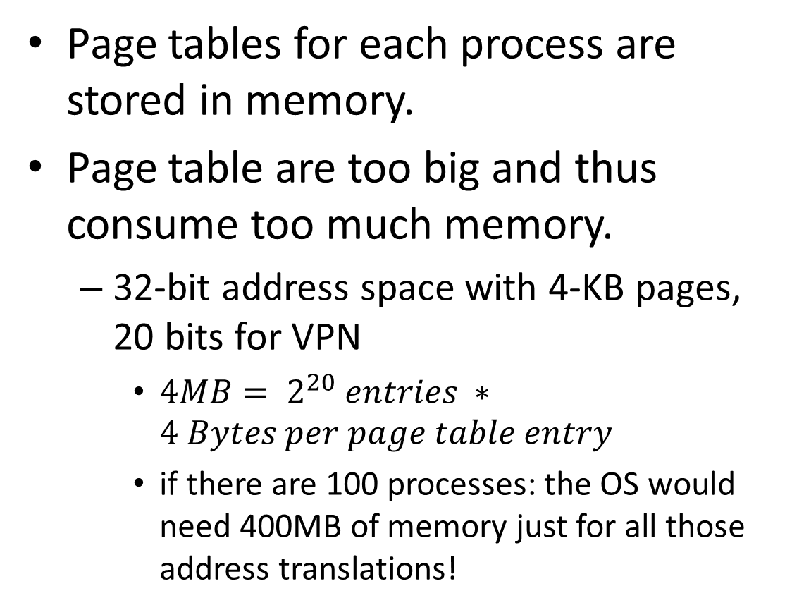
Storing Linear Page Tables
Page tables for each process are stored in memory.
Page table are too big and thus consume too much memory.
32-bit address space with 4-KB pages, 20 bits for VPN
${4MB= 2}^{20} entries ∗4 Bytes per page table entry$
if there are 100 processes: the OS would need 400MB of memory just for all those address translations!
4B
entry
4KB
Page 0
entry
entry
Page 1
…
Page 2
…
entry
Page n
Page Table of
Process A
Physical Memory

Slide 23

Page Size vs Page Table Size
We could reduce the size of the page table in one simple way: use bigger pages.
assume 32-bit address space with 16KB pages and 4-byte page-table entry
4B
entry
16KB
Page 0
entry
entry
Page 1
…
Page 2
…
entry
Page n
Page Table of
Process A
Physical Memory
$\frac{2^{32}}{2^{14}}∗4=1MB$ per page table
Big pages lead to internal fragmentation.

Slide 24
TLB
Page table is stored in main memory
The access to the page table can speedup by using a special fast-lookup hardware translation look-aside buffers (TLBs)
TLB is small, typically between 64 and 1024 entries
A cache for the page table

Slide 25
TLB
Page #
Frame #
TLB hardware supports parallel search
Address translation (A’, A’’)
If A’ is found, get frame # out
Otherwise get frame # from page table in memory

Slide 26
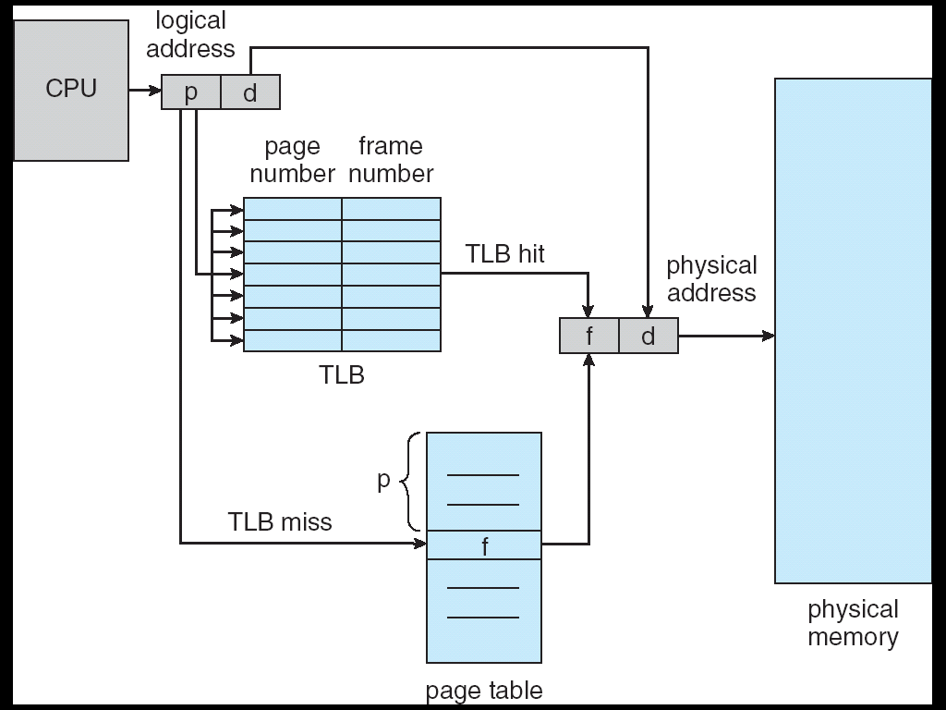
Paging Hardware With TLB

Slide 27
Multi-level (Hierarchical) Page Tables
In order to reduce the memory overhead of page tables.
Turns the linear page table into something like a tree.
Chop up the page table into page-sized units.
If an entire page of page-table entries is invalid, don’t allocate that page of the page table at all.
Use a new structure, called a page directory (outer page table)

Slide 28
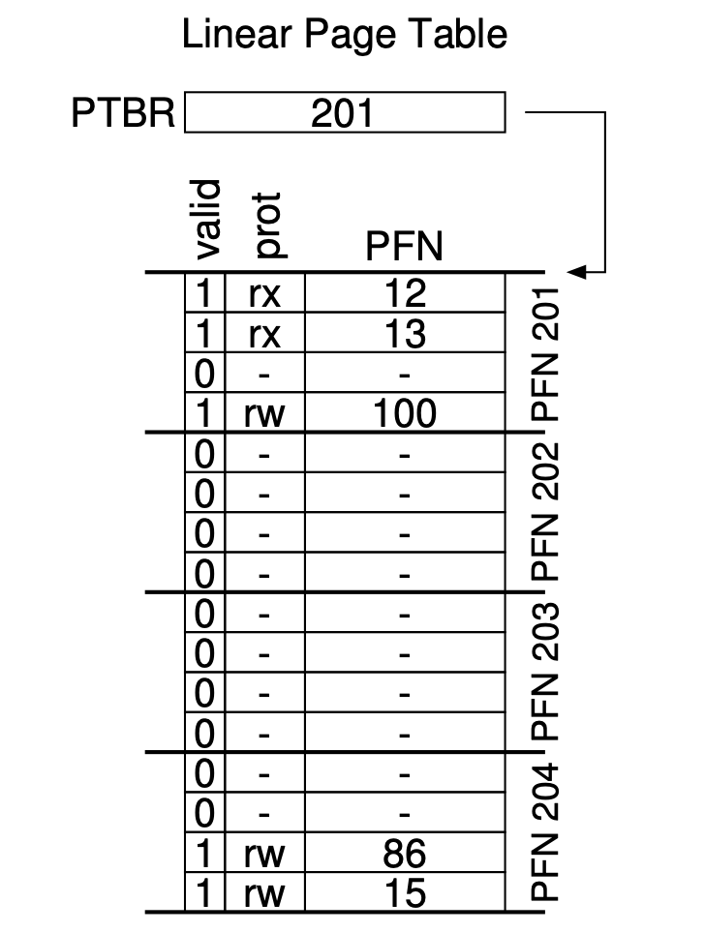
Page Directory (Outer Page Table)
Multi-level Page Table
PDBR
200
valid
PFN
valid
prot
PFN
1 | 201
0 | -
0 | -
1 | 204
1 | rx | 12
1 | rx | 13
0 | - | -
1 | rw | 100
PFN200
PFN201
Page Directory
0 | - | -
0 | - | -
1 | rw | 86
1 | rw | 15
PFN204
PTBR: page table base register, PDBR: page directory base register.

Slide 29
Multi-level (Hierarchical) Page Tables
Advantage
Only allocates page-table space in proportion to the amount of address space you are using
The OS can grab the next free page when it needs to allocate or grow a page table
Disadvantage
Multi-level table is a small example of a time-space trade-off.
Complexity.

Slide 30

A Multi-Level Page Table Example
To understand the idea behind multi-level page tables better, let's do an example.
Some basic assumptions:
Flag | Detail
Address space | 32 KB (1024 pages)
Page size | 32 bytes
Virtual address | 15 bits
VPN | 10 bits
Offset | 5 bits
Page entry per page | 32 PTEs
Physical memory size | 4 KB (128 pages)
15-bits Virtual Address
14 | 13 | 12 | 11 | 10 | 9 | 8 | 7 | 6 | 5 | 4 | 3 | 2 | 1 | 0
Virtual page no. (VPN)
Offset
12-bits Physical Address
11 | 10 | 9 | 8 | 7 | 6 | 5 | 4 | 3 | 2 | 1 | 0
$$\log_{2}{32=5}$$
Physical frame no. (PFN)
Offset

Slide 31
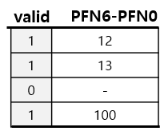
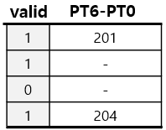
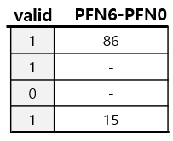
A Multi-Level Page Table Example: Page Directory Index
The page directory needs one entry per page of the page table
it has 32 page-directory entries (PDEs).
The page-directory entry is invalid → Raise an exception (The access is invalid)
The format of a page-directory entry is (8 bits):
VALID | PT6 ... PT0
15-bits Virtual Address
PDBR
page of page table
Page Directory Index
page directory
14 | 13 | 12 | 11 | 10 | 9 | 8 | 7 | 6 | 5 | 4 | 3 | 2 | 1 | 0
VPN
Offset
page of page table
VALID | PT6 | PT5 | PT4 | PT3 | PT2 | PT1 | PT0

Slide 32
A Multi-Level Page Table Example: Page Table Index
If the page directory entry (PDE) is valid
To fetch the page table entry (PTE) from the page of the page table pointed to by this page-directory entry.
This page-table index can then be used to index into the page of page table
The format of a page table entry (PTE) is (8 bits):
VALID | PFN6 ... PFN0
15-bits Virtual Address
PDBR
page of page table
Page Directory Index
Page Table Index
page director
14 | 13 | 12 | 11 | 10 | 9 | 8 | 7 | 6 | 5 | 4 | 3 | 2 | 1 | 0
VPN
Offset
page of page table
VALID | PFN6 | PFN5 | PFN4 | PFN3 | PFN2 | PFN1 | PFN0

Slide 33
A Multi-Level Page Table Example: Address Translation
Page directory base register (PDBR) : the page number used by the page directory, e.g., 108 (decimal).
A memory page dump:
shows the 32 bytes found on pages 0, 1, 2, and so forth. The first byte (0th byte) on page 0 has the value 0x1b, the second is 0x1d, the third 0x05, and so forth.
00 01 02 03 04 05 06 07 08 09 10 11 12 13 14 15 16 17 18 19 20 21 21 23 24 25 26 27 28 29 30 31
--------: -- -- -- -- -- -- -- -- -- -- -- -- -- -- -- -- -- -- -- -- -- -- -- -- -- -- -- -- -- -- -- --
page 0: 1b 1d 05 05 1d 0b 19 00 1e 00 12 1c 19 09 19 0c 0f 0b 0a 12 18 15 17 00 10 0a 06 1c 06 05 05 14
page 1: 00 00 00 00 00 00 00 00 00 00 00 00 00 00 00 00 00 00 00 00 00 00 00 00 00 00 00 00 00 00 00 00
page 2: 12 1b 0c 06 00 1e 04 13 0f 0b 10 02 1e 0f 00 0c 17 09 17 17 07 1e 00 1a 0f 04 08 12 08 19 06 0b
...

Slide 34
A Multi-Level Page Table Example: Address Translation
Steps:
Use the PDBR to find the relevant page table entries for this virtual page.
Then find if it is valid. If so, use the translation to form a final physical address. Using this address, you can find the VALUE that the memory reference is looking for. Note that the virtual address may not be valid and thus generate a fault.

Slide 35
A Multi-Level Page Table Example: Address Translation
Let’s try to translate virtual address 0x611c to physical address and fetch its value if it is a valid address.
00 01 02 03 04 05 06 07 08 09 10 11 12 13 14 15 16 17 18 19 20 21 21 23 24 25 26 27 28 29 30 31
--------: -- -- -- -- -- -- -- -- -- -- -- -- -- -- -- -- -- -- -- -- -- -- -- -- -- -- -- -- -- -- -- --
page 0: 1b 1d 05 05 1d 0b 19 00 1e 00 12 1c 19 09 19 0c 0f 0b 0a 12 18 15 17 00 10 0a 06 1c 06 05 05 14
page 1: 00 00 00 00 00 00 00 00 00 00 00 00 00 00 00 00 00 00 00 00 00 00 00 00 00 00 00 00 00 00 00 00
page 2: 12 1b 0c 06 00 1e 04 13 0f 0b 10 02 1e 0f 00 0c 17 09 17 17 07 1e 00 1a 0f 04 08 12 08 19 06 0b
....
page 33: 7f 7f 7f 7f 7f 7f 7f 7f b5 7f 9d 7f 7f 7f 7f 7f 7f 7f 7f 7f 7f 7f 7f 7f 7f 7f f6 b1 7f 7f 7f 7f
....
page 53: 0f 0c 18 09 0e 12 1c 0f 08 17 13 07 1c 1e 19 1b 09 16 1b 15 0e 03 0d 12 1c 1d 0e 1a 08 18 11 00
....
page 108: 83 fe e0 da 7f d4 7f eb be 9e d5 ad e4 ac 90 d6 92 d8 c1 f8 9f e1 ed e9 a1 e8 c7 c2 a9 d1 db ff
....
page 127: 7f 7f 7f 7f 7f 7f 7f 7f 7f 7f 7f 7f 7f 7f 7f 7f df 7f 7f 7f 7f 7f 7f 7f 7f 7f 7f 7f 7f 95 7f 7f

Slide 36
A Multi-Level Page Table Example: Address Translation
Step 1: Use the PDBR to find the page directory on page 108
Step 2: Convert virtual address 0x611c to binary (15 bits): 11000 01000 11100.
Step 3: page directory entry PDE
PDE index: 0b11000 = 0x18 = 24
PDE content: a1, 24th byte on page 108
0xa1= 0b10100001
Valid bit: 1, PT (PFN): 0b0100001=0x21=33
00 01 02 03 04 05 06 07 08 09 10 11 12 13 14 15 16 17 18 19 20 21 21 23 24 25 26 27 28 29 30 31
--------: -- -- -- -- -- -- -- -- -- -- -- -- -- -- -- -- -- -- -- -- -- -- -- -- -- -- -- -- -- -- -- --
page 108: 83 fe e0 da 7f d4 7f eb be 9e d5 ad e4 ac 90 d6 92 d8 c1 f8 9f e1 ed e9 a1 e8 c7 c2 a9 d1 db ff
Page Directory Index
Page Table Index
14 | 13 | 12 | 11 | 10 | 9 | 8 | 7 | 6 | 5 | 4 | 3 | 2 | 1 | 0
1 | 1 | 0 | 0 | 0 | 0 | 1 | 0 | 0 | 0 | 1 | 1 | 1 | 0 | 0
VPN
Offset
VALID | PT6 | PT5 | PT4 | PT3 | PT2 | PT1 | PT0
1 | 0 | 1 | 0 | 0 | 0 | 0 | 1

Slide 37
A Multi-Level Page Table Example: Address Translation
Step 4: Locate memory page 33
Step 5: PTE
PTE index: 0b01000 = 0x8 = 8
PTE content: b5, 8th byte on page 33
0xb5 = 0b10110101
Valid bit: 1, PFN: 0b0110101 = 0x35 = 53
00 01 02 03 04 05 06 07 08 09 10 11 12 13 14 15 16 17 18 19 20 21 21 23 24 25 26 27 28 29 30 31
--------: -- -- -- -- -- -- -- -- -- -- -- -- -- -- -- -- -- -- -- -- -- -- -- -- -- -- -- -- -- -- -- --
page 33: 7f 7f 7f 7f 7f 7f 7f 7f b5 7f 9d 7f 7f 7f 7f 7f 7f 7f 7f 7f 7f 7f 7f 7f 7f 7f f6 b1 7f 7f 7f 7f
Page Directory Index
Page Table Index
14 | 13 | 12 | 11 | 10 | 9 | 8 | 7 | 6 | 5 | 4 | 3 | 2 | 1 | 0
1 | 1 | 0 | 0 | 0 | 0 | 1 | 0 | 0 | 0 | 1 | 1 | 1 | 0 | 0
VPN
Offset
VALID | PFN6 | PFN5 | PFN4 | PFN3 | PFN2 | PFN1 | PFN0
1 | 0 | 1 | 1 | 0 | 1 | 0 | 1

Slide 38
A Multi-Level Page Table Example: Address Translation
Step 6: Physical Address
PFN: 0b0110101 = 53, Offset 0b11100 = 28
Physical Address: 0b011010111100 = 0x6bc
Step 7: Locate memory page 53.
Step 8: Load Data
Page offset: 0b11100 = 0x1c = 28
Value: 08, 28th byte on page 53
0x08 = 0b00001000 = 8
11 | 10 | 9 | 8 | 7 | 6 | 5 | 4 | 3 | 2 | 1 | 0
0 | 1 | 1 | 0 | 1 | 0 | 1 | 1 | 1 | 1 | 0 | 0
PFN
Offset
00 01 02 03 04 05 06 07 08 09 10 11 12 13 14 15 16 17 18 19 20 21 21 23 24 25 26 27 28 29 30 31
--------: -- -- -- -- -- -- -- -- -- -- -- -- -- -- -- -- -- -- -- -- -- -- -- -- -- -- -- -- -- -- -- --
page 53: 0f 0c 18 09 0e 12 1c 0f 08 17 13 07 1c 1e 19 1b 09 16 1b 15 0e 03 0d 12 1c 1d 0e 1a 08 18 11 00

Slide 39
A Multi-Level Page Table Example: Address Translation
Summary:
Virtual Address 0x611c:
PDE index:0x18 (24)₁₀ PED contents:0xa1 (valid 1, pfn 0x21 (33)₁₀)
PTE index:0x8 (8)₁₀ PET contents:0xb5 (valid 1, pfn 0x35 (53)₁₀ )
Translates to Physical Address 0x6bc --> Value: 08
the virtual address may not be valid and thus generate a fault.
For example: when translating virtual address 0x3da8, PTE is not valid.

Slide 40
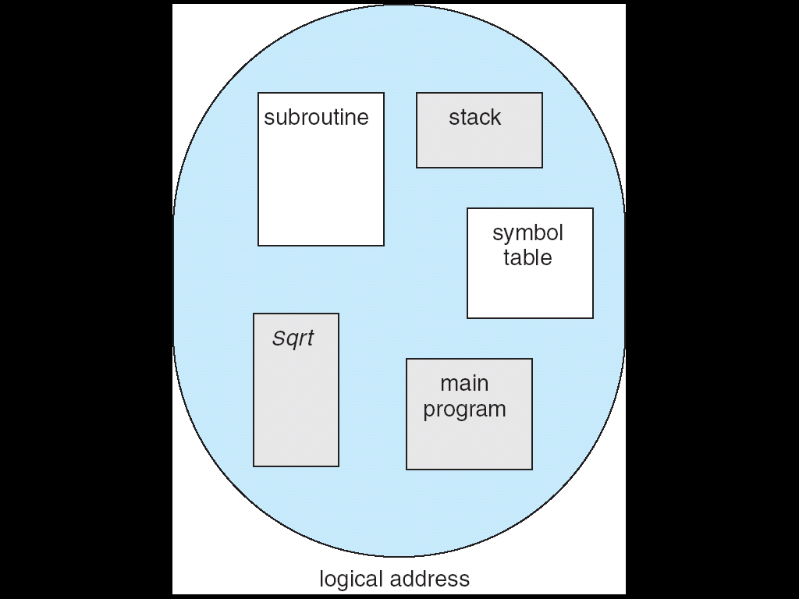
Segmentation
Memory-management scheme supports user view of memory
A program is a collection of segments
Each segment is a logical unit such as
main program,
procedure,
function,
method,
object,
local variables, global variables,
common block,
stack,
symbol table, arrays
...
Logical View of Segmentation
1
User’s View of a Program
4
1
2
3
4
2
3
user space
physical memory space

Slide 41
The following slides are optional

Slide 42
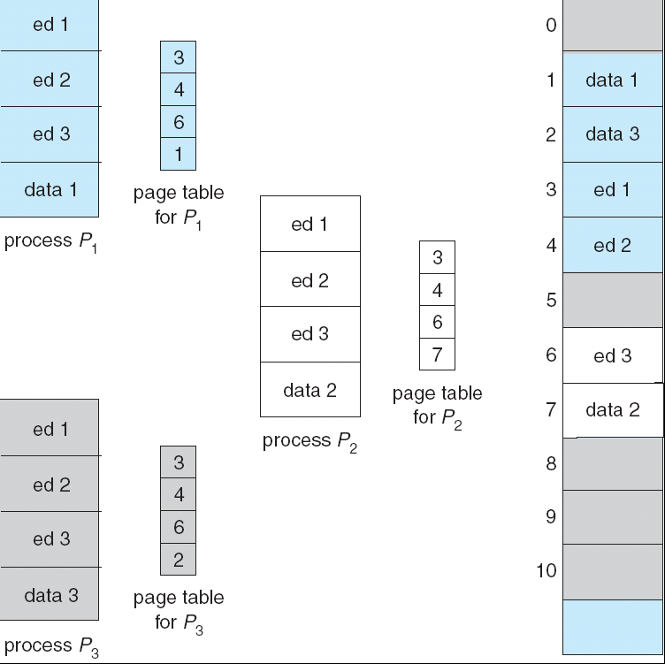
Shared Pages
Shared code
One copy of read-only (reentrant) code shared among processes
Shared code must appear in same location in the logical address space of all processes
Private code and data
Each process keeps a separate copy of the code and data
The pages for the private code and data can appear anywhere in the logical address space

Slide 43
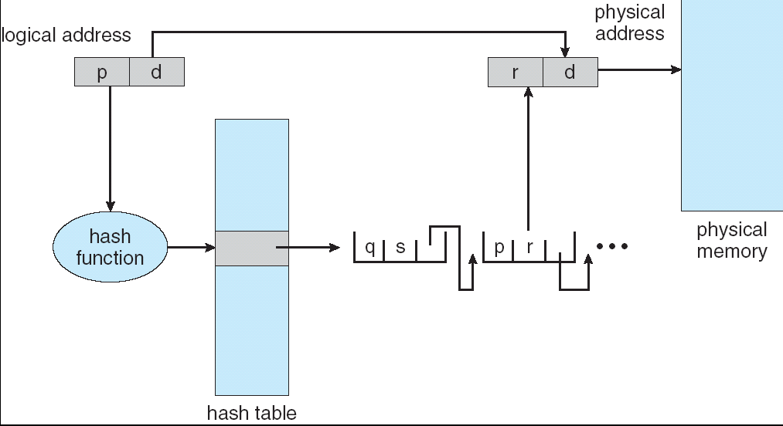
Hashed Page Tables
Common when address space > 32 bits
The virtual page number is hashed into a (small) page table
Contains a chain of elements hashing to same location in hash table
Virtual page numbers compared in this chain searching for a match. If a match is found, the corresponding physical frame is extracted
Maps a large number of keys to much fewer items in the hash table
Potential collision
Efficient if very few collisions
Each process typically only uses a small part of the entire address space

Slide 44
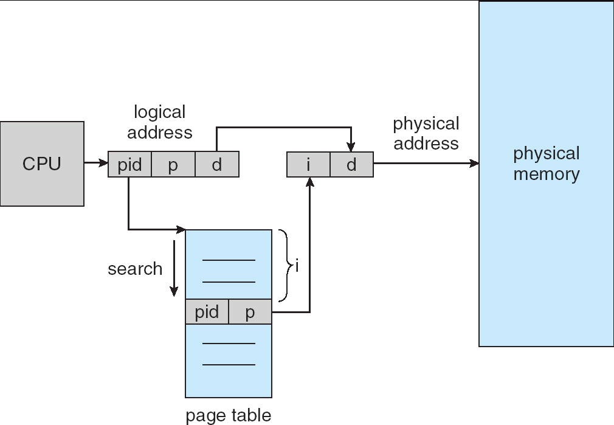
Inverted Page Table
Use the physical page number as index
Maps to an entry consists of the virtual address and which process
Save memory: as only store pages actually used by processes
Increases time: search the table when a page reference occurs

