Slide 1
CS3103 Operating System 2022/2023 Sem B
Chapter 8: Page Replacement
Dr. Nan Guan
Department of Computer Science
City University of Hong Kong

Slide 2
Background
Virtual memory: separating logical from physical memory
Separate the processes from each other and from the OS
Logical address space much larger than physical address space
Only part of the program needs to be in memory for execution
Virtual memory can be implemented via
Paging
Segmentation

Slide 3
Demand Paging
Demand paging: a paging system with swapping
To execute a program on storage (disk), swap it into memory
Instead of swapping in entire program into physical memory, only swaps those pages next to the currently executing instruction
A Page Table is used to keep track of pages that are in physical memory (Valid 1) or on disk (Invalid 0)
If the page is not currently in physical memory, then the address in back storage is also stored in Page Table
If the program tried to use a page not in memory, a Page Fault trap will occur (caused by the invalid bit in Page Table)

Slide 4
Demand Paging
Demand paging brings a page into memory only when needed
Less I/O needed
Less memory needed
Faster response
More users supported
A page is needed → reference to it
invalid reference → abort
not-in-memory → bring to memory

Slide 5
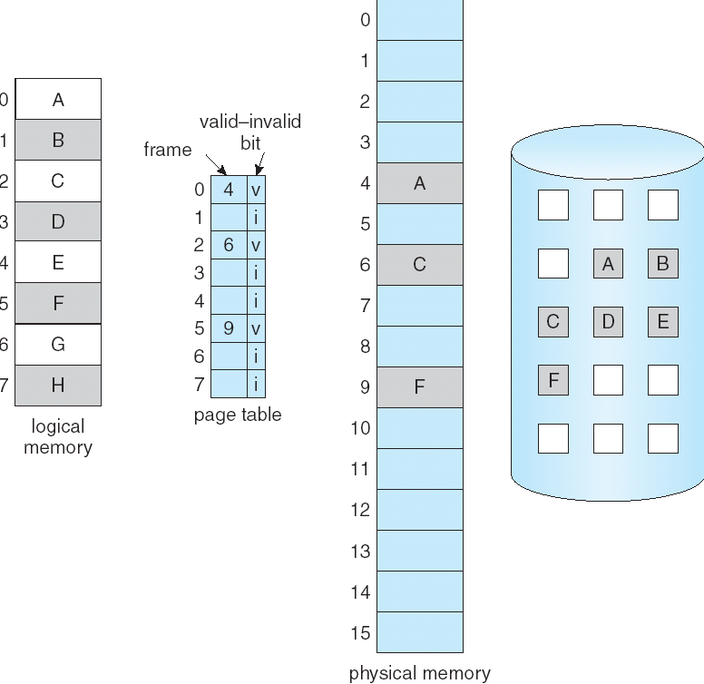
Valid-Invalid Bit
A valid–invalid bit is associated with each page table entry
v(1) → in-memory
i(0) → not-in-memory
Initially set to 0 on all entries
During address translation
valid–invalid bit is 0 → page fault

Slide 6
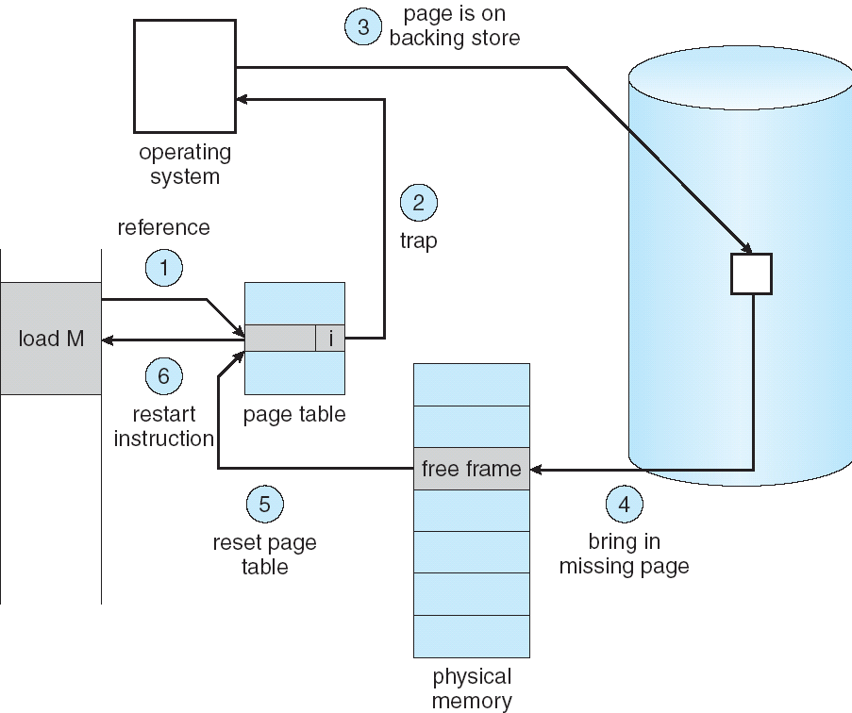
Page Fault
First reference to a page will trap to OS → page fault
Get free frame on memory
Bring page into frame.
Reset tables, validation bit = 1
Restart instruction

Slide 7
Page Replacement
What happens if there is no free frame?
swapping
Page replacement: find some page in memory, but not really in use, swap it out
Replacement algorithm
Performance: want an algorithm resulting in minimum number of page faults

Slide 8
Page Replacement
Find the location of the desired page on disk
Find a free frame:
If there is a free frame, use it
If there is no free frame, use a page replacement algorithm to select a victim frame
Read the desired page into the (newly) free frame
Update the page table
Restart the process

Slide 9
Performance
Page Fault Rate 0 ≤ p ≤ 1
if p = 0 no page faults
if p = 1, every reference is a fault
Effective Access Time (EAT)
EAT = (1 – p) x memory_access_time + p x page_fault_service_time
Example
Assume: Memory access time = 200 nanoseconds, Page fault rate = p, page fault service time = 8 milliseconds
EAT = (1 – p) x (200) + p (8 milliseconds) = 200 + 7,999,800 x p
EAT ~ p

Slide 10
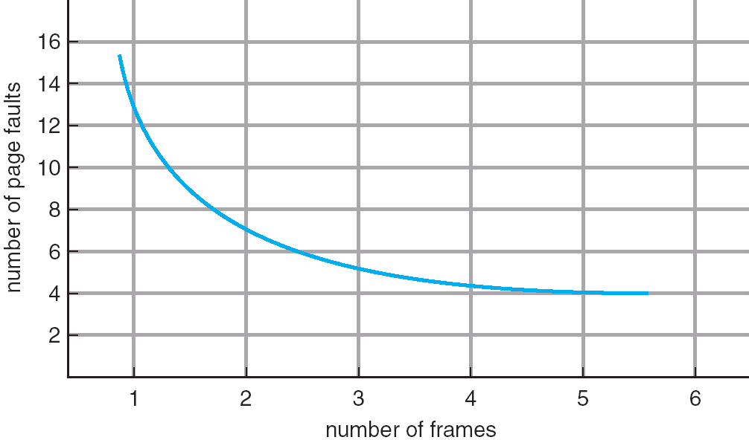
Page Faults vs The Number of Frames
In general, larger number of frames → fewer page faults

Slide 11
Optimal Algorithm
Replace page that will be unused for longest period of time in the future
Example:
Reference sequence:
Not a realistic algorithm in practice
Hard to know which one will be unused for longest time
For measuring how well a realistic algorithm performs
1 2 3 4 1 2 5 1 2 3 4 5 2 3
1
1
1
1
1
4
2
2
2
2
2
3
3
3
3
4
5
5

Slide 12
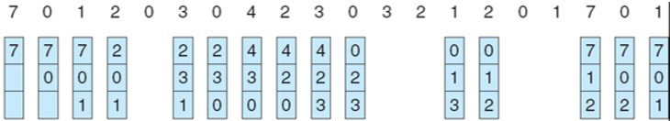
FIFO Algorithm
FIFO (First-In-First-Out): replaces earliest loaded page
Example:
Reference sequence
Frames

Slide 13
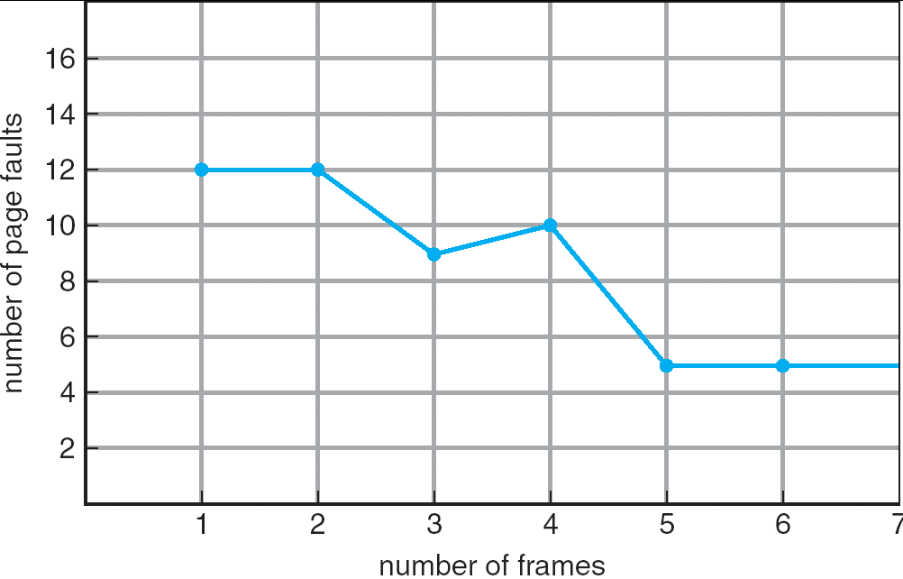
FIFO Algorithm
In general, more frames → fewer page faults
Anomaly: sometimes, more frames may lead to more page faults
Example:
Reference sequence: 1, 2, 3, 4, 1, 2, 5, 1, 2, 3, 4, 5
3 frames: 9 faults
4 frames: 10 faults

Slide 14

LRU Algorithm
LRU (Least Recently Used): replaces pages that have not been used for the longest time
Generally good algorithm and frequently used
Do not suffer Belady’s anomaly
Example:
Reference sequence
Frames

Slide 15
LRU Algorithm
Counter-based implementation
every page table entry has a counter
every time page is referenced, copy the clock into the counter
search for page with smallest counter to replace
Stack-based implementation
keep a stack of page numbers (in double linked list)
when a page is referenced, move it to the top of the stack
update is more expensive, but no need to search for replacement

Slide 16
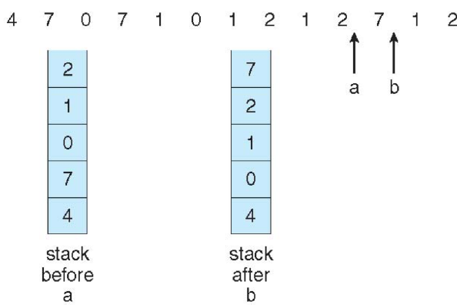
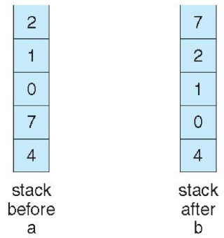
LRU Algorithm
Stack-based implementation example

Slide 17
Counting-Based Algorithms
Keep the number of references made to each page
LFU (Least Frequently Used) replaces page with smallest counter
Problem: what if a page is heavily used during process initialization and then never used?
MFU (Most Frequently Used) replaces page with largest counter
based on the argument that page with the smallest count was probably just brought in and has yet to be used

Slide 18
Second-Chance (Clock) Replacement Algorithm
Approximation of LRU
Each page has a reference bit, initially 0
When a page is referenced, the bit is set to be 1
To replace a page, check the reference bit
If currently is 0, then it can be replaced
If currently is 1, then it is changed to be 0
All pages are linked as a circle
Visit all pages in the circular order

Slide 19
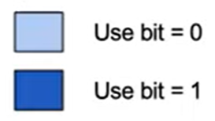
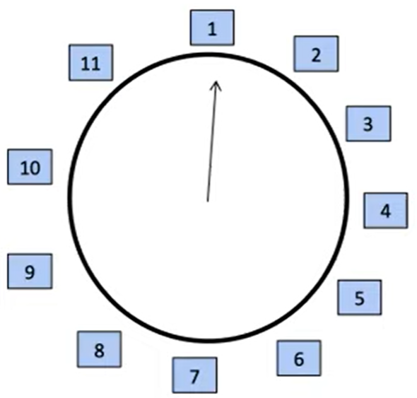
Example
Page Reference Sequence:

Slide 20
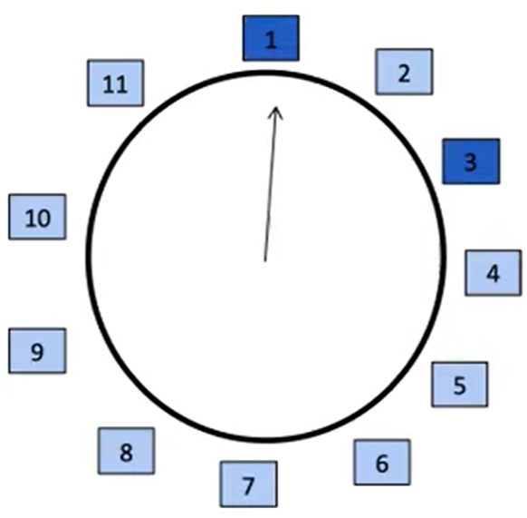
Example
Page Reference Sequence: 1 3

Slide 21
Example
Page Reference Sequence: 1 3 1

Slide 22
Example
Page Reference Sequence: 1 3 1 1

Slide 23
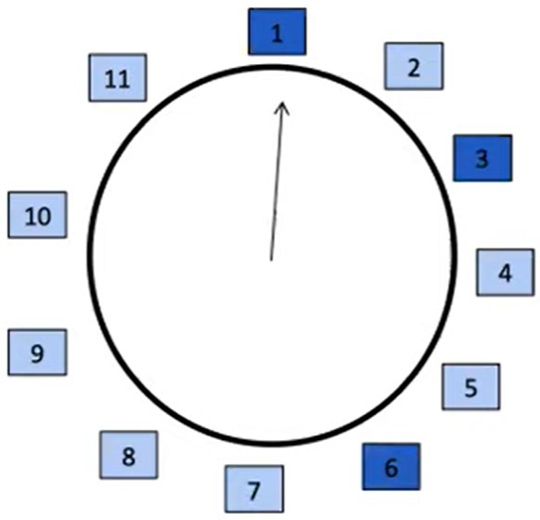
Example
Page Reference Sequence: 1 3 1 1 6

Slide 24
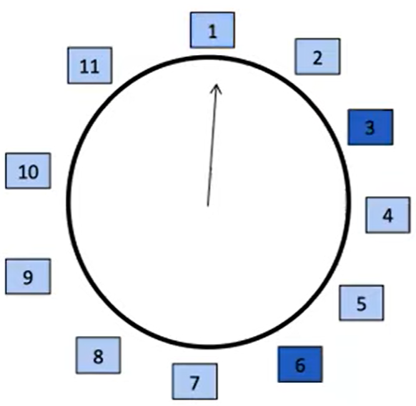
Example
Page Reference Sequence: 1 3 1 1 6 55

Slide 25
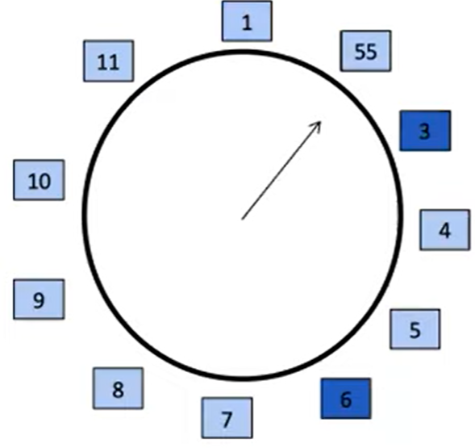
Example
Move the hand to the next position!
Page Reference Sequence: 1 3 1 1 6 55

Slide 26
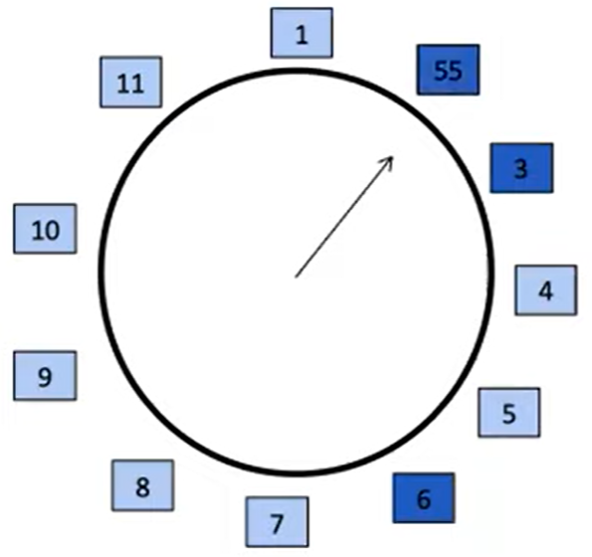
Example
Page Reference Sequence: 1 3 1 1 6 55

Slide 27
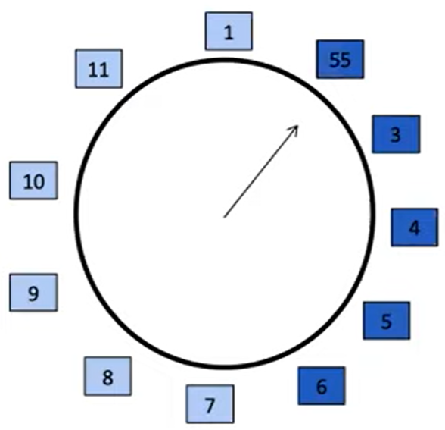
Example
Page Reference Sequence: 1 3 1 1 6 55 4 5

Slide 28
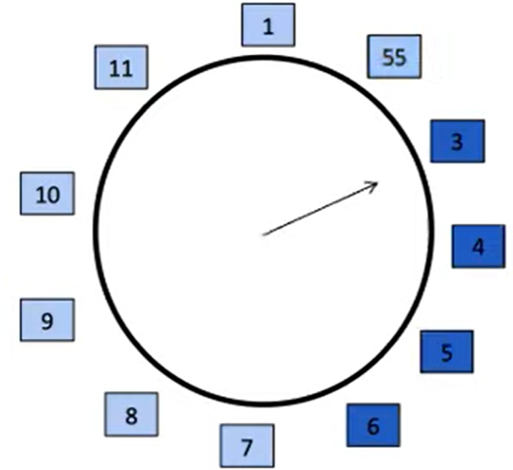
Example
Page Reference Sequence: 1 3 1 1 6 55 4 5 77

Slide 29
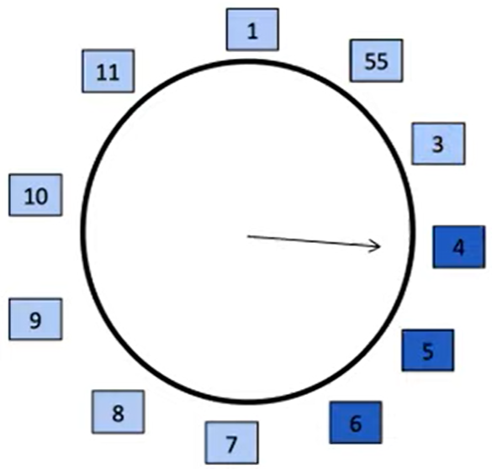
Example
Page Reference Sequence: 1 3 1 1 6 55 4 5 77

Slide 30
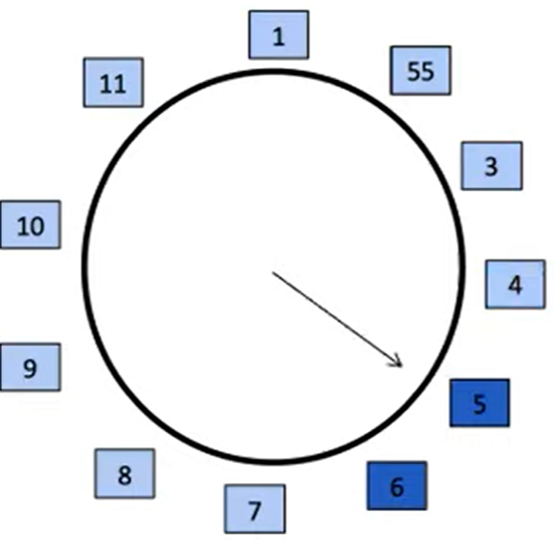
Example
Page Reference Sequence: 1 3 1 1 6 55 4 5 77

Slide 31
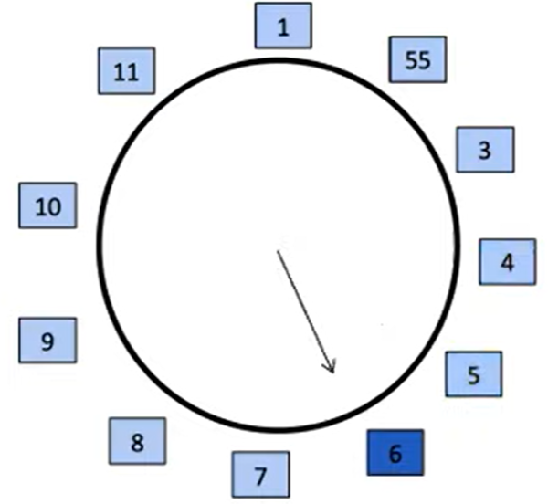
Example
Page Reference Sequence: 1 3 1 1 6 55 4 5 77

Slide 32
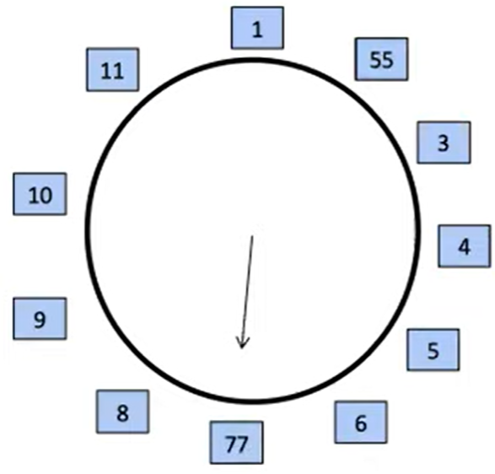
Example
Page Reference Sequence: 1 3 1 1 6 55 4 5 77

Slide 33
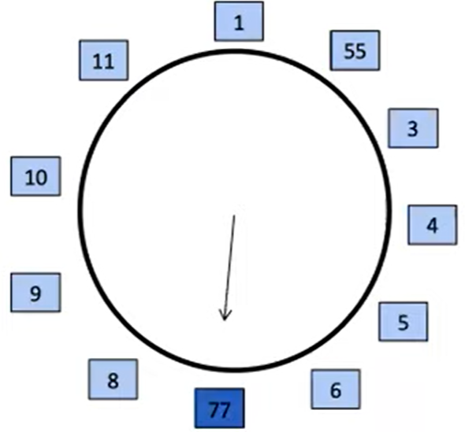
Example
Page Reference Sequence: 1 3 1 1 6 55 4 5 77

Slide 34
Allocation of Frames
How many frames should be allocated to each process
Allocation schemes
Equal allocation
Propositional allocation
Priority allocation
…

Slide 35
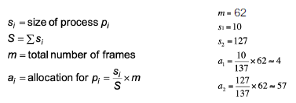
Allocation of Frames
Equal allocation
For example, if there are 100 frames (after allocating frames for the OS) and 5 processes, give each process 20 frames
Issue: But jobs use memory unequally
Proportional allocation
Allocate according to process size
How do you determine process size?
Priority allocation
give high priority process more memory than low priority process
Example

Slide 36
Replacement Scopes
Local replacement
Each process selects from only its own set of allocated frames
Process slowed down even if other less used pages of memory are available
Global replacement
Process selects replacement frame from set of all frames
One process can take a frame from another
Process may not be able to control its page fault rate

Slide 37
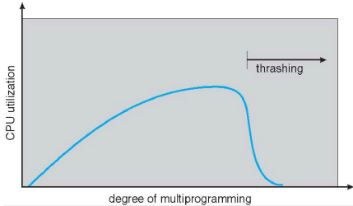
Thrashing
Thrashing: a process is busy swapping pages in and out, i.e., spending a lot of time in paging rather than executing
If a process does not have “enough” pages, page-fault rate is high
For example
Process has 3 frames allocated to it (use LRU)
Reference sequence is 123412341234 …
All cause page faults
Higher multiprogramming degree may lead
to lower CPU utilization due to thrashing

Slide 38
Working Set
How much memory is needed to keep the most recent computation in memory with few page faults?
The principle of locality
A program clusters its access to data temporally
A recently accessed page is more likely to be accessed again
Need to know the set of pages process to avoid thrashing
Requires knowing the future
Working set: Pages referenced in a certain amount of time in the past
Approximates locality

Slide 39
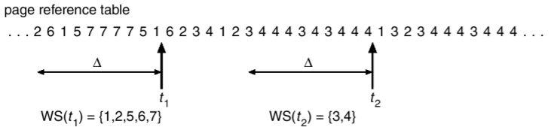
Working Set
Working set window Δ, which can be
A certain time interval, or
Fixed number of page references
Example: 10,000 page references
Working set of a process Pi = pages referenced in most recent Δ

Slide 40
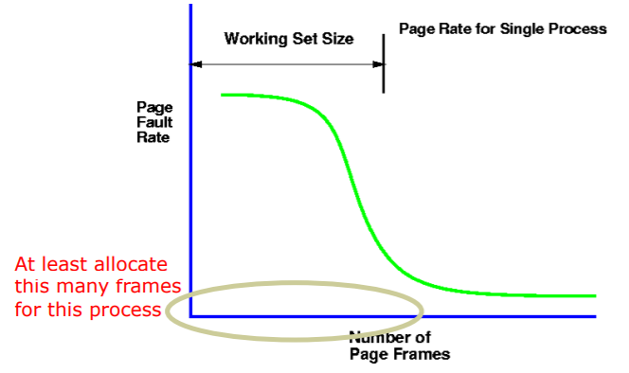
Working Set Size
Working Set Size

Slide 41
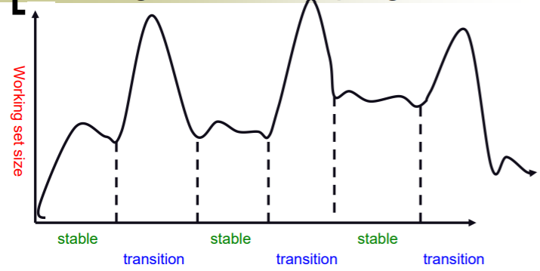
Working Set of Real Programs
Typical programs have phases

Slide 42
Prepaging
Prepage all or some of the pages that a process will need, before they are referenced
To reduce large number of page faults at process startup
If prepaged pages are unused, I/O and memory was wasted
Assume s pages are prepaged and α of the pages is used
Cost of s * α save pages faults larger or smaller than the cost of prepaging s * (1- α) unnecessary pages?
Smaller α → more prepaging loses

Slide 43
The following slides are optional

Slide 44
LRU Approximation
LRU have high overhead
LRU approximation with a reference bit (bit-LRU)
associate with each page a reference bit, initially set to 0
when page is referenced, set the bit to 1
replace some page with reference bit = 0 (if one exists), and set bit=1
when there is only one bit=0, do a global flip

Slide 45
LRU vs bit-LRU
LRU
bit-LRU
miss
hit
young
a
f
b
b
f
a
b
f
c
b
a
old
d
c
c
miss
hit
hit
miss
1
a
1
a
1
a
0
a
1
e
0
b
f
1
f
d
1
f
c
0
f
e
0
f
0
c
0
c
0
c
1
c
1
c
0
d
0
d
1
d
0
d
0
d
global-flip

