Slide 1
CS3103 Operating System 2023/2024 Sem B
Chapter 9: File System
Dr. Nan Guan
Department of Computer Science
City University of Hong Kong

Slide 2
File Concept
File is a contiguous logical address space for storing information
database, audio, video, web pages…
There are different types of file
data: numeric, character, binary, multimedia
program
device
proc file system
file-system interface to retrieve system information
…
Notes:
The directory /proc contains (among other things) one subdirectory for each process running on the system, which is named after the process ID (PID). The link ‘self’ points to the process reading the file system.

Slide 3
File Attributes
Name – the only information kept in human-readable form
Identifier – unique tag (number) identifies file within file system
Type – needed for systems that support different types
Location – pointer to file location on device
Size – current file size
Protection – controls who can do reading, writing, executing
Time, date, and user identification – data for protection, security, and usage monitoring
Many variations, including extended file attributes such as file checksum
… …

Slide 4
File Operations
OS provides file operations to
create:
space in the file system should be found
an entry must be allocated in the directory
open:
return a handler for other operations
most operations need the file to be opened first
read/write:
need to maintain a pointer

Slide 5
File Operations
OS provides file operations to
reposition within file - seek
delete
release file space
truncate:
shortening the length of a file. When truncated, its contents are preserved up to a certain point, after which any data that falls beyond that point is deleted or lost.
other operations can be implemented using these ones
copy: create and read/write
Notes:
Truncate is useful:
When you need to free up disk space: If a file is very large and contains data that is no longer needed, truncating the file can help you reclaim disk space.
When you need to start writing to a file from the beginning: Truncating a file can erase all of its contents, allowing you to start writing new data to it from the beginning.
When you need to reduce the size of a log file: Log files can grow very large over time, which can slow down system performance. Truncating a log file can help reduce its size and improve system performance.
When you need to reset a file to its default state: Truncating a file can erase all of its contents and reset it to its default state, which can be useful in certain situations (e.g., when troubleshooting software issues).

Slide 6
Open Files
Data needed to manage open files:
File handle: a data structure that represents an open file
File descriptor: a small integer that identifies an open file within a process. It is used by the operating system to manage the file's access permissions and to track its usage by various processes.

Slide 7
Open Files
Data needed to manage open files:
File table: a data structure that maintains a list of all open files in the system, along with their associated file handles and file descriptors
Lock table: keeps track of which processes have locked which files and ensures that conflicting lock requests are resolved appropriately
File cache: a portion of memory that the OS uses to store recently accessed portions of open files
I/O buffer: a portion of memory that is used to temporarily store transferred data
usually associated with a specific I/O operation

Slide 8
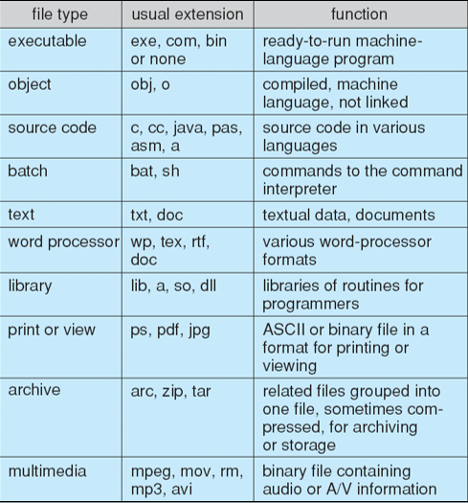
File Types – Name, Extension

Slide 9
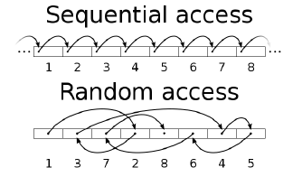
Access Methods
Sequential access
a group of elements is access in a predetermined order
for some media types, the only access mode (e.g., tape)
Direct access
access an element at an arbitrary position in a sequence in (roughly) equal time, independent of sequence size
it is possible to emulate random access in a tape, but access time varies
sometime called random access

Slide 10
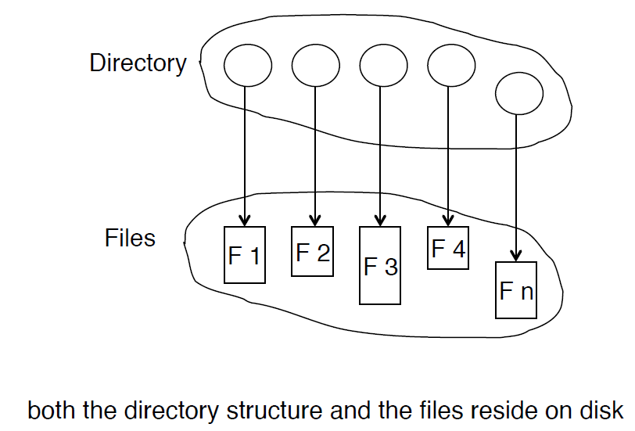
Directory Structure
Directory: a collection of nodes containing information about files

Slide 11
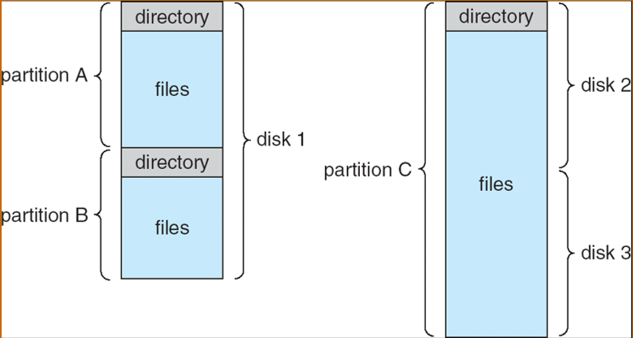
A Typical File-system Organization
Operations performed on directory
Search for a file
Create a file
Delete a file
List a directory
Rename a file
Traverse the file system
…

Slide 12
Directory Organization
Organize the directory (logically) to obtain
Efficiency – locating a file quickly
Naming – convenient to users
Two users can have the same name for different files
The same file can have several different names
Grouping – logical grouping of files by properties, (e.g., all Java programs, all games, …)

Slide 13
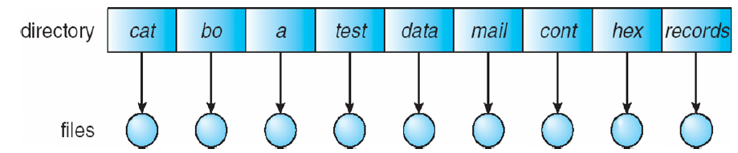
Single-Level Directory
A single directory for all users
naming problems and grouping problems
Two users want to have same file names
Hard to group files

Slide 14
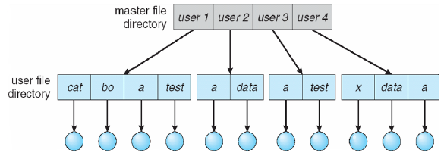
Two-Level Directory
Separate directory for each user
different users can have the same name for different files
Each user has his own user file directory (UFD), it is in the master file directory (MFD)
efficient to search
cannot group files
How to share files between
different users, and how to
share the system files?

Slide 15
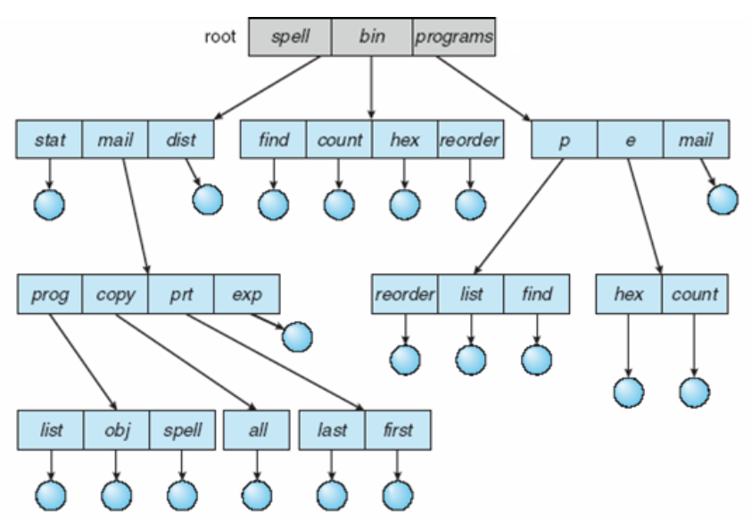
Tree-Structured Directories
Files organized into trees
efficient in searching, can group files, convenient naming

Slide 16
Tree-Structured Directories
File can be accessed using absolute or relative path name
absolute path name: /home/alice/..
relative path is relative to the current directory (pwd)
creating a new file, delete a file, or create a sub-directory
e.g., if current directory is /mail, a mkdir count will create /mail/count
How to share a file/directory?
It’s not allowed

Slide 17
Tree-Structured Directories
Delete directory
If directory is empty, then it’s easy to handle
If not
Option I: directory cannot be deleted, unless it’s empty
Option II: delete all the files, directories and sub-directories
rm -rf /

Slide 18
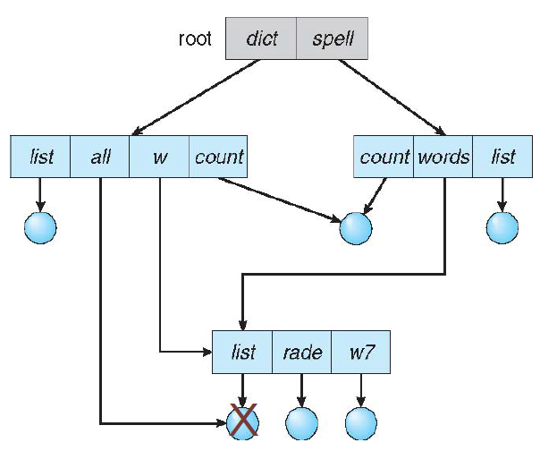
Acyclic-Graph Directories
Organize directories into acyclic-graphs
Allow links to a directory entry/files for aliasing (no longer a tree)
Dangling pointer problem
e.g., if delete file /dict/all, then /dict/w/list and /spell/words/list are dangling pointers
Solution: backpointers/reference counter
backpointers record all the pointers to the entity, a variable size record
Or count # of links to it and only (physically) delete it when counter is zero

Slide 19
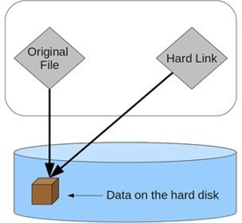

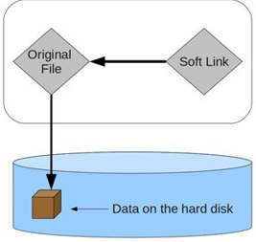

Acyclic-Graph Directories
Hardlink
Accesses the data available in the original file
If earlier selected file deleted, the hard link still contain the data of that file
Softlink (Symbolic link)
Does not access the data available in the original file
If earlier file deleted, the soft link will point to a file that does not exist anymore

Slide 20
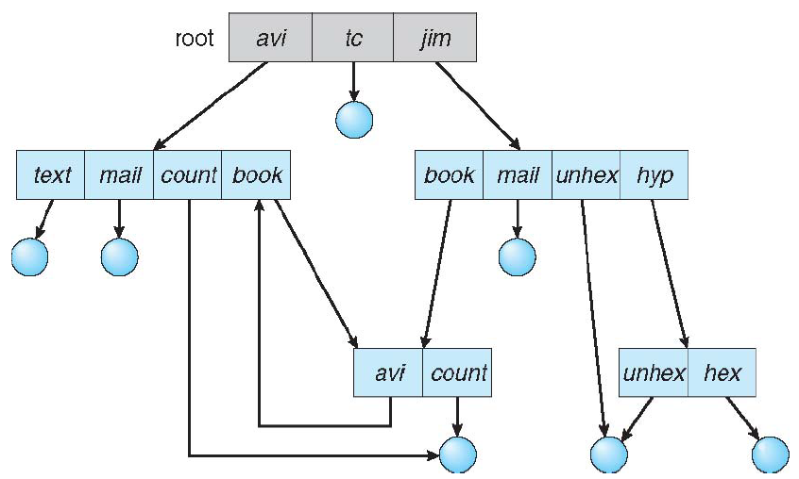
General Graph Directory
Allowing arbitrary links may generate cycles in the directory structure
Solution
Allow cycles, but use garbage collection to reclaim disk spaces
Detect the cycle every time a new link is added
Notes:
Not used in “mainstream” operating systems

Slide 21
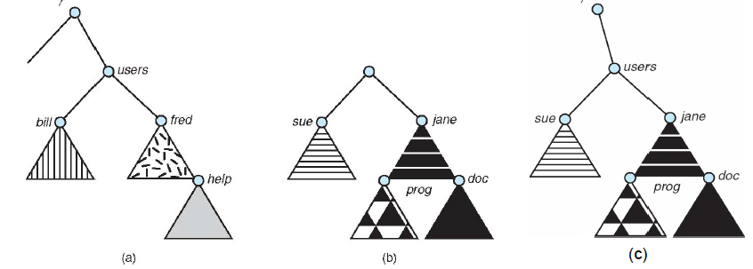
File System Mounting
A file system must be mounted before it can be accessed
Mounting a file system attaches that file system to a directory (mount point) and makes it available to the system
The root (/) file system is always mounted. Any other file system can be connected or disconnected from the root (/) file system
The old directories connected to the mount point becomes invisible
existing file system
an unmounted partition
the partition mounted at /users

Slide 22
File Sharing
Sharing of files on multi-user systems is desirable
Sharing must be done through a protection scheme
User IDs identify users, allowing protections to be per user
Group IDs allow users to be in groups, permitting group access rights
On distributed systems, files may be shared across a network
Network File System (NFS) is a common distributed filesharing method

Slide 23
Remote File Sharing
Use networking to allow file system access between systems
manually via programs like FTP (File Transfer Protocol) clients
automatically, seamlessly using distributed file systems
semi-automatically via the world wide web (e.g., hyperlinked documents)
Client-server model allows clients to mount remote FS from servers
a server can serve multiple clients
client and user-on-client identification is complicated
server cannot assume the client is trusted
standard OS file calls are translated into remote calls
NFS (Network File System) is standard for UNIX
CIFS (Common Internet File System) is standard for Windows

Slide 24
Protection
File owner/creator should be able to control
what can be done
by whom
Types of access
read
write, append
execute
delete
list

Slide 25
Access Control List
Assign each file and directory with an access control list (ACL)
Fine-grained control
Issues
How to construct the list?
How to store the list in directory?
Not widely used in modern file systems

Slide 26
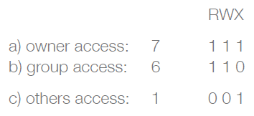

Unix Access Control
Three access modes: read, write, execute (encoded in three bits)
Three classes of users: owner, group and others
To grant access to users, change access mode
E.g., use chmod
owner group others

Slide 27
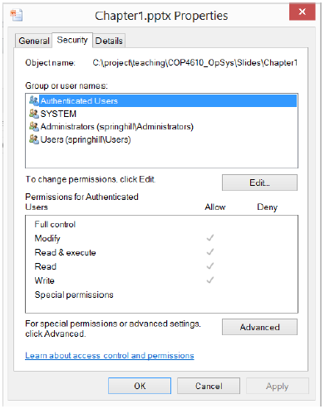
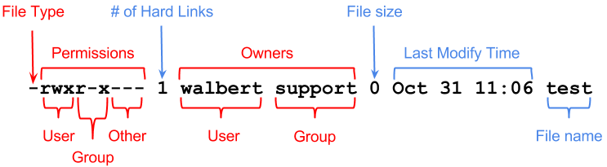
File Access Control Examples
Windows 8
Linux

Slide 28
File-System Structure
File structure
Logical storage unit
Collection of related information
File system on secondary storage (disks)
Provides user interface to storage, mapping logical to physical
Provides efficient and convenient access to disk by allowing data to be stored, located retrieved easily
File control block (FCB): structure consisting of information of a file
E.g., Unix inode structure
Device driver controls the physical device
Notes:
the file structure it is considered to be a logical storage unit and it is a collection of related information
example: if you have a file a very large video file so we can see that as one file in our folder but in in reality in the hard drive uh there is a possibility that this large video file um it is stored in an uncontiguous fashion so the chunks of its part or parts of its file are scattered in the disk
and then file system resides on secondary storage or disks so file system provided user interface to storage mapping logical to physical provides efficient convenient access to disk by allowing data to be stored located retrieved easily so that is the function of file system and for us users actually we do not care how does our file is stored as long as if we save that file in our in our hard drive we already seen that it is already saved but how it is implemented and how it is

Slide 29
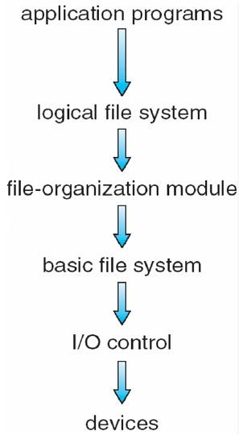
File System Layers
File system organized into layers

Slide 30
File System Layers
Device drivers manage I/O devices at the I/O control layer
Receive commands like “read drive1, cylinder 72, track 2, sector 10, into memory location 1060”
Outputs low-level hardware-specific commands to hardware controller

Slide 31
File System Layers
Basic file system given command like “retrieve block 123” translates to device driver
Also manages memory buffers and caches (allocation, freeing, replacement)
Buffers hold data in transit
Caches hold frequently used data

Slide 32
File System Layers
File-organization module understands files, logical address, and physical blocks
Translates logical block # to physical block #
Manages free space
maintains the list of free blocks, and allocates free blocks to files as needed

Slide 33
File System Layers
Logical file system manages metadata information
The level at which users can request file operations by system calls
Provides a consistent view of what might be multiple physical file systems and multiple file system implementations
Translates file name into file number, file handle, location by maintaining file control blocks
Directory management
Protection

Slide 34
File System Layers
Many file systems, sometimes many within an OS
CD-ROM is ISO 9660
Unix has UFS, FFS
Windows has FAT, FAT32, NTFS
Linux has more than 130 types, with extended file system ext3 and ext4 leading; plus distributed file systems, etc.
New ones still arriving – ZFS, GoogleFS, Oracle ASM, FUSE
… …

Slide 35
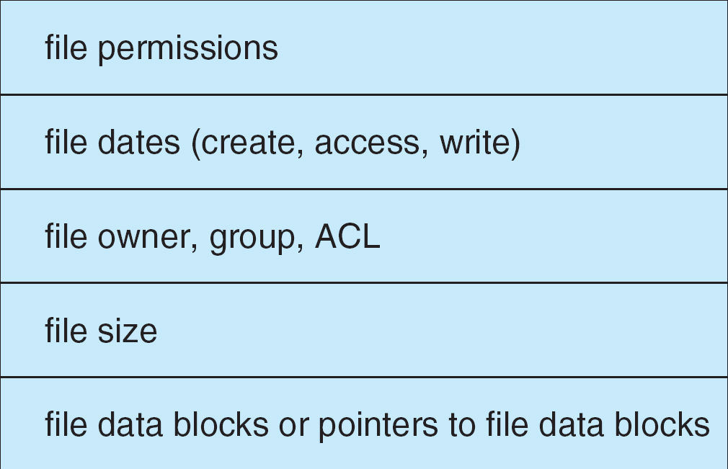
File Control Block (FCB)
OS maintains FCB per file, contains many details about the file
E.g., inode number, permissions, size, dates
Example

Slide 36
Structures to Implement a File System
On-Disk
Boot control block per volume
Volume control block per volume
Directory structure per file system
A FCB per file
In-memory
In-memory mount table with entries for each mounted volume
In-memory directory structure cache
System-wide open-file table : contain FCB, etc
Per-process open-file table : Pointers to system-wide entries
Volume or logical drive is a single accessible storage area with a single file system, typically (not necessarily) resident on a single partition of a hard disk.
Notes:
boot block in UNIX or the partition boot sector in Windows contains information about how to boot the system off of this disk. This will generally be the first sector of the volume if there is a bootable system loaded on that volume, or the block will be left vacant otherwise.
volume control block: master file table in UNIX or the superblock in Windows, which contains information such as the partition table, number of blocks on each filesystem, and pointers to free blocks and free FCB blocks.

Slide 37
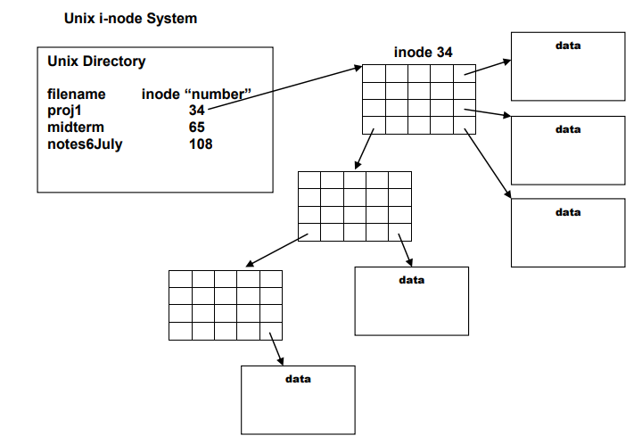
Inode
An inode is a data structure in Unix that denotes a file or a directory on file system
It contains information about file, such as location of file on the disk, access mode, ownership, file type …
Each inode has a number that is used in the index table
Unix kernel uses inode number to access the contents of an inode

Slide 38
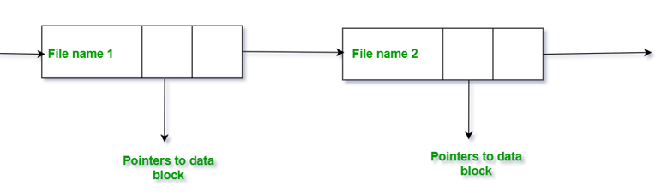
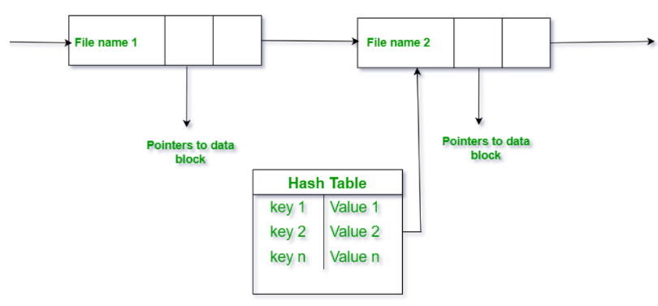
Directory Implementation
Linear list of file names with pointer to the data blocks
simple to program
time-consuming to execute
Hash Table: linear list with hash data structure
hash function on the file name determines the key directory
Potential collisions
decreases directory search time
Notes:
In the hash table for each pair in the directory key-value pair is generated. The hash function on the file name determines the key and this key points to the corresponding file stored in the directory. This method efficiently decreases the directory search time as the entire list will not be searched on every operation. Using the keys the hash table entries are checked and when the file is found it is fetched.

Slide 39
File Creation
Application process requests the creation of a new file
Logical file system allocates a new FCB
Appropriate directory updated with the new file name and FCB
Disk blocks allocated for files

Slide 40
Allocation Methods
Allocation method: how disk blocks are allocated for files
The main problem is how to allocate space to files so that disk space is utilized effectively and files can be accessed quickly
Three major methods:
Contiguous allocation
Linked allocation
Indexed allocation

Slide 41
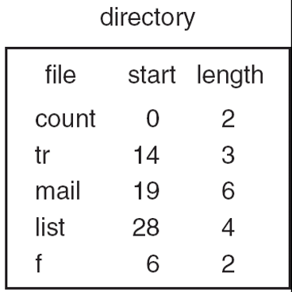
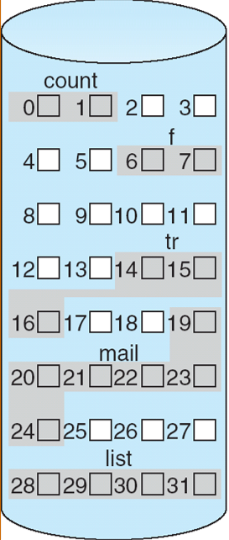
Contiguous Allocation
Each file occupies a set of contiguous blocks on the disk
Simple – only starting location (block #) and length (number of blocks) are required
Random access
the address of the k^{th} block starting at block b can easily be obtained as (b+k)

Slide 42
Contiguous Allocation
Advantages:
Both the Sequential and Random Accesses are supported
Extremely fast since the number of seeks are minimal because of contiguous allocation of file blocks
Disadvantages:
Suffers external fragmentation (similar to memory allocation)
Increasing file size is difficult as it depends on the availability of contiguous space

Slide 43
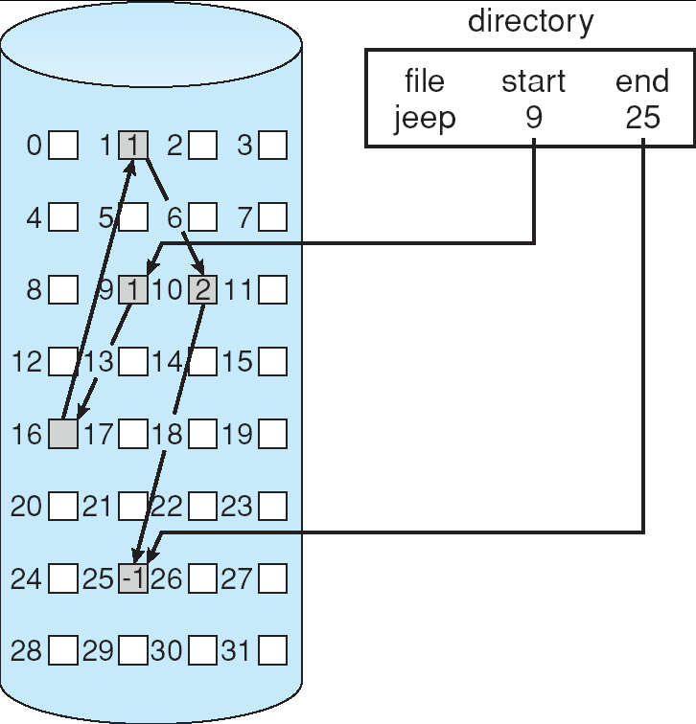
Linked Allocation
Linked allocation: each file is a linked list of disk blocks
each block contains pointer to next block, file ends at null pointer
blocks may be scattered anywhere on the disk (no external fragmentation)

Slide 44
Linked Allocation
Advantages
Flexible in terms of file size
Does not suffer from external fragmentation
Disadvantages
Slow: locating a file block can take many I/Os and disk seeks
Possible improvements: cluster blocks; however, has internal fragmentation
Does not support random/direct access
Pointer size overhead
Reliability: what if the pointer has corrupted
Notes:
. File size can be increased easily since the system does not have to look for a contiguous chunk of memory. This method

Slide 45
File Allocation Table
A file allocation table (FAT) is a table that an OS maintains on a disk that provides a map of the blocks that a file is stored in
Example:
 |  |  |  |  |  | Block No. | File Blocks
 |  |  |  |  |  | 4 | File1 Blk3
 |  |  | 4 | 6 |  | 5 | File3 Last
 |  |  | 5 | null |  | 6 | File1 Last
Directory |  |  | 6 | null |  | 7 | File1 Blk1
File 1 | 7 |  | 7 | 15 |  | 8 | File3 Blk3
File 2 | 2 |  | 8 | 12 |  | 9
File 3 | 10 |  | 9 | free |  | 10 | File3 Blk1
File 4 | 57 |  | 10 | 11 |  | 11 | File3 Blk2
 |  |  | 11 | 8 |  | 12 | File3 Blk4
 |  |  | 12 | 5 |  | 13
 |  |  | 14 | 13 |  | 14
 |  |  | 15 | 4 |  | 15 | File1 Blk2
 |  |  |  |  |  | 16
 |  |  |  |  |  | 17
 |  |  |  |  |  | …
File1 consist of 7, 15, 4, 6
File3 consist of 10, 11, 8, 12, 5

Slide 46
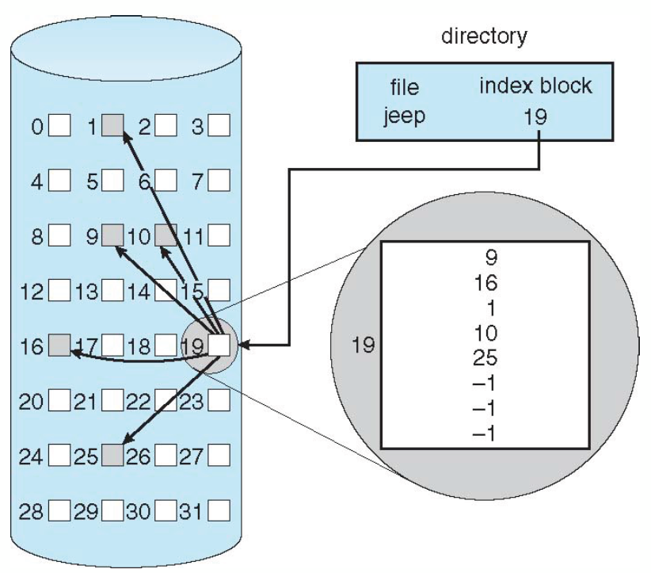
Index Allocation
Indexed allocation: each file has its own index blocks of pointers to its data blocks
Advantages:
Fast
Supports random/direct access to the blocks
No external fragmentation

Slide 47
Index Allocation
Disadvantages:
The pointer overhead for indexed allocation is greater than linked allocation
for very small files, say files that expand only 2-3 blocks, the indexed allocation would keep one entire block (index block) for the pointers

Slide 48
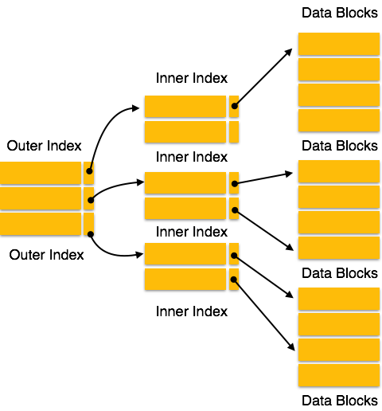
Index Allocation
Multiple-level index blocks (e.g., 2-level)

Slide 49
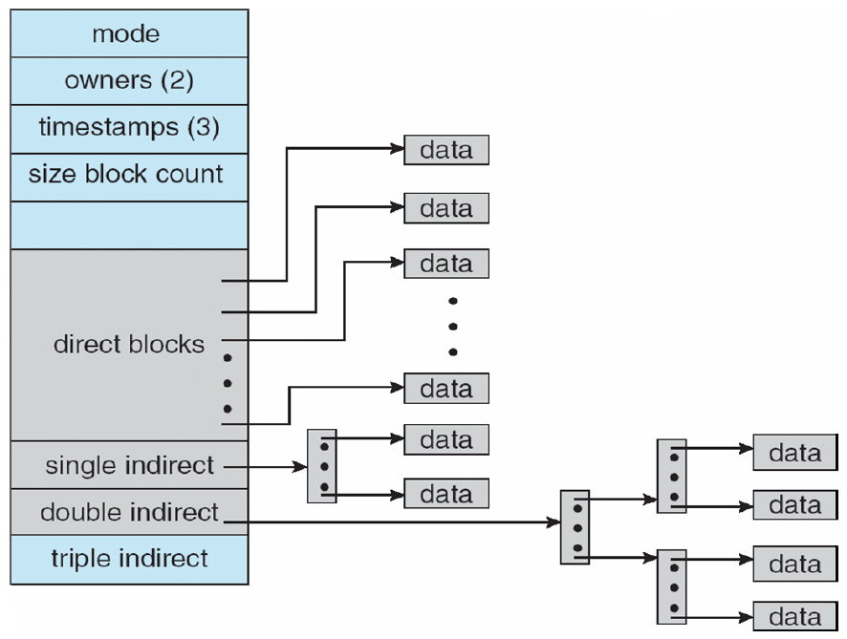
Index Allocation
Combined approach
Used in Unix
Notes:
Best allocation method depends on file access type
contiguous is great for sequential and random
linked is good for sequential, not random
indexed is great for sequential and random
single block access require multiple block reads

Slide 50
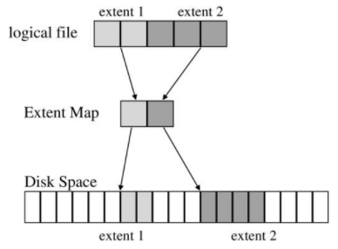
Extent-Based Systems
Many new file systems (e.g., Veritas File System) use a partially contiguous allocation scheme
Extent-based file systems allocate disk blocks in extents
An extent is a contiguous block of disks
Extents are allocated for file allocation
A file consists of one or more extents
Mitigate external fragmentation
Notes:
An extent map is a data structure used by some file systems to track the layout of file data on disk.
In a file system, a file's data is typically stored on disk in one or more contiguous blocks or fragments. An extent map tracks the location and size of each of these contiguous blocks or fragments, allowing the file system to efficiently read or write large portions of a file without having to perform multiple disk seeks.
An extent map can be thought of as a map of the file's data on disk, with each extent representing a contiguous block or fragment. The extent map typically includes information such as the starting block number, the length of the extent, and the file offset of the extent within the file.
Using an extent map can provide several benefits, including reduced fragmentation, faster file access times, and improved disk usage efficiency.

Slide 51
Free-Space Management
File system maintains free-space list to track available blocks
The space of deleted files should be reclaimed
Many management methods:
bit vector (bit map)
linked free space
…

Slide 52
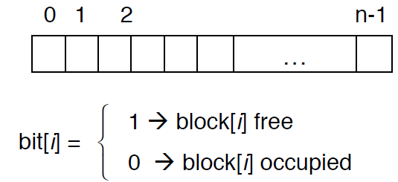
Bitmap Free-Space Management
Use one bit for each block, track its allocation status
Searching contiguous blocks is easy/efficient
requires extra space
example:
block size = 4KB = 2¹² bytes
disk size = 2⁴⁰ bytes (1 terabyte)
n = 2⁴⁰/2¹² = 2²⁸ bits (or 256 MB)
if clusters of 4 blocks -> 64MB of memory

Slide 53
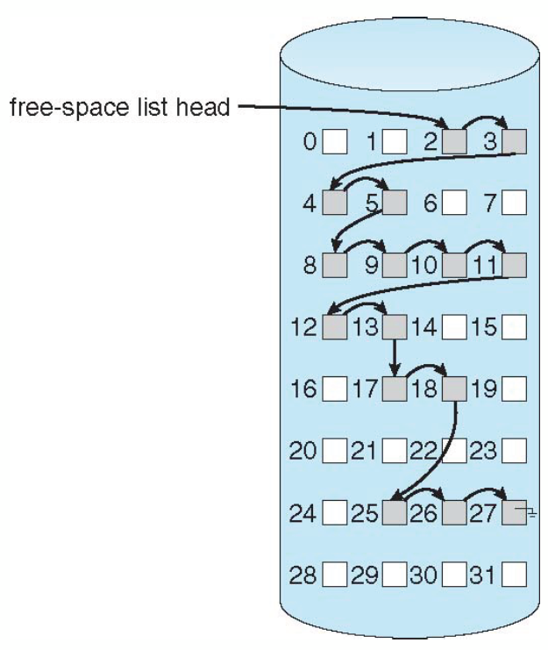
Linked Free Space
Keep free blocks in linked list
no waste of space, just use the memory in the free block for pointers
usually no need to traverse the entire list: return the first one
cannot get contiguous space easily
Simple linked list of free-space is inefficient
one extra disk I/O to allocate one free block disk
I/O is extremely slow
allocating multiple free blocks require traverse the list
difficult to allocate contiguous free blocks
Notes:
Simple linked list of free-space is inefficient
one extra disk I/O to allocate one free block disk I/O is extremely slow
allocating multiple free blocks require traverse the list
difficult to allocate contiguous free blocks

Slide 54
Grouping
Grouping: use indexes to group free blocks
store address of n-1 free blocks in the first free block, and the next index block
…
n=6
2
3, 4, 5, 8, 9, 10
10
11, 12, 13, 17, 18, 25
25
26, 27

Slide 55
Counting
Counting: a link of clusters (starting block + # of contiguous blocks)
space is frequently contiguously used and freed, so typically more efficient than simple linked list
(2, 4)
(8, 6)
(17,2)
(25,3)

Slide 56
File System Performance
To improve file system performance:
keeping data and metadata close together
use cache: separate section of main memory for frequently used blocks
use asynchronous writes, it can be buffered/cached, thus faster
cannot cache synchronous write, which must hit disk before return
synchronous writes sometimes requested by apps or needed by OS
free-behind and read-ahead
… …

Slide 57
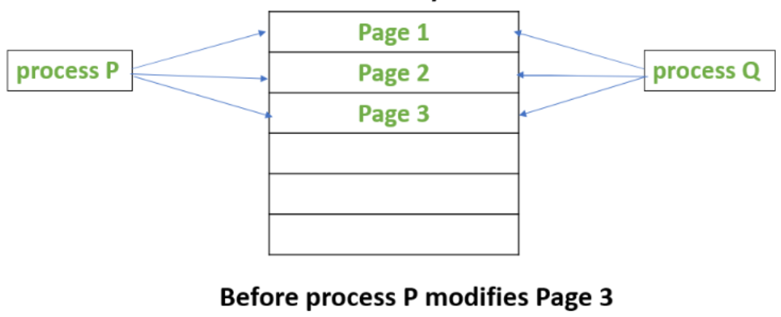
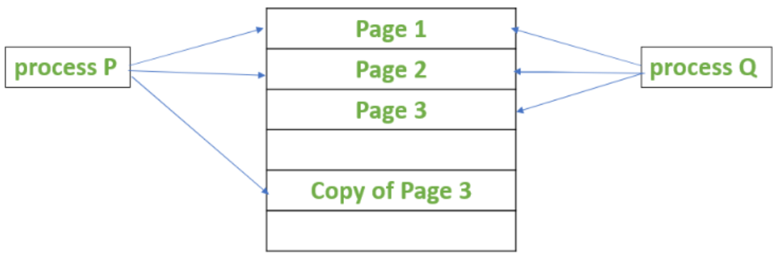
Copy-on-write (COW)
Copy-on-write or CoW is a technique to efficiently copy data resources in a computer system. If a unit of data is copied but not modified, the "copy" can exist as a reference to the original data. Only when the copied data is modified is a copy created, and new bytes are actually written.
Block 1
Block 1
Block 2
Block 2
Block 3
Block 3
Copy of Block 3

Slide 58
Recovery
File system needs consistency checking to ensure consistency
compares data in directory with some metadata on disk for consistency
file system recovery can be slow and sometimes fails
File system recovery methods
backup
log-structured file system

