Slide 1
CS3103 Operating System 2023/2024 Sem B
Chapter 0: Course Information
Dr. Nan Guan
Department of Computer Science
City University of Hong Kong
nanguan@cityu.edu.hk

Slide 2
Teaching Team
Lecture and Course Leader: Dr. Nan GUAN (關楠)
Associate Professor, Department of Computing
Office: YEUNG Y7719
Email: nanguan@cityu.edu.hk
Tutor:
Ruoxiang LI, Yuxin DU, Tao HU

Slide 3
Course Delivery
Lecture:
Face-to-face (with Zoom streaming and recording)
Tutorials:
Face-to-face (with Zoom streaming and recording)
Canvas for teaching materials, zoom links, assignments…
LLM-TA: an AI Teaching Assistant system
based on the Large Language Model (LLM)
I Will explain this in detail

Slide 4
Assessment
Coursework: 40%
10% for 2 assignments (5% for each)
10% for 1 group project
3-person group, programming (C/C++) needed
4% for 8 tutorial exercises (0.5% each)
16% for Mid-term exam
Final exam: 60%
Minimum requirement for Pass:
30% of final exam

Slide 5
Schedule
Lecture (YEUNG LT-18):
Thu. 15:00-17:50, Nan GUAN
Tutorial (MMW 2450):
TA1/TB1: Tue. 16:00-16:50, Tutor
TA2/TB2: Wed. 10:00-10:50, Tutor
TA3/TB3: Wed. 18:00-18:50, Tutor
TA4/TB4: Fri. 11:00-11:50, Nan GUAN
The tutorials are in week 4-11

Slide 6
Schedule
Week | Lec. date | Lecture
1 | Jan. 18 | ✓
2 | Jan. 25 | ✓
3 | Feb. 1 | ✓
4 | Feb. 8 | ✓
5 | Feb. 22 | ✓
6 | Feb. 29 | ✓
7 | Mar. 7 | ✓
8 | Mar. 14 | Midterm
9 | Mar. 21 | ✓
10 | Mar. 28 | ✓
11 | Apr. 4 | ✓
12 | Apr. 11 | ✓
13 | Apr. 18 | ✓
Tutorial
✓
✓
✓
✓
✓
✓
✓
✓

Slide 7
Schedule
Mid-term: Week 8
Project: Release week 8, Due week 13
Assignment 1: Release week 5, due week 7
Assignment 2: Release week 9, due week 11
Tutorial, due every Sunday 23:59PM
The Schedule is tentative and subject to change. Please stay tuned.

Slide 8

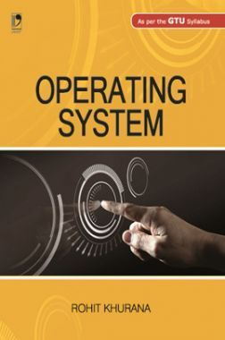

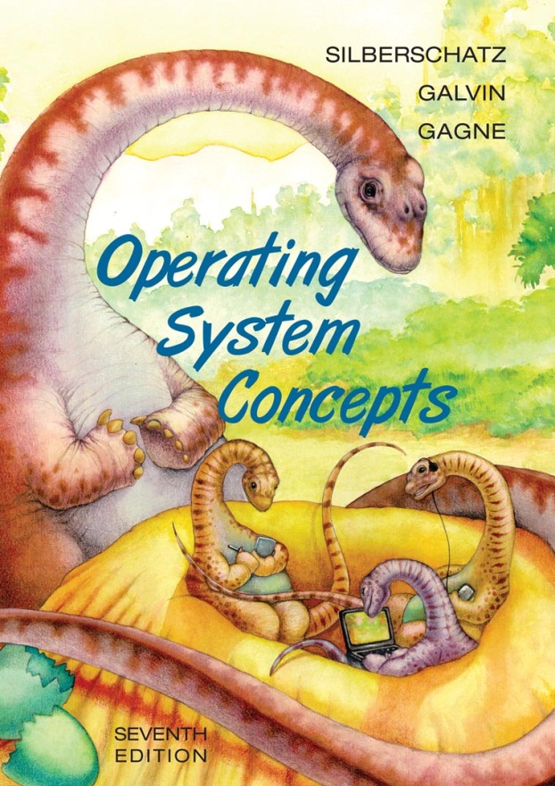
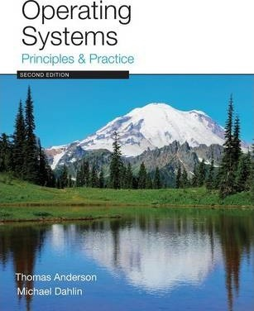

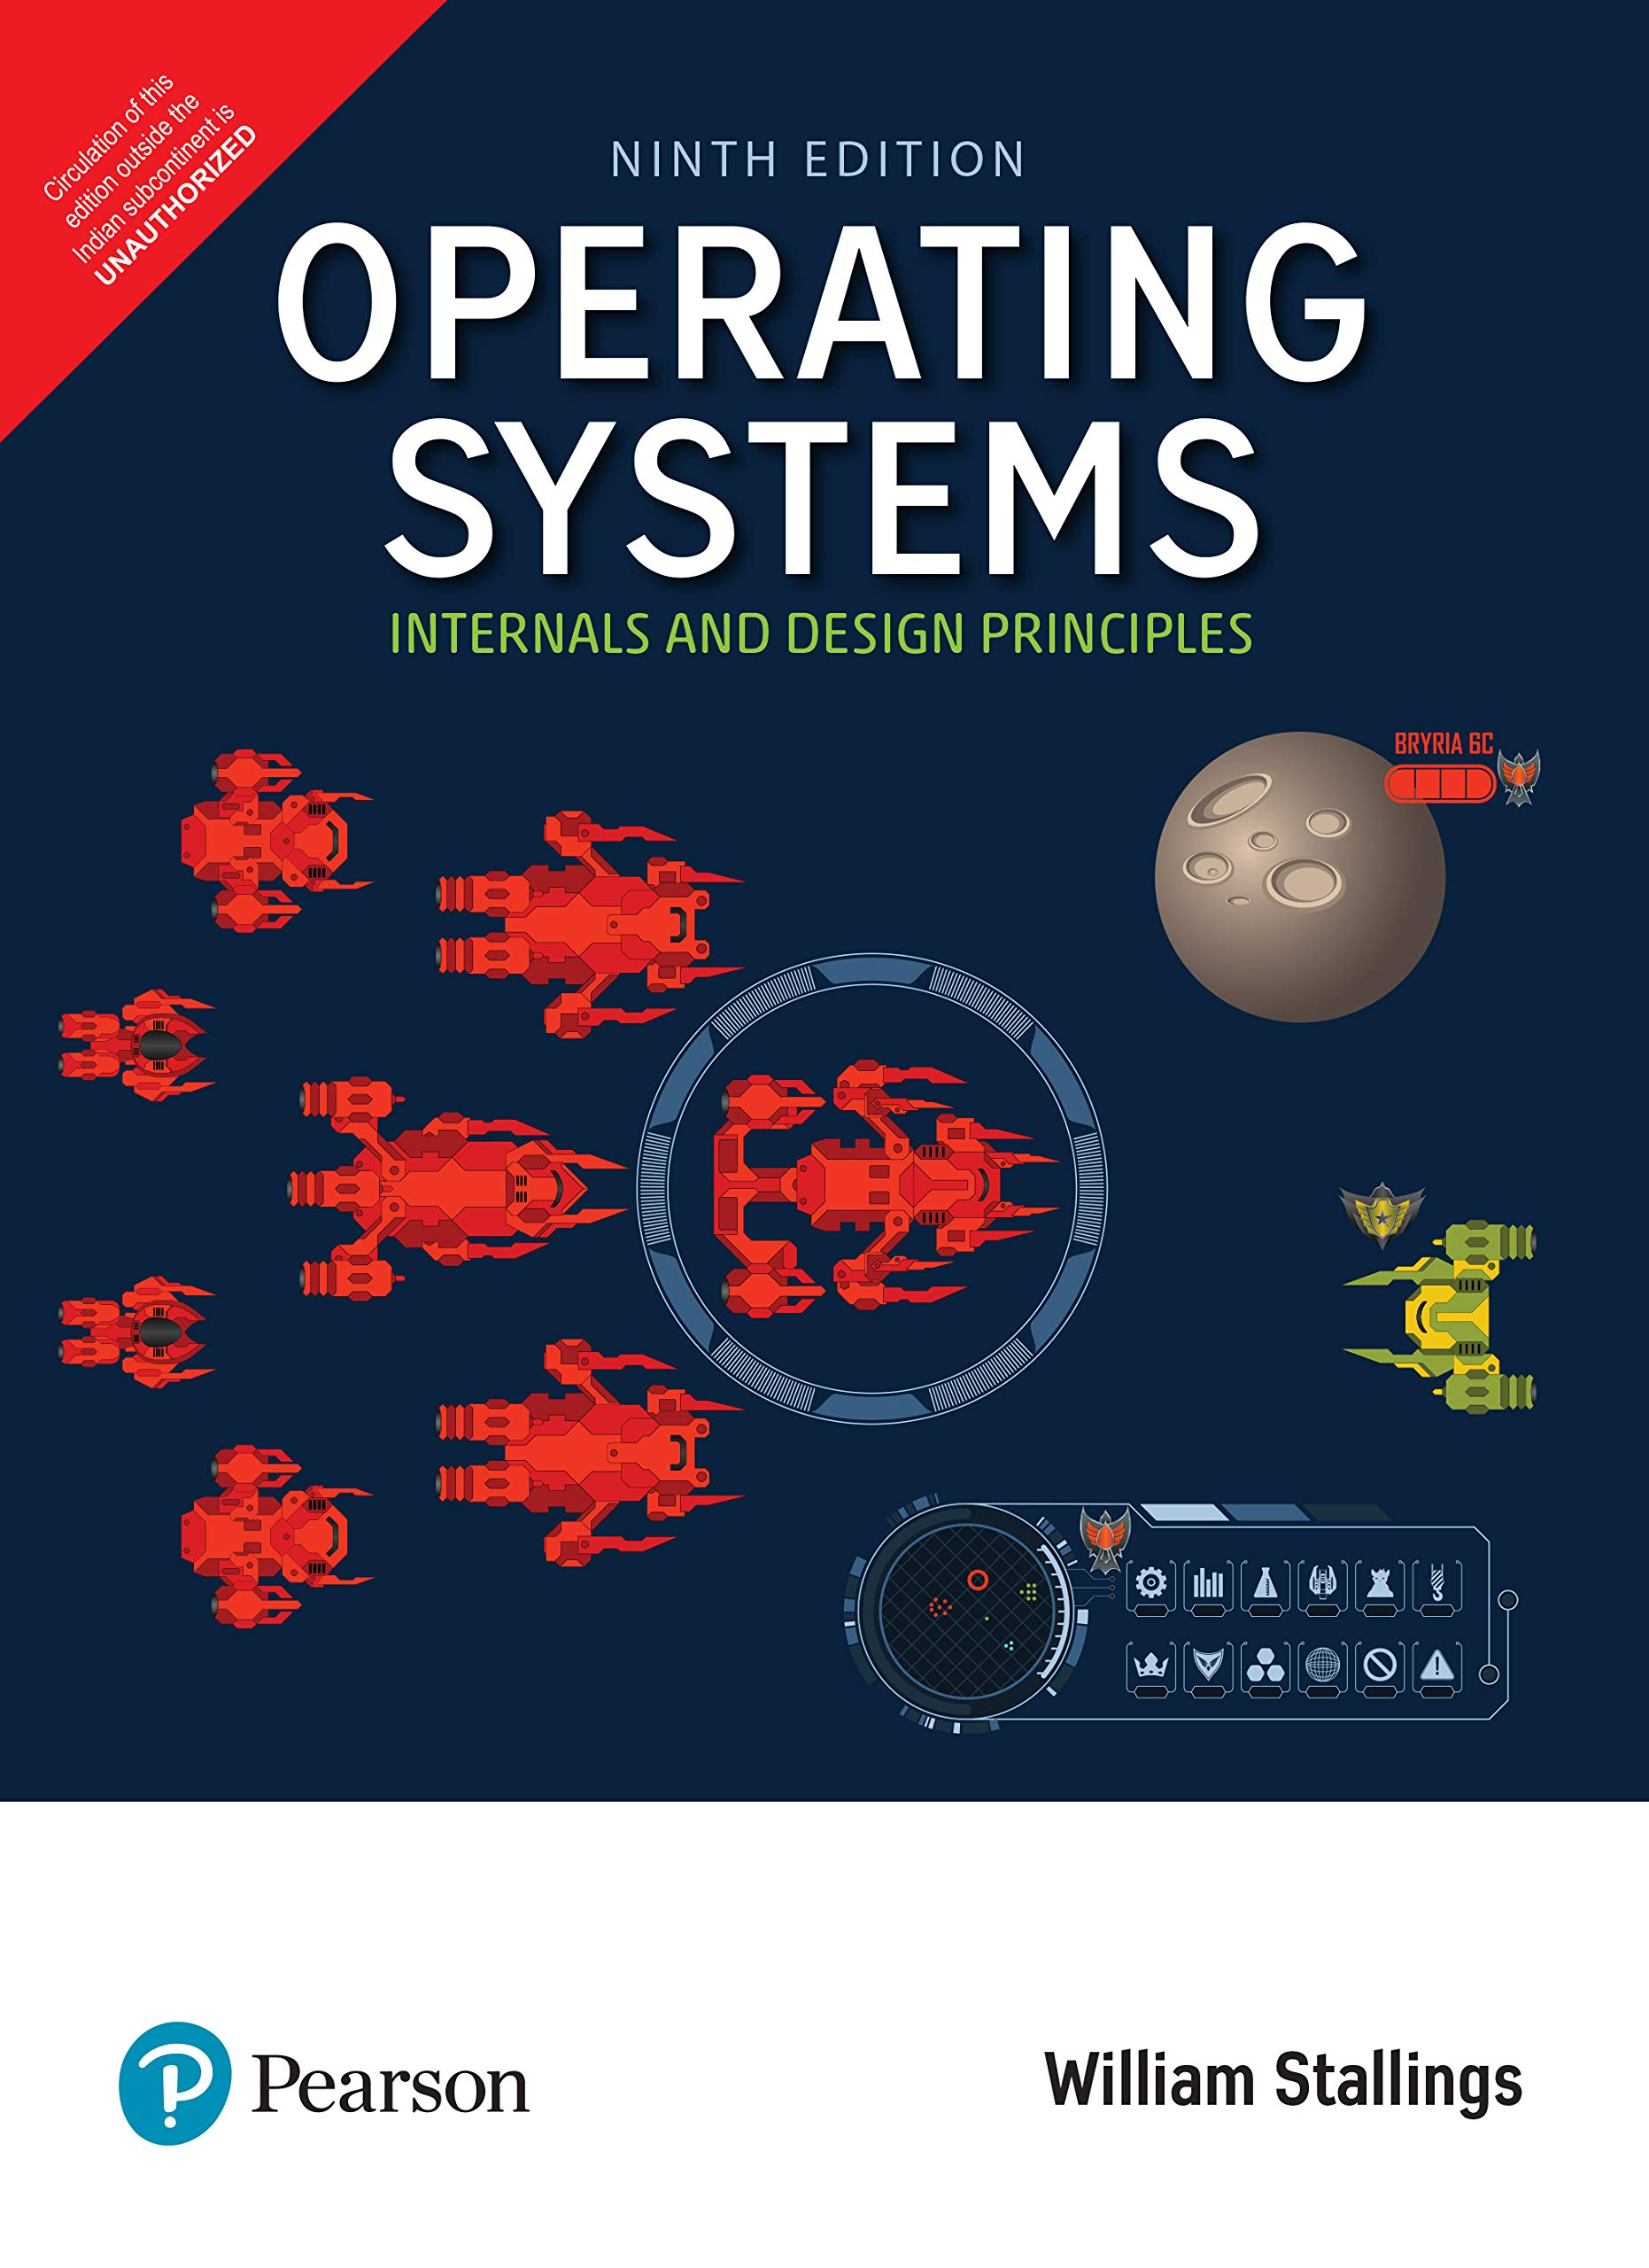
Textbook & Readings
Textbook
Readings

Slide 9
Some Online Courses
“Introduction to Operating System”, Neso Academy
https://www.youtube.com/watch?v=vBURTt97EkA&list=PLBlnK6fEyqRiVhbXDGLXDk_OQAeuVcp2O
“Operating Systems Introduction”, UMass OS
https://www.youtube.com/watch?v=dv4mXBsv6TI&list=PLacuG5pysFbDQU8kKxbUh4K5c1iL5_k7k

Slide 10
You are Expected to
Attend all lectures and tutorials
Think and ask questions
Be active and have your own ideas/opinions
Learn to learn (via internet)
Start to do your assignment/project early and finish them on time
Late submissions not accepted
No cheating or plagiarism in any exam, assignment, and project
Penalty to the giver and receiver
Subject to disciplinary actions for serious cases
Let me have your feedback as much as possible

Slide 11
LLM-TA
https://www.llmta23.com/cityu/cs3103/2024b
You can ask the LLM-TA for
Arrangement of the course
Time, venue, schedule, exam scope, … …
Clarification of the assignment questions, project instructions …

