Slide 1
CS3103 Operating System 2023/2024 Sem B
Chapter 1: Overview of OS
Dr. Nan Guan
Department of Computer Science
City University of Hong Kong
nanguan@cityu.edu.hk

Slide 2


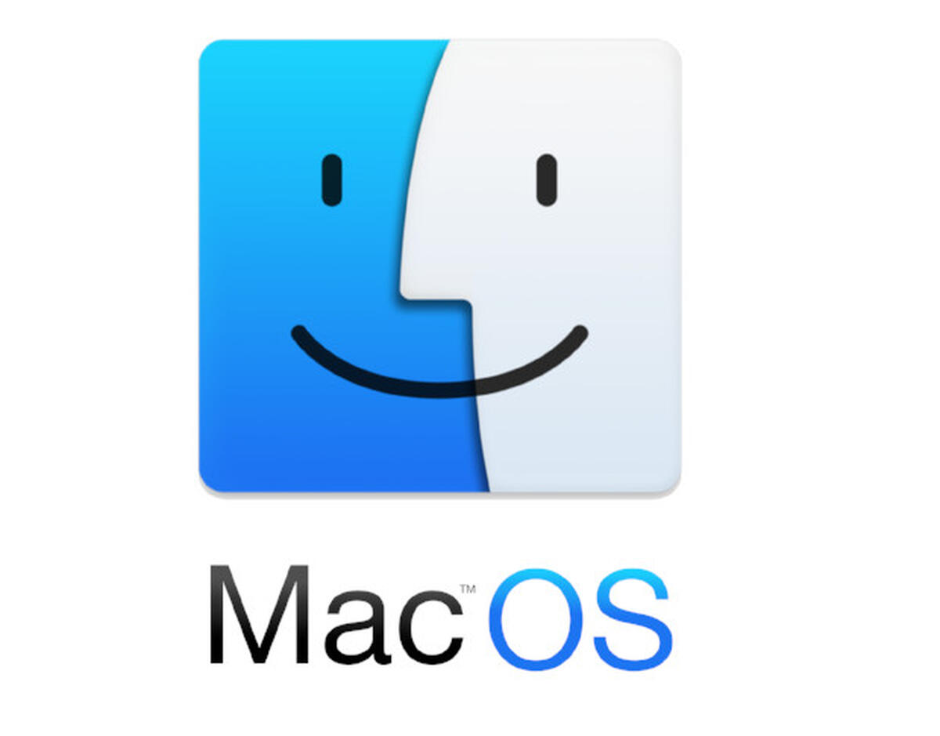









What is an OS?
Intermediary program between application software and hardware
Operating system
Makes the computer system convenient to use
Makes the development of application programs easier
Uses the computer hardware in an efficient manner
… …

Slide 3
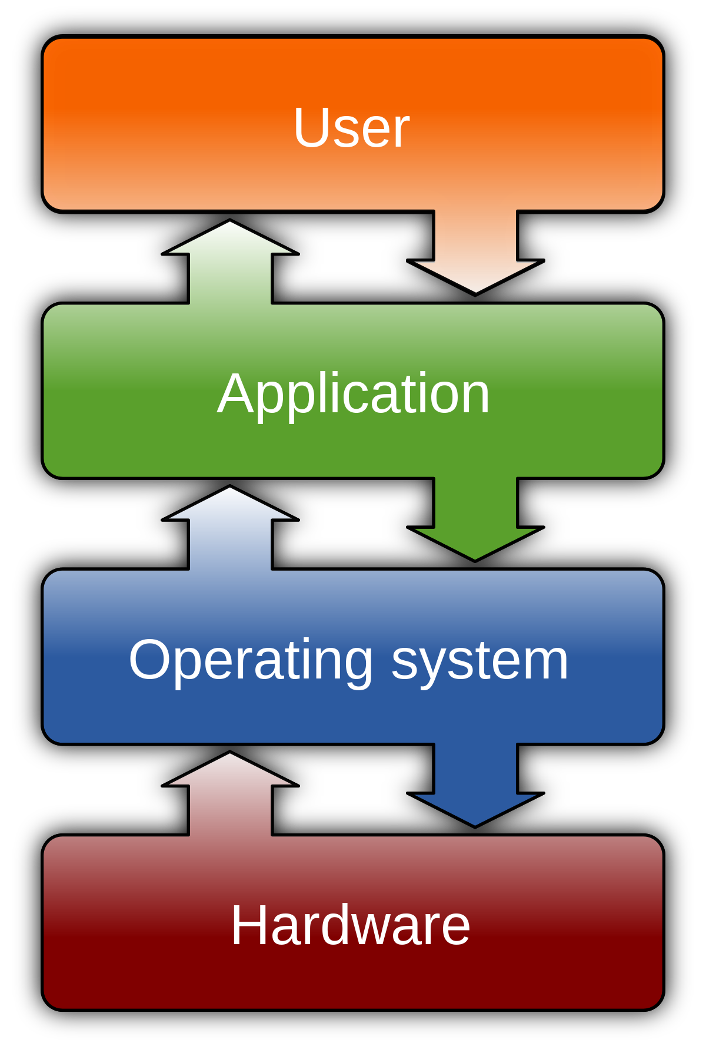
Computer System Structure
Computer system in four layers:
Users
People, machines, other computers
Application programs
Word processors, web browsers, database systems, video games
Operating system
Controls and coordinates use of hardware among various applications and users
Hardware – provides computing resources
CPU, memory, I/O devices

Slide 4
What does a OS Do?
OS is a resource allocator
Manages all resources
Decides among requests from different applications
“Make finite resources appear as infinite resources”
OS is a control program
Controls execution of programs to prevent errors and improper use of the computer

Slide 5
Why do We Learn OS?
OS is a key part of a computer system
It is “magic” and we want to understand how it happens
How many procedures does a keystroke invoke?
What happens when your program references a pointer having the value 0?
OS “provides” infinite CPUs, memory, devices, and networked computing
… …
To develop high-quality programs, you must know how OS works

Slide 6
Why do We Learn OS?
OS is complex
Real OS can be huge and very expensive to build
Windows NT: 8 years, 1000s of people
Linux: 27,000,000 lines code, since 1991, 200,000+ contributors
OS developer is on the top of the programmer pyramid
A lot of cool techniques and algorithms in OS
Tradeoffs between performance and functionality, division of labor between HW and SW
Combining programming language, hardware, data structures, algorithms, money, art, luck …

Slide 7
What We will Learn in this Course?
Understand how OS works
Learn important abstractions and techniques
Knowledge and skills that facilitate us to develop complex, high-performance, reliable and secure software
Starting point of creating a better OS
Learn general concepts; emphasize on UNIX/UNIX-like OS
Along the way, we also learn how to use OS
E.g., learn to use Linux command lines, which are important when you work with, e.g., open-source software, tools, packages, …
Notes:
Build our own OS?

Slide 8
Is it Difficulty to Learn OS?
In some sense, no
No deep math
You can find many materials online
Some interesting algorithms/techniques, but understandable with efforts
In some sense, yes
A huge software system with many aspects and many levels
Need to know many details before seeing the big picture
From “What is that” to “Why is that”
“You can't connect the dots looking forward; you can only connect them looking backward. So you have to trust that the dots will somehow connect in your future” – Steve Jobs

Slide 9
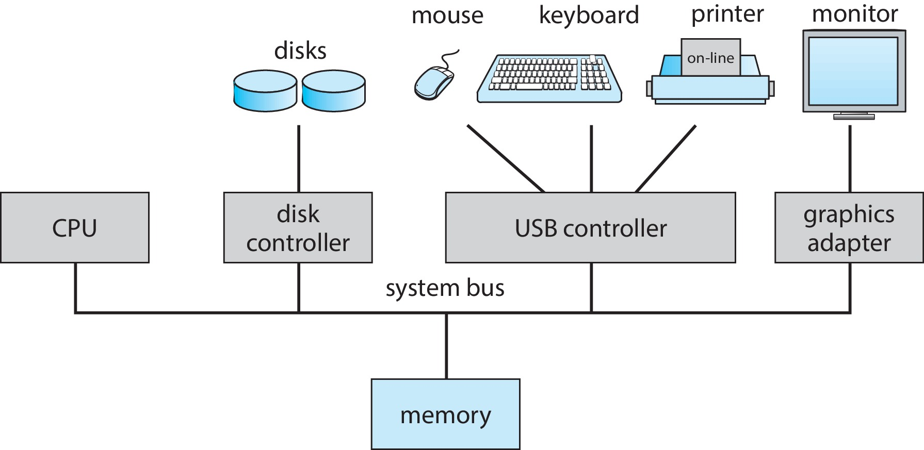
Computer Organization
One or more CPUs, device controllers connect through common bus providing access to shared memory
Concurrent execution of CPUs and devices competing for memory

Slide 10
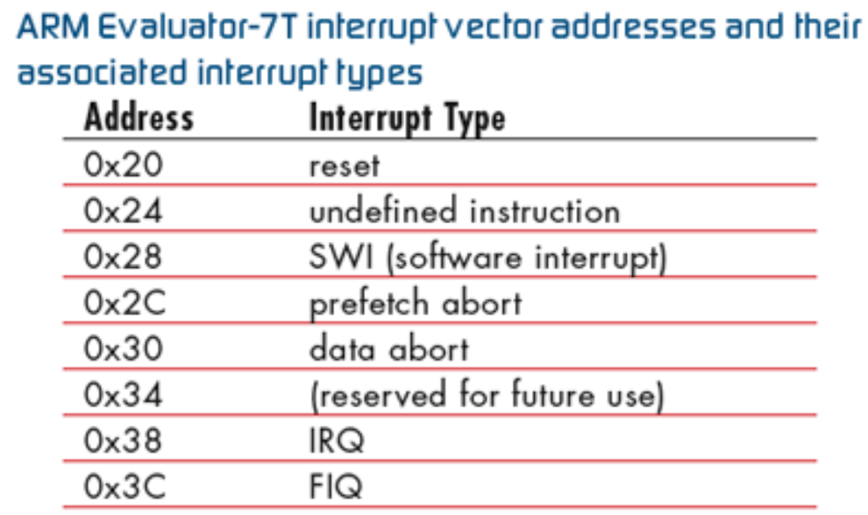
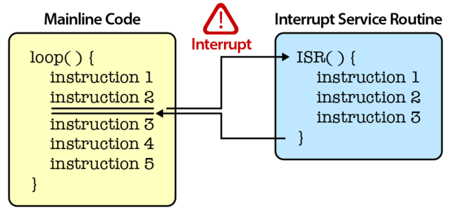
Interrupt
Transfers control from the running program to the interrupt service routine (ISR), and save the address interrupted instruction
The interrupt vector contains the addresses of all the service routines.
Operating systems are interrupt-driven

Slide 11
Interrupt
Hardware Interrupt:
caused by hardware device such as request of I/O, hardware failure ...
to avoid wasting the processor’s time waiting for external events
Software Interrupt:
invoked by the use of some special instruction (e.g., INT instruction)
immediately stops execution of the program and passes to INT handler
INT handler is a part of OS and determines the action to be taken
It occurs when an application program terminates or requests certain services from the OS

Slide 12
Software Interrupt
Part of the ISR operation is to perform a context switching to allow another process to execute
Due to, e.g., blocking and preemption has occurred for the current process controlled by the O/S
Blocking: a process is waiting for some event, such as a resource becoming available or the completion of an I/O operation.
Preemption: taking CPU away from a process
At the end of ISR, always call Scheduler!
Scheduler: an operating system module that selects the next jobs to be admitted into the system and the next process to run.

Slide 13
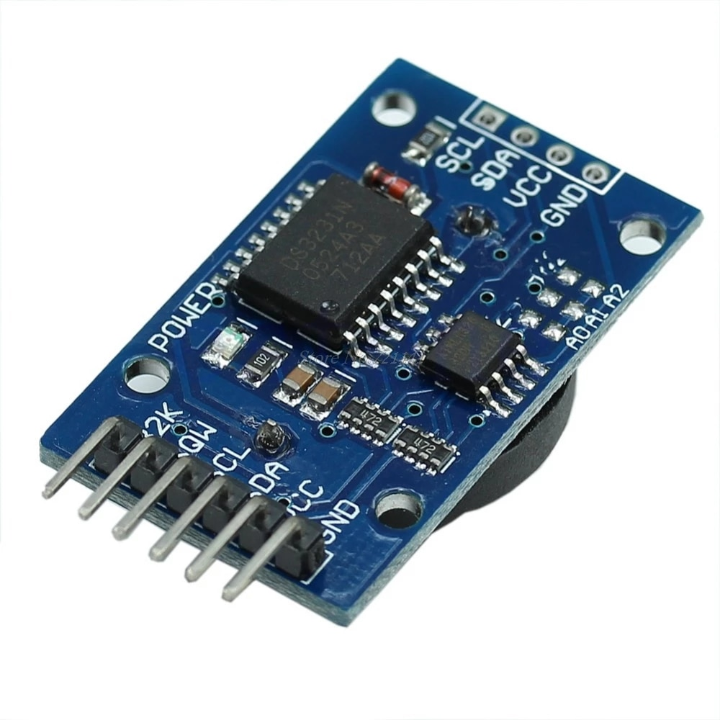

Timer
Timers are used to prevent a program to run too long
Interrupt the computer after some time period
Before transferring the control to any user program, OS must ensure that the timer has been properly set
When timer expires, generates a software interrupt, OS regains control
Only OS can set the timer counter (privileged instruction)
Timers are implemented based on hardware clocks
E.g., the real-time clock (RTC) module
hardware
RTC module
software
…
Timer 1
Timer 2
Timer N

Slide 14
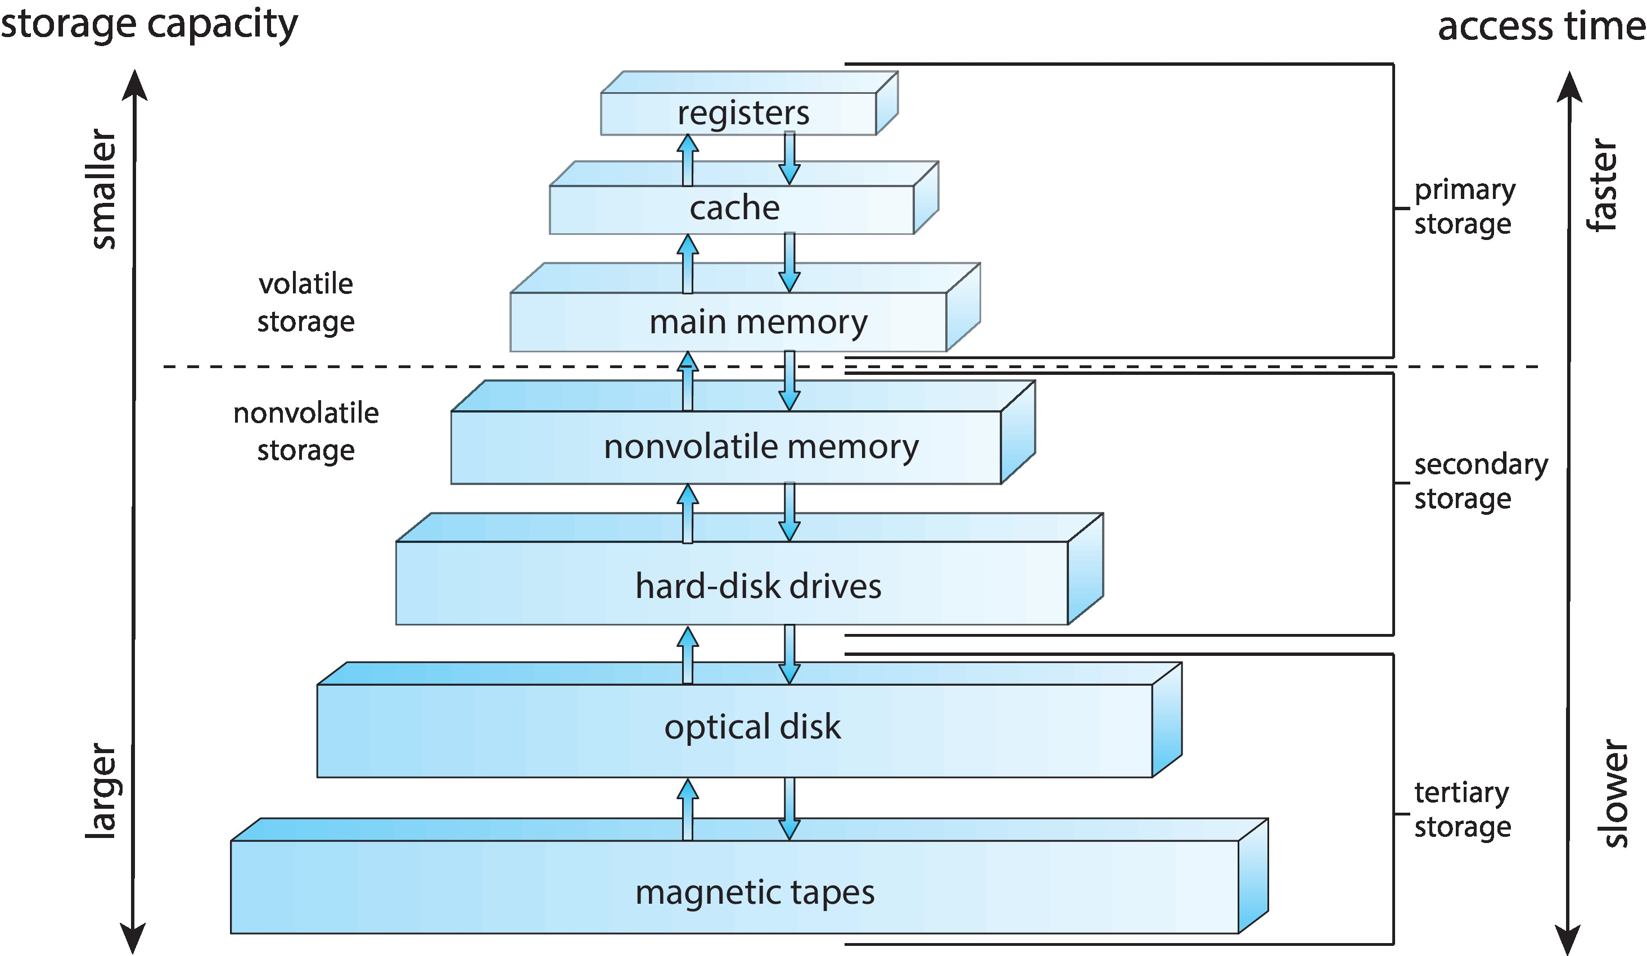
Storage Structure
Caching – copying information into faster storage system

Slide 15
Memory Management
All data in memory before and after processing
All instructions in memory in order to execute
Memory management determines what is in memory
Optimizing CPU utilization and computer response to users
Memory management activities
Keeping track of which parts of memory currently used and by whom
Deciding which processes and data to move into and out of memory
Allocating and deallocating memory space as needed

Slide 16
File System
OS provides uniform, logical view of information storage
Abstracts physical properties to logical storage unit - file
Each medium is controlled by device driver (i.e., disk drive)
different properties: speed, capacity, data rate, sequential or random access
File-System management
Files usually organized into directories
Access control to determine who can access what
OS activities include
Create, delete and manipulate files and directories
Map and store files to (non-volatile) storage media
…

Slide 17
Storage Management
Usually disks used to store data that do not fit in main memory or data that must be kept for a “long” period of time
Proper management is of central importance
Entire speed of computer operation hinges on disk subsystem
OS activities include
Free-space management
Storage allocation
Disk scheduling
…

Slide 18
Multiprogramming
Single user/application not always keep CPU and I/O busy
OS organizes jobs (code and data) so CPU always has one to execute
A subset of total jobs in system is kept in memory
One job selected by scheduler and run
When job has to wait (e.g., for I/O), OS switches to another job

Slide 19
Multitasking (Timesharing)
The CPU switches jobs frequently so that users interact with each job while it is running, creating interactive computing
Response time is short
A user has at least one program executing  process
If several jobs ready to run  scheduler decides
If processes don’t fit in memory, swapping moves them in and out to run

Slide 20
Process
A process is a program in execution
A unit of work within the system
Program is a passive entity, process is an active entity
a program is a sequence of instructions, whereas a process is any such program that is currently “working”
Process needs resources to accomplish its task
CPU, memory, I/O, files
Initialization data
Process termination requires reclaim of any reusable resources

Slide 21
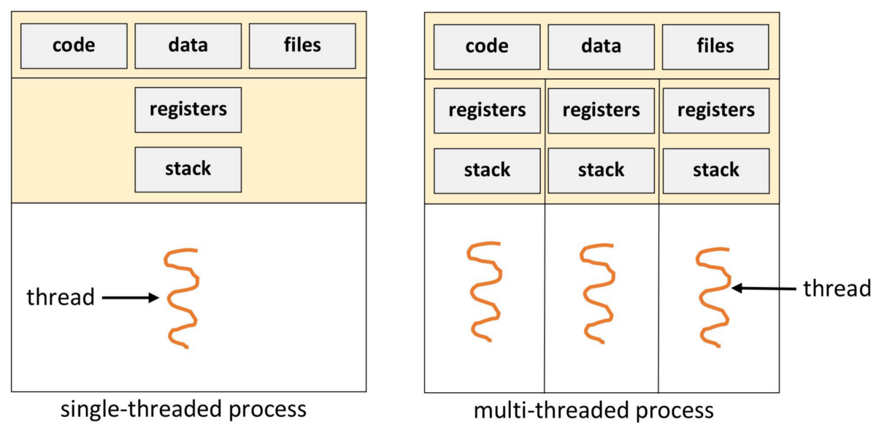
Thread
A thread of execution is the smallest sequence of programmed instructions that can be managed independently by a scheduler
Typically, a thread is a component of a process
“lightweight process” inside a process
In some OS, a process has only one thread (e.g., Linux); In some OS, a processor has multiple threads, each having its own program counter (PC), stack and register context

Slide 22
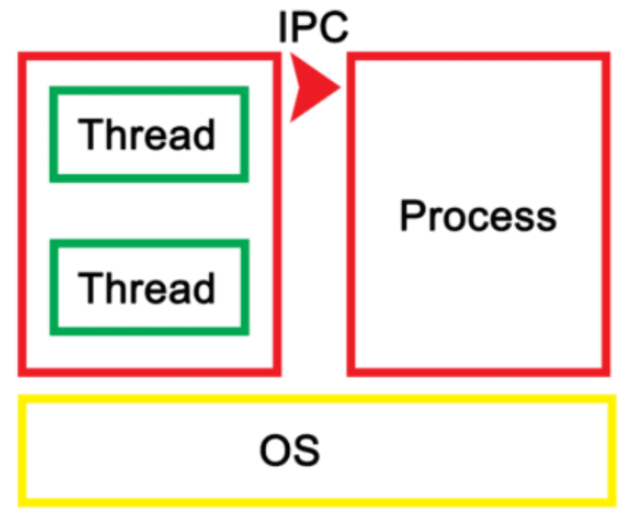
Thread vs Process
Different threads in a process share resources such as memory
They can interact directly via these resource
Different process do not share these resources
They interact via Inter-Process Communication (IPC) mechanism
Typically, we use different processes to do different work, while use different threads in a process to do the same work

Slide 23
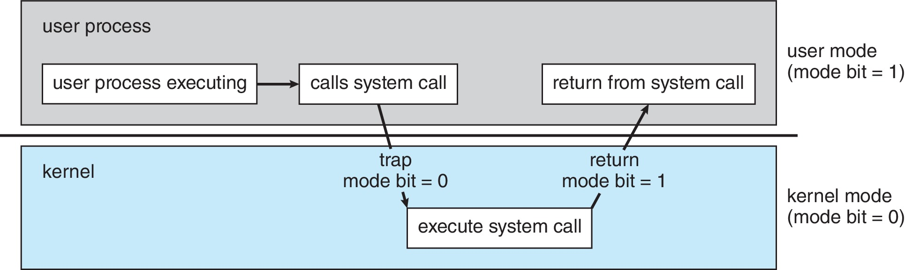
User Mode & Kernel Mode
Two-mode operation allows OS to protect itself
User mode and kernel mode
Mode bit provided by hardware
Ability to distinguish when system is running user or kernel code
When a user is running  mode bit is “user”
When kernel code is executing  mode bit is “kernel”

Slide 24
Privileged Instructions
Some instructions designated as privileged, only executable in kernel mode
Examples: I/O instructions, halt instructions, turn off Interrupts, set timers, context switching, clear memory, modify device-status table
If try to execute a privileged instruction in user mode, will not be executed and treated as an illegal instruction
Generate some special type of interrupts; the hardware traps it in OS

Slide 25
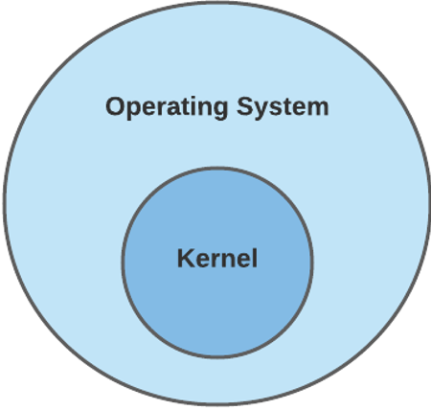
OS Kernel
Kernel is central component of an OS that manages operations of computer and hardware
Particularly, manages operations of memory and CPU time
The remaining part, called systems programs, provides richer functionalities of the OS
Services to users
Notice the similarity and difference of the term “Kernel” in “Kernel Mode” and “OS Kernel”

Slide 26
Monolithic Kernel vs Microkernel
Monolithic kernel: the entire OS runs in kernel mode
Both kernel and system programs implemented in same address space
Examples: UNIX (a large family), Linux, Windows
Microkernel: part of the OS runs in the user mode (user services) and part runs in the kernel mode (kernel services)
User services and kernel are kept in separate address space
Examples: MacOS, iOS, watchOS, Windows NT (all based on Mach kernel); L4 Kernel
In this course, concepts are introduced based on monolithic kernel, unless explicitly stated otherwise

Slide 27
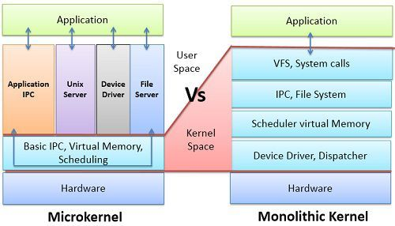
Monolithic Kernel vs Microkernel

Slide 28
OS Services
OS services provides functions that are helpful to the user, which usually include:
User interface (UI)
Command-Line (CLI), Graphics User Interface (GUI), Batch
Program execution: load a program into memory and to run it, end execution, either normally or abnormally (indicating error)
I/O operations: A running program may require I/O, which may involve a file or an I/O device
File-system manipulation: programs need to read and write files and directories, create and delete them, search them, list file Information, permission management

Slide 29
OS Services
OS services provides functions that are helpful to the user, which usually include:
Communication: Processes may exchange information, on the same computer or between computers over a network
Communications may be via shared memory or through message passing (packets moved by the OS)
Error detection: OS needs to be constantly aware of possible errors
May occur in the CPU and memory hardware, in I/O devices, in user program
For each type of error, OS should take the appropriate action to ensure correct and consistent computing
Debugging facilities can greatly enhance the user’s and programmer’s abilities to efficiently use the system

Slide 30
OS Services
Some OS services ensure the efficient operation of the system via resource sharing
Resource allocation: When multiple users or multiple jobs running concurrently, resources must be allocated to each of them
Many types of resources
Some (such as CPU cycles, memory, and file storage) may have special allocation code
Others (such as I/O devices) may have general request and release code
Accounting: To keep track of which users use how much and what kinds of computer resources

Slide 31
OS Services
Some OS services ensure the efficient operation of the system via resource sharing
Protection and security: The owners of information stored in a multiuser or networked computer system may want to control use of that information
Protection – any mechanism for controlling access of processes or users to resources defined by the OS
Security – defense of the system against internal and external attacks
Huge range, including denial-of-service, worms, viruses, identity theft, theft of service

Slide 32
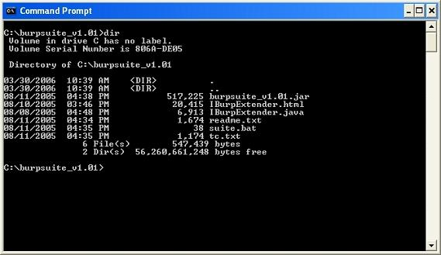
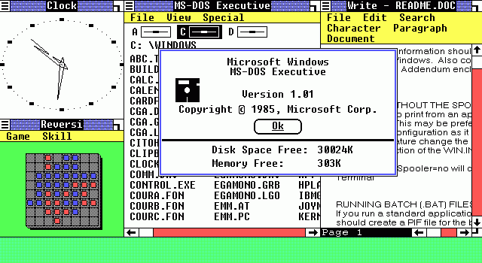
User Interface
A shell is a OS component which exposes an OS's services to a human user or other programs
Command-line interface (CLI)
fetches a command from user and executes it
built-in commands and program names
Graphical user interface (GUI)
User-friendly desktop metaphor interface
Usually mouse, keyboard, monitor, touchscreen …
Invented at Xerox PARC, made popular by Microsoft
Windows 1.0 (1985)

Slide 33
System Calls
Recall the switching between user mode and kernel mode

Slide 34
System Calls
Programming interface to the services provided by the OS
Typically written in a high-level language (C or C++)
OS combines low-level (Assembly) and high-level language (C or C++)
Types of system calls
Process control
File management
Device management
Information maintenance
Communications
… …

Slide 35
System Calls
Mostly accessed by programs via a high-level Application Program Interface (API) rather than directly via system call
API is usually, but not necessarily provided by OS
Why use APIs rather than system calls?
System calls are detailed and more difficult to work with
Using APIs can allow programs to compile and run on other system
Three most common APIs
Win32 API for Windows
POSIX API for POSIX systems (all versions of UNIX, Linux, and Mac OS X),
Java API for the Java virtual machine (JVM)

Slide 36
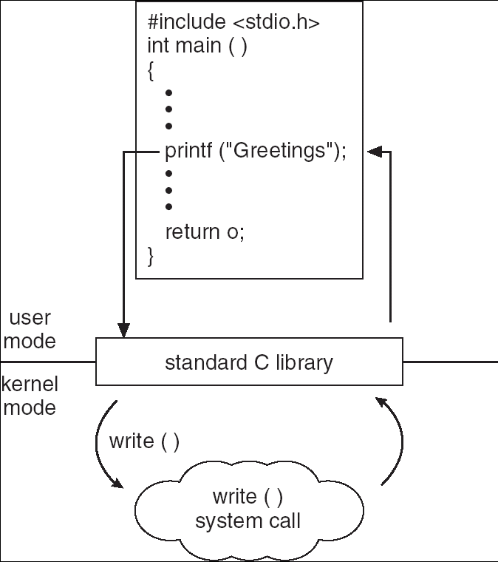
API – System Call
C program invoking printf() API
(a C library function), which calls write() system call

Slide 37
System Call Implementation
Typically, a number is associated with each system call
System-call interface maintains a table according to these numbers
The system call interface invokes intended system call in OS kernel and returns status of the system call and return values
The caller needs to know nothing about how the system call is implemented
Just needs to obey the system call or API format and understand what OS will do as a result call

Slide 38
OS Design and Implementation
Many ways, but some approaches have proven successful
Structure of different OS can vary widely
Start by defining goals and specifications
Affected by choice of hardware, type of system
User goals and System goals
User goals – operating system should be convenient to use, easy to learn, reliable, safe, and fast
System goals – operating system should be easy to design, implement, and maintain, as well as flexible, reliable, error-free, and efficient

Slide 39
OS Design and Implementation
Important principle to separate
Mechanism: the framework/facilities to do something
Policy: the concrete rule to follow
For example: a OS support to compression when storing a file (mechanism), while it is possible to use different compression algorithms (policies)
The separation of policy from mechanism is important principle, it allows maximum flexibility if policy decisions changed later

Slide 40
Unix
Created at Bell Labs starting from late 1960s with the goals
Simplicity
Recyclable code
Written in C instead of assembly
Establish many widely adopted concepts in modern OS
a hierarchical file system; treating devices as files; and the use of a large number of software tools; small programs be strung together through a CLI …
Many variances …

Slide 41
Linux
Open-source Unix-like OS based on the Linux kernel
Linux kernel first released on September 17, 1991, by Linus Torvalds
To create a free implementation of UNIX
MSC thesis “Linux: A Portable Operating System”
Typically packaged with supporting software and libraries, many provided by the GNU Project
GNU: GNU Not Unix
Includes many other well-known projects such as GCC, Emacs, Bash
Many distributions: Ubuntu, Fedora, CentOS, Redhat …

Slide 42
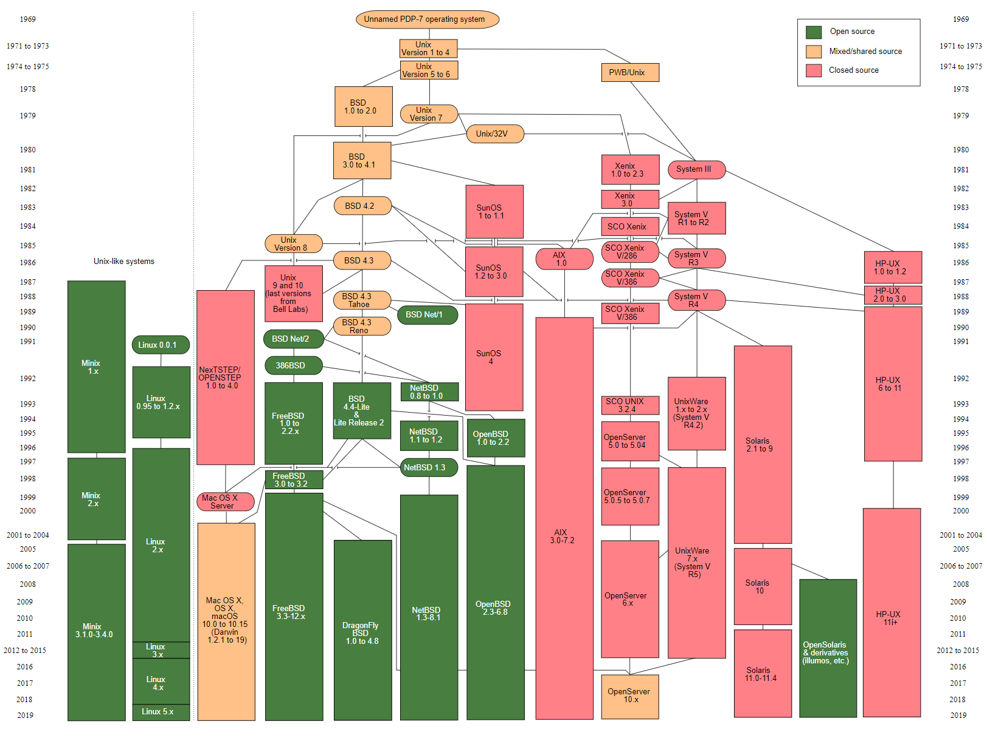
UNIX/UNIX-like OS family

Slide 43
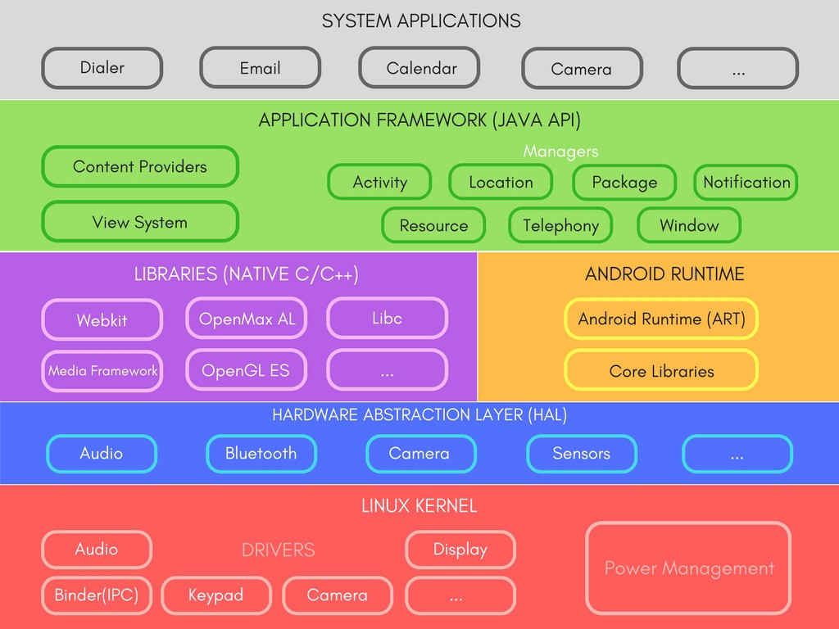
Android
Target mobile devices
Based on a modified version of Linux kernel and other open source software
It’s a “framework”
OS + many development and runtime supports
User space
Kernel space

Slide 44


RTOS
Real-time operating system (RTOS) is an OS for real-time applications (having critically defined time constraints)
RTOS is usually event-driven and preemptive
Event-drive: mainly used to respond to external events
Preemptive: a more urgent task can be served immediately
Distinct from a time-sharing OS, such as Unix, which switch the task based on clock interrupts
Usually much smaller and simpler
fast, small memory foot print

Slide 45
POSIX
The Portable Operating System Interface (POSIX) is a family of standards for maintaining compatibility between OS
Defines both the system- and user-level APIs, along with command line shells and utility interfaces
For software compatibility (portability) with variants of Unix and other OS
For example, POSIX thread (pthread)

Slide 46
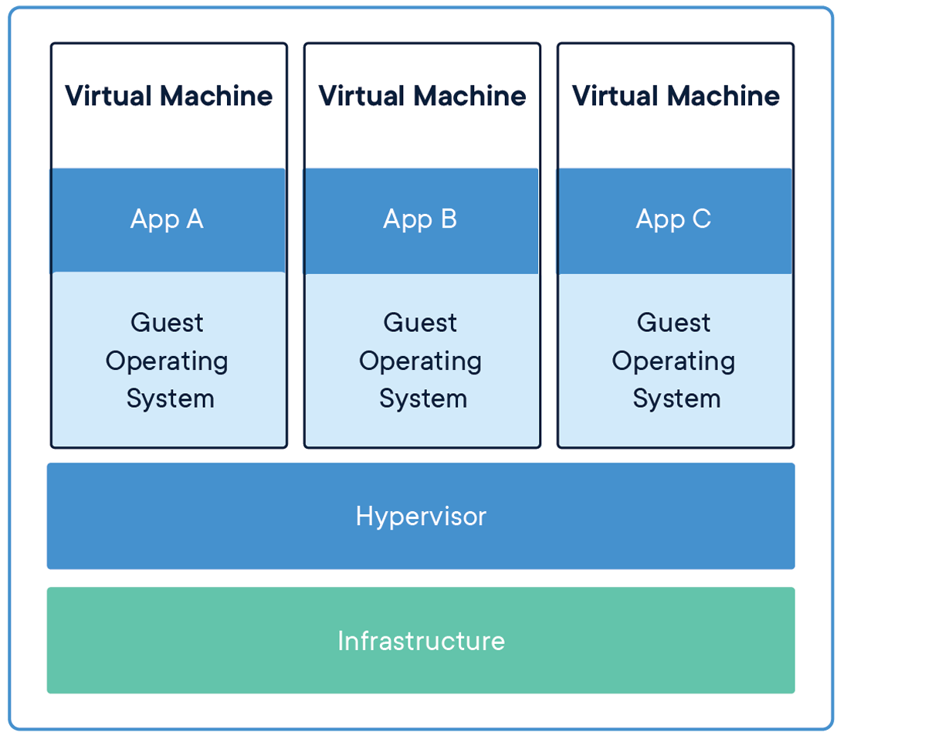
Virtual Machine
A virtual machine (VM) is the virtualization/emulation of a computer system
Guest OS
(Runtime)
Guest OS
(Runtime)
Guest OS
(Runtime)
(Host OS)
Hardware

Slide 47
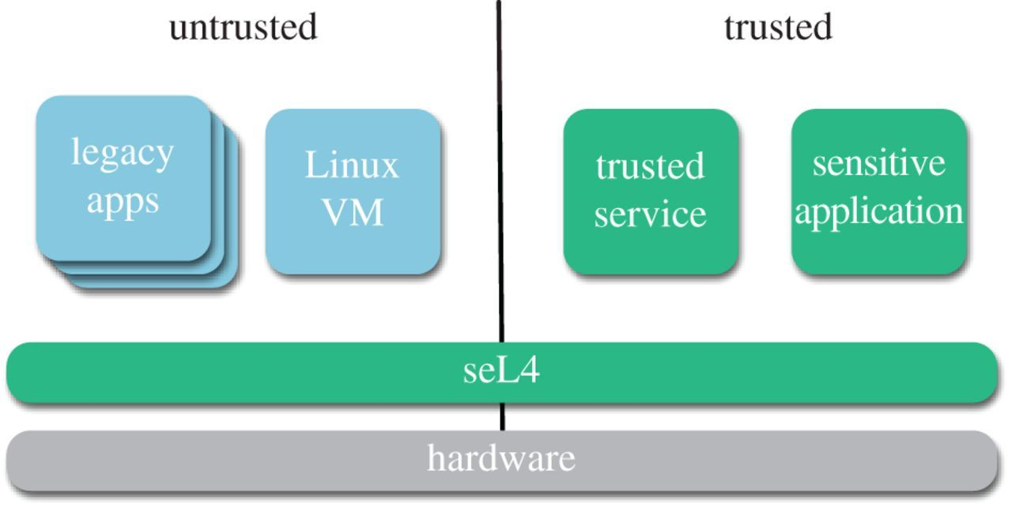
Virtual Machine
VM are used for different purposes
Run another OS inside your host OS
E.g., run some Linux software on your Windows laptop
Provide a platform-independent programming environment that abstracts away details of the underlying hardware or OS
E.g., Java virtual machine
Provide full isolate of different sub systems
E.g., isolate the trusted and untrusted

