Slide 1
Energy Aware Multi-hop Multi-path Hierarchical(EAMMH) Routing Protocol in Wireless Sensor Network
Under the guidance of :
Monica R Mundada
Associate Professor Submitted by:
Raja Nahusha Varsha 1MS08CS082
Savan Kiran 1MS08CS095
Seira Ann George 1MS08CS096
Shivanand Khobanna 1MS08CS106

Slide 2
What is Wireless Sensor Network?

Slide 3
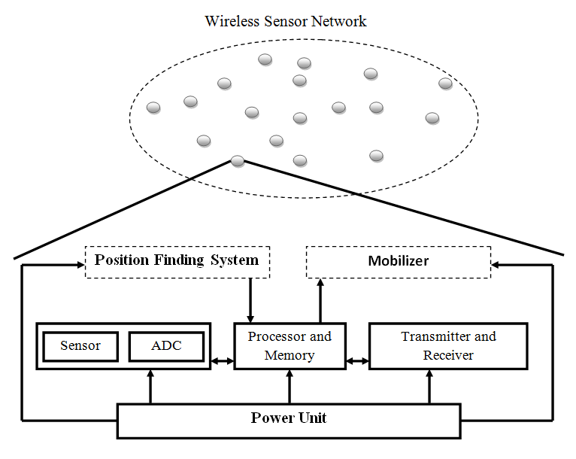

Sensor Node
Elements of a node:
Sensing element
Transceiver (Radio)
Processing unit
Power supply
Avg. cost of 1 transmission/reception =~ 800 computations.
Transmission eqn:

Slide 4
Routing protocols in WSNs
Major objective = efficiently utilize the limited resources of sensor nodes and reliability.
Large number of protocols, No one best protocol.
Applications can be classified as, event-driven, time-critical, periodic update systems.
Generally, the routing protocols are classified into :Data-centric routing protocols, Hierarchical routing protocols, Location based routing protocols.
Challenges in routing techniques :
Limited energy and Bandwidth.
Time criticality.
Scalability and Mobility.
Coverage problem and Data redundancy.
Quality of Service.

Slide 5
Low energy adaptive clustering hierarchy(LEACH) routing protocol
A comparison to EAMMH protocol

Slide 6
LEACH operation
Cluster head(CH) broadcasts the ‘adv’ message.
Each node listens to the ‘adv’ message from various CHs and joins the CH with the greatest signal strength.
Each node in the cluster is one hop away from CH.
CH allots each node in the cluster a time slot.
Each node senses data and sends it to the CH.
CH aggregates data from each node and transmits it to Base station.

Slide 7
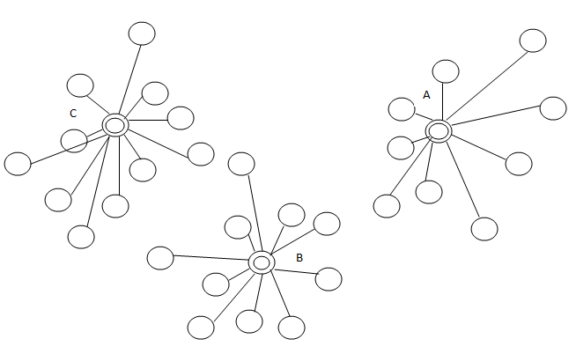
Node ‘A’ , ’B’ and ‘C’ are Cluster heads

Slide 8
“Knowledge is Power” but….
“Gathering data doesn’t make you smart, but what you do with it, is what defines you”

Slide 9
EAMMH routing protocol in Wireless Sensor Network
A dynamic, always learning and intelligent protocol

Slide 10
Overview
Neighbor discovery algorithm
Cluster head (CH) selection
Cluster formation
Routing table creation
Timeslot assignment using TDMA algorithm

Slide 11
Neighbour Discovery and CH selection
Either ping, beacon messaging or k-of-n approach.
One hop neighbors discovered.
Cluster head is chosen using a probabilistic approach to facilitate load balancing.
T(n) = P ,if n € G
1 – P * (r mod(1/P))
0 ,otherwise
Every node selects a random number between 0 and 1. If the number < T(n), it becomes a cluster head else it doesn’t.
Network operates in rounds and cluster head is rotated periodically.

Slide 12
Cluster Formation
Each CH is allotted a budget.
Every node consumes 1 from the budget it has been allotted.
They divide the rest of the budget among their one hop neighbors.
They broadcast the ‘adv’ message to their one-hop neighbors along with the following information:
Budget allotted, ‘b’
Minimum no. of hops to reach CH through it , ‘hmin’
Average energy of the path, ‘Eavg ’
Traffic information through that node, ‘t’
Energy of the node with the least energy along the path, ‘Emin’
If this ‘adv’ message received by the neighbor is the first ‘adv’ that it listens, then it is added as the ‘minimum hop path’/’shortest path’.
If this ‘adv’ message is not the first ‘adv’ it listens, then it adds the path as ‘alternate path’.

Slide 13
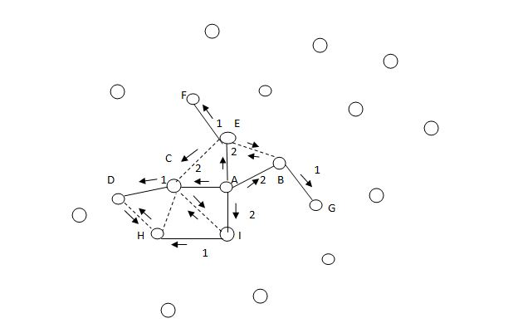
Node ‘A’ is the CH and is allotted a budget of 9.

Slide 14
Data Transmission Phase
A node receives data from its neighbors and aggregates it with its own sensed data.
While forwarding, it has to choose a path from the routing table.
It uses a heuristic function to choose a path,
h=k. E avg
h min * t
where , k- constant
the path with highest heuristic function value is chosen.
If this path’s E min > threshold , it is chosen.
Else the path with the next highest heuristic value is chosen.
Emin = Eavg /constant(like 10).

Slide 15
Arriving at the Heuristic Function
Probability of choosing the path α E_{avg}
Probability of choosing the path α 1 / h_{min}
Probability of choosing the path α 1 / traffic
From equations 1,2 and 3
h=k. E avg
h min * t
where , k- constant

Slide 16
Routing Table
Energy of Min. Energy Node | Shortest Path | Next Hop | Min. number of Hops | Avg. Energy of the Path | Traffic | Heuristic Function Value
w | Yes | Node ‘V’ | x | y | z | h1
a | No | Node ‘D’ | b | c | d | h2
p | No | Node ‘T’ | q | r | s | h3
g | No | Node ‘Q’ | h | i | j | h4

Slide 17
Project Contributions
The major objective - extend the network lifetime.
Self organization, Autonomous cluster operation.
Highly scalable.
Probabilistic cluster head selection to balance load.
Establishing multi-hop intra-cluster network.
Robustness to node failure.
Energy Aware routing.

Slide 18
Application areas
Area monitoring
Industrial monitoring
Structural health monitoring
Agriculture
Military
Vehicle monitoring
Environmental
Health industry
Home applications
And many more ……………………

Slide 19
Thank you
Any Questions ?

