Slide 1


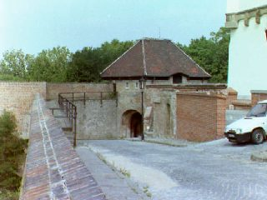
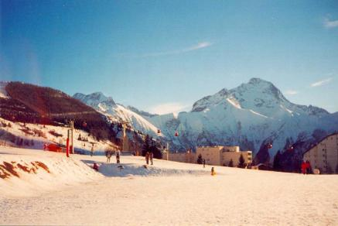

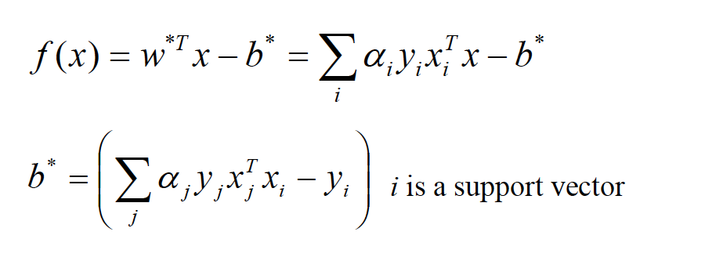
Linear-SVM in People Detection Learning Algorithm
f(x) =+1
f(x) = -1
An image is an instance of variable x
static double dot(const svm_node *px, const svm_node *py);
double kernel_linear(int i, int j) const
{
return dot(x[i],x[j]); // what we choose to demo.
}
double kernel_poly(int i, int j) const
{
return powi(gamma*dot(x[i],x[j])+coef0,degree);
}
double kernel_rbf(int i, int j) const
{
return exp(-gamma*(x_square[i]+x_square[j]-2*dot(x[i],x[j])));
}
Notes:
My main contribution : Parallel the SVM kernel function. Kernel function( candidates are linear, polynomial , RBF, etc.. ) is used to map original data into higher dimension feature space.

Slide 2
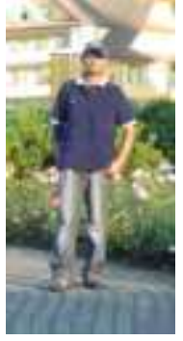
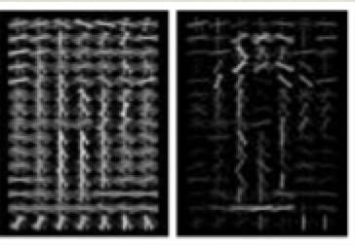
Architecture
Linear SVM used in HOG People-Detection
Data
I/O
HOG-feature
Computation
Linear SVM
data
data
data
HSA-Applied Scope
Notes:
HOG Features : Histogram Oriented Gradients features , used by people detection algorithm. Of cause it is worth being parallelized in the future.

Slide 3
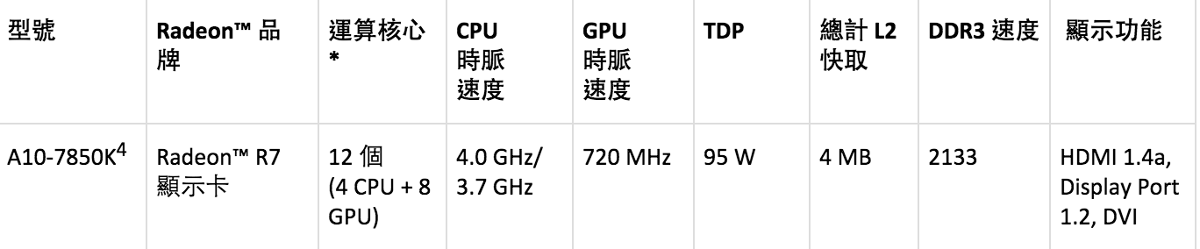
Build and Run
Build the machine : AMD A10-7850K
compile opencv-3.0.0
Modify svm.cpp and recompile the ml-module
Using OpenCL and SNACK to parallelize the kernel function ( an intensive computation of inner product ).
The kernel function is called calc_non_rbf_base() in svm.cpp
When utilizing SNACK, use CLOC to generate SNACK object file and include it in ld stage.
make and run “./hogsvm ” . ( library dependency on OpenCL

Slide 4
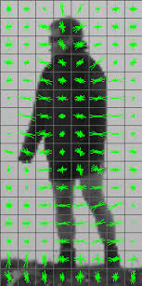
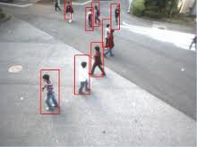
Performance
Training data : 3000 images, size of each file ranges from 40KB to 800KB
Those results are derived from the execution time of one-time iteration.

Slide 5
Analysis
OpenCL and SNACK improved the performance of the algorithm by 2 and 7 times of the single thread mode, respectively.
In this algorithm , training data were loaded only once and then the kernel iterates by several times for saturation condition. => only small part of data need to be reloaded => HSA helps only in initialization.
The time cost for SNACK configuration is much more than legacy OpenCL API. In this case, this HSA-API performs more poorly than legacy one. => separate configuration and execution will be expected to implemented.

Slide 6
References
http://www.cmlab.csie.ntu.edu.tw/~cyy/learning/tutorials/SVM2.pdf

