Slide 1
Time-series Analysis
Team 10 – Xun Peng, Jiahua Liu

Slide 2
Time-series Analysis
A time series is a series of data points indexed (or listed or graphed) in time order.
Time series forecasting is the use of a model to predict future values based on previously observed values.

Slide 3

Autoregressive Model (AR)
A model that uses the dependent relationship between an observation and some number of lagged observations.
The current GDP of a country is dependent on the last year’s GDP. The hypothesis being that the total cost of production of products & services in a country in a fiscal year (known as GDP) is dependent on the set up of manufacturing plants / services in the previous year and the newly set up industries / plants / services in the current year.

Slide 4

Moving Average Model (MA)
A model that uses the dependency between an observation and a residual error from a moving average model applied to lagged observations.
A manufacturer produces a certain type of bag. He was able to sell the entire stock of 1000 bags (lets call this as x(t) ). The demand got so high that the bag ran out of stock. As a result, some 100 odd customers couldn’t purchase this bag. Lets call this gap as the error at that time point. For the next day, still few customers were left who went empty handed the previous day.

Slide 5

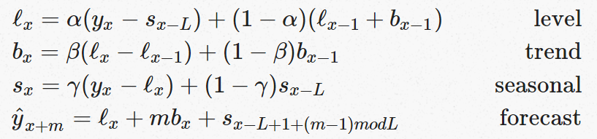
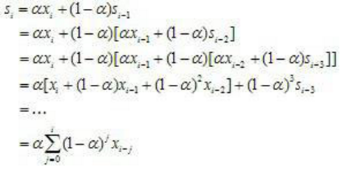
Holt Winters Model (Triple Exponential Smoothing)
Constraints: 1) one and only one trend 2) no level shifts in the data i.e. no intercept changes 3) that seasonal parameters do not vary over time 4) no outliers
Notes:
jagged lines become smoother (1−α)(1−α) is multiplied by itself again and again all the way to beginning of the series

Slide 6
Stationary Time-series
Stationary Time-series Conditions: Mean, Variance, and Covariance are not a function of time.
TS models only work on a stationary time-series.
Because if a TS has a particular behaviour over time, there is a very high probability that it will follow the same in the future.

Slide 7
Make a Time Series Stationary
Two reasons behind non-stationary series: Trend, Season.
Methods:
Transformation: log, square root, cube root, etc.
Differencing – taking the difference with a particular time lag
Decomposition – modeling both trend and seasonality and removing them from the model.

Slide 8
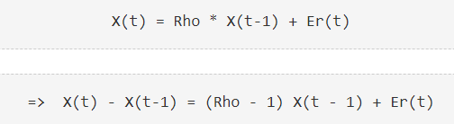
Dickey-Fuller Stationary Test
If Rho < 1, say 0.3, then if X moves to any direction from zero, it is pulled back to zero in next step.
If Rho = 1, then there is no force that can pull X down in the next step.
If (Rho - 1) is less than some critical value, then we reject the null hypothesis, meaning we determine the time series is stationary.
Notes:
The only component which can drive it even further is the error term. Error term is equally probable to go in either direction.

Slide 9
ACF and PACF
ACF: Autocorrelation Function. a measure of the correlation between the TS with a lagged version of itself.
Used to determine MA term (q)
PACF: Partial Autocorrelation Function. ACF with linear dependency with that signal at shorter lags removed.
Used to determine AR term (p)
Notes:
In a moving average series of lag n, we will not get any correlation between x(t) and x(t – n -1) . Hence, the total correlation chart cuts off at nth lag. So it becomes simple to find the lag for a MA series. For an AR series this correlation will gradually go down without any cut off value. So what do we do if it is an AR series?
Here is the second trick. If we find out the partial correlation of each lag, it will cut off after the degree of AR series. For instance,if we have a AR(1) series, if we exclude the effect of 1st lag (x (t-1) ), our 2nd lag (x (t-2) ) is independent of x(t). Hence, the partial correlation function (PACF) will drop sharply after the 1st lag. Following are the examples which will clarify any doubts you have on this concept :

Slide 10
ARIMA (AR Integrated MA)
Parameters:
p: AR term
q: MA term
d: Differencing degree

Slide 11
Thank You

