Slide 1
Theory of Computation
Part I Model of Computation
chapter 1 finite automata
chapter 3 Turing machines
Part II Computability theory
chapter 4 ∃ problem without algorithm
Part III Complexity theory
chapter 7 P, NP and NP complete
What are the fundamental capabilities
and limitations of computers?
Notes:
学习计算理论的目的在于理解计算机能做哪些事
是什么使得一些问题难于计算，另一些问题容易计算（能不能给问题分类，告诉我们这些问题一定存在高效算法，另一些问题不一定存在高效算法）
这就涉及到对“计算”本质的分析。
用自动机对“计算”这个操作建模。使我们分析“计算”的本质时有形式化的定义

Slide 2
Chapter 1 Finite automata
1. deterministic finite automata
2. non-deterministic finite automata
3. regular expression
4. pumping lemma of regular languages

Slide 3
Finite Automata
Example: an automatic door controller
Input signal
 | Neither | Front | Rear | Both
Closed | Closed | Open | Closed | Closed
Open | Closed | Open | Open | Open
state
front
pad
rare
pad
Front
Rear
Both
Rear
Both
Neither
closed door
Front
front
pad
rare
pad
Closed
Open
opened door
Neither

Slide 4
Formal def: Finite Automata(P35)
Def: a finite automata is a 5-tuple (Q,Σ,δ,s,F),
Q is a finite set called the states
Σ is a finite set called the alphabet
δ: Q× Σ→Q is the transition function
s∈Q is the start state
F⊆Q is the set of accept states;
Q={q₁,q₂,q₃}
Σ={0,1}
s=q₁ start state
F={q₂}
δ is described as
0
1
δ | 0 | 1
q₁ | q₁ | q₂
q₂* | q₃ | q₂
q₃ | q₂ | q₂
0
M₁
1
q₁
q₂
q₃
0,1
state diagram ≡ formal def
Notes:
一般的图是一个二元组G=(V,E)

Slide 5
A FA is an algorithm
0
1
q₁
M₁
0
1
1 | 1 | 0 | 1
q₁
q₂
q₃
0,1
q₂
Denote states as 1,2,3
1. initially q=1
2. while(read(s))
3. switch( (q,s) ),
4. (1,0): q=1; (1,1): q=2;
5. (2,0): q=3; (2,1): q=2;
6. (3,0): q=2; (3,1): q=2;
7. if(q==2)return(true);
8. return(false)
1 | 1 | 0 | 1
q₂
1 | 1 | 0 | 1
q₃
1 | 1 | 0 | 1
q₂
1 | 1 | 0 | 1

Slide 6
running of a FA
0
1
q₁
M₁
0
1
q₁
q₂
q₃
1 | 1 | 0 | 1
0,1
run: start from the start state, go along arrows.
output: when finish reading, for the current state q if q is an accept state, then accept; else, reject.
accept strings: 1, 11, 100, 101, 1101, …
reject strings: ε, 0, 10, 110, 1010, …
for a string, the computation path is unique
We also call it Deterministic Finite Automata (DFA)

Slide 7
formal def. of computation of DFA
w₁
w₂
…
Let M=(Q,Σ,δ,s,F) be a DFA,
w=w₁w₂…w_{n} be a string over Σ.
if ∃ a sequence of states r₀,r₁,…,r_{n} in Q, such that
1) r₀ = s; //start in the start state
2) δ(r_{i}, w_{i+1}) = r_{i+1}; //go according to transition function
3) r_{n} ∈F //ends up in an accept state
then we say M accept w.
w_{n}
s
r₁
r₂
r_{n-1}
r_{n}
0
1
0
1
1
0
q₁
q₁
q₂
q₂
M₁ accept 011
1
q₁
q₂
q₃
0
1
0
0,1
q₁
q₁
q₂
q₃
M₁ do not accept 010

Slide 8
The language of a DFA
Def: For a DFA M, letting A = { w ∈Σ* | M accept w },
we call A the language of M and write L(M)=A.
We say that M recognizes A or M accepts A.
0
1
M₁
0
1
q₁
q₂
q₃
0,1
Note: Reading 1 follows by go to state q₂.
L(M₁)={w ∈{0,1}* | w contains at least one 1,
an even number of 0s follow the last 1 }

Slide 9
Important notice
Let M be a DFA. The language of M L(M) = { w ∈{0,1}* | M accept w }
M is an algorithm, it solve the problem L(M).
M may accept many strings or no string, but M accepts only one language.
M₁ accept only A={w ∈{0,1}* | w contains at least one 1, an even number of 0s follow the last 1 }
M₁ do not accept any proper subset of A,
e.g., languages {1,11,100} and
{1,11,111,1111,…}
0
1
M₁
0
1
q₁
q₂
q₃
0,1
Notes:
比如1111不是{1,11,100}的串，但M1也能识别，所以M1对应的语言不是{1,11,100}

Slide 10
Regular Language
A = { w∈{0,1}* |
w contains at least one 1,
an even number of 0s follow the last 1 }
0
1
M₁
0
1
q₁
q₂
q₃
0,1
Def: We call A a regular language, if A is the language of some DFA.
We also call A is regular
Example: A is a regular language
Notice: a subset of a regular language may be non regular
Example: {0,1}* is regular
P(Σ*)
Recognizable
decidable
CFL
regular
Notes:
正则语言，上下文无关语言，可判定语言，图灵可识别语言

Slide 11
Designing finite automata
Given a language A, design FA to recognize it
accept all strings in A, reject all strings not in A
“reader as automaton”, look for key information
Design DFAs for the following languages:
A={ w∈{0,1}* | w start from 1, end with 0 }
B={ w∈{0,1}* | w contain 1010 as sub-string }
C={ w∈{0,1}* | w contain an 1 at the second place from the right hand end }
D={ w∈{0,1}* | the binary w equals 1 module 3 }
Notes:
Put yourself in place of the machine you are tring to design.

Slide 12
Design a DFA for A
A = { w∈{0,1}* | w start from 1, end with 0 }
Σ={0,1}, design states according to key information,
Empty, //ε, read nothing initially
Start From 0, //0*
Start From 1 End With 0, //1*0
Start From 1 End With 1, //1*1
Start state: ε
Accept states: 1*0
1
0
0
1*1
1*0
1
ε
1
0
0*
0,1
Examples: 1100, 101
1100: (ε)--1--(1*1)--1--(1*1)--0--(1*0)--0--(1*0) accept
101: (ε)--1--(1*1)--0--(1*0)--1--(1*1) reject

Slide 13
Design a DFA for B
B = { w∈{0,1}* | w contain 1010 as sub-string }
Σ = {0,1}, key information: ε, 1, 10, 101, 1010
Start state: ε
Accept states: 1010
0
0
1
1
0
ε
1
10
1
1
Examples:
1011: (ε)--1--(1)--0--(10) --1--(101)--1--(1) reject
010101: (ε)--0--(ε)--1--(1) --0--(10)--1--(101)--0--(1010)--1--(1010) accept
0,1
1010
0
101

Slide 14
Design a DFA for C
C={ w∈{0,1}* | w contain an 1 at the second place from the right hand end }
only need to remember the last two read symbols
Σ={0,1}, key information: ε, 0, 00, 1, 01, 10, 11
ε, 0, 00 are equivalent; 1, 01 are equivalent
Simplified states: ε, 1, 10, 11
Start state: ε
Accept states: 10,11
0
0
1
1
0
ε
1
10
Examples:
101: (ε)--1--(1)--0--(10)--1--(1) reject
110: (ε)--1--(1)--1--(11)--0--(10) accept
1
0
1
11

Slide 15
Design a DFA for D
D={ w∈{0,1}* | the binary w equals 1 module 3 }
Σ={0,1}, key information?
the remainders 0,1,2 module 3
start state: 0
accept state: 1
0
1
1
0
0
1
2
1
0
Examples:
1011: (ε)--1--(1)--0--(2)--1--(2)--1--(2) reject
1101: (ε)--1--(1)--1--(0)--0--(0)--1--(1) accept

Slide 16
the regular operations
In arithmetic, objects→numbers, tools→operations: +×.
In theory of computation, objects→languages, tools?
Def: Let A and B be two languages, define regular operations union, concatenation, and star as follows
• Union: A∪B = { x | x ∈ A or x ∈ B }
• Concatenation: A°B = { xy | x∈A and y∈B}
• star: A* = {x₁x₂…x_{k} | k≥0, x_{i}∈A }
Notes:
注意k可以等于0，说明允许空串作为元素

Slide 17
Example of regular operations
Let the alphabet Σ be the standard 26 letters.
Let A={good,bad}, B={boy,girl}. Then
A∪B={ good, bad, boy, girl }
A°B={ goodboy, goodgirl, badboy, badgirl }
A*={ε, good, bad, goodgood, goodbad, … }
Theorem: If A,B are regular, then
A∪B, A°B and A* are regular.
We will prove the theorem after we study NFA

Slide 18
Exercise
1.1 The following are the state diagrams
of two DFAs, M₁ and M₂. Answer the following
questions about each of these machines.
a. What is the start state?
b. What is the set of accept states?
c. What sequence of states does the
machine go through on input aabb?
d. Does the machine accept the string aabb?
e. Does the machine accept the string ε?

Slide 19
Exercise
1.6 Give state diagrams of DFAs recognizing the following
languages. In all parts, the alphabet is {0,1}.
b. {w| w contains at least three 1s}
d. {w| w has length at least 3 and its third symbol is a 0}
f. {w| w doesn’t contain the substring 110}

Slide 20
Chapter 1 Finite automata
1. deterministic finite automata
2. non-deterministic finite automata
3. regular expression
4. pumping lemma of regular languages
P(Σ*)
Recognizable
decidable
CFL
regular

Slide 21
Nondeterministic Finite Automata
Deterministic finite automata (DFA),
next state exists and unique ( δ: Q×Σ → Q )
Nondeterministic finite automata (NFA):
0,1
0,1
1
0,ε
1
q₁
q₂
q₃
q₄
there may be many or no next choices:
q₁ has two arrows for 1; q₂ has no arrows for 1;
there may be arrows with label ε,
we can go along the arrow without read a symbol
Notes:
Nondeterministic finite automata

Slide 22
Nondeterministic Computation
0,1
0,1
What is NC?
How to understand NC?
1
0,ε
1
q₁
q₂
q₃
q₄
0
1
0
1
1
Input
01011
q₃
×
q₄
q₄
q₁
q₁
q₃
q₃
q₃
q₂
q₂
×
q₁
q₂
q₁
q₁
q₁
1. NC is a kind of parallel computation
if necessary, machine split into copies to follow all choices
2. NC is a tree of possibilities: branches corresponding to choices
Notes:
一个类似“薛定谔猫的状态”

Slide 23
Process of nondeterministic computation
0,1
N
0,1
1
0,ε
1
q₁
q₂
q₃
q₄
0
1
0
1
1
q₃
×
q₄
q₄
q₁
q₁
q₃
q₂
q₃
q₃
1. one machine in start state
2. split into copies along ε-arrows
3. while(read s), //one copy one state
4. split into copies along s-arrows
5. split into copies along ε-arrows
6. if there is a copy in accept state, accept.
accept ≡ there exists accept path : N accept 01011
q₂
×
q₁
q₂
q₁
q₁
q₁

Slide 24
Nondeterministic Computation: reject
0,1
N
0,1
1
0,ε
1
q₁
q₂
q₃
q₄
0
1
0
Input
010
q₃
×
q₁
q₁
q₂
q₃
q₁
q₁
N reject 010

Slide 25
Formal def: Finite Automata(P35)
Def: a finite automata is a 5-tuple (Q,Σ,δ,s,F),
Q is a finite set of states
Σ is a finite set of alphabet
δ: Q×Σ→Q is the transition function
s∈Q is the start state
F⊆Q is the set of accept states;
M₁
0
1
0
1
state diagram ≡ formal def
q₁
q₂
q₃
0,1
Notes:
Deterministic finite automata

Slide 26
formal definition of NFA
0,1
0,1
1
0,ε
1
q₁
q₂
q₃
q₄
Def: an NFA is a 5-tuple (Q,Σ,δ,s,F),
Q is a finite set of states
Σ is a finite alphabet
δ: Q×Σ_{ε}→P(Q) is the transition function;
s∈Q is the start state;
F⊆Q is the set of accept states
Note:
Σ_{ε} = Σ ∪ {ε},
P(Q): all subsets of Q
δ(q₁,1) = {q₁,q₂}
δ(q₂,ε) = {q₃}
δ(q₂,1) = ∅
δ(q₁,ε) = ∅

Slide 27
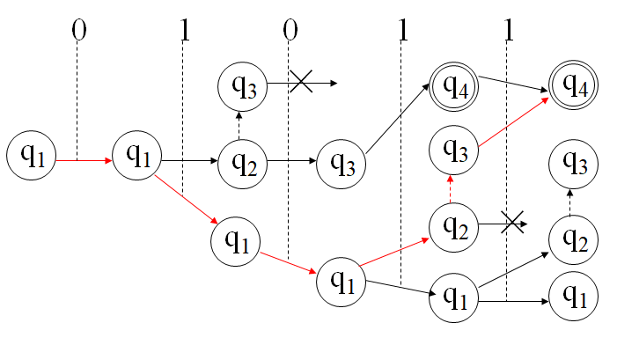
How to define computation of NFA
0,1
0,1
N
1
0,ε
1
q₁
q₂
q₃
q₄
How to define N accept w
two equivalent ways:
1. draw the whole tree, whether after computation ∃ copy in accept state
2. ∃ accept path
0
1
0
1
ε
1
q₁
q₁
q₁
q₁
q₂
q₃
q₄
Notes:
2.文章本天成，妙手偶得之

Slide 28
formal definition of computation of NFA
Let N=(Q,Σ,δ,q₀,F) be an NFA, w is a string over Σ,
we say that N accept w,
if we can write w as w=w₁w₂…w_{n}, w_{i}∈Σ_{ε}, and
there exists a sequence r₀,r₁,…,r_{n}∈Q, such that
1) r₀ = q₀;
2) r_{i+1}∈δ(r_{i}, w_{i+1});
3) r_{n} ∈F.
w₁
w₂
…
w_{n}
r₀
r₁
r₂
r_{n-1}
r_{n}

Slide 29
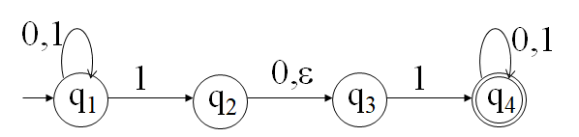
Examples: computation of NFA
We say that N accept w,
if we can write w as w=w₁w₂…w_{n}, w_{i}∈Σ_{ε}, and
there exists a sequence r₀,r₁,…,r_{n}∈Q, such that
1) r₀ = q₀;
2) r_{i+1}∈δ(r_{i}, w_{i+1});
3) r_{n} ∈F.
w₁
w₂
…
w_{n}
r₀
r₁
r₂
r_{n-1}
r_{n}
N
w = w₁w₂…w₆ = 0101ε1
(r₀,r₁,…,r₆) = (q₁,q₁,q₁,q₁,q₂,q₃,q₄)
0
1
0
1
ε
1
N accept 01011
q₁
q₁
q₁
q₁
q₂
q₃
q₄

Slide 30
Examples: computation of NFA
We say that N accept w,
if we can write w as w=w₁w₂…w_{n}, w_{i}∈Σ_{ε}, and
there exists a sequence r₀,r₁,…,r_{n}∈Q, such that
1) r₀ = q₀;
2) r_{i+1}∈δ(r_{i}, w_{i+1});
3) r_{n} ∈F.
N
0
1
0
Input
010
q₃
×
q₁
q₁
q₂
q₃
N reject 010
q₁
q₁

Slide 31
Design of NFA
reader as automata
look for key informations
Design NFAs for the following languages:
A={ w∈{0,1}* | w start from 1, end with 0 }
B={ w∈{0,1}* | w contain 1010 as sub-string }
C={ w∈{0,1}* | w contain a 1 at the second place from the right hand end }
D={ w∈{0,1}* | the binary w equals 1 module 3 }

Slide 32
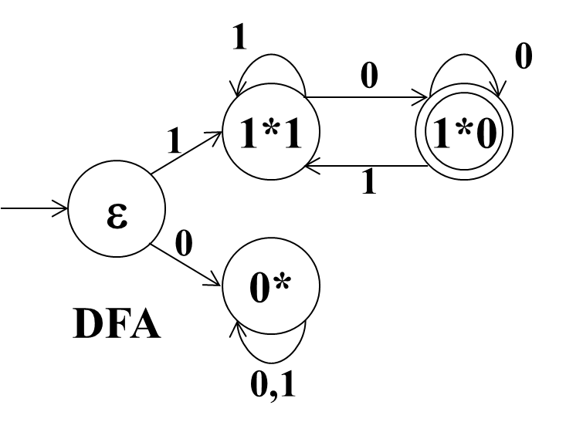
Design an NFA for A
A = { w∈{0,1}* | w start from 1, end with 0 }
Σ={0,1}, design states according to key information,
DFA: Empty(ε), Start From 0(0*),
Start From 1 End With 0(1*0), Start From 1 End With 1(1*0)
NFA: ε, 1*, 1*0.
0,1
ε
1
1*
0
1*0
NFA
Notes:
因为NFA可以并行地试探，所以在设计的过程中，只关注能接受的字符串的特点即可

Slide 33
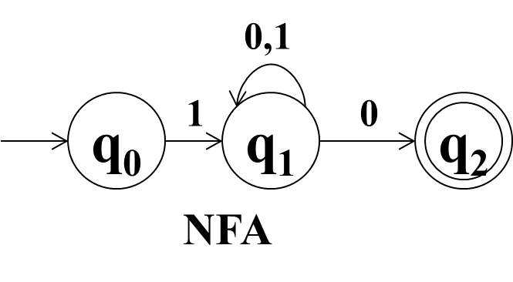
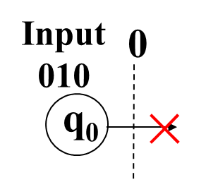
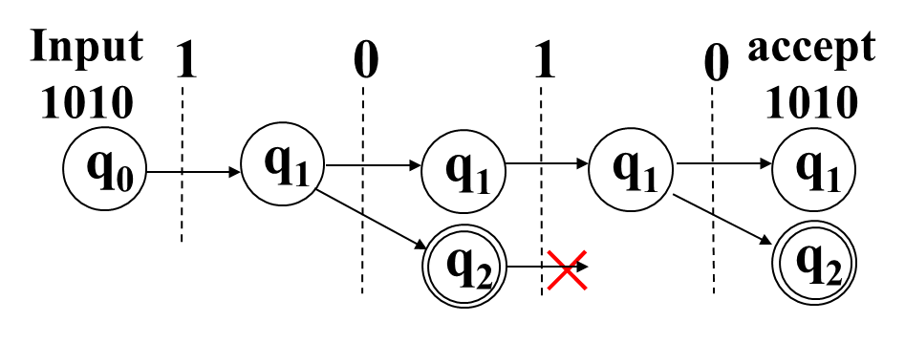
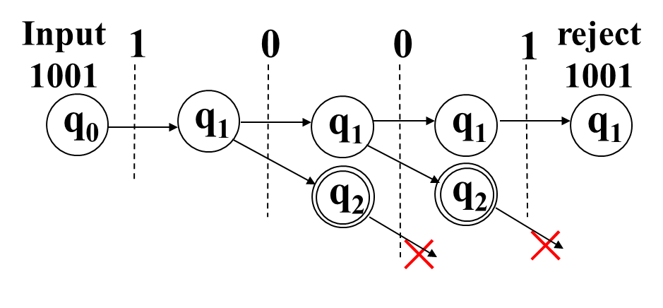
Understanding the NFA for A
A = { w∈{0,1}* | w start from 1, end with 0 }
States: (q₀, q₁, q₂) = (ε, 1*, 1*0)
1010
1001
010

Slide 34
Design an NFA for B
B = { w∈{0,1}* | w contain 1010 as sub-string }
Σ = {0,1}, key information: Ignore(ε), 1, 10, 101, 1010
0
0,1
0
1
1
0
1
0
ε
1
10
Ignore
1
10
1
1
1
0,1
1010
0
101
0,1
1010
0
101
DFA
NFA

Slide 35
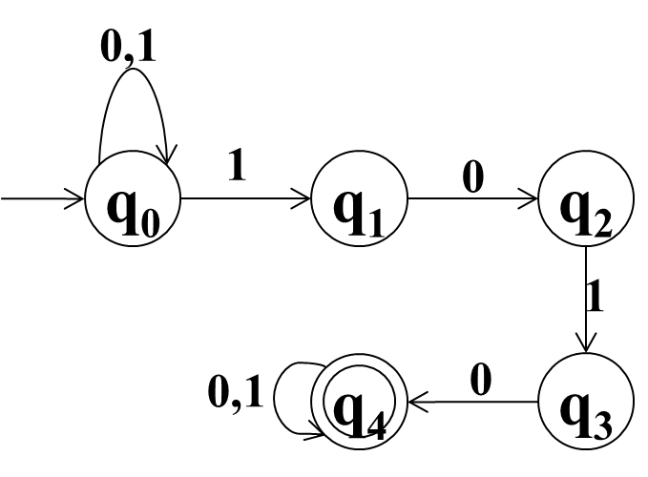
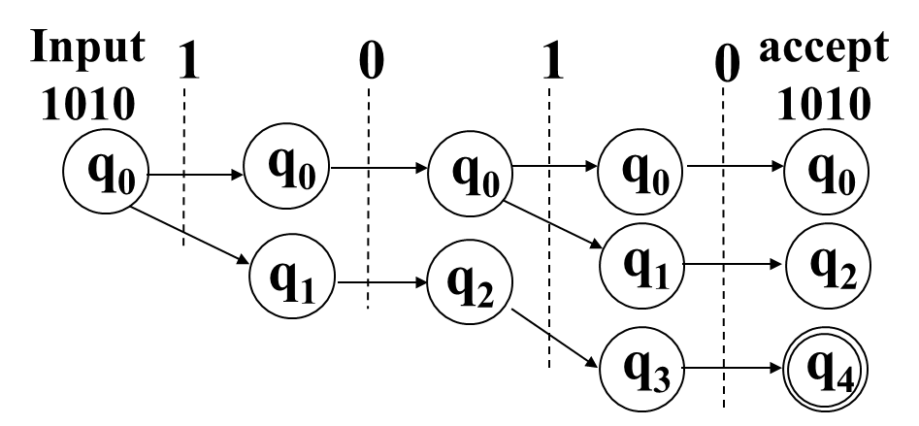
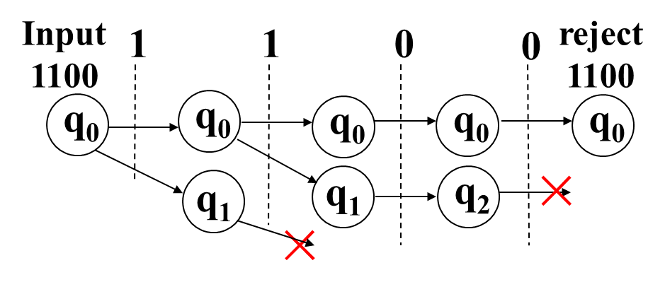
Understanding the NFA for B
B = { w∈{0,1}* | w contain 1010 as sub-string }
States: (q₀,q₁,q₂,q₃,q₄) = ( Ignore(ε), 1, 10, 101, 1010 )
1010
1100

Slide 36
Design an NFA for C
C={ w∈{0,1}* | w contain an 1 at the second place from the right hand end }
Σ={0,1}, DFA: ε, 1, 10, 11
NFA: Ignore(ε), 1, 1x,
0
0,1
0
1
1
0
1
ε
1
10
Ignore
1
0,1
1x
1
NFA
0
1
11
DFA

Slide 37
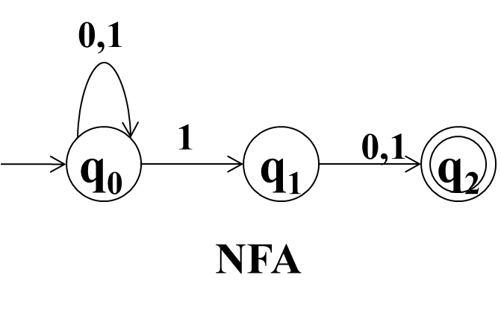
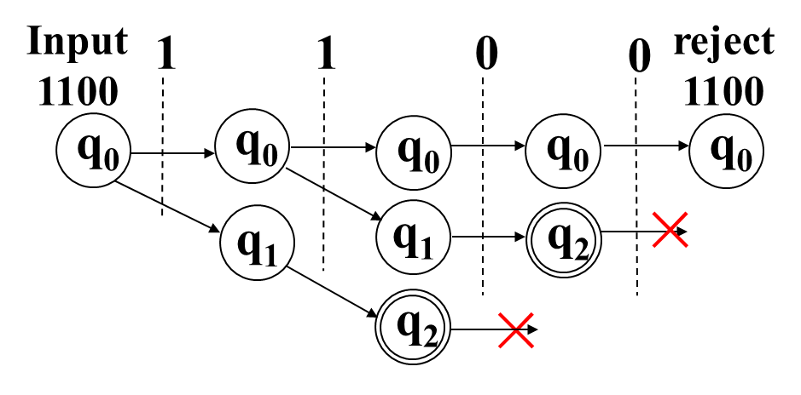
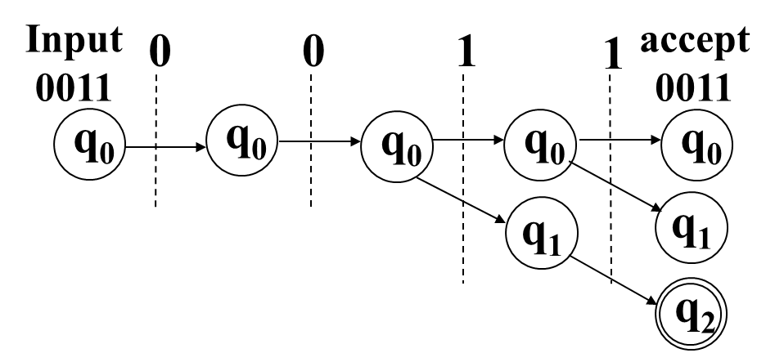
Understanding the NFA for C
C={ w∈{0,1}* | the next to last symbol of w is 1 }
States: (q₀,q₁,q₂) = (Ignore(ε), 1, 1x)
1100
0011

Slide 38
The equivalence of NFA and DFA
Def. Two machines are called equivalent, if their languages are equal.
Theorem: Every NFA has an equivalent DFA.
Note: Every DFA can be seen as an NFA.
The theorem implies that NFAs and DFAs have same ability.
The theorem implies that the language of each NFA is also regular language.
To prove the theorem, we need to design DFA.

Slide 39
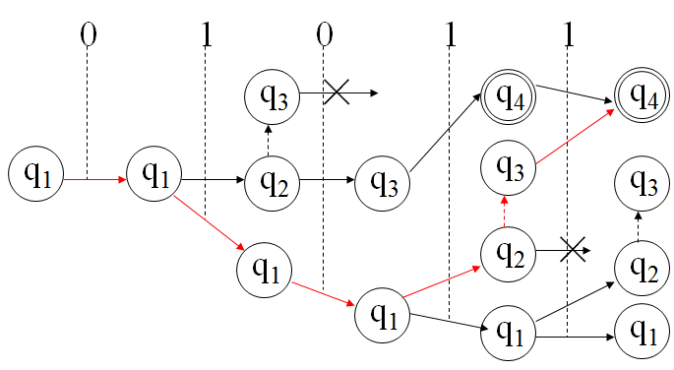
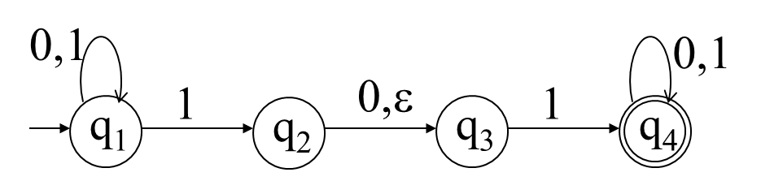
Design an equivalent DFA for N
N
to construct an equivalent DFA, we need to look for determinacy
NFA is nondeterministic:
if read 1 at state q₁, which state of {q₁,q₂,q₃} do we take?
deterministic:
if read 1 at state q₁, it will split into 3 state copies:q₁,q₂,q₃.
further deterministic:
for a set of states, if we read a symbol,
it will split into a fixed set of states.
key information: sets of states
start state? accept states? transition function?

Slide 40
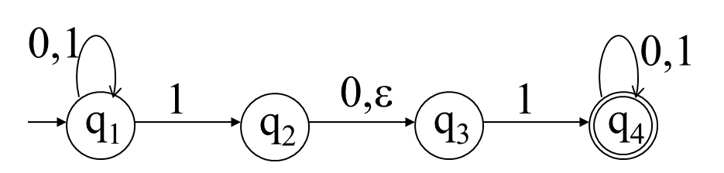
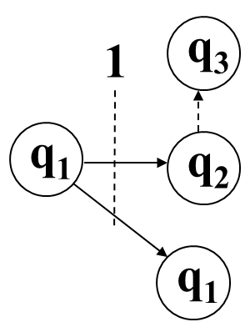
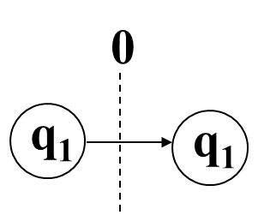
Every NFA has an equivalent DFA
N=(Q₁, Σ, δ₁, q₁, {q₄})
Construct a DFA
M=(Q, Σ, δ, s, F)
key information: sets of states
Take S₁={q₁}.
S₁--0--S₁--1--S₂
Q = { S₁,S₂, … },
s = S₁,
δ(S₁,0) = S₁, δ(S₁,1) = S₂,
Let S₂={q₁,q₂,q₃}. We have
δ(S₁,0) = S₁, δ(S₁,1) = S₂,

Slide 41
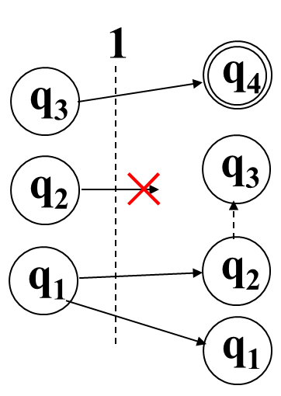
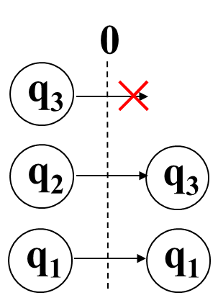
Every NFA has an equivalent DFA
N=(Q₁, Σ, δ₁, q₁, {q₄})
key information: sets of states
S₁={q₁}, S₂={q₁,q₂,q₃}, s = S₁,
δ(S₁,0) = S₁, δ(S₁,1) = S₂,
S₁--0--S₁--1--S₂--0--S₃--1--S₄--1--S₄
Let S₃={q₁,q₃}, S₄={q₁,q₂,q₃,q₄}. We have
δ(S₂,0) = S₃, δ(S₂,1) = S₄, and S₄ should be an accept state

Slide 42
Every NFA has an equivalent DFA
key information: sets of states
S₁--0--S₁--1--S₂--0--S₃--1--S₄--1--S₄ accept
new states | δ | 0 | 1
S₁ | {q₁} | {q₁}S₁ | {q₁, q₂, q₃}S₂
S₂ | {q₁, q₂, q₃} | {q₁, q₃}S₃ | {q₁, q₂, q₃, q₄}S₄
S₃ | {q₁, q₃} | {q₁}S₁ | {q₁, q₂, q₃, q₄}S₄
S₄ | {q₁, q₂, q₃, q₄} | {q₁, q₃, q₄}S₅ | {q₁, q₂, q₃, q₄}S₄
S₅ | {q₁, q₃, q₄} | {q₁, q₄}S₆ | {q₁, q₂, q₃, q₄}S₄
S₆ | {q₁, q₄} | {q₁, q₄}S₆ | {q₁, q₂, q₃, q₄}S₄
Notes:
How to define states in general case? How to define transition function in general case?

Slide 43
Every NFA has an equivalent DFA
Pf: Let N = (Q₁, Σ, δ₁,s₁,F₁) be an NFA. Define
Q = P(Q₁), //all subset of Q₁
F = { A ∈ Q : F₁ ∩ A ≠ ∅ },
s = E({s₁}), E(R)={q : q can reached from R by traveling 0 or more ε arrows}
δ: Q×Σ→Q, ∀a∈Σ, ∀A∈Q,
δ( A, a ) = E( ∪_{r∈A} δ₁(r,a) )
Let M = (Q,Σ,δ,s,F).
then ∀x ( x∈L(M) ↔ x∈L(N) ),
such that L(M) = L(N).
δ({q₁, q₃},1)
= E({q₁, q₂, q₄})
= {q₁, q₂, q₃, q₄}

Slide 44
∀x ( x∈L(M) ↔ x∈L(N) )
0,1
NFA N:
0,1
DFA M:
S₁={q₁}, S₂={q₁,q₂,q₃},
S₃={q₁,q₃}, S₄={q₁,q₂,q₃,q₄}.
δ(S₁,0) = S₁, δ(S₁,1) = S₂,
δ(S₂,0) = S₃, δ(S₃,1) = S₄, δ(S₄,1) = S₄
1
0,ε
1
q₁
q₂
q₃
q₄
0
1
0
1
1
q₃
×
q₄
q₄
q₁
q₁
q₃
q₂
q₃
q₃
N accept w
q₂
×
q₁
q₂
q₁
q₁
q₁
S₁--0--S₁--1--S₂--0--S₃--1--S₄--1--S₄ M accept w

Slide 45
closure under regular operations
Theorem: The class of regular languages
is closed under regular operations, i.e.,
if A,B are regular, then
A∪B, A°B and A* are regular.

Slide 46
A,B regular ⇒ A∪B regular
A regular ⇒ ∃ DFA: M₁=(Q₁,Σ,δ₁,s₁,F₁), L(M₁)=A
B regular ⇒ ∃ DFA: M₂=(Q₂,Σ,δ₂,s₂,F₂), L(M₂)=B,
Construct an NFA M.
We have L(M) = A ∪ B.
Hence, A∪B regular
ε
s
ε
M
s₁
s₂
s₁
s₂
M₁
M₂
M₁
M₂

Slide 47
A,B regular ⇒ A°B regular
A regular ⇒ ∃ DFA: M₁=(Q₁,Σ,δ₁,s₁,F₁), L(M₁)=A
B regular ⇒ ∃ DFA: M₂=(Q₂,Σ,δ₂,s₂,F₂), L(M₂)=B,
Construct an NFA M.
We have L(M) = A ° B.
Hence, A ° B regular
M
ε
s₁
s₂
s₁
s₂
ε
M₁
M₂
M₁
M₂

Slide 48
A regular ⇒ A* regular
A regular ⇒ ∃ DFA: M₁=(Q₁,Σ,δ₁,s₁,F₁), L(M₁)=A,
Construct an NFA M.
We have L(M) = A* = { x₁x₂...x_{k} | k≥0, x_{i}∈A }
Hence A* is regular.
M
ε
s₁
ε
s
s₁
M₁
ε
M₁

Slide 49
Chapter 1 Finite automata
1. deterministic finite automata
2. non-deterministic finite automata
3. regular expression
4. pumping lemma of regular languages

Slide 50
Regular Expression(RE)
Def: Say that R is a regular expression, if R is
1) a, a∈Σ ; 2) ε ; 3) ∅ ;
4) (R₁∪R₂), where R₁ and R₂ is RE;
5) (R₁°R₂), where R₁ and R₂ is RE;
6) (R₁*), where R₁ is RE;
This is an inductive definition.
Every RE represent a language, write L(R).
1) L(a)={a}. 2) L(ε)={ε}. 3) L(∅)= ∅
4) L((R₁∪R₂))=L(R₁)∪L(R₂).
5) L((R₁°R₂))=L(R₁)°L(R₂). 6) L((R₁*))=(L(R₁))*
Notes:
6）重复多次的正则表达式也是正则表达式

Slide 51
Examples: Regular Expression(RE)
0*10* = ((0*)°1)°(0*)) is a regular expression
L(0*10*) = {w∈{0,1}*| w contain a single 1 }
01∪10 is a RE,
L(01∪10) = { 01, 10 }
(ΣΣ)* is a RE,
L((ΣΣ)*) = {w∈{0,1}*| |w| is even }
1*∅ is a RE,
L(1*∅) = L(1*)°L(∅) = L(1*)°∅ = ∅.
∅* is a RE,
L(∅*) = {ε}.
Notes:
∅对应的自动机不接受任何字符串

Slide 52
Equivalence of RE and DFA
Theorem: A regular ⇔ A has a RE.
(⇐) if A has a Regular Expression, then A is regular. (easy to prove)
(⇒) if A is regular, then A has a RE.
(difficult to prove, omit)

Slide 53
A has a RE ⇒ A is regular
by mathematical induction
by definition, R is a RE , if R is
1) a, a∈Σ
2) ε
3) ∅
4) (R₁∪R₂)
5) (R₁°R₂)
6) (R₁*)
a

Slide 54
A regular ⇒ A has a RE
Generalized Nondeterministic Finite Automaton
Nondeterministic Finite Automaton
arrows are labeled with a Regular Expression
reading a block of symbols described by the RE
Some require in proof:
the start state has no coming arrows.
a single accept state, no outgoing arrows.
Method: delete middle states one by one.

Slide 55
delete a middle state from a pair of states
Let q_{rip} be the state that we want to delete,
we need to modify label for any pair of states q_{i}, q_{j}.
new label: a RE that describes all strings that would
take the machine from q_{i} to q_{j} either directly or via q_{rip}.
R₄
q_{i}
q_{j}
R₁
R₃
(R₁)(R₂)*(R₃)∪(R₄)
q_{rip}
q_{i}
q_{j}
R₂

Slide 56
Example: A regular ⇒ A has a RE
delete state 1
aa∪b
b
b
a
ε
a
a
1
2
s
1
2
s
2
a
a
b
b
b
ab
ε
b
a
b
a
ε
add a start state s
add a new accept state ac
ba∪a
ε
ε
3
3
ac
3
ac
bb
delete 1 from (s,2)
delete 1 from (2,2)
delete 1 from (2,ac)
∅
b
ε
s
2
2
2
2
ac
ε
a
a
a
a
∅
1
1
1
∅
∅
∅
∅ ∪ (ε∅*a) = a
b∪(a∅*a)=b∪aa
ε∪ (a∅*∅) = ε

Slide 57
Example: A regular ⇒ A has a RE
delete state 1
aa∪b
b
b
a
ε
a
a
1
2
s
1
2
s
2
a
a
b
b
b
ab
ε
b
a
b
a
ε
add a start state s
add a new accept state ac
ba∪a
ε
ε
3
3
ac
3
ac
bb
delete state 2
a(aa∪b)*
s
ac
delete state 3
(ba∪a)(aa∪b)* ∪ ε
( (a(aa∪b)*ab∪b)((ba∪a)(aa∪b)*ab ∪ bb)*
((ba∪a)(aa∪b)*∪ε) ) ∪ ( a(aa∪b)*)
a(aa∪b)*ab∪b
3
s
ac
(ba∪a)(aa∪b)*ab ∪ bb

Slide 58
Chapter 1 Finite automata
1. deterministic finite automata
2. non-deterministic finite automata
3. regular expression
4. pumping lemma of regular languages

Slide 59
non regular languages
Which of the following are non regular?
B = { 0^{n}1^{n} | n≥0 }
C = { ww | w is a 01 string }
D = { w | w has equal number of occurrences
of 01 and 10 as substrings }
= { w | w start from 0 and end with 0, or,
w start from 1 and end with 1 }
E = { 1^{k} | k=2^{n}, n≥0 }

Slide 60
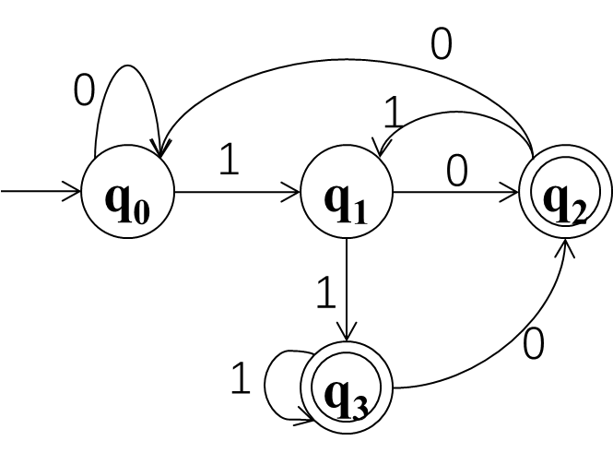
Pumping lemma
Thm: If A is regular, then ∃p>0 such that
∀w∈A, |w|≥p, ∃ partition w=xyz satisfies
1) ∀ i ≥ 0, xy^{i}z ∈ A;
2) |y|>0; 3) |xy|≤p.
11011: q₀-1-q₁-1-q₃-0-q₂-1-q₁-1-q₃-accept
11011 : q₀-1-q₁-101-q₁ -1-q₃-accept
1(101)^{i}1: q₀-1-q₁-(101)^{i}-q₁-1-q₃-accept
11011=xyz, x=1, y=101, z=1. ∀ i ≥ 0, xy^{i}z can be accepted
p=4, w=11011, x=1, y=101, z=1, 1), 2), 3) holds
A regular⇒∃DFA M,L(M)=A. Let M has p states.
∀w∈A with |w|≥p, by pigeonhole principle,
there are repeat states in the previous p+1 states.
Notes:
任何有穷语言都是正则语言（可以用有限个状态的自动机识别），如果一个无穷集合的语言是正则的（能用有限自动机识别），一定存在很长的字符串，长到用自动机识别这个字符串的时候会重复经历某些状态，这个状态被重复经历时所经过的子串被重复若干次或被删掉得到的新字符串也可以被这个自动机所识别
pigeonhole principle鸽巢原理；识别长度为p的字符串需要p+1个状态

Slide 61
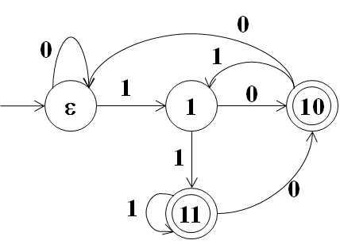
Proof of Pumping lemma
Thm: If A is regular, then ∃p>0 such that
∀w∈A, |w|≥p, ∃ partition w=xyz satisfies
1) ∀k ≥ 0, xy^{k}z ∈ A;
2) |y|>0; 3) |xy|≤p.
Pf: Let DFA M=(Q,Σ,δ,s,F). L(M)=A and p=|Q|,
if w = w₁w₂…w_{n}∈A, w_{i}∈Σ, and n≥p, then
w₁
w₂
…
w_{n}
by Pegionhole
∃i<j≤p, r_{i}=r_{j}.
s=r₀
r₁
r₂
r_{n-1}
r_{n}∈F
Let x=w₁…w_{i}, y=w_{i+1}…w_{j}, z=w_{j+1}…w_{n}.
x
y
z
s=r₀
r_{i}
r_{i}
r_{n}∈F
∀k≥0, xy^{k}z∈A
x
z
x
y
…
y
z
r₀
r_{i}
r_{n}
r₀
r_{i}
r_{i}
r_{i}
r_{i}
r_{n}
Notes:
剪切粘贴技术

Slide 62
equivalent statement of pumping lemma
Thm: If A is regular, then ∃p>0 such that
∀w∈A, |w|≥p, ∃ partition w=xyz satisfies
1) ∀ i ≥ 0, xy^{i}z ∈ A;
2) |y|>0;
3) |xy|≤p.
0
0
1
1
0
ε
1
10
if A is regular,
then ∃p>0
∀w∈A(|w|≥p)
∃x,y,z(|y|>0, |xy|≤p, w=xyz)
∀i≥0,
xy^{i}z ∈ A.
1
0
1
11

Slide 63
equivalent statement of pumping lemma
Thm: If A is regular, then ∃p>0 such that
∀w∈A, |w|≥p, ∃ partition w=xyz satisfies
1) ∀ i ≥ 0, xy^{i}z ∈ A;
2) |y|>0;
3) |xy|≤p.
Contrapositive:
if ∀p>0
∃w∈A(|w|≥p)
∀x,y,z(|y|>0, |xy|≤p, w=xyz)
∃i≥0,
xy^{i}z ∉ A.
then A is not regular
if A is regular,
then ∃p>0
∀w∈A(|w|≥p)
∃x,y,z(|y|>0, |xy|≤p, w=xyz)
∀i≥0,
xy^{i}z ∈ A.

Slide 64
B = { 0^{n}1^{n} | n≥0 } nonregular
∵ ∀p>0,
let w=0^{p}1^{p},
∀x,y,z(|y|>0, |xy|≤p, w=xyz)
let i=0,
xz = 0^{p-|y|}1^{p} ∉ B
∴ B is not regular
if ∀p>0
∃w∈A(|w|≥p)
∀x,y,z(|y|>0, |xy|≤p, w=xyz)
∃i≥0,
xy^{i}z ∉ A.
then A is not regular
Notes:
|xy|不超过p，所以y只能是由0构成的串

Slide 65
C = { ww | w∈{0,1}* } nonregular
∵ ∀p>0,
let w=0^{p}10^{p}1,
∀x,y,z(|y|>0, |xy|≤p, w=xyz)
let i=0,
xz = 0^{p-|y|}10^{p}1 ∉ C
∴ C is not regular
if ∀p>0
∃w∈A(|w|≥p)
∀x,y,z(|y|>0, |xy|≤p, w=xyz)
∃i≥0,
xy^{i}z ∉ A.
then A is not regular

Slide 66
E = { 1^{k} | k=2^{n}, n≥0 } nonregular
∵ ∀p>0,
let w=1^{k}, k=2^{p+1},
∀x,y,z(|y|>0, |xy|≤p, w=xyz)
let i=2,
2^{p+1}<|xy²z|=k+|y|<2^{p+2},
i.e., xy²z ∉ E
∴ E is not regular
if ∀p>0
∃w∈A(|w|≥p)
∀x,y,z(|y|>0, |xy|≤p, w=xyz)
∃i≥0,
xy^{i}z ∉ A.
then A is not regular
Notes:
长度是完全平方数的字符串集合，|y|<|w|=2^(p+1)

Slide 67
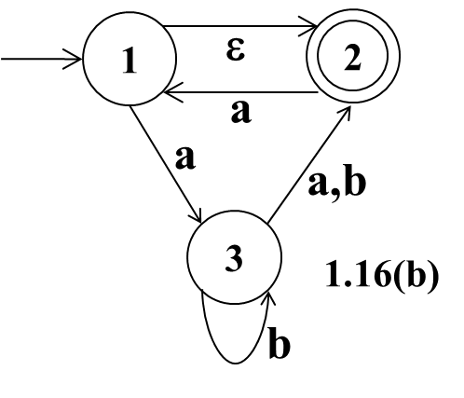
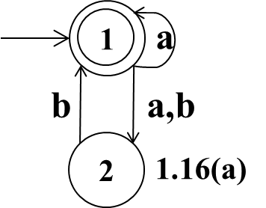
Exercises
1.7. Give state diagrams of NFAs with the specified number of states recognizing each of the following languages. In all parts, the alphabet is {0,1}.
c. The language {w| w contains an even number of 0s, or contains exactly two 1s} with six states
d. The language {0} with two states
e. The language 0*1*0*0 with 3 states
1.16 Use the construction given in Theorem 1.39 to convert the following two nondeterministic finite automata to equivalent deterministic finite automata.
1.29 Use the pumping lemma to show that the following languages are not regular.
a. A₁ = {0^{n}1^{n}2^{n}| n ≥ 0}.
b. A₂ = { www | w∈{a,b}* }.

