Slide 1
EZParking
Where Parking Spots Are Found

Slide 2
Pain Points
Finding a parking spots has been a big challenge in NYC
Lack of information on real-time available parking spots
No existing apps for users to share information

Slide 3
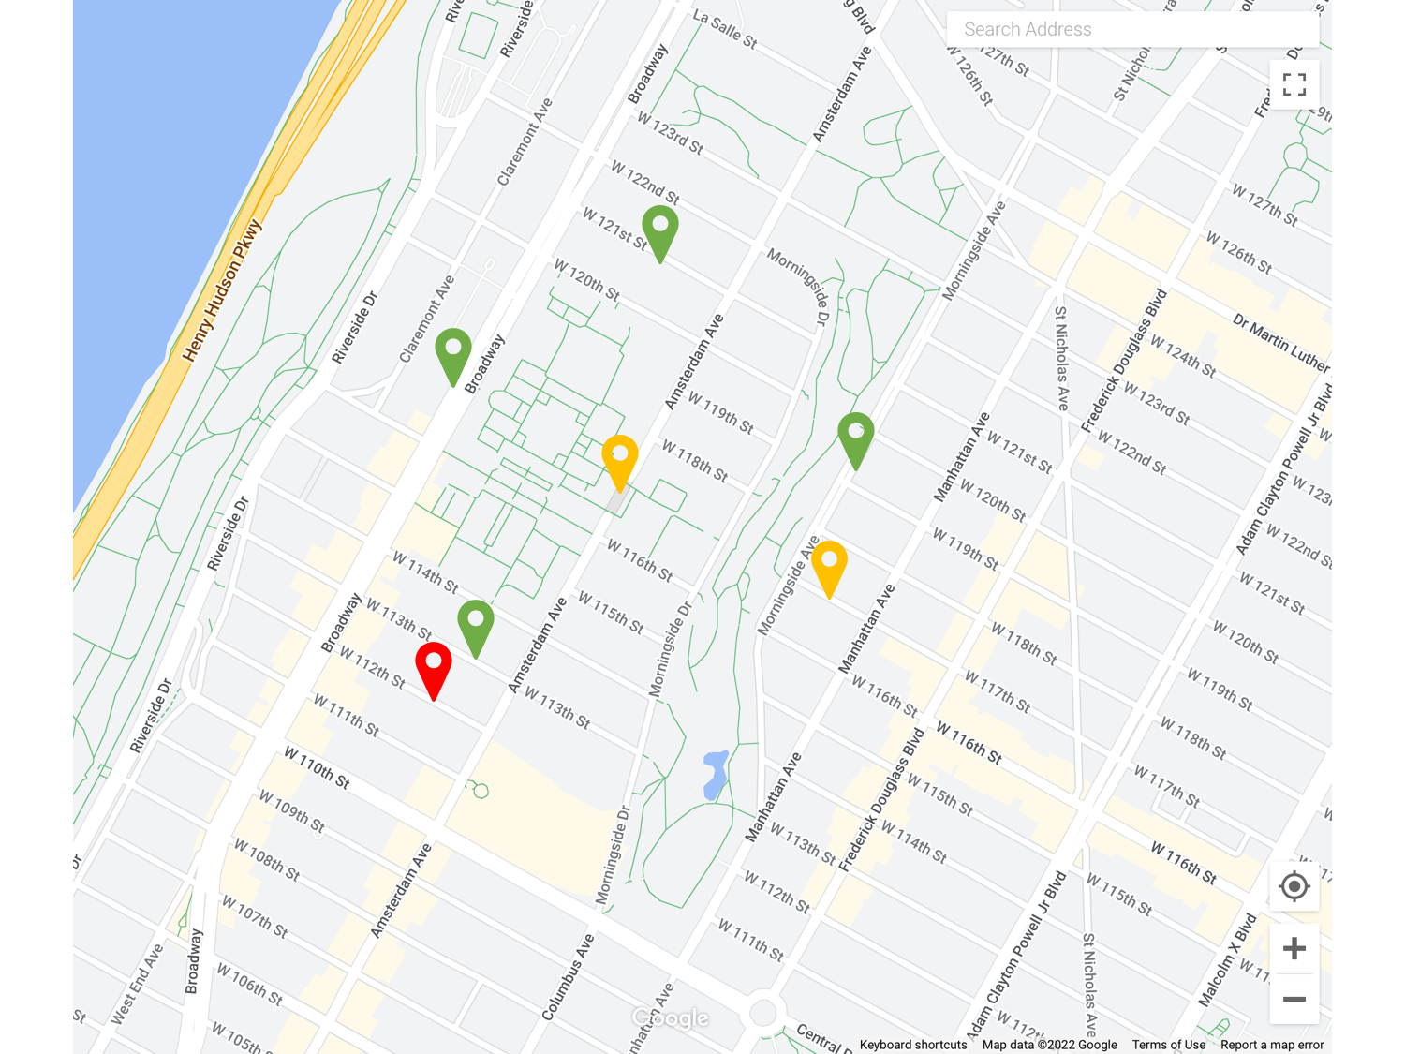
What our Saas Does
Form a community for users share location and time when about to leave
Notify users in the corresponding areas when the spots are available
Display information of parking spots
Location
Time of availability
# of people going

Slide 4

Unique Points
SpotAngels
Gathers historical parking data to infer available spots
Predictions often inaccurate
EZParking
Provides real-time available parking spots shared by users
Based on the fact instead of inference

