Slide 1



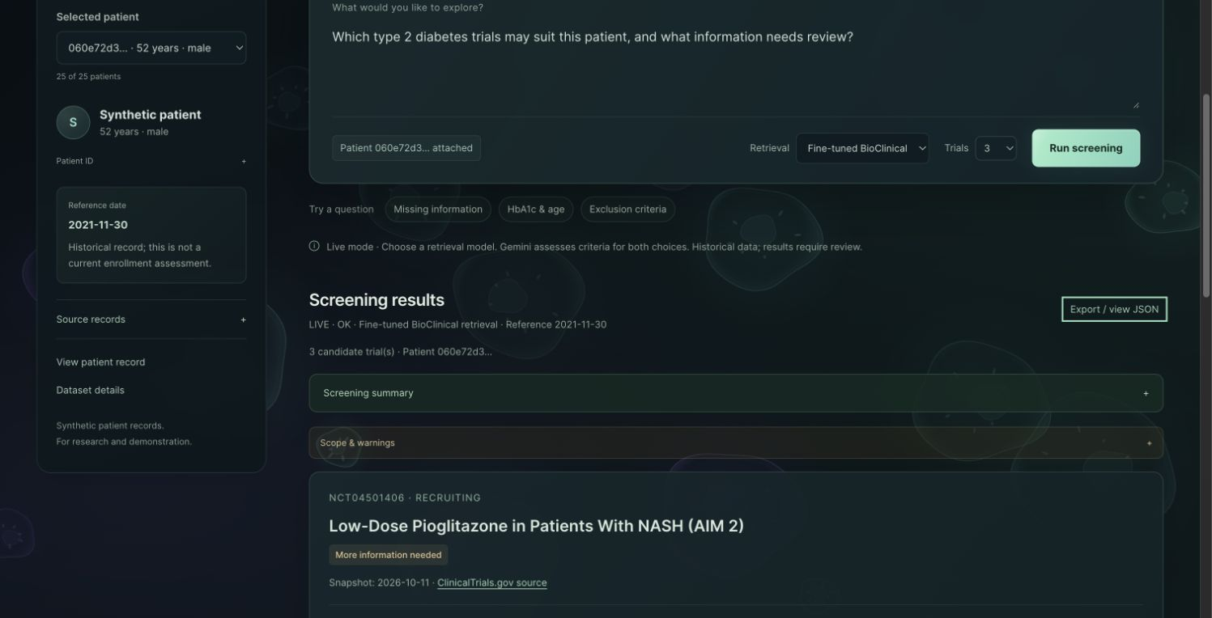


TEAM ORANGE CHICKEN
TrialMatch
Explainable clinical trial
pre-screening
AC215 Milestone 3
An evidence-based shortlist for human review
Jiaxi Liu · Xuyang Sun · Jenny Yang · Yixiao Chen · Mengze Zhao

Slide 2
The screening problem
Which trials may fit this patient?
A synthetic patient
What do we still need to check?
52 years · male
Type 2 diabetes
Dated health records
TrialMatch finds candidates and explains
the evidence behind each criterion.
Reference: 2021-11-30
A shortlist for human review—not a final enrollment decision.
02

Slide 3
Traceable data
ClinicalTrials.gov
Synthea · FHIR R4
1,313 trials
18,456 eligibility criteria
25 synthetic patients
Dated diagnoses, labs and prescriptions
“Aged 21 to 75 years.”
Age: 52 years
NCT04501406 · inc_002
Patient record · 2021-11-30
Trial ID + original wording
Source ID + date + units
Demo scope: 50 fixed trials + 25 patients. Ambiguous criteria stay ambiguous.
03

Slide 4
The TrialMatch workflow
1. Choose
2. Retrieve
3. Assess
4. Review
Patient +
question
Candidate
trials
Individual
criteria
Evidence +
missing facts
A candidate trial still needs criterion-by-criterion review.
04

Slide 5
Retrieval and criterion assessment
Find candidate trials
BM25
Vector search
RRF
+
Keywords
Gemini or fine-tuned encoder
Reciprocal rank fusion
Check each criterion
Rule checks
Selected patient facts
Evidence checks
Known values and codes
Gemini assesses open criteria
Missing support: UNKNOWN
Both retrieval choices use Gemini for criterion assessment.
05

Slide 6
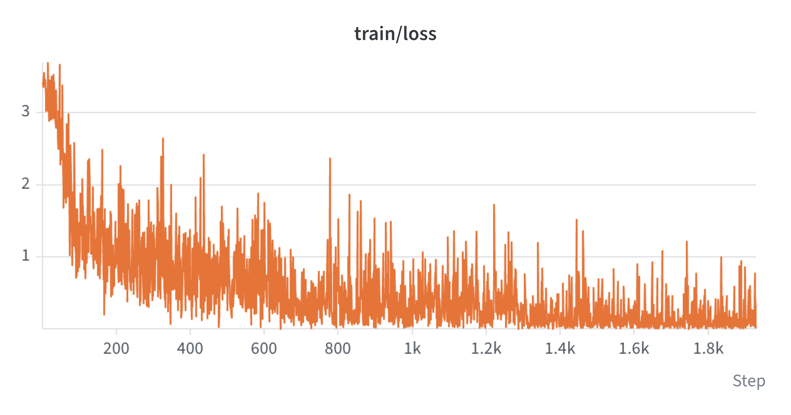
Encoder training
Learn which trial criteria are relevant to a question.
BioClinical-
ModernBERT
5,137 training pairs
476 validation pairs
3 epochs · 1 T4
Vertex AI + W&B
Contrastive learning on
query–criterion pairs
Training queries are generated. All 50 benchmark trials were excluded from training.
06

Slide 7
Cloud architecture
Chroma · VM
Vectors + persistent data
Cloud Run
Browser
Web page + API
Trained encoder
Matching workflow
Gemini · Vertex AI
Public web app
Embedding / assessment
Cloud Storage
Versioned data + models
Independent images keep each service’s code and dependencies separate.
Each service has its own Dockerfile and uv.lock. Deploying changed code requires a rebuild.
07

Slide 8
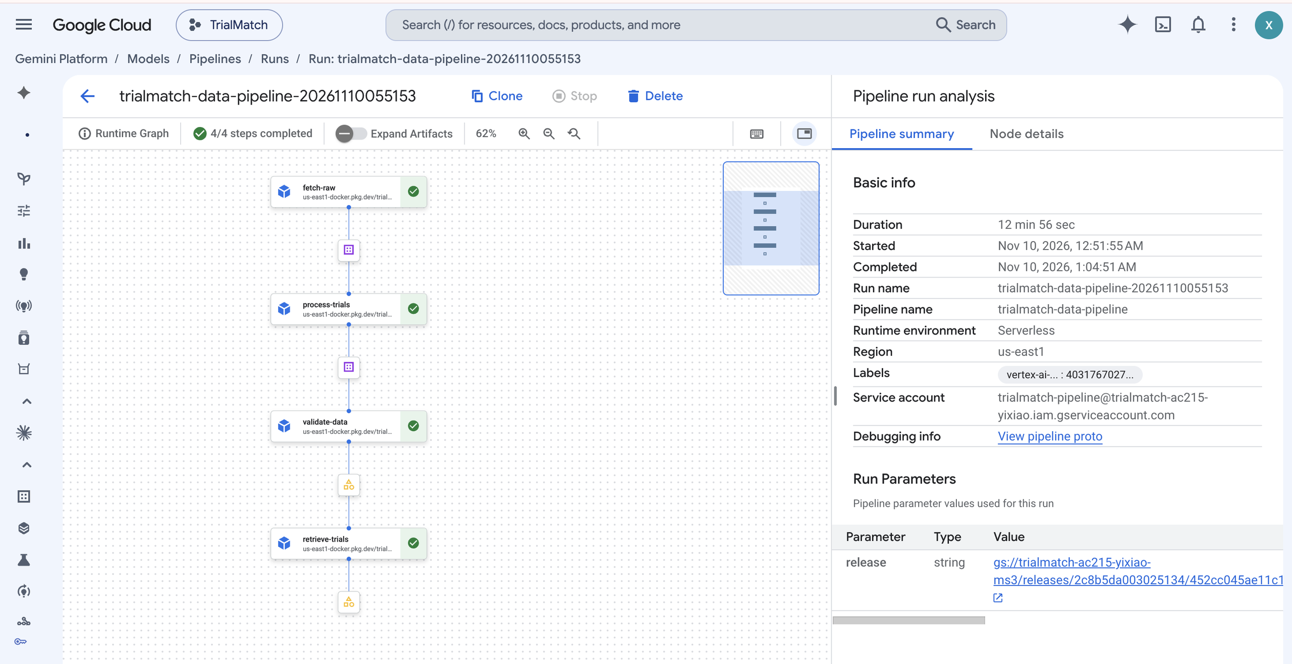
A repeatable data pipeline
Load snapshot
Process trials
Validate
Retrieve
Fixed data versions
DVC selects the same snapshot.
Checks before retrieval
A changed checksum blocks the job.
Reusable cloud outputs
Processed files and rankings in GCS.
The evaluated encoder comes from
a separate Vertex AI training job.
08

Slide 9
Retrieval quality
P@3
nDCG@5
Fine-tuning improves
the frozen baseline.
BM25 leads on
ranking quality.
P@3: top-3 precision
nDCG@5: top-5 ranking quality
6 reporting queries · 50 trials · 182 pooled judgments
Question-only results; patient-aware variants were weaker.
09

Slide 10
Criterion-level evaluation
Many criteria still need more evidence or review.
8 patient–trial pairs
Of 33 definite reference labels:
115 criteria evaluated
8 → correct definite decisions
78.3% overall agreement
25 → returned UNKNOWN
82 reference labels
were already UNKNOWN.
Evidence selection and guard rules need work.
Exploratory, non-clinician review; clinical accuracy is not established.
10

Slide 11
Live demo
Example output
3 candidate trials
Evidence by criterion
Age 21–75
52 years → MET
Missing facts
→ UNKNOWN
Open demo
Choose Gemini or the trained encoder for retrieval; Gemini assesses criteria in both paths.
11

Slide 12
API and monitoring
POST /screen
Response
Cloud Logging
Patient + question
+ retrieval choice
Decisions + evidence
+ request ID
Status + latency
+ model use / errors
Trace a screening request
API checks
Match its request ID with Cloud Logging.
Health and data readiness
Valid and invalid inputs
Model/index failures
Patient text stays out of application events.
HTTP 200 can still contain partial assessments or UNKNOWN criteria.
12

Slide 13
What works, and what comes next
Available today
Next steps
Traceable trial and patient data
Trained encoder in the cloud app
Evidence for each criterion
Automated cloud workflow
Evaluate new rankings
Refine evidence selection
Add independent human review
Expanded pipeline evaluation
needs new relevance labels.
Find candidates. Show evidence. Keep people in the decision.
Template artwork: Slidesgo / Freepik
13

