Slide 1
BtrFS
The Next Generation Linux File System

Slide 2
What is BtrFS
“Btrfs is a new copy on write filesystem for Linux aimed at implementing advanced features while focusing on fault tolerance, repair, and easy administration”
BtrFS uses a b-tree derivative optimized for copy-on-write and concurrency created by IBM researcher Ohad Rodeh for every layer of the file system

Slide 3
Significance of BtrFS
BtrFS is the future of Linux file systems
Since Linux is a popular database and server platform the development of BtrFS is poised to have a hugh impact on the market space
Ted T’So, principle developer of standard Linux FSs ext3 and ext4, sees the new ext4 as a “short-term solution” and believes that BtrFS is the way forward.

Slide 4
Definitions
Copy-on-write (COW): data is copied when it is written to add redundancy; also called shadowing
Inode: data structure used to store basic information about a file system component
Extent: a contiguous block of allocated storage
Checksum: a hash value used to check the integrity of stored data
Snapshot: a copy of the file system taken at a certain point in time; also called a clone

Slide 5
Rodeh’s Research
Remove links between leaf nodes in a b+-tree so that the entire tree does not have to be copied during copy-on-write
Provide a way to perform COW
Support a large number of clones efficiently

Slide 6
Rodeh’s Research: COW
Enable COW by “shadowing”:
each change to a page is performed on a copy of the page in memory and a log of each operation is kept on disk
Occasionally perform a checkpoint and write all changed pages to disk in one batch
If a crash occurs before a checkpoint is performed, the operations stored in the long are performed to update the data

Slide 7
Rodeh’s Research: Clones
“To clone a b-tree means to create a writable copy of it that allows all operations: lookup, insert, remove, and delete.”
Desirable properties:
Space efficiency: sharing of common pages
Speed: clone creation should be fast
Number of clones: a large number of clones should be supported
Clones as first class citizens: a clone can in turn be cloned

Slide 8
Rodeh’s Research: Clones II
Main idea: avoid large free-space maps and entire tree traversal during cloning by assigning each block a reference counter
The counter tracks the number of times the block is referenced
If the block is referenced zero times, it is free space
Updating the block reference counter is done “lazily” to improve speed

Slide 9
Rodeh’s Research: Clones III
Create a clone of a tree by copying its root node and incrementing the reference counter of the root’s children
When new data is written to a node, the parent node it is accessed through is noted and when the changes are written to disk they are placed in a new block and all affected block reference counters are updated

Slide 10
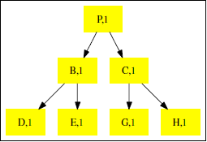
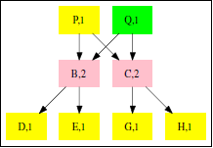
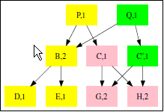
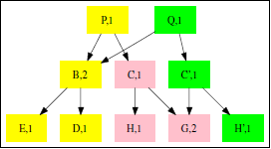
Rodeh’s Research: Clones IV
Notes:
P is cloned
C is updated through the clone
Updated c is copied to a new block c’, whose ref counter is set to 1
Original c ref counter is decremented
C’s children node reference counters are incremented
H is updated through the clone
Updated h is copied to a new block h’, whose ref counter is set to 1
Original h ref counter is decremented

Slide 11
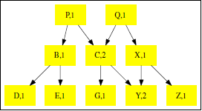
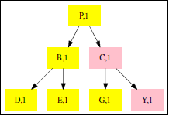
Rodeh’s Research: Clones V
Delete a clone
Reference counter > 1: decrement the reference counter and stop downward traversal because the node is also part of another tree
Reference counter = 1: continue downward traversal and on the way back up the root node deallocate the space because it only belongs to the tree being deleted

Slide 12
Beginning of BtrFS
In 2007, Chris Mason, a former ReiserFS developer at SUSE who had recently moved to Oracle, was given the opportunity to design and create a next-generation Linux file system
After seeing Rodeh’s research presentation at USENIX FAST ‘07, Mason had the idea to create “everything in the file system—inodes, file data, directory entries, bitmaps, the works—[as] an item in a copy-on-write b-tree”

Slide 13
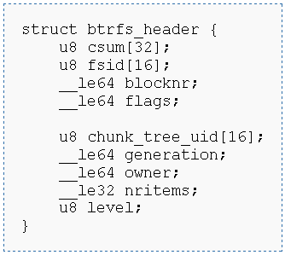
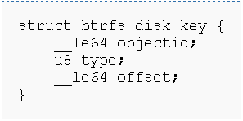
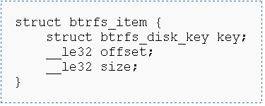
Design of BtrFS
There are only 3 basic on-disk structures: block-headers, keys, and items
Notes:
Since the dynamically allocated objectid is the MSBs of the key, all of the items for the object are logically grouped together within the tree
Type being the second part of the key allows for related data to automatically be grouped together
Offset indicates the byte offset of the particular item within the object

Slide 14
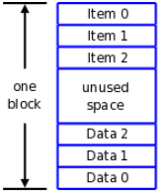
Design of BtrFS II
Interior tree nodes consist only of <key, block pointer> pairs, just like a normal b+-tree
The tree leaves are extents that contain both items and item data in space efficient storage
Each leaf may hold any type of data, each kind of which has its own unique type id
Notes:
The items and their data grow towards each other until the leaf is full
The item offset and size variables refer to the offset and size of its corresponding data
If a file is small enough, it may be stored in the tree in the data section of the extent
Larger files are allocated to free extents and pointed to in the data sections

Slide 15
Design of BtrFS III
As mentioned, the COW b-tree is used to represent everything in the file system
3 main file system trees
Tree of tree roots
Tree of allocated extents
Tree of directory items

Slide 16
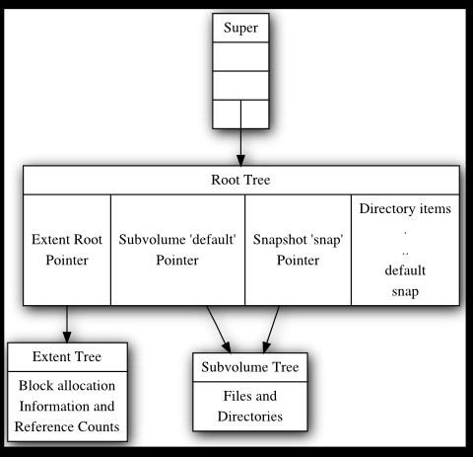
Design of BtrFS IV

Slide 17
Design of BtrFS V
Extent Tree
Where extent reference counting takes place
Keeps track of available extents for new data
Extents are divided into block groups so that certain kinds of data can be specified to be allocated to certain kinds of groups
Policies may also be defined for the sections of the disk that each extent tree owns
Allows fine-grained control of RAID functionality
Allows physical consolidation of data

Slide 18
Design of BtrFS VI
Directories
Allow for the lookup of specific data
2 types in BtrFS
File name lookup
Contains a hash of the file name
Currently uses crc32c hashing; may be expanded later
Inode number order
Closely resembles the order of the blocks on the disk
Provides better performance for reading data in bulk

Slide 19
BtrFS Features
“The main Btrfs features include:
Extent based file storage (2^64 max file size)
Space efficient packing of small files
Space efficient indexed directories
Dynamic inode allocation
Writable snapshots
Subvolumes (separate internal filesystem roots)
Object level mirroring and striping
Checksums on data and metadata (multiple algorithms available)
Compression
Integrated multiple device support, with several raid algorithms
Online filesystem check
Very fast offline filesystem check
Efficient incremental backup and FS mirroring
Online filesystem defragmentation”

Slide 20
BtrFS Features II
Chris Mason: “very important that [BtrFS] be administration focused. We wanted something that scales not only in its ability to address huge amounts of storage but also in its ability to be administered easily even when the administrator is staring at many terabytes of data”

Slide 21
BtrFS Features III
Multiple Devices
Currently has built in support for RAID-0, RAID-1, and RAID -10
More RAID level support is being actively developed
Devices are hot swappable, meaning they can be added to and removed from the FS without downtime
Online fsck and defraging
Performance is slowed, but data is still accessible
Compression
Uses the Linux kernel’s zlib
Saves space and improves performance
Encryption
Basics are built in; more options to be developed later
Notes:
Hot swap: does this by storing “hints” to find parent extents and then moving the data that has parents on other disks
Pointer to parent is not kept in each node, rather another tree tracks the info, but does not hold a direct pointer. Rather it holds optimized data that allows the parent for a node to be found

Slide 22
BtrFS Features IV
Since RAID is built in to the FS, some cool features can be implemented
In BtrFS, if one device is corrupted, the correct data will still be served to you from a mirrored, uncorrupted device if it is available

Slide 23
Recent Development and the Future
BtrFS was merged in January 2009 into Linux kernel 2.6.29
It was merged as experimental, and is not recommended for use in non-test systems
Mason said in a recent interview that he “expect[s] to have things in a state where we can start collecting early adopters for heavy testing” after the release of Linux kernel 2.6.32

Slide 24
?

Slide 25
Bibliography
Layton, Jeffrey B. “Linux Don't Need No Stinkin' ZFS: BTRFS Intro & Benchmarks.” http://www.linux-mag.com/id/7308/
Mason, Chris. BtrFS Project website. http://btrfs.wiki.kernel.org/index.php/Main_Page
Mason, Chris. “Btrfs: Filesystem Status and Future Plans.” http://video.linuxfoundation.org/video/1608
McPherson, Amanda. “A Conversation with Chris Mason on BTRfs.” https://ldn.linuxfoundation.org/blog-entry/a-conversation-with-chris-mason-btrfs-next-generation-file-system-linux
Rodeh, Ohad. “B-trees, Shadowing, and Clones.” http://www.cs.huji.ac.il/~orodeh/papers/LinuxFS_Workshop.pdf
Paul, Ryan. “Panelists ponder the kernel at Linux Collaboration Summit.” http://arstechnica.com/open-source/news/2009/04/linux-collaboration-summit-the-kernel-panel.ars

