Slide 1
Introduction to BTRFS
--- focus on usage
王坤山、王少岩
Taobao R&D Core-Sys
Notes:
自我介绍+高效沟通的

Slide 2
Content
The Fundamental Functionality of Hard Disk File System
Limitation and Challenge of Existed Linux File Systems
New File Systems Breakthrough
BTRFS, Next Generation Linux File System Candidate
Concepts of BTRFS
BTRFS Usage & Live Demo
Exploring BTRFS from Taobao

Slide 3
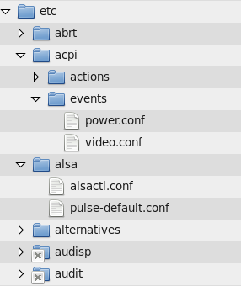
The Fundamental Functionality of File System
From end users' view
– File
The data constructed by DATA
– Directory
Contains other files and sub-directories
– Files creation/deletion, access permission management

Slide 4
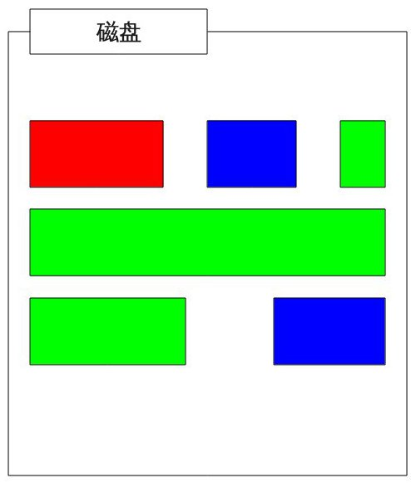
The Fundamental Functionality of File System (Cont.)
For hard disk file systems,
– <logical, physical> location mapping
– Hard disk space management

Slide 5
Limitation and Challenge of Existed Linux File Systems
Flexibility Limitation
- Max physical media capacity
- Max files number
- Max file size
Storage efficiency
- Big/small files
Access efficiency
- large directory
Challenge
– High concurrent workload for random I/O
– Huge storage space
– Application bound I/O patterns
– Security, stability, disaster recovery
– Etc

Slide 6
Limitation and Challenge of Existed Linux File Systems (Cont)
Status of existing Linux hard disk file systems,
– FAT
Single link list storage
Fragment and performance bottleneck
– Ext2
Multiple level indirect block pointers
– Faster random I/O
– Linear directory lookup
– Ext3
Journaling
Faster file system check/recovery
– Ext4
Extent based blocks management
More efficient for big files storage

Slide 7
Limitation and Challenge of Existed Linux File Systems (Cont)
Challenges of existing file systems,
– Max file system size (PB level)
– Max individual file size (PB level)
– Higher I/O and storage efficiency for (small) files
– Online file system check
– Online high efficient file system defragmentation
– Faster directory lookup
– More flexible data/metadata allocation
– Cross physical volumes file system
– File system level data concurrency and redundancy
– Data and metadata check-sum

Slide 8
New File Systems Breakthrough
There are some breakthrough from new file system development efforts
– ZFS
Copy-on-write, snapshot, EB (1024P) level large capacity
– LogFS
Special optimization for flash based storage (SSD, Flash disk)
– ReiserFS
Tree structure on disk
Optimized for small files I/O and storage
– BTRFS
The most promising candidate for next generation Linux hard disk file system
The one this talk is focused on

Slide 9
BTRFS, Next Generation Linux File System Candidate
Larger storage capacity
– Max volume size 16EB
– Max file size 16EB
(comparing Ext4 max file size 16TB)
Faster directory lookup
– Btree structure
– for hashed directory entries order
– inode order
Higher storage effiency
– COW (Copy On Write)
– Extent for large files
– Inline data for small files
Multiple device support
– Increase storage capacity and stability

Slide 10
BTRFS, Next Generation Linux File System Candidate (Cont.)
Snapshot
– Backup all files of a file system at a given moment
– No extra space consumed
– Faster, more convenient backup/restore
File compress
– For text based files, save more disk space
Checksum
– Data corruption detection
Online file system check
– No mandatory offline
– More flexible task schedule
– Run time data consistency check

Slide 11
BTRFS, Next Generation Linux File System Candidate (Cont.)
Optimization for Solid State Disk
– Wear-out leveling
– Delay write-back for large (2M) SSD data chunk

Slide 12
Concepts of BTRFS
Mount point
Mount point

Slide 13
Concepts of BTRFS (Cont.)
/
Mounting (2)
mnt
/dev/sda6
btr1
/dev/sda6

Slide 14
Concepts of BTRFS (Cont.)
Volume
Subvolume
– like directory
– can contain files and directories
– can be created as directory
Main subvolume
subvolume 2
subvolume 3
子卷2
子卷3
Shared node

Slide 15
Concepts of BTRFS (Cont.)
Snapshot
– What we want ?
– Complete backup
– Accessible and recoverable
– Frequently access
BTRFS' Implementation
– Snapshot is a subvolume
– Created by copying another subvolume
– Share most data and metadata
– Writable snapshot (Copy On Write)

Slide 16
Concepts of BTRFS (Cont.)
COW
Snapshot illustration
Original subvolume
Original subvolume
snapshot
Original subvolume
snapshot
1
1
1
1
1
1
1
1
2
2
2
2
2
1
1
1
1
1
1
1
1
1
1
1
1
2
2

Slide 17
BTRFS Usage & Live Demo
– Create file system
– Mount & umount
– Subvolume create, delete
– Snapshot create
– Writable snapshot
– Compress
– Multiple device support

Slide 18
Exploring BTRFS from Taobao
Most promising Linux disk file system for enterprise environment.
We are working on a research between existing BTRFS features and application requirement from Taobao's deployment.
More upstream efforts to make BTRFS to be a enterprise usage ready file system.

Slide 19
Exploring BTRFS from Taobao (Cont.)
Something we can improve to make BTRFS fit Taobao's requirement
Subvolume Compress
– Requirement
– automatic compress when place data in a specific direcotry
– friendly usage experience for end user and developers
– Current status
– global compress option provided
– no per-subvolume compress supported
– OPPORTUNITY

Slide 20
Exploring BTRFS from Taobao (Cont.)
Something we can improve to make BTRFS fit Taobao's requirement
Metadata on SSD
– Requirement
– Metadata allocation on dedicated SSD
– Current status
– Metadata on first device of file system
– Can not prevent data allocation on a specific device
– Single point of failure problem
– OPPORTUNITY

Slide 21
Exploring BTRFS from Taobao (Cont.)
Something we can improve to make BTRFS fit Taobao's requirement
Underlying Media Topology Aware allocation
– Requirement
– RAID, 4K sector hard disk ...
– Current status
– not implementated yet
– OPPORTUNITY
磁盘
4k
4k
4k
4k
Hard disk
partition
分区
4k
4k
4k
4k

Slide 22
Q & A

Slide 23
Thank you

