Slide 1
Naïve Bayes classifier
Introduction to Machine Learning Experiment 1
Spring 2017

Slide 2
Goal
Implement a Naïve Bayes classifier and test it on a real dataset
Have basic ideas about:
How to implement and apply a machine learning algorithm on a practical dataset
How to evaluate its performance
How to analyze your results
NOTE: all these parts are very important, and should be included in your code/report.

Slide 3
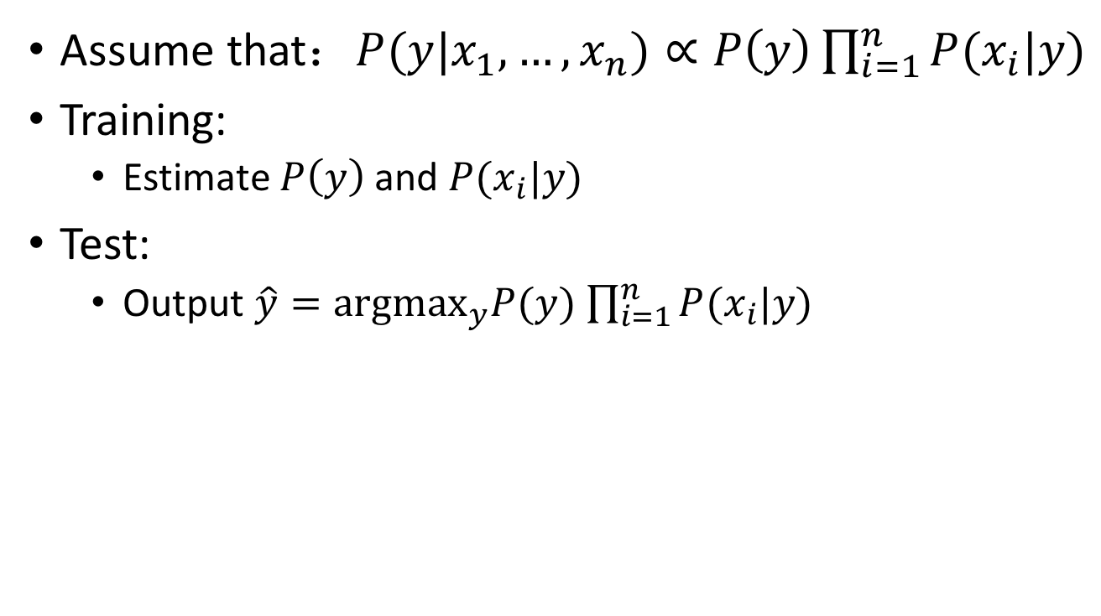
Naïve Bayes classifier
Assume that：$P(y|x_{1},…,x_{n})∝P\left(y\right)\prod_{i=1}^{n}{P(x_{i}|y)}$
Training:
Estimate $P\left(y\right)$ and $P(x_{i}|y)$
Test:
Output $\hat{y}={\text{argmax}}_{y}P(y)$ $\prod_{i=1}^{n}{P(x_{i}|y)}$

Slide 4
Data
The Adult Data set: (http://archive.ics.uci.edu/ml/datasets/Adult )
Aims at determining whether a person’s income exceed a certain amount (50k)
Each record (a line in the file) corresponds to a person, and has 15 attributes
The last attributes, (<=50k or >50k), is the class label
There are continuous and categorical attributes, and some of the values are missing (denoted by “?”)

Slide 5
Data (cont.)
Files:
adult.train: training set, 32561 lines
adult.test: test set, 16281 lines
adult.names: detailed description of the dataset, including the meaning/type/possible values of each attributes

Slide 6
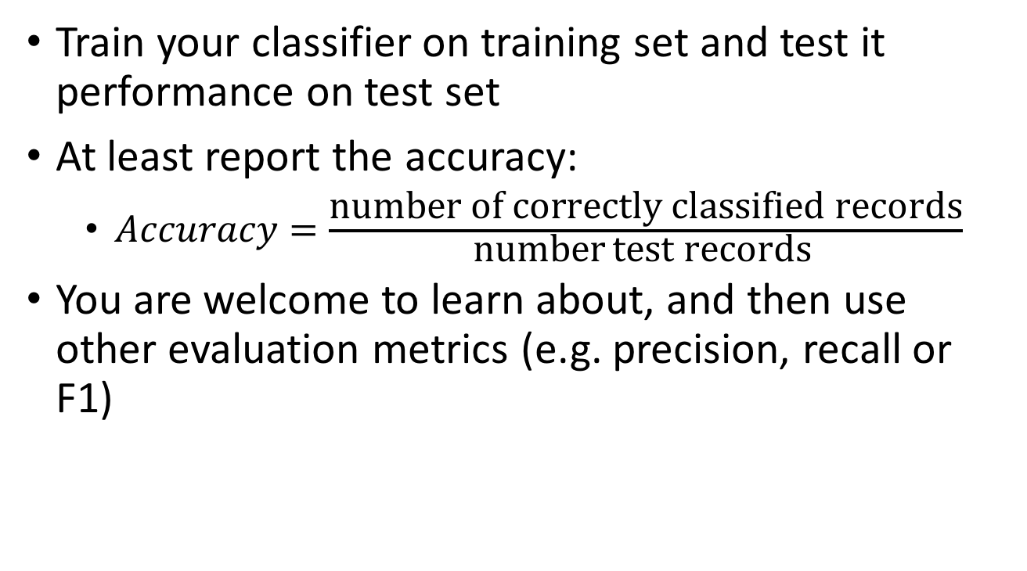
How to Evaluate the Performance
Train your classifier on training set and test it performance on test set
At least report the accuracy:
$Accuracy=\frac{\text{number} \text{of} \text{correctly} \text{classified} \text{records}}{\text{number} \text{test} \text{records} }$
You are welcome to learn about, and then use other evaluation metrics (e.g. precision, recall or F1)

Slide 7
How to Analyze Your Results
What is the issue that you encounter?
How do you address the issue?
how do you design the experiment?
how do you modify the algorithm?
Does your solution work or not?
Does the classification performance improve?
And finally try to explain why your solution works (or why it does not)

Slide 8
Issue 1: the impact of the size of training set
How does the size of training set influence the classification performance?
Suggested solution:
Sample 5%, 50% and 100% from the whole training set to train your model
Repeat the random sampling (5 times) and report min/max/average accuracy

Slide 9
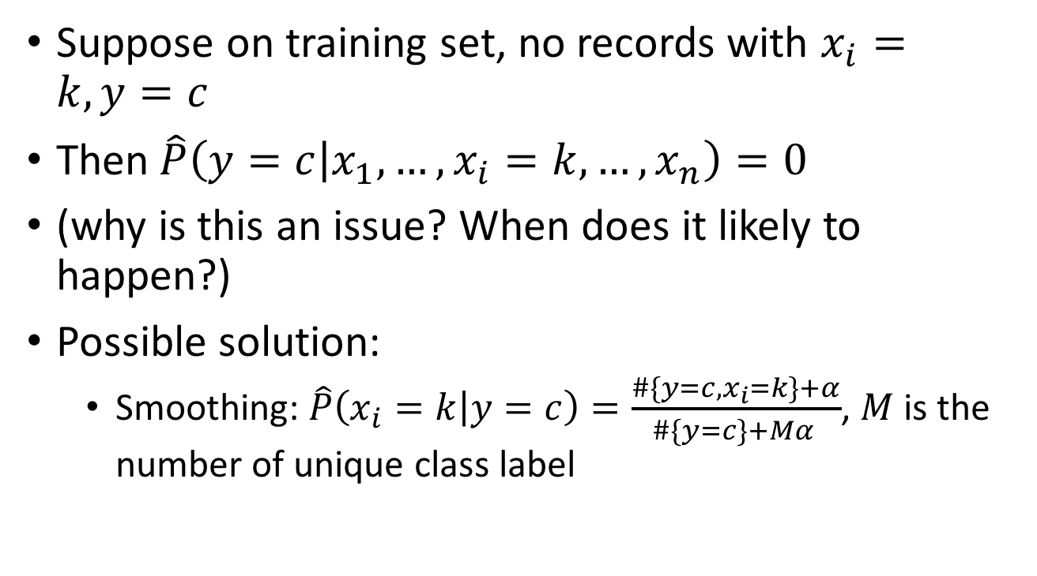
Issue 2: zero-probabilities
Suppose on training set, no records with $x_{i}=k, y=c$
Then$\hat{P}\left(y=c | x_{1},…,x_{i}=k,…,x_{n}\right)=0$
(why is this an issue? When does it likely to happen?)
Possible solution:
Smoothing: $\hat{P}\left(x_{i}=k | y=c\right)=\frac{\#\{y=c, x_{i}=k\}+α}{\#\{y=c\}+Mα }$, $M$ is the number of unique class label

Slide 10
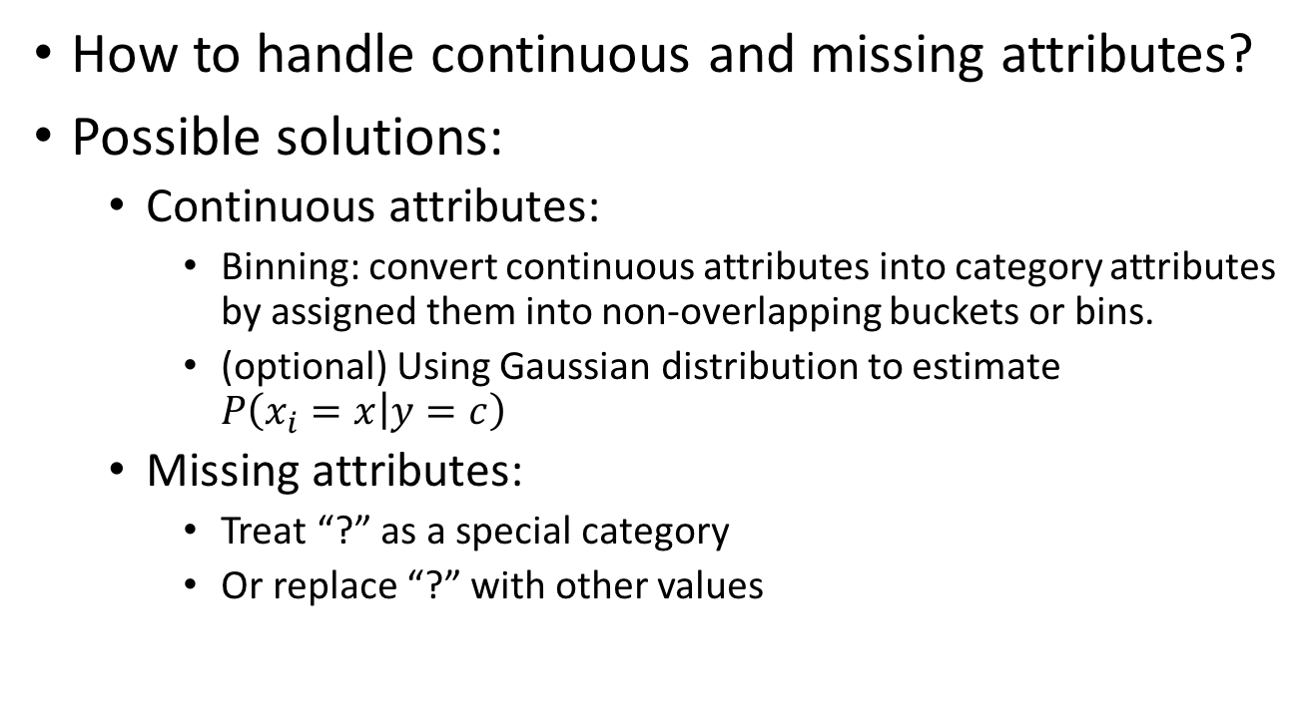
Issue 3: continuous and missing attributes
How to handle continuous and missing attributes?
Possible solutions:
Continuous attributes:
Binning: convert continuous attributes into category attributes by assigned them into non-overlapping buckets or bins.
(optional) Using Gaussian distribution to estimate $P\left(x_{i}=x | y=c\right)$
Missing attributes:
Treat “?” as a special category
Or replace “?” with other values

Slide 11
Requirement
Implement a Naïve Bayes classifier (30% of the overall score)
Address all 3 mentioned issues:
Issue 1 (30%)
Issue 2&3 (2*20%=40%)
NOTE: the score is not based on the performance (i.e. the accuracy) of your model, but how you implement the algorithm, evaluate its performance and analyze your results.

Slide 12
Submission
A zipped file that contains:
Source Code:
With necessary comments
Make sure the TA can understand/run your code
README
A text file (in utf8 encoding)
Includes your name, student id and contact information (the TA may give you feedbacks if you submit before the deadline:) )
Report
A PDF file
Experiment design/results/analysis/discussion
Don’t just copy&paste the source code

Slide 13
Deadline & other Information
Deadline: 2016.03.23 Thursday 23:59
Upload the zipped file, with your name and student id in the filename, to learn.tsinghua.edu.cn
Late submissions WILL NOT BE ACCEPTED
In fact, they will. But the final score will be at most the original score*0.8.
Contact the TA:
frankyzf94@gmail.com
18671829106

Slide 14
Reference
http://scikit-learn.org/stable/modules/naive_bayes.html (for smoothing and Gaussian estimation for continuous attributes)

