Slide 1

Caffe
计62 胡致远
2016011260

Slide 2
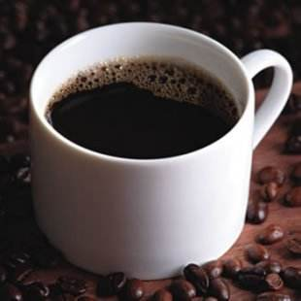
WHAT?
Caffe is a deep learning framework made with expression, speed, and modularity in mind.
Developed by BVLC
By Yangqing Jia.

Slide 3
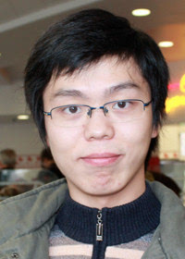
Yangqing Jia
Doctor of computer science, University of California at Berkeley
Master's degree and bachelor's degree from Tsinghua University
Yangqing Jia created Caffe during his PhD at UC Berkeley
He has worked at National University of Singapore, Microsoft Asia Research Institute, NEC American laboratory, Google Brain.
Now Facebook research scientist, is responsible for the development of cutting-edge AI platform and the depth of the forefront of learning

Slide 4
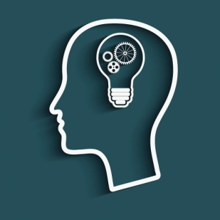
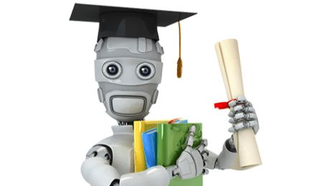
Deep Learning
coffee

Slide 5
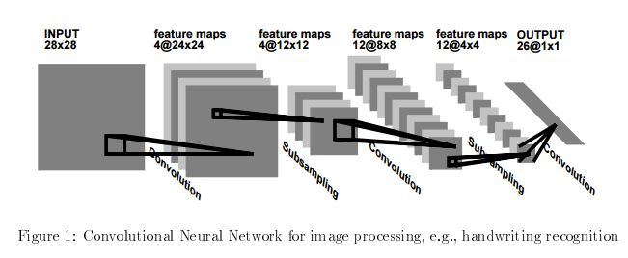
A deep learning framework?

Slide 6
What can you do?
Develop your own module.
Train&Use your module.
Examples and modules by dalaos.
Train&Use.

Slide 7
About Caffe
Convolutional Neural NetWork(CNN).
Mainly for images(classification).
Multi-input&multi-task
Input—convolution—subsampling—…— (full connection) —…—(classifier) —output

Slide 8
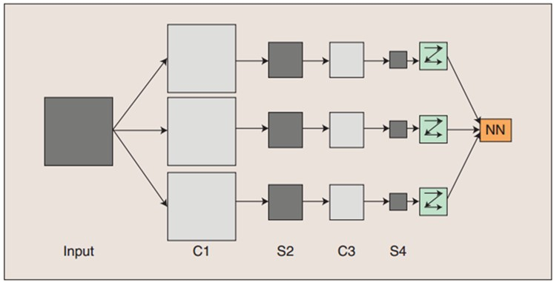
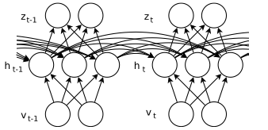
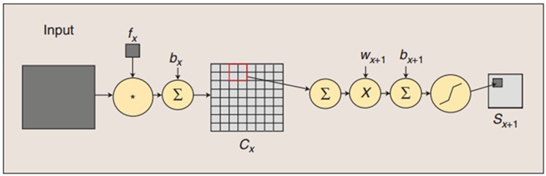
CNN

Slide 9
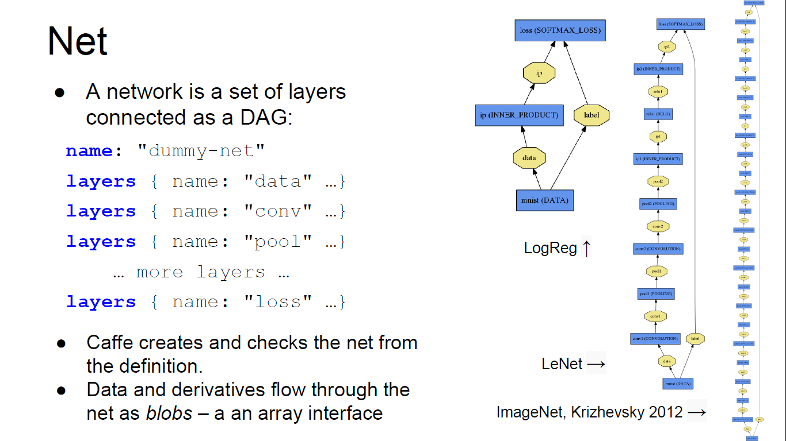
How to write

Slide 10
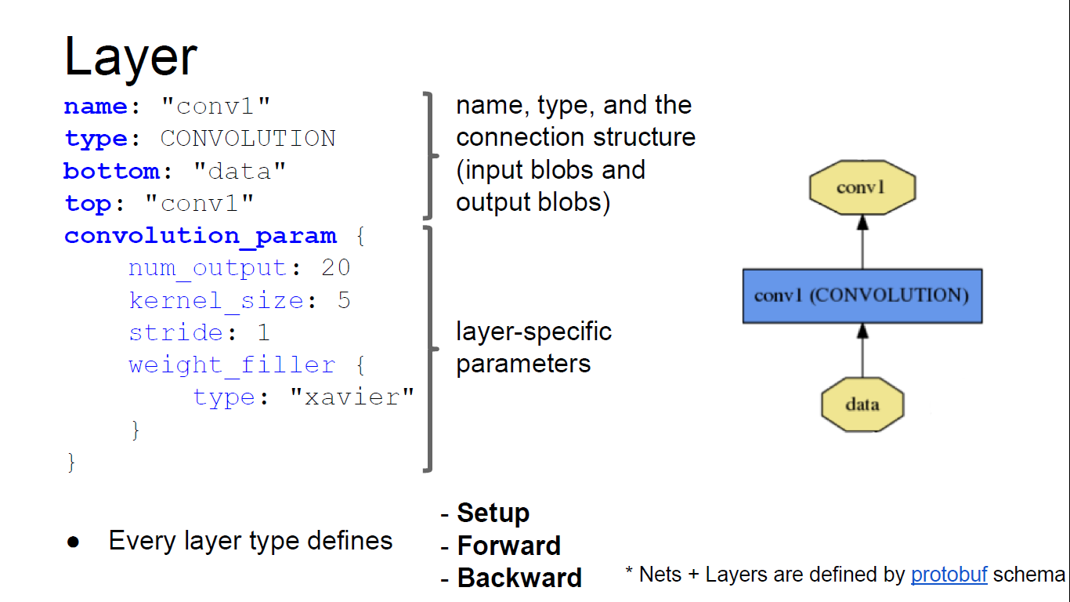
How to write

Slide 11
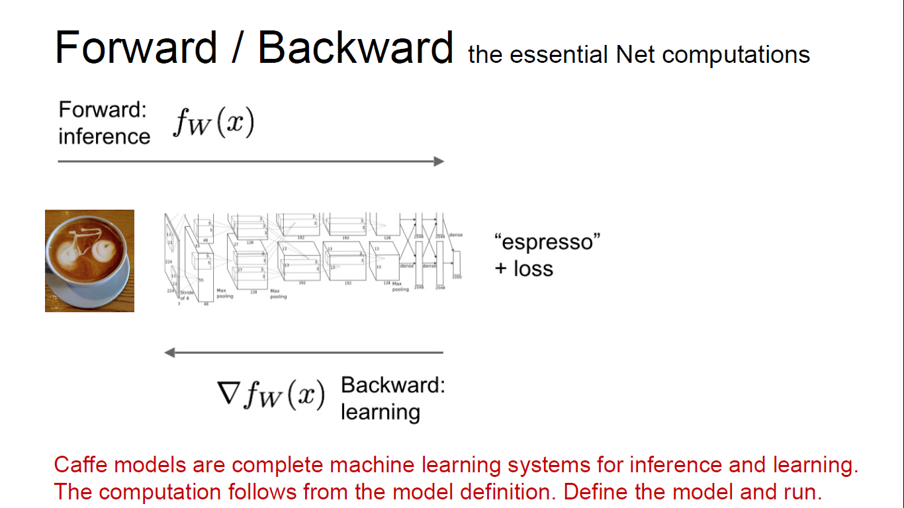
How to write

Slide 12
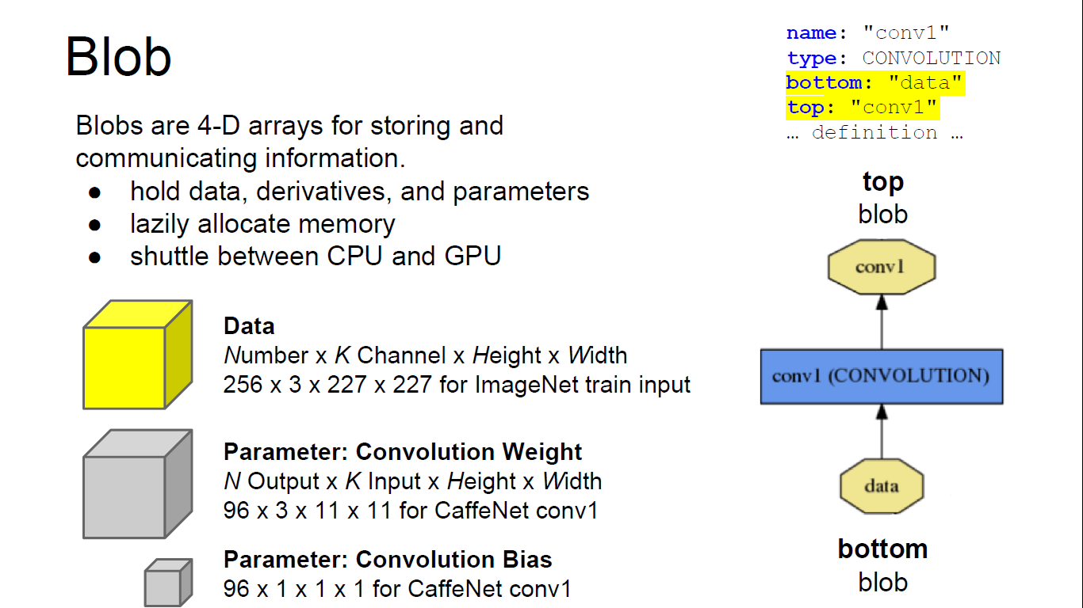
How to write

Slide 13
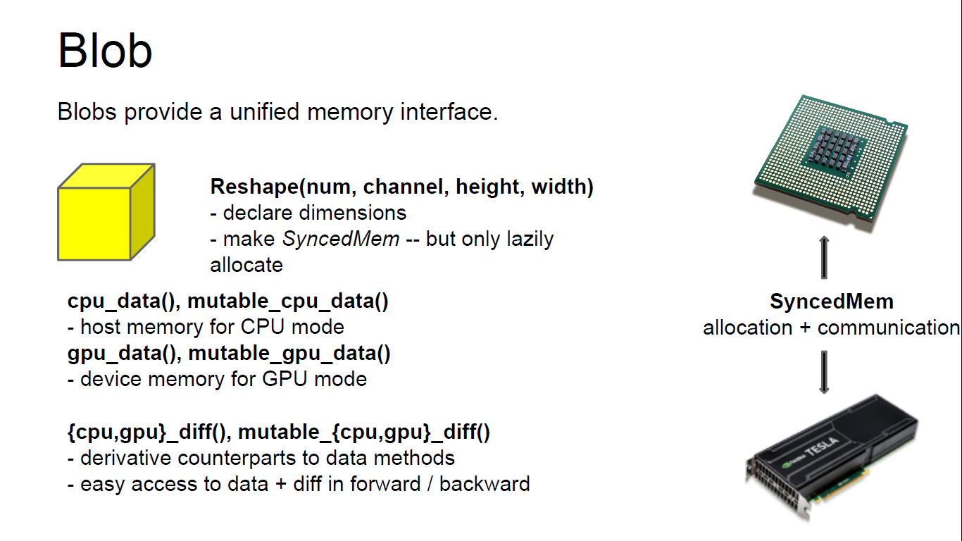
How to write

Slide 14
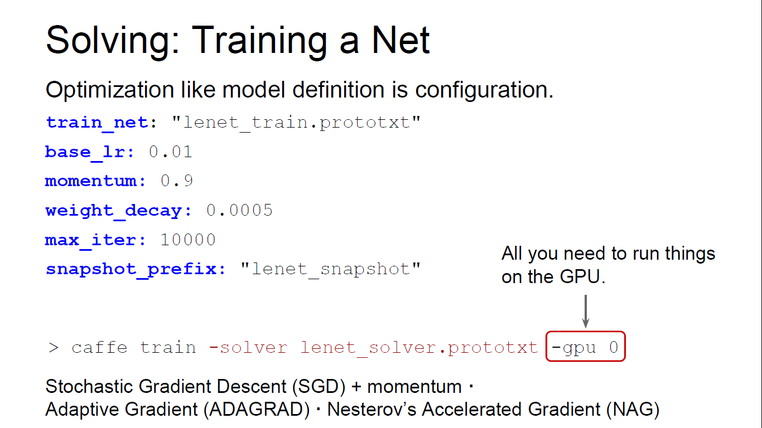
How to write

Slide 15
Why Caffe?
Torch7
Theano/Pylearn2
Cuda-Convnet2

Slide 16
Why Caffe?
Expressive architecture
Layers
Speed
Modularity
Openness&Community

Slide 17
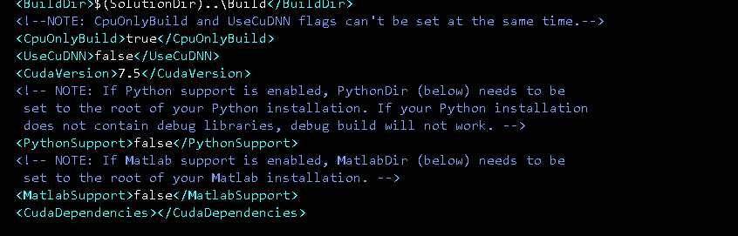
Expressive architecture
All platform
Command line/Python/MATLAB.
CPU—GPU
Caffe::set_mode(Caffe::GPU);

Slide 18
Layers
Data Layers
Vision Layers
Recurrent Layers
Common Layers
Normalization Layers
Activation / Neuron Layers
Utility Layers
Loss Layers

Slide 19
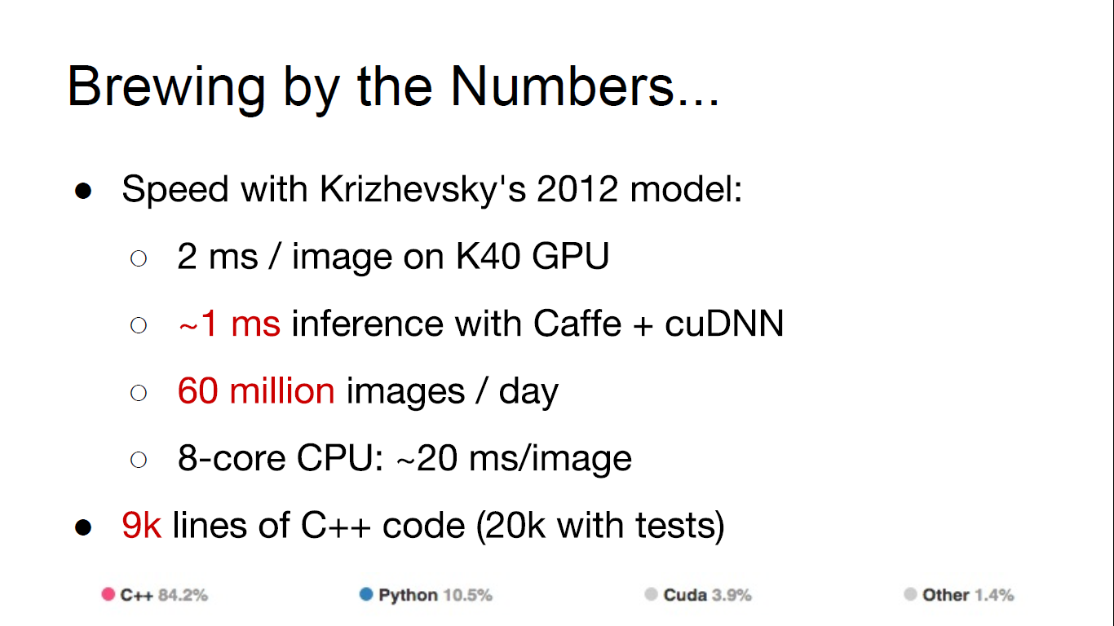
Speed

Slide 20
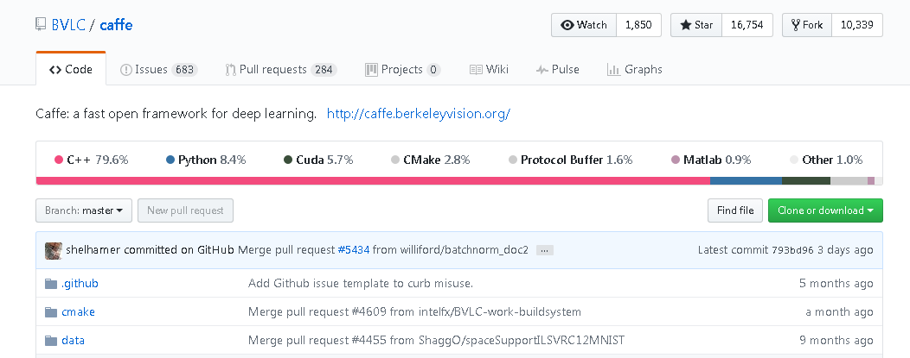
Openness&Community
GitHub
Open Model Collection—The Caffe Model Zoo

Slide 21
How to install and configure…

Slide 22
THANKS FOR LISTENING

