Slide 1
Doxygen
CST 6-5 Guo Jingzhe 2016011362
Notes:
Today I’m going to talk about Doxygen.

Slide 2
Why?
Documents are important.
Annotations are important.
So how to document your code easily?
By generating documents from your annotations!
Notes:
This has been done by JavaDoc, but for other languages as well as Java we have Doxygen.

Slide 3
What is Doxygen?
Doxygen is the de facto standard tool for generating documentation from annotated C++ sources, but it also supports other popular programming languages such as C, Objective-C, C#, PHP, Java, Python, IDL (Corba, Microsoft, and UNO/OpenOffice flavors), Fortran, VHDL, Tcl, and to some extent D.
Notes:
Why colourful? I don’t know.

Slide 4
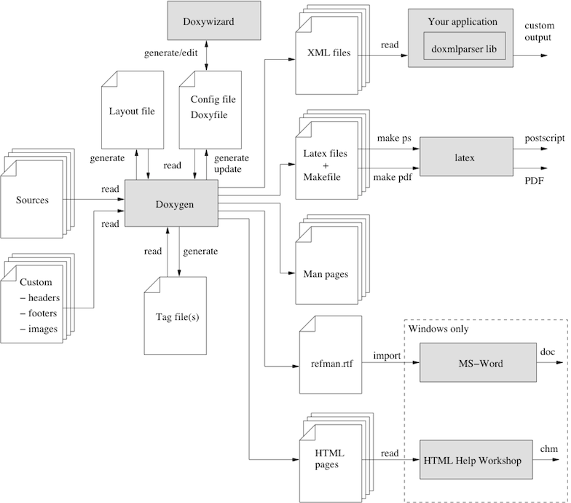
What is Doxygen?
Notes:
Many kinds of output.

Slide 5
Installing
Installing from precompiled binaries.
Recommended for Windows users.
Installing from source code.
This requires CMake and other libraries.
Tested under Linux.
The compilation took about 10 minutes on a Raspberry Pi 3.
$ git clone https://github.com/doxygen/doxygen.git && cd doxygen
$ mkdir build && cd build
$ cmake –g “Unix Makefiles” ..
$ make
Notes:
Installing is super simple.

Slide 6
How to use?
GUI – DoxyWizard
CLI – Using Doxyfile

Slide 7
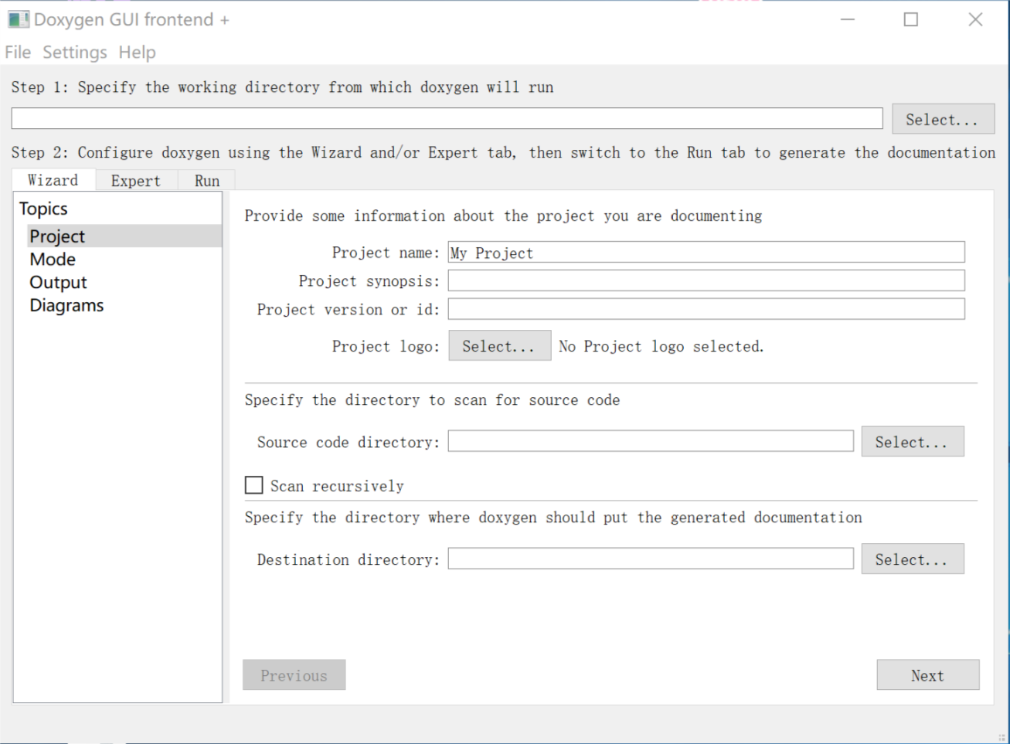
Using DoxyWizard

Slide 8
Using Doxyfile
Write a Doxyfile or generate one using doxygen –g.
Modify it.
Run doxygen.

Slide 9
How to annotate? (C++)
Special Comment Blocks
Definition
Styles/Varieties
/**
* \brief The great class.
* \author gjz010
*/
/// \brief The great class.
/// \author gjz010
/**
* \brief The great class.
* \author gjz010
*/

Slide 10
How to annotate? (C++)
Documenting members
Before member
After member
Anywhere
class Great{
public:
///How great the class is.
int great;
};
class Great{
public:
int great; ///<How great the class is.
};
/*! \class Great
\brief A great class.
The greatest one in the universe.
*/

Slide 11
How to annotate? (C++)
Special Commands
\brief,\author,\todo,\bug,\par …
Custom Commands
Modifying Doxyfile.

Slide 12
How to annotate? (C++)
Embedding markdown
/**
* \brief The great class.
* \author gjz010
* Great class.
* ================
* [Here](https://www.baidu.com/) is a bad example of a search engine.
* So we need a great one!
*/

Slide 13
Thank you!
http://www.doxygen.nl/
(This website is also generated by Doxygen!)

