Slide 1

Debug Using GDB
In-Class Talk for Oriented to Object Programming Class
Ding Xiangyun 2016011361

Slide 2
Why use a debugger
Dalao doesn’t need it at all.
Most of us tend to have bugs in our code. We could use printing commands to test our code, or we could use a debugger.

Slide 3
What is GDB
GDB: The GNU Project Debugger
First written by Richard Stallman in 1986 as part of his GNU system.
It allows you to see what is going on ‘inside’ another program while it executes -- or what another program was doing at the moment it crashed.
It can work on almost every operating system.

Slide 4
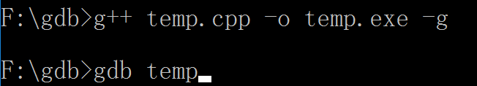
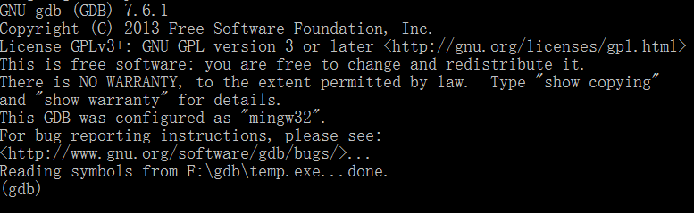
Install and invoke
The following sections are based on the windows platform.
Those who installed CodeBlocks don’t need to install it.
Compile your program with the ‘-g’ flag.
Invoke GDB to run the program from the same directory it was compiled in .

Slide 5

Basic commands
file <name>: to load the .exe file
We can load the .exe file when we invoking gdb.

Slide 6
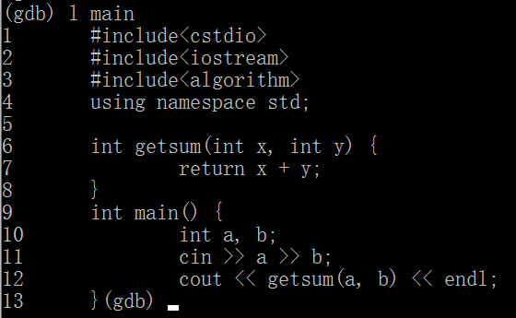
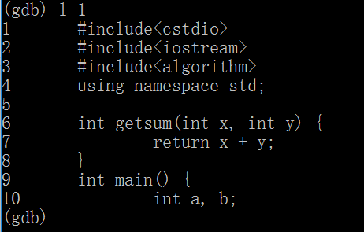
Basic commands
l(list):to show source code
l <line number>
l <line number>,<line number>
l <function name>
Default listsize is 10 lines.
set listsize 30
show listsize

Slide 7
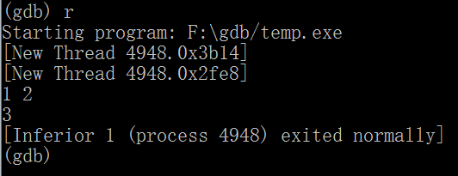
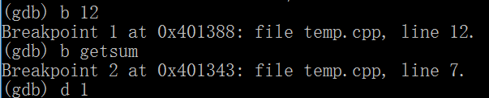
Basic commands
r(run):to start running the program
b(breakpoint): to set breakpoints in the program.
b <line number>
b <function name>
d(delete):to delete breakpoints
d <breakpoint number>
d (delete all breakpoints)

Slide 8
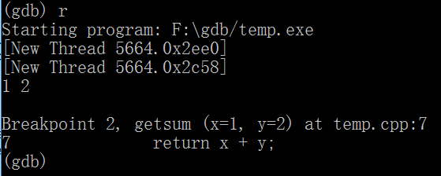
Basic commands

Slide 9
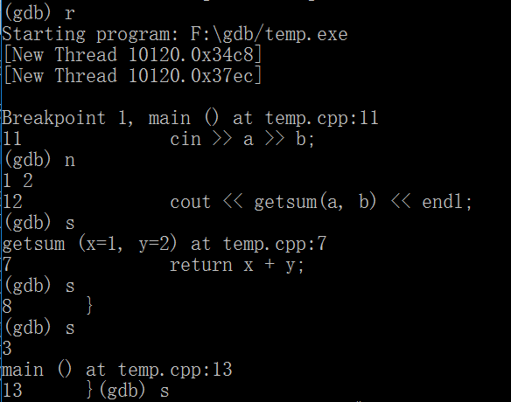
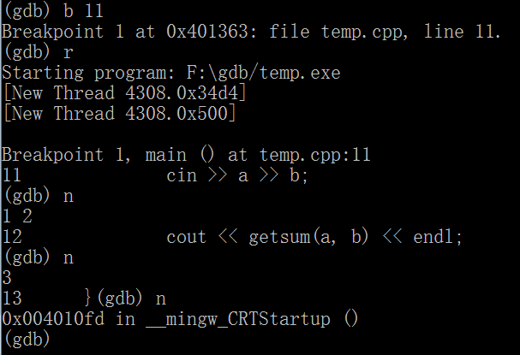
Basic commands
n: to cause the debugger to execute the current command, and stop again, showing the next command in the code to be executed.
s: to cause the debugger to execute the current command, and if it is a function call – go to the beginning of that function (which means go into the function).

Slide 10
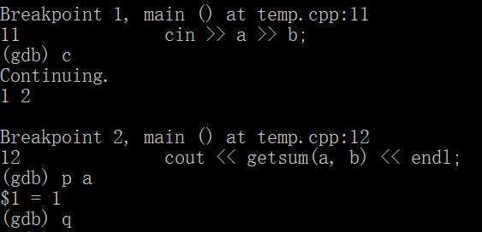
Basic commands
c(continue): to let the program continue running until next breakpoint . If there’s no breakpoint behind, go to the end of the program.
p(print): to print the contents of a variable or an expression.
q(quit): to end debug and exit GDB.

Slide 11
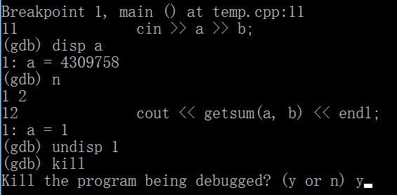
Basic commands
disp(display): to show the contents of a variable or an expression every time.
disp <variable name>
disp <expression>
undisp(undisplay): to delete displays
undisp <display number>
kill: to kill the debugging program (still stay in GDB)

Slide 12
More details
info b: to show the information of all breakpoints.
clear <line number>: to delete all breakpoints on a specific line.
tb (temporary breakpoint): to set a breakpoint that is automatically removed after it stops program execution.
search <string>: to search a specific string after the current line.
rev <string>: to search a specific string before the current line.

Slide 13
More details
save b <file name>: to save a list of breakpoints .
source <filename>: to load the breakpoints that has been saved.
break if ..: to break the program on specific condition.
bt (backtrace): to view system stack information.
whatis <variable>: to view the type of a variable.
help (<command name>)

Slide 14
Debug a multi-file project
Add ‘-g’ flag in ‘makefile’.
Set breakpoints as follows:
b <file name>:<line number>
b <file name>:<function number>
Use other commands in the same way.
Any question?

Slide 15
Thanks for listening
more information about GDB on https://sourceware.org/gdb/onlinedocs/gdb/index.html#SEC_Contents

