Slide 1
Emacs
Notes:
Today I'm going to talk about one of the TOP2 Editors , that is -- Emacs. Hope I will not start a fight today, and here we go.

Slide 2
Emacs
MIT AI Lab 1975
Richard Stallman & Guy Steele
C/C++, Python, Lisp, Perl…
GDB, gcc, g++
Notes:
EMACS was born in MIT AI Lab in 1975, mainly by Richard Stallman & Guy Steele. It support almost all the main programming language, such as C/C++, JAVA, Python, Lisp. It also has GDB, gcc, and g++ inside it, which makes it a really great text editor for programmers.

Slide 3
Well… Emacs is not only an “Editor”.
It is actually an operating system.
Notes:
But Emacs is not only a text editor. It can also be an... operating system.

Slide 4
Things Emacs Can Do
Send/Receive Emails
Browse Web Sites
Edit Other Files Like PDF
Play Games
Make Coffee
Notes:
Emacs can send/receive mails, browse web sites, play games, edit PDF files, even make coffee. In other word, except for the things that must be dealt with Adobes, everything can be done in Emacs.

Slide 5
Emacs Operations
Notes:
Now, I'd like to introduce some of Emacs Basic Operations.

Slide 6
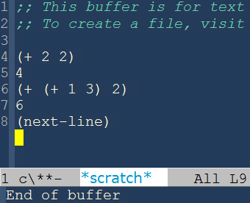
Elisp
Operation – Functions
2+2
(+ 2 2)
(1+3)+2
(+ (+ 1 3) 2)
(next-line)
Notes:
EMACS has an ELisp interpreter inside it, so actually most of the operations are ELisp functions. Therefore, to operate Emacs, we have to know something about ELisp.
In ELisp, our normal expression 2+2 will be like (+ 2 2),
(1+2)+3 will be like (+ (+ 1 2) 3). In other word, we have to write them as prefix expressions. And if we want to call an existing function, you have to write like this. That's just grammar. If you use Emacs in "lisp-interaction" mode, you can directly see the result of the scripts.
At least every simple operation in Emacs is an ELisp function. You call the function, then it runs, and gives you the desired outcome.

Slide 7
Keystrokes
find-files
previous-line
lisp-interaction-mode
Default
Macros
M-x

Slide 8
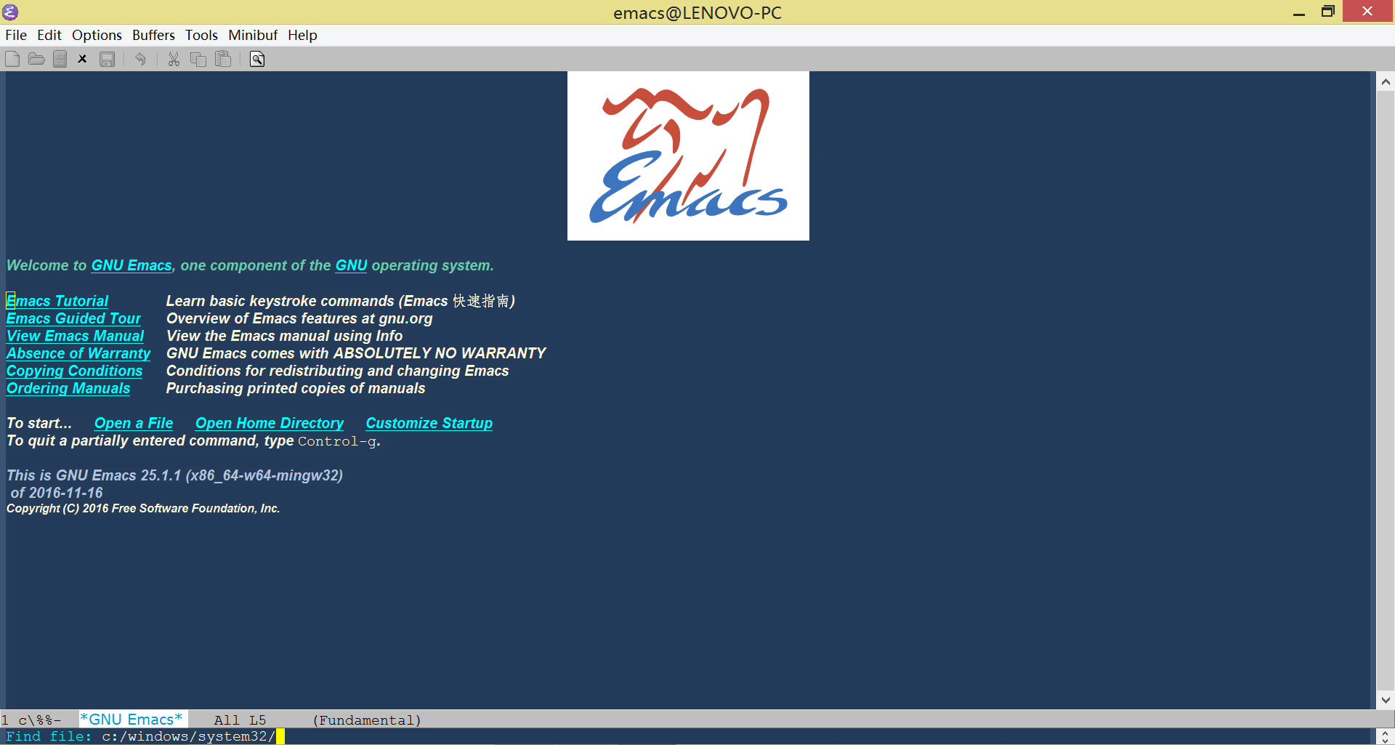
Keystrokes
Default
previous-line
C-p
find-file
C-x C-f
Macros
Editing MACroS
M-x
M-x previous line
Notes:
For default ones, let's take "find-files" and "previous-line" as examples.
"previous-line" has a default keystroke "C-p". It'll get you to the previous line, just like it's name.
"find-files" has a default keystroke "C-x C-f". So, when you want to open a file, you type "C-x C-f". The mini buffer will ask you for further information about the address of the file. You type in the address, then open the file.
Defining your own macros. In fact, EMACS stands for Editing MACroS. And it got its name mainly because the originally programmers in MIT lab wrote a lot of macros to define new keystrokes for an editor called TACO. We use ELisp to define our own macros to satisfy our own needs.
And if you want to use a function by its name still, you can type M-x then the name of the function, like "M-x previous-line". This can also make you to the previous line, but Emacs will suggest that you should use "C-p" in the mini buffer afterwards.

Slide 9
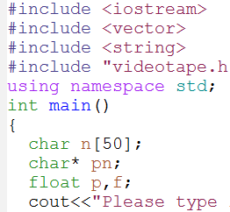
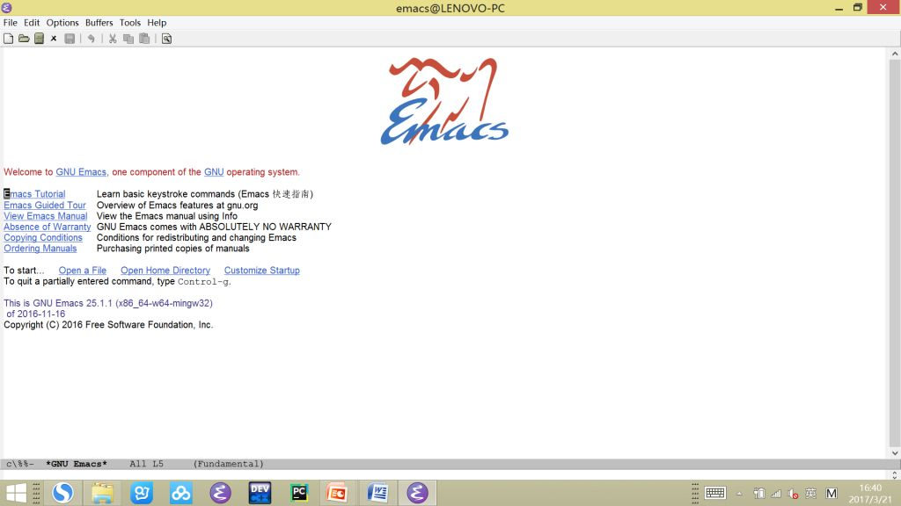
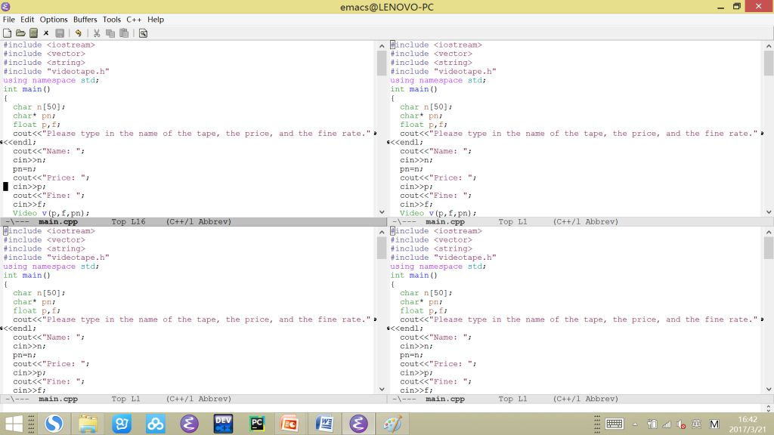
Notes:
Well, to some extent, Emacs is a little bit stupid, because when you download a brand new Emacs, you'll find it has an ugly color, it cannot show you the line number, and if you want to wander around several different sub-frames, you have to type "C-x o" again, again, and again. You will definitely want to solve these problems.

Slide 10
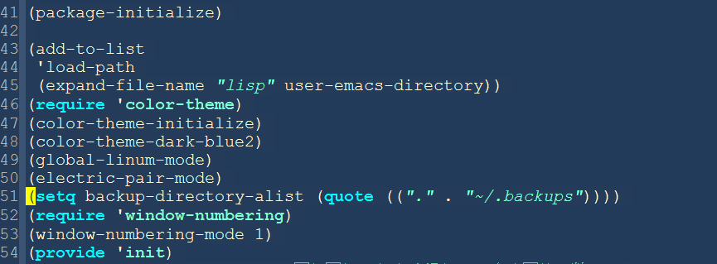
Configuration Files
Notes:
So we have configuration files. It is usually located in "emacs/.emacs.d", and we usually name it as "init.el". Inside this file, we put in the setting we need in ELisp, especially some useful editing modes, such as bracket pairs. So here is part of my configuration file: line 49 means to show the line number, line 50 means to add pair of brackets automatically, line 51 means not to create backup files, line 46-48 set the theme, line 52-53 gives a quick way to switch between sub-frames. We can also call those functions in the "M-x" style, but I think it's obviously more convenient to directly write them in the initialization file.
You may discover that in "color theme" and "window numbering" there is a key word named "require". This means there are other files required. These files are located in "emacs/.emacs.d/lisp", and we use the script in line 43-45 to add this path to the program.
As for these additional files, there are lots of them on the Internet. You can easily download and use them. You can also write your own files, and upload them for everyone to share all over the world. This is highly encouraged by Emacs to create a free software environment.

Slide 11
Thanks!
More Information: http://www.gnuemacs.org/
Notes:
If you're interested, you can go to Emacs' official website for more information.
That's all. Thank you.

