Slide 1
Flow Free Game
Variant Solved
Using Z3SAT Optimiser
Hong Wenhao 2016011266

Slide 2
Overview

Slide 3
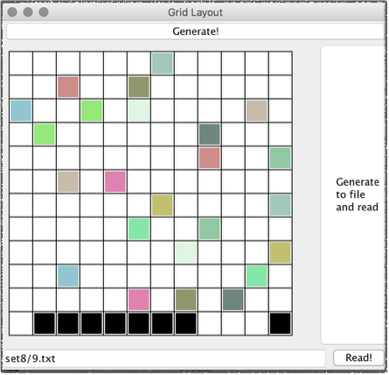
Overview
A problem akin to Flow Free game is solved using SAT formulation.
Problem size up to 13*13 can be handled well.
A generator and a visualiser is also provided for testing and debugging.
Figure 1: randomised input

Slide 4
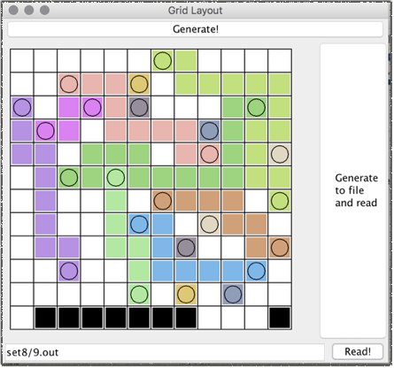
Problem Description
Given an N by N board, find non-crossing routes that connect pairs of terminals.
Maximise # of connected pairs.
Minimise # of grids used.
Figure 2: An optimal solution.

Slide 5
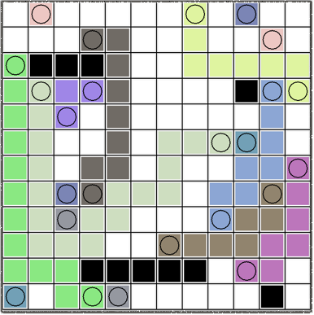
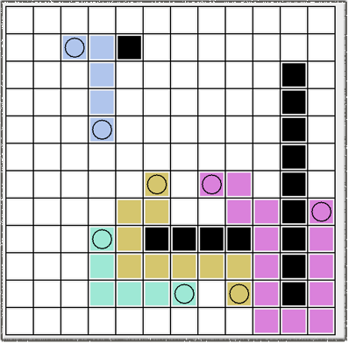

Slide 6
Demo.

Slide 7
Development

Slide 8
Personal Principle
Always make debug-friendly decisions!
Also, make your screen colourful! So that you don’t feel dull.
credit: http://www.quickmeme.com/meme/355pk9

Slide 9
Development Procedure
Implement visualiser first!
Colourful images speed up development!
Implement generator second!
Test cases are also important for testing!
Finally, the solver… But how to solve ( ? )

Slide 10
Solution Process

Slide 11
Object Design
Class Board keeps all information about a board.
Class BaseSolver manages I/O by keeping input and output boards, and has an abstract method solve().
Class Z3Solver implements the solution using Z3.

Slide 12

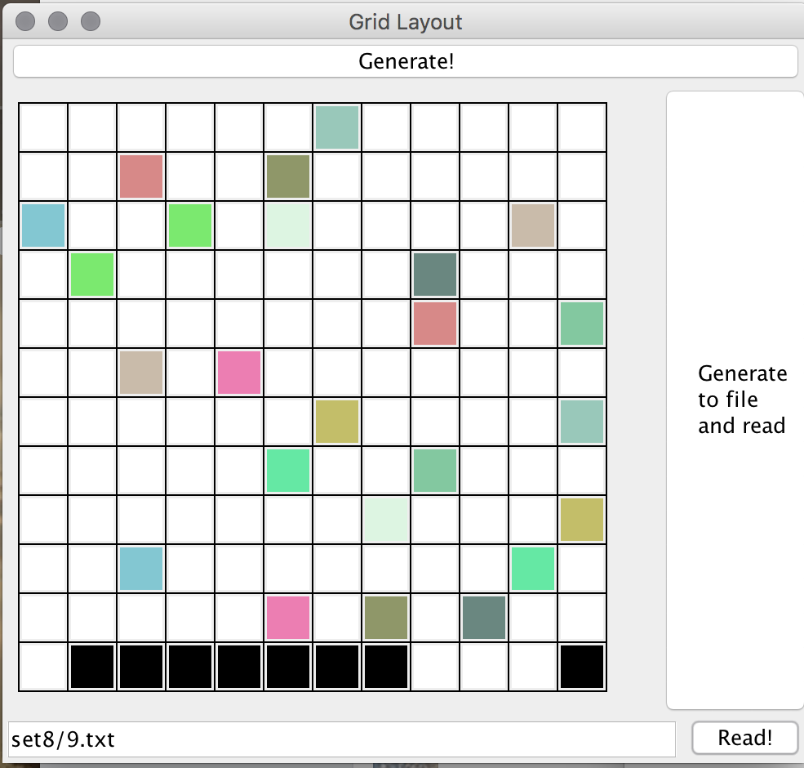
Data Design
What can be a lightweight repr. for the board?
…
⋯⋯
。。。
?

Slide 13
Board
Dimension N. (N x N)
Keep a number in each table cell (i, j)
c[i, j] = 0, if the grid is empty
c[i, j] = -1, if the grid is an obstacle
c[i, j] = k, k is from 1,2,…,C, where C is the total # of colours

Slide 14

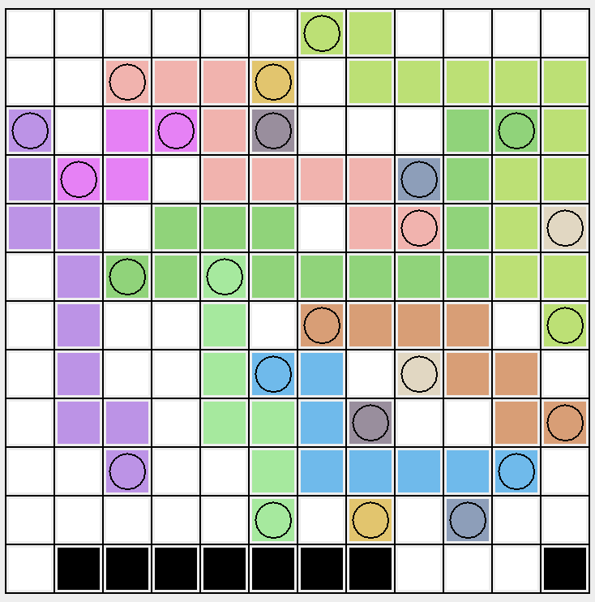
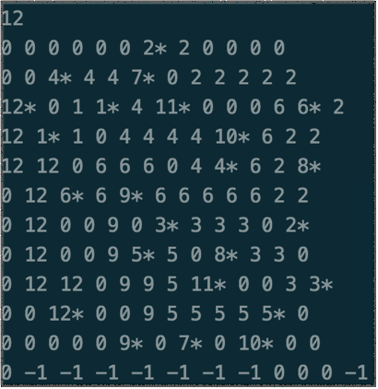
Board
Also, append a “*” to show terminals.
=

Slide 15
SAT formulation

Slide 16



Variables To Feed To Z3
integers: , record the colour at each grid
function: , whether colour i is matched
A total search space of : astronomical!

Slide 17
Consistency Constraints
color_i_j
if c[i, j] is empty, (assert 0 <= colour_i_j <= C)
otherwise, (assert colour_i_j = c[i, j])

Slide 18
Routing Constraints
for each grid [i, j]
if routed(c[i, j])
if [i, j] is terminal, (assert there is exactly one neighbour with the same colour).
else, (assert there is exactly two neighbours with the same colour).

Slide 19
Pitfalls :
these constraints are not enough!

Slide 20
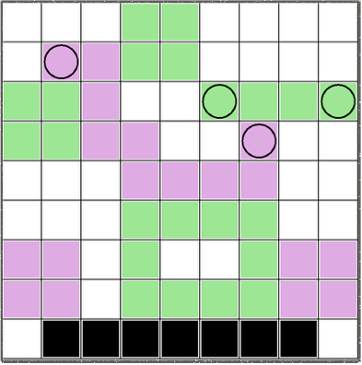

“Cyclic Flow”
Requiring that internal grids has degree 2 is not enough.

Slide 21
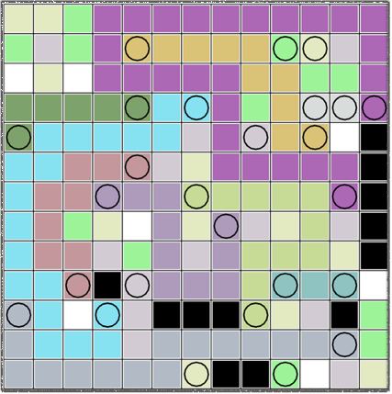
“Random non-routing grids”
We did not forbid unmatched grids to appear on the solution.

Slide 22
Optimisation Constraints

Slide 23
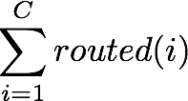

Optimisation Goals
1. Maximise # matched terminals
which is
2. Minimise # used routing grids (*)
which is
This constraint eliminates the wrong solutions discussed just now.

Slide 24
Finally…
Feeding all these constraints to Z3Opt, the solver is finishes its job!

Slide 25

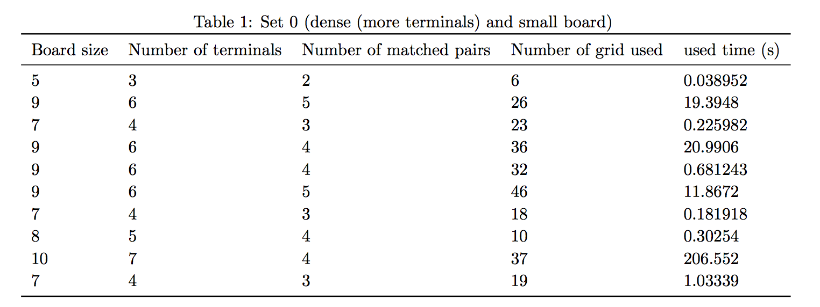
Empirical Results
Solution for small board is fast.

Slide 26

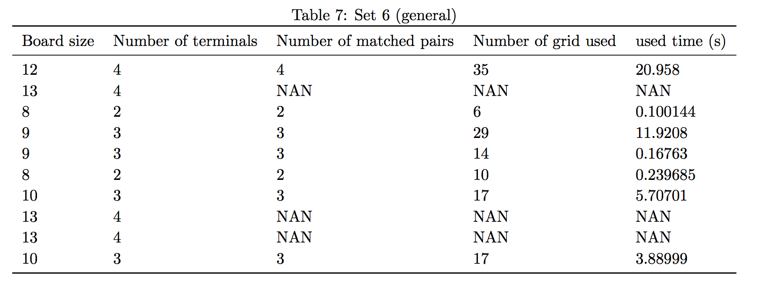
Empirical Results
When the board gets larger, some test cases do not terminate within 2 hours. (Exponential growth)

Slide 27
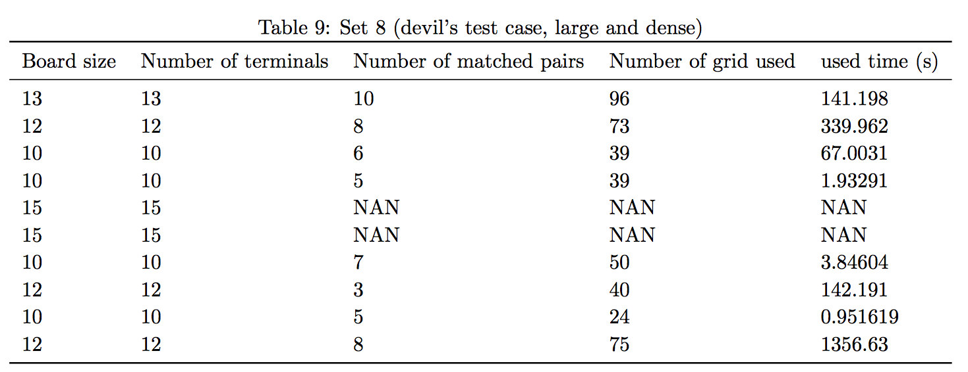
Empirical Results
When terminals or obstacles are dense, solver performance improves because search space is truncated. (13x13 was not solvable before)

Slide 28
Conclusion
SAT formulation
a generic & simple way to attack several NP problems because it is NPC.
Enable by Modern SAT solvers.
However, specific / approximate algorithms may substantially outperform this approach.

Slide 29
References
Oliver Keszocze et al. “A General and Exact Routing Methodology for Digital Microfluidic Biochips”
Microsoft Co. “Z3Opt” solver https://github.com/Z3Prover/z3
Oracle Co. “Java Swing Documentation” http://docs.oracle.com/javase/tutorial/uiswing/

Slide 30
Thank you

