Slide 1
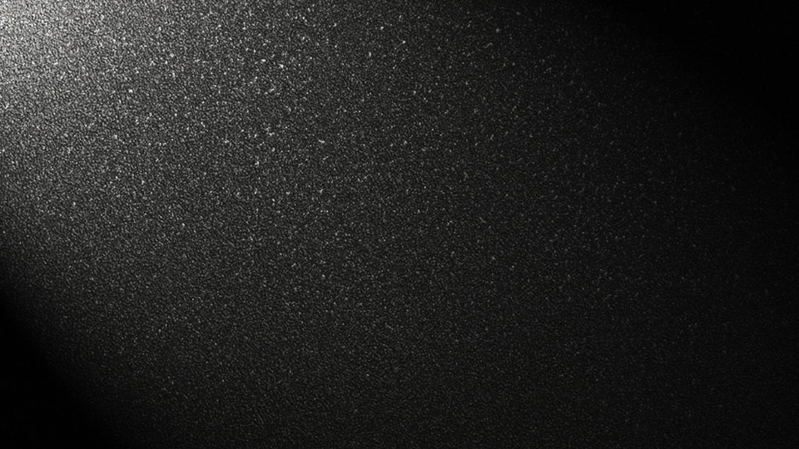
Graphics
in Qt
Chen Zhikang, CST 62, Tsinghua University

Slide 2
QPainter
OpenGL
for Qt
Custom
Controls
QML
Directory

Slide 3
Part 0
Custom Controls

Slide 4
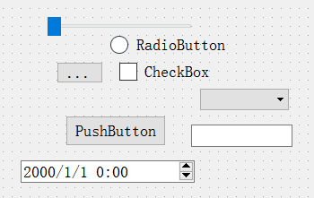
Different
Control Style
Traditional Style
Custom Style
Extra data?
Extra interface?
and...
Shape!
Color!

Slide 5
How to implement
Custom Style Controls
Inheritance

Slide 6
How to implement
Custom Style Controls
Abstract Base class
Traditional-style control class
Custom control class
QButton
->
QPushButton
QToolButton
QRadioButton
QCheckBox
......
QPushButton:
Traditional-style
push button
MyPushButton:
A push button with my style

Slide 7
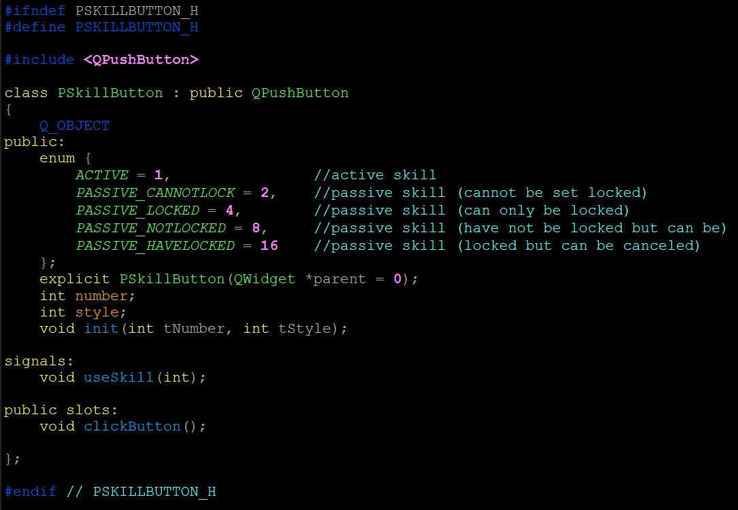
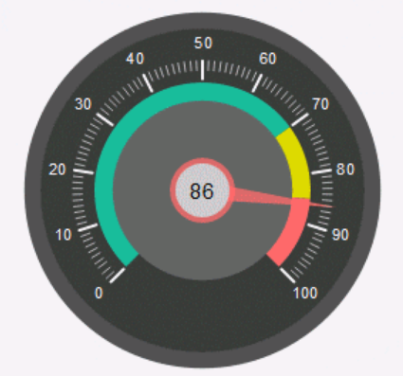


How to implement
Custom Style Controls
original signal
-> custom slot
do extra things
- > emit custom signal (extra parameters)
->slot
USE setStyleSheet & CSS

Slide 8
Part 1
QPainter

Slide 9
QPainter
QPainter is a class for 2D graphics in Qt.
·We overload the protected member function of QWidget: void paintEvent(QPaintEvent*);
·In paintEvent() we create a QPainter object to complete some painting tasks.
·Use update() to call paintEvent()
Actually, I remember when Qt is introduced in this class, the introducer gave us a demo which uses QPainter to paint MST...

Slide 10

QPainter
QPainter::begin(QPaintDevice*): begin to paint
QPainter::end(): finish painting
QPaint::drawLine/drawRect/drawRoundRect/
drawEllipse/drawArc/drawChord/
drawPolyline/drawPolygon/....
paint shapes
QPaint::drawPixmap/drawImage/drawText/...
USE QPen & QBrush
to implement style, color, ...
This clock is one of the official demos in Qt.

Slide 11
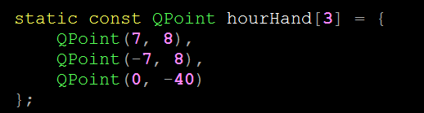

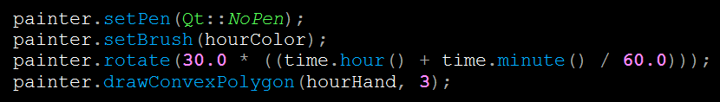
QPainter
QPainter::translate(double dx, double dy)
QPainter::rotate(double a)
The painter has a position and a direction.
This clock is one of the official demos in Qt.

Slide 12
Part 2
OpenGL for Qt

Slide 13
QPainter
QPainter is a class for 2D graphics in Qt.
·We overload the protected member function of QWidget: void paintEvent(QPaintEvent*);
·In paintEvent() we create a QPainter object to complete some painting tasks.
·Use update() to call paintEvent()

Slide 14
OpenGL for Qt
OpenGL is a widely used library for 3D painting.
QGLWidget inherits QWidget and it can support OpenGL. However, in QGLWidget, the OpenGL functions are not actually you use in other situations, they are designed only for Qt.

Slide 15
OpenGL for Qt
QGLWidget has 3 protected functions that is used for OpenGL painting:
void initializeGL();
void resizeGL(int w, int h);
void paintGL(); (used like paintEvent())
and updateGL(); is used the same way as update()

Slide 16
OpenGL for Qt
glRotatef(float angle, float x, float y, float z);
glTranslatef(float dx, floart dy, float dz);
The transformation in 3D space is much more complex than that in 2D.
We need to use Euler angle or quaternion to describe the rotation of a rigid body. (in 2D we only need an angle)

Slide 17
OpenGL for Qt
(The OpenGL functions are for the classmate who wants to introduce OpenGL or 3D graphics)
Example: My last term's final project: magic cube.
Besides, OpenGL has a lot of more powerful functions - the classmates who choose LiquidFun as their individual project will show you.

Slide 18
Part 3
QML

Slide 19
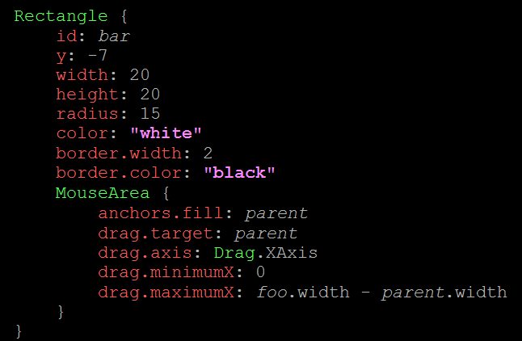
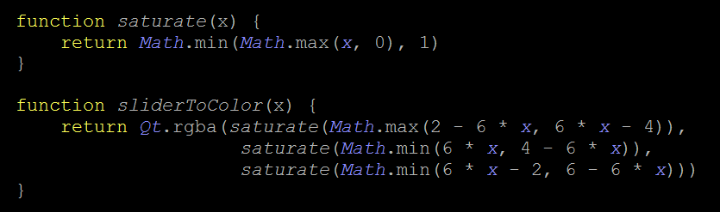
QML
Just now I have introduced how to use
setStyleSheet(QString) to introduce CSS to Qt.
QML is another way (actually another program-ming language) to introduce CSS to Qt.
QML is similar to a combination of CSS and Java-Script in appearance.

Slide 20


