Slide 1
了解编译器优化
Compiler Optimizations

Slide 2
The two most important characteristics：
execution time
(code size)
Expense :
compilation time
possibly the ability to debug the program

Slide 3
Options that Control Optimization
-O1 without performing any optimizations that take a great deal of compilation time
-O2 perform nearly all supported optimizations that do not involve a space-speed tradeoff
-O3 optimize yet more
-Os enable all -O2 optimizations that do not typically increase code size
(多用于嵌入式系统)
-Og enable optimizations that do not interfere with debugging
Using the GNU Compiler Collection (GCC)

Slide 4
Optimization Flags
-fauto-inc-dec -fbranch-count-reg -fcombine-stack-adjustments -fcompare-elim -fcprop-registers -fdce -fdefer-pop -fdelayed-branch -fdse -fforward-propagate -fguess-branch-probability -fif-conversion2 -fif-conversion -finline-functions-called-once -fipa-pure-const -fipa-profile -fipa-reference -fmerge-constants -fmove-loop-invariants -freorder-blocks -fshrink-wrap -fshrink-wrap-separate -fsplit-wide-types -fssa-backprop -fssa-phiopt -ftree-bit-ccp -ftree-ccp -ftree-ch -ftree-coalesce-vars -ftree-copy-prop -ftree-dce -ftree-dominator-opts -ftree-dse -ftree-forwprop -ftree-fre -ftree-phiprop -ftree-sink -ftree-slsr -ftree-sra -ftree-pta -ftree-ter -funit-at-a-time -fthread-jumps -falign-functions -falign-jumps -falign-loops -falign-labels -fcaller-saves -fcrossjumping -fcse-follow-jumps -fcse-skip-blocks -fdelete-null-pointer-checks -fdevirtualize -fdevirtualize-speculatively -fexpensive-optimizations -fgcse -fgcse-lm -fhoist-adjacent-loads -finline-small-functions -findirect-inlining -fipa-cp -fipa-bit-cp -fipa-sra -fipa-icf -fisolate-erroneous-paths-dereference -flra-remat -foptimize-sibling-calls -foptimize-strlen -fpartial-inlining -fpeephole2 -freorder-blocks-algorithm=stc -freorder-blocks-and-partition -freorder-functions -frerun-cse-after-loop -fsched-interblock -fsched-spec -fschedule-insns -fschedule-insns2 -fstore-merging -fstrict-aliasing -fstrict-overflow -ftree-builtin-call-dce -ftree-switch-conversion -ftree-tail-merge -fcode-hoisting -ftree-pre -ftree-vrp -fipa-ra -finline-functions -funswitch-loops -fpredictive-commoning -fgcse-after-reload -ftree-loop-vectorize -ftree-loop-distribute-patterns -fsplit-paths -ftree-slp-vectorize -fvect-cost-model -ftree-partial-pre -fpeel-loops -fipa-cp-clone options

Slide 5
Two steps:
from Source Code to Intermediate Representation(IR)
reduce the amount of computation
from IR to object code (machine code generation)
to make the full use of hardware

Slide 6
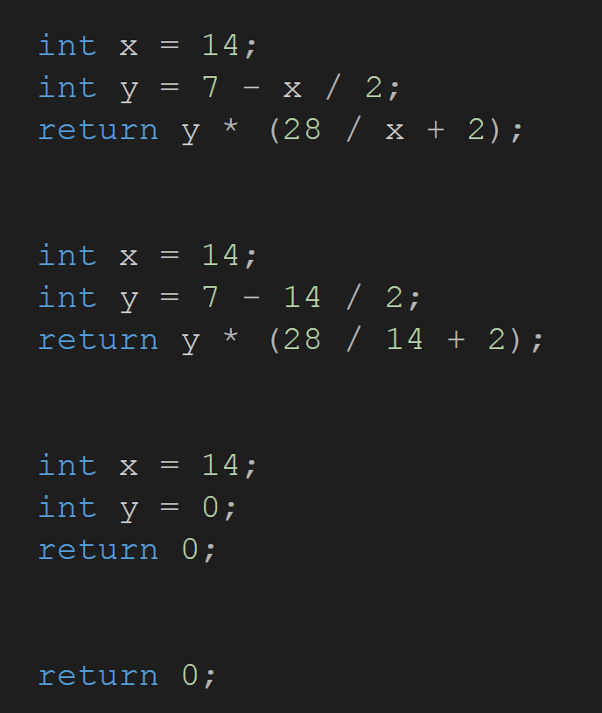
Common Practice from Source Code to Intermediate Representation
Constant Propagation
substitute the values of known constants in expressions at compile time
Constant Folding
recognize and evaluate constant expressions at compile time rather than computing them at runtime
Dead Code Elimination

Slide 7
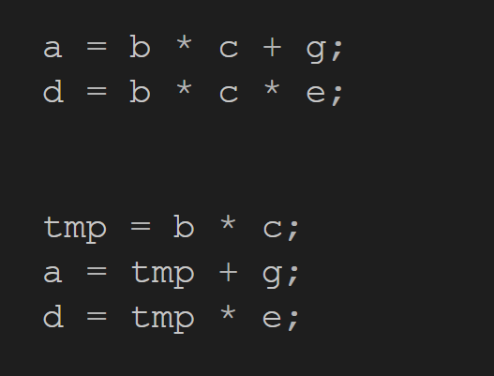
Common Subexpression Elimination
search for instances of identical expressions, and analyzes whether it is worthwhile replacing them with a single variable holding the computed value
It happens when the time cost of calculating "b * c" an extra time outweighs the cost of storing and retrieving "tmp" .

Slide 8
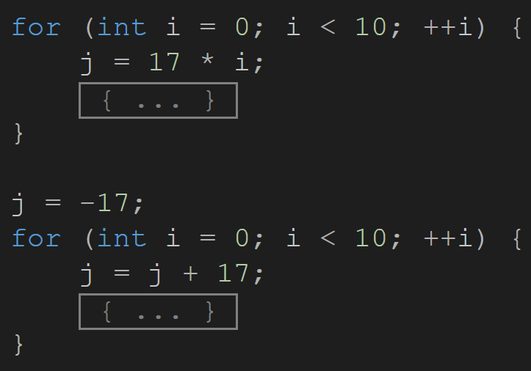
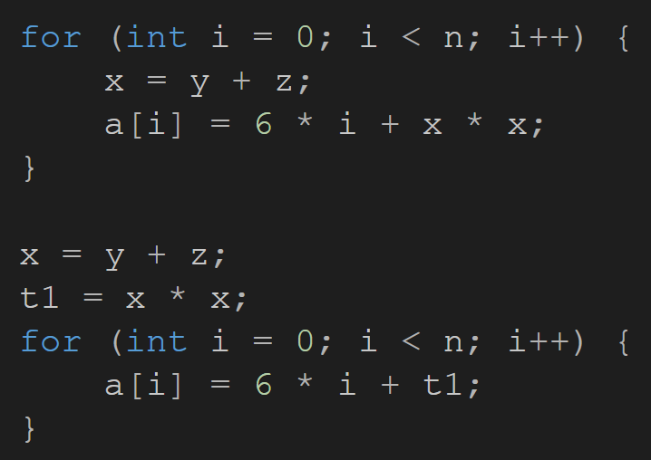
Strength Reduction
replace slow operations with faster equivalents
Loop-invariant Code Motion
move statements outside the body of a loop without affecting the semantics of the program

Slide 9
Machine Code Generation
Register Allocation
Instruction Selection and Scheduling

Slide 10
space-speed tradeoff

Slide 11
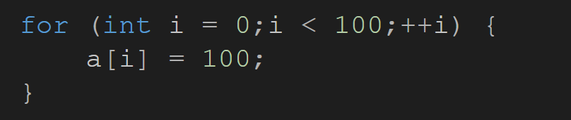

Loop Unrolling
increase code size
decrease the number of operations
further optimizations
potentially be executed in parallel
……

Slide 12
Inlining
replace a function call site with the body of the called function
-finline-functions-called-once
-finline-small-functions
-finline-functions

Slide 13
Inlining
advantages
disadvantages
eliminate instructions required for a function call
"global optimizations" becomes possible on the enlarged function body
register allocation can be done across the larger function body
large functions that are used in many places greatly increase code size
code expansion may hurt instruction cache performance

Slide 14
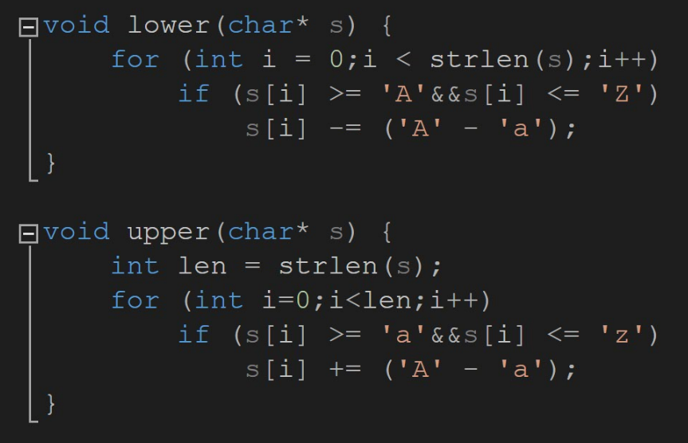
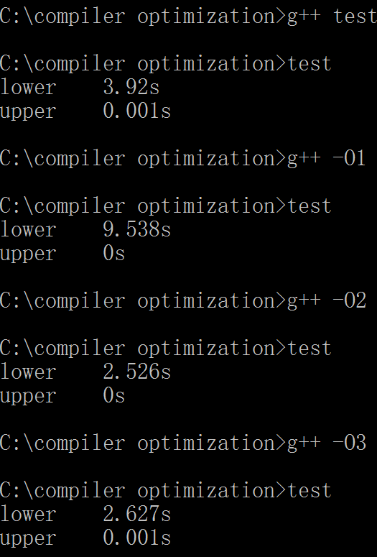
An example

Slide 15
Conclusion
It’s much better to focus on writing understandable code, than making manual optimizations that result in cryptic, hard-to-maintain code.
..Avoid writing both unnecessary and extremely inefficient codes, especially those block the optimization.

