Slide 1
A brief introduction to Protocol Buffer
计65 琚锡廷 2016011366

Slide 2
What is protocol buffers
a flexible, efficient, automated mechanism for delivering structured data between different programs.

Slide 3
How does it work
You define how you want your data to be structured once, then you can use special generated source code to easily write and read your structured data to and from a variety of data streams and using a variety of languages.
Serializing -> deliver -> Parsing
OK.But what should we do when using it?

Slide 4
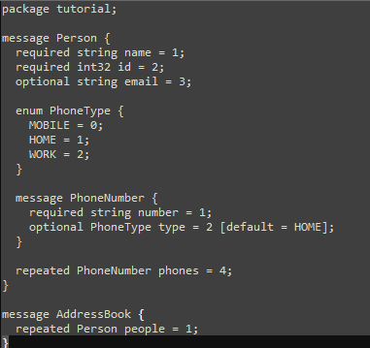
Create a .proto file define the protocol format
Package → namespace
Message → class/struct
Field type:
required/optional/repeated
optional:a single variable.
required:a value for the field must be provided.Other than this,a required field behaves exactly like an optional field.
repeated:the field may be repeated any number of times(0 is ok).Similar to dynamically sized arrays

Slide 5
Create a .proto file define the protocol format
Data types:
String/int32/bool/other messages
Tags:
0/1/2
the unique "tag" that field uses in the binary encoding.
There can’t be more than one same tags in a message

Slide 6

Compile the protocol buffers
-I=SRC_DIR the source directory
--cpp_out=DST_DIR the destination directory
-SRC_DIR/ .proto the path to the .proto file
This will generate two files
h:the header file while declares the generated classes
cc:It contains the implementation of the classes

Slide 7
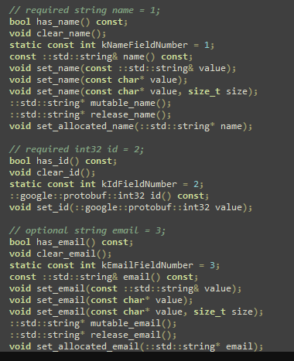
Protocol Buffer API
has_xxx():to check is it has been set
set_xxx():to set a value for it
xxx():to get its value
clear_xxx():the field back to its empty stateun_sets
mutable_XXX():a getter set for “strings” type
You can call mutable_xxx() even if it is not set,it will be initialized to an empty string automatically

Slide 8
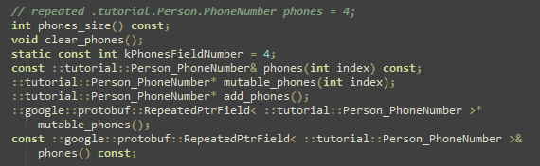
Protocol buffer API
Some functions for repeated field:
size():the numbers of element
add_xxx():add a new element to the repeated field

Slide 9
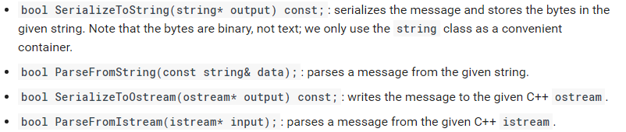
Protocol Buffer API
Parsing and serializing

Slide 10
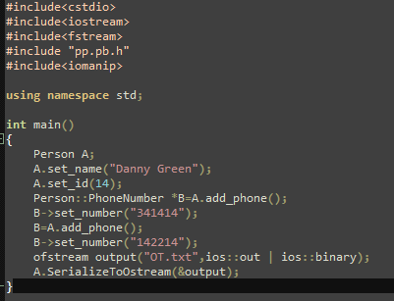
Example codes
Include the header file it produces and then you can use the functions it created in the class

Slide 11

Build the Protocol Buffer in Windows using MinGW
1. Install MSYS with MinGW
2. Extract the source tarball to your MSYS home directory.
3 .Go to the directory<… \minGW\msys\1.0> and double click the “msys.bat” and then run the Unix scripts as follow
Then you can compile your programs using command line

Slide 12
Compile the program using command line
Use the command to produce an executive file

Slide 13
Thank you.
For more information,please visit https://developers.google.com/protocol-buffers

