Slide 1
Enterprise Resource Planning and Supply Chain Management
Shaohong Fang
fangshaohong@hust.edu.cn

Slide 2
Reference
“Concepts in Enterprise Resource Planning”, Joseph A. Brady ( University of Delaware), Thomson Learning，2001.
“SAP R/3 Business Blueprint Understanding Enterprise Supply Chain Management”, Thomas A. Curran, Higher Education Press. 2003.
ERP原理设计实施，罗鸿，电子工业出版社

Slide 3
Contents
Chapter 1: Business Functions, Processes, and Date Requirements
Chapter 2: The Development of Enterprise Resource Planning System
Chapter 3: Marketing Information Systems and the Sales Order Process

Slide 4
Contents
Chapter 4: Production and Materials Management Information Systems
Chapter 5: Accounting and Finance
Chapter 6: Human Resource Management
Chapter 7: Supply Chain Management
Chapter 8: ERP Implementation

Slide 5
1 Business Functions, Processes, and Data Requirements
  Name a business’s main functional areas of operation.
  Differentiate a business process from a business function.
  Identify the kinds of data that each main functional area produces.
  Identify the kinds of data that each main functional area needs.
  Define integrated information systems and state why the are important.

Slide 6
1.1 Functional Areas and business Processes
1.1.1 Functional areas of Operation
Each functional area comprises a variety of Business Functions
Marketing and Sales: Marketing, sales order processing, customer relationship management, customer support, sales forecasting, advertising.
1.1.1 Functional areas of Operation
Each functional area comprises a variety of Business Functions
Marketing and Sales: Marketing, sales order processing, customer relationship management, customer support, sales forecasting, advertising.

Slide 7
Production and Materials Management: Purchasing, receiving, transportation/logistics, production scheduling, manufacturing, and plant maintenance
Accounting Finance: Financial accounting, cost allocation and control, planning and budgeting, and cash-flow management
Human Resources: Recruiting and hiring, training, payroll, and benefits

Slide 8
1.1.2 Business Processes
A Business Processes
is a collection of activities that takes one or more kinds of input and creates an output that is of value to the customer.
Inputs Process Outputs

Slide 9
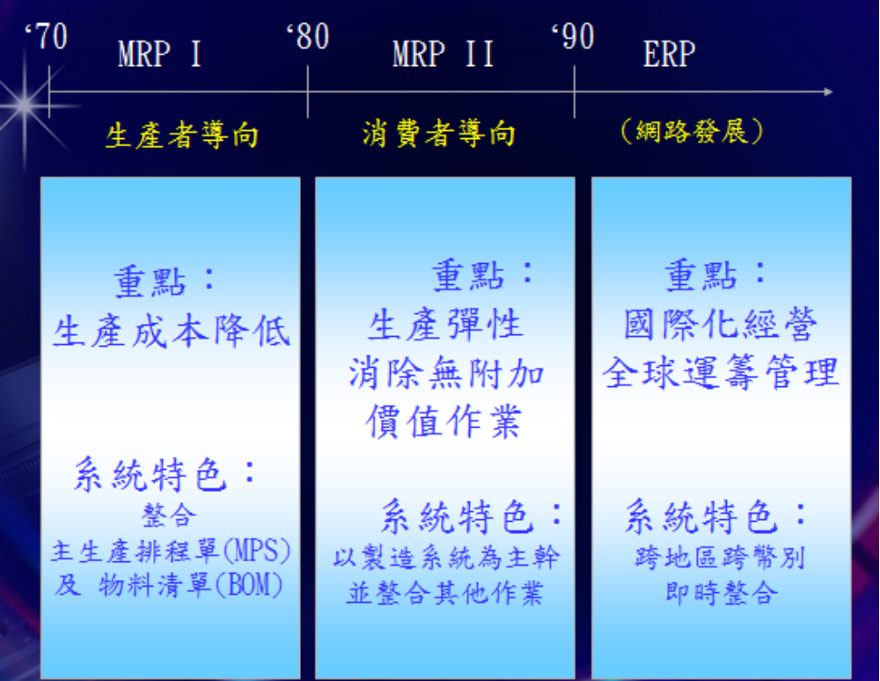

Slide 10
Customer Order
Sales
Accounting
Purchasing
Production
Logistics
Material Order
A process view of business

Slide 11
Integrated information systems
Sharing data effectively and efficiently between and within functional areas leads to more efficient business processes.
Information systems can be designed so that accurate and timely data are shared between functional areas.

Slide 12
1.2 Functional Areas and Business Processes of a Very Small Business
A lemonade stand
1 Marketing and Sales
The functions within Marketing and Sales include developing products, determining pricing, promoting products to customers, and taking customers’ orders. It also helps to create a sales forecast that will be used to ensure the successful operation of the stand.

Slide 13
Production and Materials
Management
Functions within Production and Materials Management include making the lemonade and buying raw materials.

Slide 14
3 Accounting and Finance
Functions within Accounting and Finance include recording raw data about transactions, including sales, raw material purchases, payroll, and receipt of cash from customers. To determine the profitability of the lemonade stand and to support decision making.

Slide 15
4 Human Resources
Even in a simple business, employees must be found to support the Sales and Production functions. This implies a need to recruit, train, evaluate, and compensate employees.

Slide 16
1.3 Functional Area Information Systems
1. Marketing and Sales
Process sales order
Analysis sales trends
Determine product price

Slide 17
Marketing and Sales
Legal requirements
and job information
Customer
HR
Sales order
Hiring needs and
personnel information
Order status
Sales forecasts
and sales orders
M/S
Sales order
data
Product
availability data
and order status
P/MM
Cost/profit
analysis
A/F

Slide 18
2. Production and Materials Management
Long-range plans
Medium-range plans
Short-range plans

Slide 19
Production and Materials Management
Legal requirements
and job information
Raw materials
availability and
delivery
Suppliers
HR
Orders for raw
materials and
supplies
Hiring needs and
personnel information
Production
plans,materials,
and inventory
P/MM
Product
availability
data and
order status
Sales data and
manufacturing
cost analysis
A/F
Sales forecasts
and sales order
M/S

Slide 20
3. Accounting and Finance
Record the company’s transaction in
the books of account.
sales and payments
raw materials and payments
preparing reports

Slide 21
Accounting and Finance
Legal requirements
and job information,
payroll and benefit
expense data
Customer
HR
Payment
Invoices and
credit memos
Hiring needs and
personnel information
A/F
Sales data and
manufacturing
cost analysis
Cost/profit
analysis
Production plans,
materials, and
inventory data
Sales order
data
P/MM
M/S

Slide 22
4. Human Resources
To properly recruit new employees, HR need accurate forecasts of personnel needs.
What skills are needed to perform a particular job.
How much the company can afford to pay employees.

Slide 23
Human Resources
Hiring needs and
personnel information
A/F
Payroll and benefit/expense
data,legal requirements
and job information
Legal requirements
and job information
HR
Legal requirements
and job information,
Hiring needs
and personnel
information
P/MM
Hiring needs
and personnel
information
M/S

Slide 24
Summary
1. Four basic functional areas and its functions
M/S: sets product price, promotes products,
takes customer orders, and creates sales
forecasts.
P/MM: develops manufacturing plans, orders
raw materials from suppliers, receives the
raw material into the facility, manufactures
products, and ships products to customers.

Slide 25
Summary
A/F: records sales transactions, record
customers’ payments, records suppliers’
invoices and payments to suppliers, and
summarizes operational data in managerial
reports.
H/R: recruits, trains, compensates, and oversees the
evaluation of employees.
2. A functional area is served by an information system.

Slide 26
Summary
3. Employees working in one functional area need data
from those in other functional areas. Ideally, functional area information systems should be integrated, so shared data are accurate and timely.
4. Today business managers try to think in terms of
business process that integrate functional areas, in
order to promote efficiency and competitiveness.
ERP software allow all functional areas to use a single common database, so that accurate, real time
information is available.

