Slide 1
C2 The Development of Enterprise Resource Planning Systems
Objectives
Identify the factors that led to the development of Enterprise Resource Planning(ERP) systems.
Describe the distinguishing characteristics of ERP software.
Discuss the pros and cons of implementing an ERP system.
Summarize ongoing developments in ERP.
Chapter2:The Development of ERP Systems

Slide 2
C2 The Development of Enterprise Resource Planning Systems
Contents
2.1 The Evolution of Information Systems
2.2 ERP Software Emerges: SAP and R/3
2.3 Questions About ERP
2.4 The Continuing Evolution of ERP
Chapter2:The Development of ERP Systems

Slide 3
2.1 The Evolution of Information Systems
Current ERP Systems evolved as a result of
1. The development of hardware and software
technology need to support the system
2. The development of a vision of integrated
information systems
Chapter2:The Development of ERP Systems

Slide 4
2.1 The Evolution of Information Systems
Hardware:
faster computers, networked access,
and c/s architecture
Software:
database, software tools
The Manufacturing Roots of ERP
MRP: Materials Requirements Planning
MRP II: Manufacturing Resource Planning
EDI: Electronic data interchange
SCM: Supply-chain management
Chapter2:The Development of ERP Systems

Slide 5
The development of a vision of integrated
information systems
Management’s Impetus to Adopt ERP
The difficult economic times in later 80s.
“Reengineering the Corporation:
a Manifesto for Business Revolution”
Michael Hammer, 1993
Chapter2:The Development of ERP Systems

Slide 6
2.2 ERP Software Emerges: SAP and R/3
1. SAP Begins Developing Software Modules
Batch mode financial accounting package.
A standard, real-time financial accounting package.
Materials Management program.
Asset Accounting.(1977)
R/2 system.(1978)
Cost Accounting, Production Planning and Control,
Personnel Management, and Plant Maintenance.(80s)
Chapter2:The Development of ERP Systems

Slide 7
2. SAP ‘s R/3 Release
Marketing
and Sales
Accounting
and Finance
Central Data
Production and
Materials
Management
Human
Resources
Chapter2:The Development of ERP Systems

Slide 8
R/3 经营应用
ABAP/4 开发平台
R/3 基础软件或中间件
通用API
UNIX/Linux
Windows NT
OS/400
通用API
Oracle
SQl server
Adabas
Informix
DB2/6000
通用API
TCP/IP
RPC
FRC
通用API
Windows
Motif
OS/2 PM
Macintosh
Chapter2:The Development of ERP Systems

Slide 9
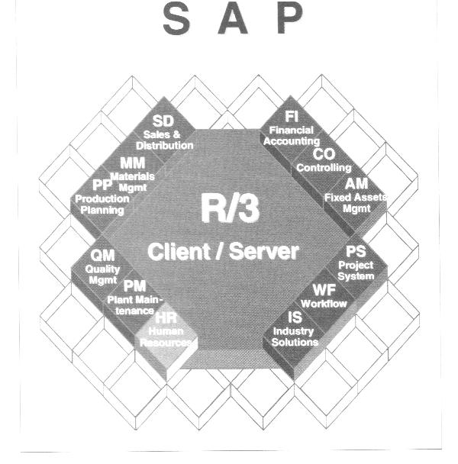
Chapter2:The Development of ERP Systems

Slide 10
Modules within SAP’s R/3 integrated information
systems environment
SD-Sales and Distribution
MM- Materials Management
PP- Production Planning
QM- quality Management
PM- Plant Maintenance
HR- Human Resources
FI- Financial Accounting
CO- Controlling
AM- Asset Management
PS- Project System
WF- Workflow
IS- Industry Solutions
Chapter2:The Development of ERP Systems

Slide 11
2.3 The Significance and Benefits of ERP
Software and Systems
1. ERP allows easier global integration
2. ERP not only integrates people and data, but it
also eliminates updating and repairing many
separate computer systems.
3. ERP allows management to manage operations,
not just monitor them
Chapter2:The Development of ERP Systems

Slide 12
2.4 Questions About ERP
1.How much does an ERP Package Cost
2. Should every business buy an ERP Package
3. Is ERP software inflexible
4. What return can be expected from an ERP investment
5. How long does it take for most companies to see a return on an ERP investment
6. Why do some companies have more success with ERP than do others
Chapter2:The Development of ERP Systems

Slide 13
2.5 The Continuing Evolution of ERP
1. Additional capabilities within ERP
Customer Resource Management packages
Decision support, management reporting, and
data mining.
Integrates the business with its dealers, vendors,
and customers
2. The Internet
Oracle NetSuite: http://www.netsuite.com/
SAP: https://www.sap.com
Microsoft dynamics: https://dynamics.microsoft.com
Chapter2:The Development of ERP Systems

Slide 14
Summary
1. Several factors led to the development of ERP
The speed and power of computing hardware increased
exponentially, while cost and size decreased.
The early c/s architecture provided the conceptual
framework for multiple users sharing common data
Increasingly sophisticated software facilitated integration,
especially in two areas: Accounting/Finance and
Manufacturing Resource Planning
The growth of business size, complexity, and competition
made business managers yearn for more efficient and
competitive information systems.
Chapter2:The Development of ERP Systems

Slide 15
2.SAP AG produced a complex, modular ERP program
called R/3. The software could integrate a company’s
entire business by using a common database that
linked all operations, allowing real-time data sharing
and streamlined operations.
3. Purchasing ERP software is expensive, time consuming
to implement, and requires significant employee training,
but the payoffs can be spectacular. For some companies,
however, the ROI may not be immediate or even calculable.
4. In the future, experts anticipate that ERP’s focus will
be on managing customer relationships, improving
planning and decision making, and linking operations
to the Internet.
Chapter2:The Development of ERP Systems

Slide 16
Exercises
1.
Imagine that you have a job interview with the owner of a manufacturing company that employs about 300 people. The owner of the company has heard about ERP, but she hasn't done any research on it. She asks you, "Do you think we need an ERP system?" What would you say to her? What questions might you ask to help her think about ERP in her company? List your response and questions.
2
Using library resources or the Internet, report on (1) one company’s positive experience with implementing ERP and (2) one company’s disappointing experience.
Chapter2:The Development of ERP Systems

