Slide 1
C3 Marketing Information Systems and the Sales Order Process
Learning Objectives
Describe the un-integrated sales processes of Fitter Snacker, a fictitious company whose operations are used as an example.
Explain why un-integrated Sales and Marketing information systems lead to company-wide inefficiency, higher costs, lost profits, and customer dissatisfaction.
Discuss sales and distribution in SAP R/3 system, and explain how integrated data sharing increases company-wide efficiency.
Describe how SAP R/3 processes a standard sales order.
Describe the benefits of Customer Relationship Management software, a useful extension of ERP software.

Slide 2
C3 Marketing Information Systems and the Sales Order Process
Contents
3.1 Overview of Fitter Snacker
3.2 Problems with Fitter Snacker’s Sales Process
3.3 Sales and Distribution in ERP
3.4 A Standard Order in SAP R/3
3.5 Customer Relationship Management

Slide 3
3.1 Overview of Fitter Snacker
Productions:
  NRG-A: Advanced Energy
  NRG-B: Body Building Proteins
  Ingredients: Vitamins and minerals, dry base mixture, and wet base mixture.
Sales:
  Wholesale division: sells to middlemen.
  Direct sales division:sells directly to large grocery stores, chain stores.
  2% discount with paying in 10 days.

Slide 4
3.2 Problems with Fitter Snacker’s Sales Process
Three un-integrated information systems: the sales order system, the warehouse system, and the accounting system. Data shared by periodic file transfers and by paper printout.
12 Sales, 6 for each sales division, 4 work on road, and 2 work in office.
“Discretionary discounts”

Slide 5
Price quote
Sales Order
Sales
Pick, Pack, and Ship
Warehouse
Accounting
Invoice
Payment
Receiving
Fitter Snacker’s Sales Process
Returns

Slide 6
Sales Quotations and Orders
  Prepare a handwritten quotations.
  Fax quotations to the sales office.
  Place an order, get a shipping date.
  Check the customer’s credit status.
  Enter the customer’s order.

Slide 7
Order Filling
  Packing lists and shipping labels are printed twice a day.
  FS bars are packed 24 to a display box,12 display box form a standard shipping case.
  Picking
  Packing
  Shipping
  Contact the sales

Slide 8
Accounting and Invoicing
  Three times a week, sales clerks send the Accounting department the disk containing the sales order data for customer invoices.
  Manually make adjustments for partial shipments and any other changes that occurred during the order process.

Slide 9
Payment and Returns
  Payment
    Confirm invoices
    Payment
    “During ” letter
  Returns
    Customers call FS to get a RMA number
    Receiving returned material with its RMA number.
    Accounting department credit the appropriate account.

Slide 10
3.3 Sales and Distribution in ERP
Sales Order Processing
Pre-Sales Activities
Inventory Sourcing
Payment
Delivery
Billing

Slide 11
Briefly describe four kinds of decisions made by Marketing managers
  What products should we sell?
  How are the products best promoted?
  What price should we charge?
  How should we distribute?

Slide 12
Pre-Sales Activities
  A customer can get pricing information
    An inquiry
    A price quotation
  Marketing activities
    Tracking customer contacts
    Maintain data of customer
Sales Order Processing
  Collect customers’ information
  Record items, prices, and quantities
  Check the customer’s credit availability
    Corrective action can be configured

Slide 13
Inventory Sourcing
  Check the inventory records
  Check the production planning records
Delivery
  Releasing the documents that the warehouse will use to pick, pack, and ship orders.
Billing
  Create an invoice.
  Accounting
Payment
  Accounting

Slide 14
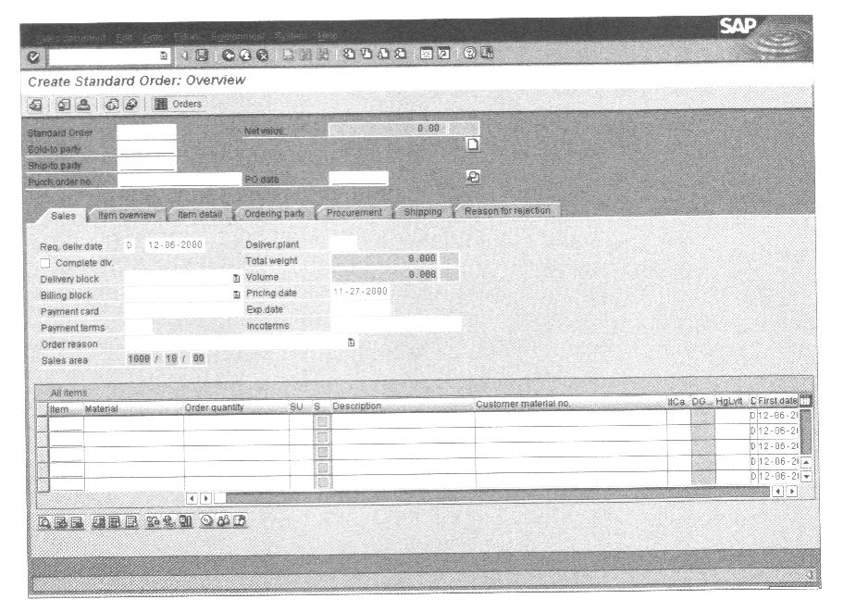
3.4 A Standard Order in SAP R/3
Taking an Order in SAP’s R/3

Slide 15
  Data entry field and explanation:
    Sold-to party, the seller’s code number for the customer.
    Purch. Order no., the customer’s purchase order number, which is on the customer’s order form.
    Req.deliv.date, Requested delivery date—the date the customer wants to receive the order.
    Material, a code number for the inventory item ordered.
    Order quantity, the number of units the customer ordered.

Slide 16
  Customer Master Data
  Material Master Data
  Organizational Structures
    Grouping customers and salespeople
    Distribution Channel
  Document flow
    Document number
    Delivery
    Picking
    Goods issue
    Invoice
    Accounting

Slide 17
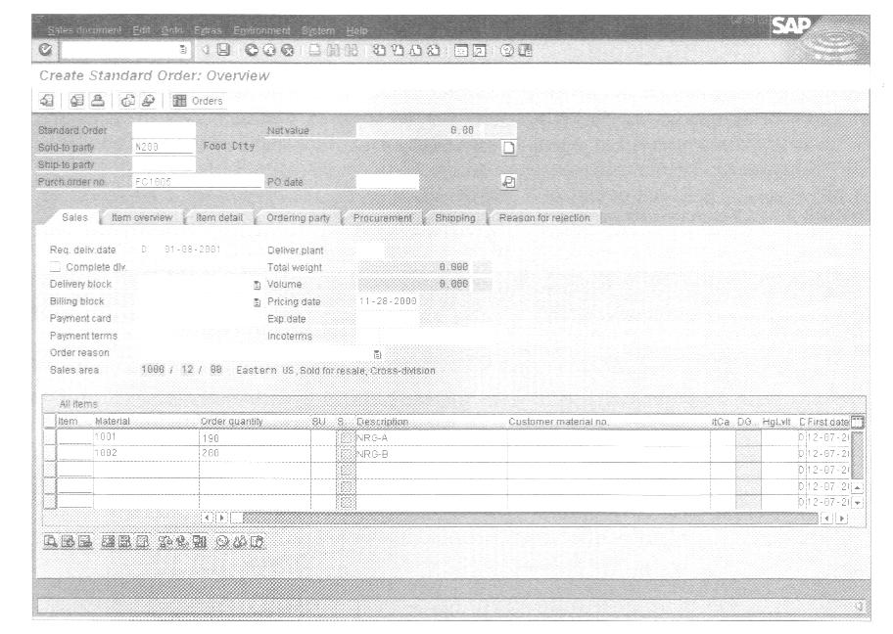

Slide 18
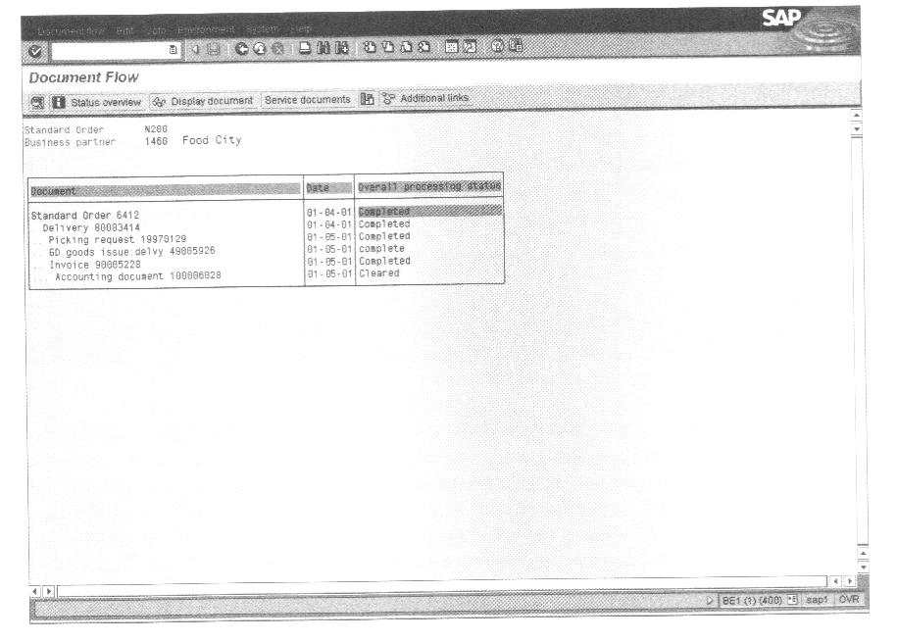

Slide 19
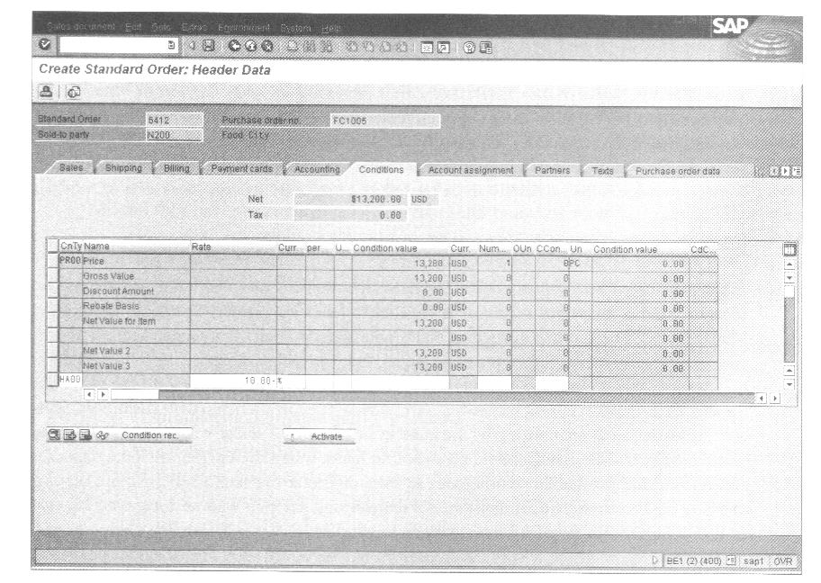
Discount Pricing in SAP

Slide 20
Integration of sales and accounting
  Keep billing information up to date
  Keep discounts report up to date

Slide 21
3.5 Customer Relationship Management
CRM as a corporate strategy
  To determine each customer’s needs and then uses that knowledge to build a long-term relationship with each customer.
CRM as a set of activities
  To segment customers by data warehouse and data mining.
  One to One Marketing
  Sales Force Automation
  Sale Campaign Management Software
  Marketing Encyclopedias
  Call Center Automation

Slide 22
CRM needs ERP as a base
The benefits of CRM
  Lower costs
  Higher revenue
  Improved strategy and performance measurement
Another look at CRM
  CRM is a set of related marketing-oriented activities.
  Dell Computer Corp.
  BMG Music Services

Slide 23
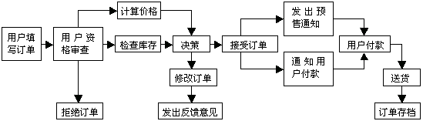

Slide 24
Summary
Fitter Snacker’s un-integrated information systems are at the root of an inefficient and costly sales order process. Because information is not shared in real time, customers are asked to repeat initial sales order information. As an order is processed, invoicing also occur, presenting a poor company image to customers. Integrated ERP software would let FS avoid errors because all customer data are stored in a central database that is shared in real time by all company employees.
An ERP system such as SAP’s R/3 sees a sale as a cycle of related functions, including taking orders, setting prices, checking product availability, checking the customer’s credit line, arranging for delivery, billing the customer, and collecting payment. In R/3 all these transactions, or documents, are electronically linked, so tracking an order’s status (partial shipments, returns, partial payments, and so forth) is easily accomplished.

Slide 25
When an ERP system is installed, various configuration decisions are made. These decisions reflect management’s desires of how transactions should be recorded and later used for decision making. For example, the system can be configured to limit selling price discounts, thus avoiding unprofitable pricing.
An ERP system’s central database has master data tables for customers, suppliers, and inventory. The tables hold relatively permanent information about each subject.
Customer Relationship Management systems build on what ERP provides, in particular on the company’s common database. There are various kinds of CRM software, some available from ERP vendors and some from third-party software companies. CRM software can lead to operational savings, but most companies buy it because they feel that having better customer relationship will result in higher revenues.

