Slide 1
C4 Production and Materials Management Information Systems
Learning Objectives
Describe the steps in the production planning process of a high-volume manufacturer such as Fitter Snacker.
Describe Fitter Snacker’s production and materials management problems.
Describe how a structured process for production and materials management planning enhances efficiency and decision making.
Describe how production planning data in an ERP system can be shared with suppliers to increase supply-chain efficiency.

Slide 2
C3 Marketing Information Systems and the Sales Order Process
Contents
4.1 Production Overview
4.2 The Production Planning Process
4.3 ERP in Supply-Chain Management

Slide 3
Managers in FS’s Production and Materials Management departments must answer three questions:
How many of each snack bar should we produce?
What quantities of raw materials should we order so we can meet that level of production?
When should we order raw materials?

Slide 4
4.1 Production Overview
There are three general approaches to production:
  Make-to-stock
  Make-to-order
  Assemble-to-order
Fitter Snacker’s Manufacturing Process
Mixer
Snack Bar Line
Form Bake Pack
Raw
Material
Warehouse
Finished
Goods
Warehouse
Mixer
Mixer
Mixer

Slide 5
Fitter Snacker’s Production Sequence
Fitter Snacker’s Production Problems
  Communications Problems
    Marketing personnel do not share information with production personnel
    When Production must meet an unexpected increase in demand,
      Depleting warehouse inventories
      Causing Shortages or a stock out of materials
      Degrading performance of Production personnel
  Invertory Problems
  Accounting and Purchasing Problems

Slide 6
4.2 The Production Planning Process
Production planners follow three important principles:
  Work from a sales forecast to create an ‘aggregate’ production plan for all products.
  Break down the aggregate plan into more specific production plans for individual products and limited time periods
  Use the production plan to determine raw material requirements.
The R/3 Approach to Production Planning

Slide 7
Sales Forecasting
Sales and Operations Planning
Demand Management
Detailed Scheduling
MRP
Purchasing
Production

Slide 8
The R/3 Approach to Production Planning
  Sales Forecasting
  Sales and Operations Planning
  Demand Management
  MRP and Purchasing/Materials Management
  Detailed Scheduling

Slide 9
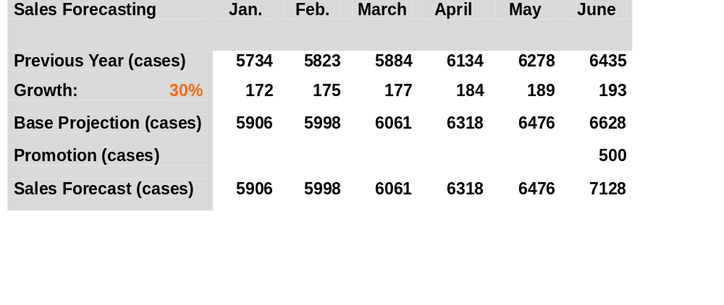
Fitter Snacker’s sales forecast for January through June

Slide 10
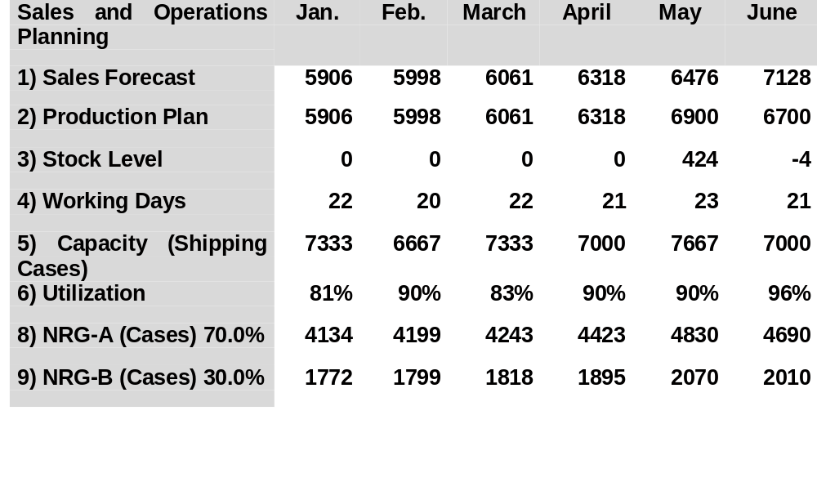
Fitter Snacker’s sales and operations plan for January through June

Slide 11
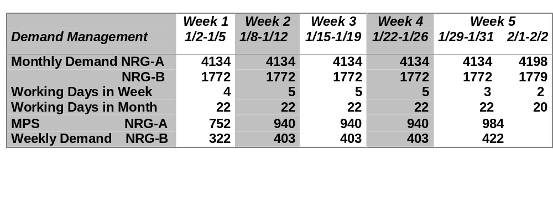
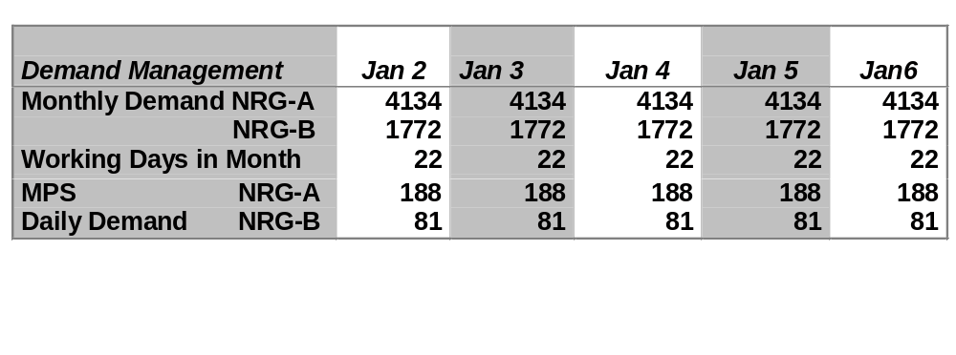
Fitter Snacker’s production plan for January: The first five weeks of production are followed by a day-by-day disaggregation of week 1

Slide 12
 | Quantity
Ingredient | NRG-A | NRG-B
Oats(lb.) | 300 | 250
Wheat germ (lb.) | 50 | 50
Cinnamon(lb.) | 5 | 5
Nutmeg(lb.) | 2 | 2
Cloves(lb.) | 1 | 1
Honey(gal.) | 10 | 10
Raisins(lb.) | 50
Protein Powder (lb.) |  | 50
Hazelnuts(lb.) |  | 30

Slide 13
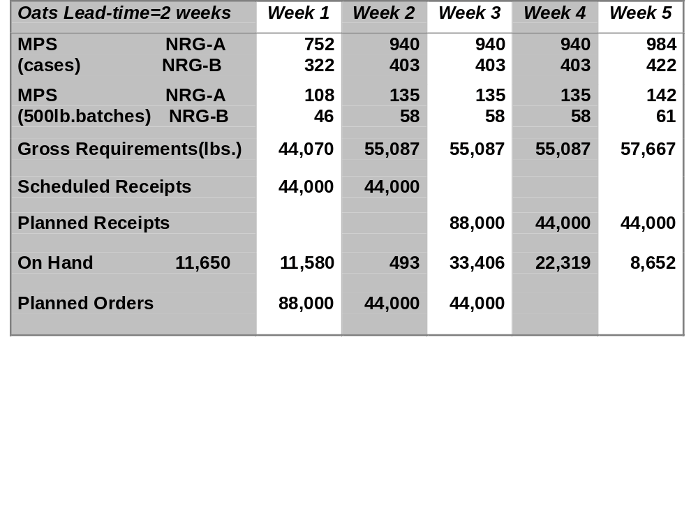
The MRP record for Fitter Snacker, weeks 1 through 5

Slide 14
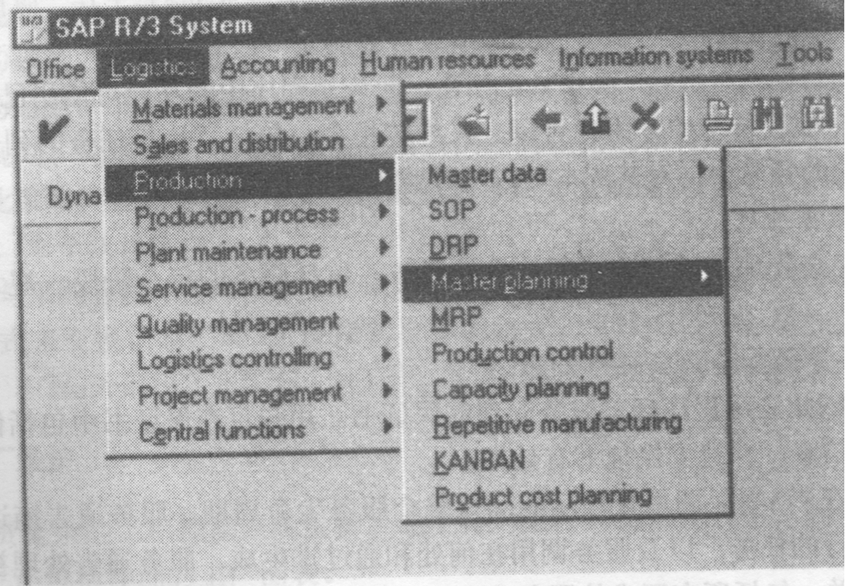

Slide 15
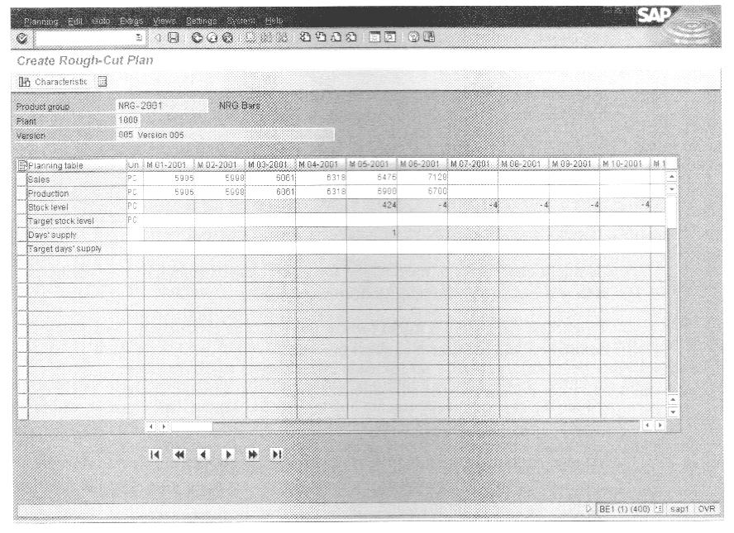

Slide 16
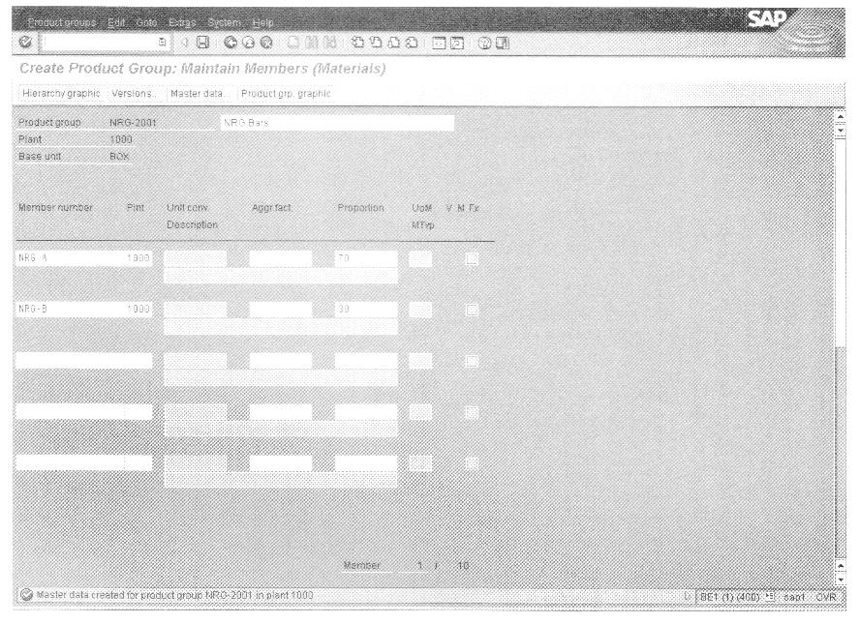

Slide 17
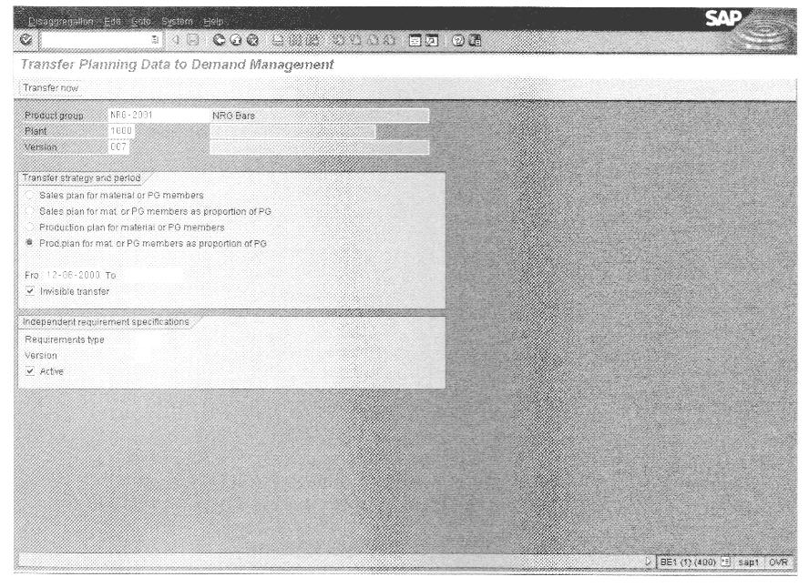

Slide 18
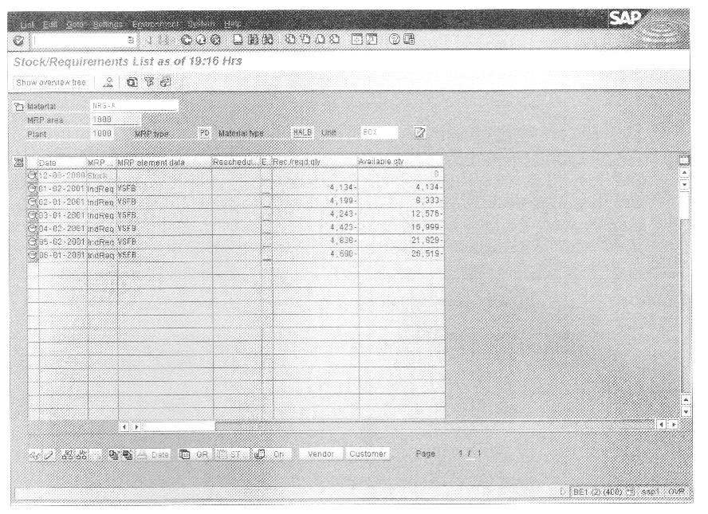

Slide 19
