Slide 1

C6 Organization and Human Resource Management d Finance
Learning Objectives
State and describe human resource functional area activities.
Explain the main human resources processes, organizations, scenarios, and business objects in SAP R/3.
Understand the Event-driven Process Chain Methodology.
Understand the event, function, information object, control flow in recruitment process.

Slide 2
C6 Organization and Human Resource Management
Contents
6.1 Human resource activities.
6.2 Overview of Human Resource
Management in SAP R/3.
6.3 Event-driven Process Chain
Methodology.
6.4 Recruitment Process

Slide 3
6.1 Human resource activities
In many industries, such as business consulting or software development, the human assets typically exit the company every evening. Having modern and flexible human resource processes makes better use of these assets and can make the difference in whether a company thrives over time.

Slide 4
Human resource systems cover the following activities:
Human resource organizational management (job description, ergonomics, work-place assessment, salary/wage structure)
Personnel planning (labor market, requirements planning, recruitment planning, etc.)
Recruitment (internal job advertisements, temporary staff, external job advertisements, selection procedures, employment contracts)

Slide 5
Word-force planning and administration (introduction and training labor and social legislation, reorganization due to internal transfer, terminations, dismissals, retirement)
Personnel development (performance appraisal, employee-suggestion system, wage/salary policy)
Personnel training and further education (training of new employees, employee training program)
Social benefits (social facilities, leisure activities, employment protection)

Slide 6
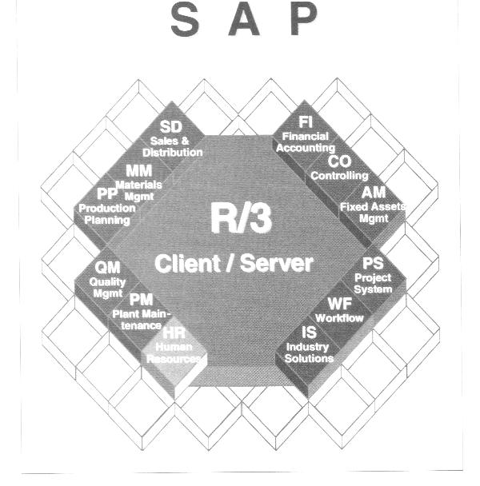
6.2 Overview of Human Resource
Management in SAP R/3

Slide 7
Organizational Units
Personnel area
Personnel sub-area
Employee group
Payroll accounting area
Supply Chain Scenarios
Recruitment
Personnel development
Business trip management
Training and event management
Payroll accounting
Human Resource
Management
Business Objects
Position
Person
Qualification
Business trip
Application
Business Process
Personnel selection
employee hiring
Salary adjustment
Career planning
Personnel development planning

Slide 8
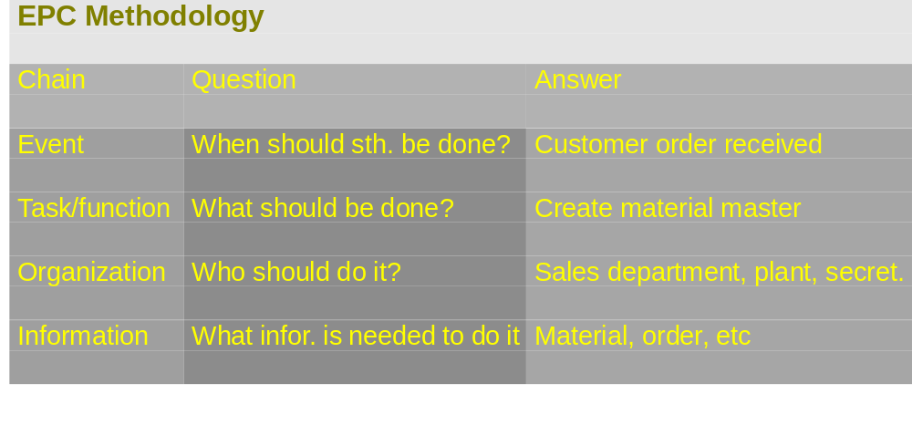
6.3 Event-driven Process Chain
Methodology

Slide 9
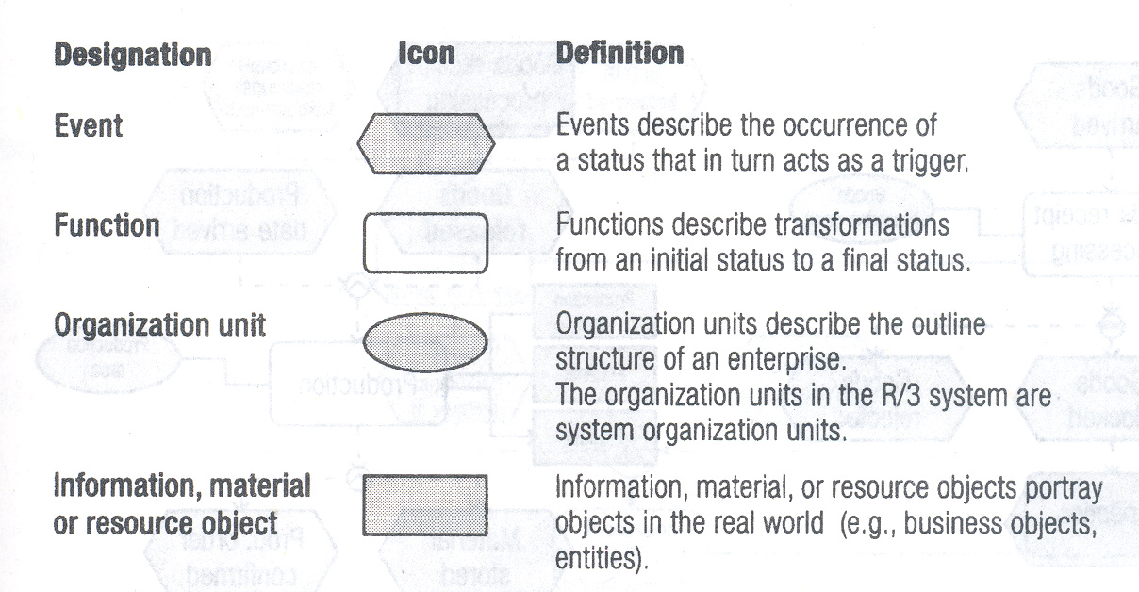
Process description language elements in EPC

Slide 10
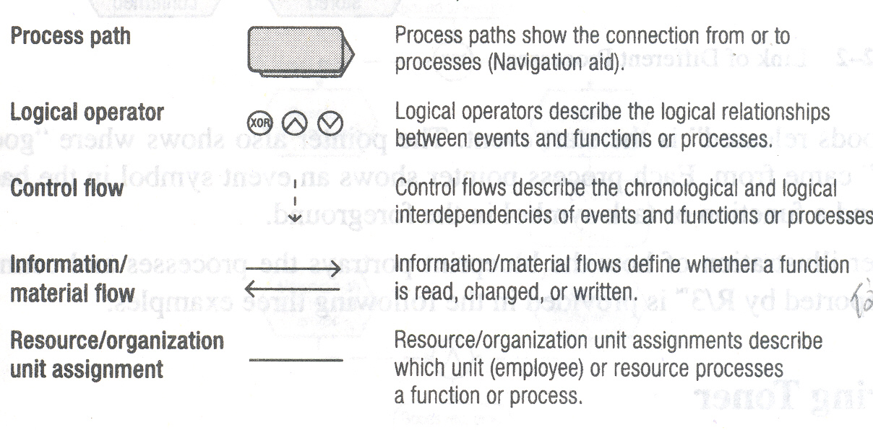

Slide 11
Key to elements of the EPC
Geometric shape designates EPC function.
Arrows made up of dotted lines show the flow of
business.
“Connecting operators” (AND, exclusive/OR, OR)
illustrate alternative or parallel flows of information
through the chain.
Arrows made up of solid lines indicate information is
input into a task or generated by that task.
Connecting lines show which task is assigned to which
organizational unit.

Slide 12
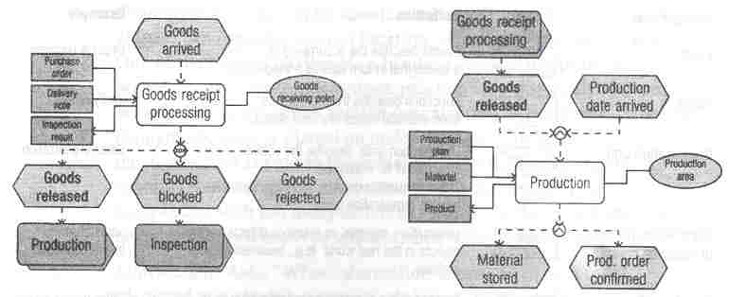

Slide 13
6.4 Recruitment Process
Recruitment
Receipt of
application
Personnel
advertising
Applicant pool
admin.
Personnel
selection
Contract
admin.
Infor.
system
Value chain: Recruitment

Slide 14
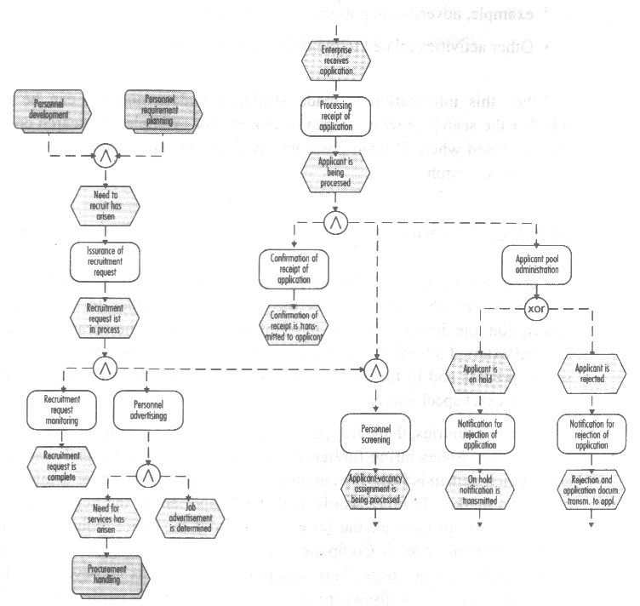

Slide 15
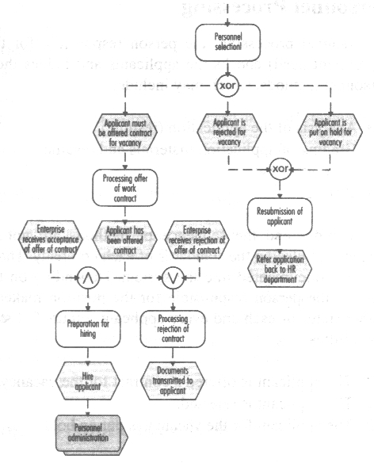

Slide 16
Recruitment Process
Creating a search:
When a company experiences the need for recruitment, a search contract is created in order to handle these needs and document the entire process.
Tracking the search process
The person responsible for the search will need the information followed:
  The number of open and already filled search positions
  The number of open positions for which a candidate has already been found
  The amount of budget, and information about the activities, for example, advertising, publication of positions
  Other activities related to the direct search process

Slide 17
Job Description
  Information about the vacancy
  Information about internal/external job market
  Information about financial resources available to conduct the search process and to fill the position
  Information about special requirements for personnel
Employee application processing
When a company receives an application, the data for the applicant and the application are entered into the R/3 system.
Confirming the application Receipt
The applicant receives a letter in which the company confirms the receipt of the application, printed regular mail, fax, email

Slide 18
Preliminary Personnel Choice
  The company searches through the applicants for the vacant position and checks each applicant to see if he or she has the basic requirements to fill that position.
  Basic requirements profile comparison
  Secondary pool of candidates
Personnel Processing
  The person responsible for the position checks the applicants and judges them by: analysis of the application, grading of application materials and resume, first interview, testing,
  The results of the personnel choice is documented into the system. There three possibilities to applicant: offered a contract, rejected, or on hold.

Slide 19
Employment agreement offer processing
The qualified applicant will receive a written contractual offer from the company
Applicant status check
Preparation for employing the applicant
The acceptance of the contractual offer is documented, the employee’s department head is informed, and the applicant file is converted into a personnel file
Rejection of offer
If the applicant rejects the contractual offer, the event is recorded into the system, and the would-be boss is informed of the rejection. The applicant status is reset to rejected.

Slide 20
Applicant pool administration
All the applicants are administered in a central applicant pool
Putting an application on hold
An applicant would be considered for employment in the company at a later point in time, an offer can be made that allows the application to be placed on hold. The applicant receives a letter.
Rejection of application
The applicant is informed if and when the company decides that it cannot offer a position of employment.

Slide 21
Business analysis based Employee object
The Employee business object is used as a source of information for the following types of business analysis.
Employees who have entered and /of left the company, Family members, Birthday list, Education and training, Telephone directory, employees with powers of attorney, time spent in each pay scale area/type/group/level, reference personnel numbers, absence/attendance data, atts./absences for each employee, remuneration statements, payroll accounts, bank details, employee history report

