Slide 1
C6 ERP and the World Wide Web
Learning Objectives
Name and describe the types of e-commerce.
State why ERP is essential to the success of a company engaged in e-commerce.
Describe what an ASP does.
State how ERP is delivered to users by an ASP
Provide examples of wireless connectivity to ERP systems and explain why they are important.

Slide 2
C6 ERP and the World Wide Web
Contents
6.1 E-Commerce Background
6.2 Using ERP Through an ASP
6.3 Connectivity
6.4 Another look at the Future of ERP
6.5 Another look at E-Commerce

Slide 3
6.1 E-Commerce Background
Business-to-Consumer E-commerce
  E-commerce is a good way to reach customers.
  With transactions allow a company to use data-mining techniques to record and analyze information about its customers.
  E-commerce allows companies to be more efficient, streamlining operations and lowering costs.
  E-commerce provides customers with incentives to order.
  The web gives small companies access to huge markets that once were only available to large companies.

Slide 4
Business-to-Business E-Commerce
  Electronic Data Interchange (EDI)
    Costs of paper, printing, and postage have almost disappeared from ordering systems.
    Errors have been brought to a minimum because orders do not have to be re-keyed into a supplier’s system.
    Ordering is fast and efficient.
    Suppliers and buyers are “locked” into business relationships.

Slide 5
  Internet-Based Procurement
    Reasons:
      The Internet is a lower-cost network than private EDI networks.
      Purchasing costs are further reduced as suppliers compete for orders on the buyer’s Web site.
    Examples:
      B-to-B automotive trading exchange
      A vertical marketplace for oil and gas services.
      World Chemical Exchange

Slide 6
  Internet Auctions and Reverse Auctions
    In a standard auction, a company might put up for bid its products or its obsolete equipment.
    In a reverse auction, a company might ask for bids to supply it with goods, services, or even telecommunications capacity.
    Internet-based auctions are changing the way in which commodities are purchased.
    Dynamic pricing through Internet is forcing out middlemen and putting pressure on sellers too.
    As a result of these market changes, companies are seeing efficiency gains through Internet buying and selling.
    No company (or government agency, etc.) is totally immune to security breaches.

Slide 7
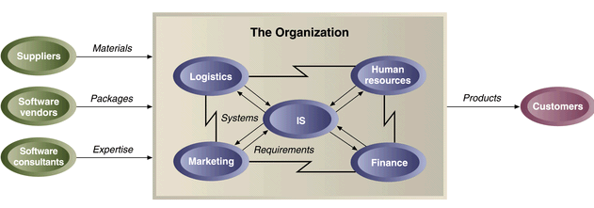
E-Commerce and ERP

Slide 8
  Without e-commerce, a company cannot compete with companies offering similar goods. Without ERP, a company cannot fill Web orders expeditiously.
FS’s Web-Ordering Problem

Slide 9
6.2 Using ERP Through an ASP
ASP
  Application service provider
  Advantages of Using an ASP
    Affordability
    Shorter implementation times
    Expertise
  Disadvantages of Using an ASP
    Security
    Bandwidth/response time
    Flexibility
  Other considerations

Slide 10
6.3 Connectivity
Types of Connectivity: Web and Wireless
Advantages of connectivity
  Efficiency
  Productivity
  Data collection
  Profits
  Examples:
    Barnes and Noble,
    Continental Airlines, J
    .P. Morgan

