Slide 1
JSON
A popular altenative to XML
with
Less Space & Faster Speed!

Slide 2
JSON Definition
JavaScript Object Notation
a lightweight data-interchange format
Less Space & Faster Speed

Slide 3
JSON structure
Question:
How do we store and access data in C/ C++ language?
Object : string God = “Pantao”
Array: char God_name = {‘P’, ‘a’, ‘n’, ‘t’, ‘a’, ‘o’}
Two basic structures of JSON:
Object
Array

Slide 4
Object (or data!)
——A collection of name/value pairs
{“Search”: [
{ “name”: “Li Donghui” , “gender” : “male”, “class”: “02”},
{ “name”: “Liu Jiayuan”, “gender” : “male”, “class”: “02”},
{ “name”: “Xu Tianyang”, “gender” : “male”, “class”: “02”},
{ “name”: “Yuan Quan”, “gender” : “male”, “class”: “02”},
{ “name”: “Fei Fei”, “gender” : “female”, “class”: “01”},
{ “name”: “Sun Jiankun”, “gender” : “female”, “class”: “02”},
{ “name”: “Chu Yi”, “gender” : “female”, “class”: “02”}
],
“Wiki”: [
{ “name”: “Li Zheran”, “gender” : “male”, “class”: “02”},
{ “name”: “Lei Chen”, “gender” : “female”, “class”: “02”},
{ “name”: “Yao Le”, “gender” : “female”, “class”: “02”}
]}
name/value
object

Slide 5
Array
——An ordered list of values
{“Search”: [
{ “name”: “Li Donghui” , “gender” : “male”, “class”: “02”},
{ “name”: “Liu Jiayuan”, “gender” : “male”, “class”: “02”},
{ “name”: “Xu Tianyang”, “gender” : “male”, “class”: “02”},
{ “name”: “Yuan Quan”, “gender” : “male”, “class”: “02”},
{ “name”: “Fei Fei”, “gender” : “female”, “class”: “01”},
{ “name”: “Sun Jiankun”, “gender” : “female”, “class”: “02”},
{ “name”: “Chu Yi”, “gender” : “female”, “class”: “02”}
],
“Wiki”: [
{ “name”: “Li Zheran”, “gender” : “male”, “class”: “02”},
{ “name”: “Lei Chen”, “gender” : “female”, “class”: “02”},
{ “name”: “Yao Le”, “gender” : “female”, “class”: “02”}
]}
Values
Array

Slide 6
Grammar (or rules)
Mapping : “:”
“name”: “Li Donghui”
Coordinate data: “,”
{ “name”: “Li Donghui” , “gender” : “male”}
Object: “{ }”
{ “name”: “Li Donghui” , “gender” : “male”}
Array: “[ ]”
[ { “name”: “Li Donghui” , “gender” : “male”},
{ “name”: “Liu Jiayuan”, “gender” : “male”} ]

Slide 7
Characteristics
Text format
Simple rules
Easy for humans to read and write
Easy for machines to parse and generate
(Why?)

Slide 8
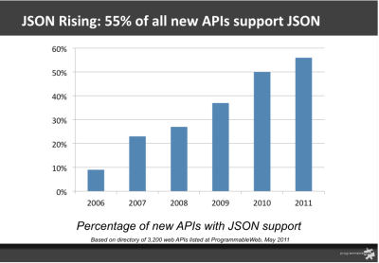
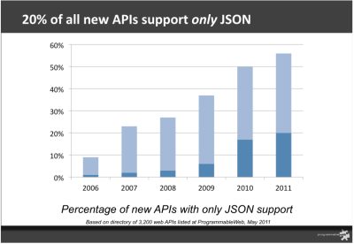
JSON VS XML
Advantages of JSON:
Less Space
Faster Speed

Slide 9
Less Space
XML file:
43 characters!
JSON file:
38 characters!
<?xml version="1.0" encoding=“UTF-8”?> <channel> <item type=“question”> <title>Answered: How about qianxiaodang</title> <description>This is the answer of 2nd question</description> <pubDate>Wed, 07 Nov 2012 02:52:06 +0000</pubDate> </item> <item type=“question”> <title>Answered: what is pantao?? </title> <description>very good one</description> <pubDate>Wed, 07 Nov 2012 02:44:55 +0000</pubDate> </item>
</channel> </xml>
Why?
{“question”:
[{“title”: “Answered: How about qianxiaodang”,
“description”: “This is the answer of 2nd question”,
“pubDate”: “Wed, 07 Nov 2012 02:52:06 +0000”},
{“title”: “Answered: what is pantao??”,
“description”: “very good one”,
“pubDate”: “Wed, 07 Nov 2012 02:44:55 +0000”}]
}
XML has a lot of tags!

Slide 10
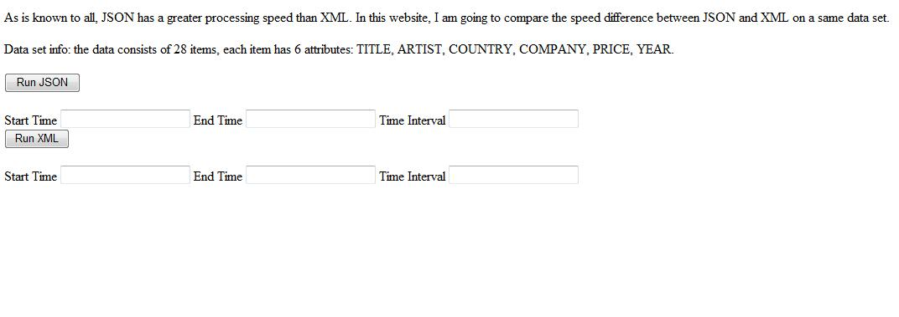
Faster Speed
现场演示。暂时自己的例子用php写一个简单网页显示两者解析速度，进行比较，但容易受网速影响，正在想办法解决
http://localhost/time.php

