Slide 1
Data Serialization

Slide 2





Human beings

Slide 3
Analogy
Human communication
Culture science
Computer science
Data serialization

Slide 4
What is data serialization
Data structure
Data structure
Object state
Object state
system
system
series of bits

Slide 5
What is data serialization
In computer science, in the context of data storage and transmission：
Serialization, is the process of converting a data structure or object state into a format that can be stored and "resurrected" later in the same or another computer environment.
----from wikipedia

Slide 6
Why data serialization
Need it
Must exist，the key point is the quality
Store
Transmit

Slide 7
Human communication
Purposes
Approaches
Processing
……
Data serialization

Slide 8
Method
Binary
SQL
XML
JSON
YAML
Property List
HDF etc.

Slide 9
Programming language support
Ruby
Smalltalk
Python
PHP
Objective-C
Java
the .NET family of languages

Slide 10
Criteria
speed
space
versatility
extensibility

Slide 11
History of XML
GML IBM base on content
SGML flexible and versatile
HTML simple
XML versatile and minitype

Slide 12
Data serialization & data storage
Background Condition: No data transmission between systems

Slide 13
Data storing process
data
Serialized format
Storage media
why this step?
Only serialized data can be stored

Slide 14
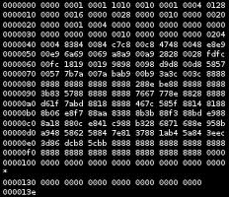
Binary serialization
Multi-programming- language support
data
Binary stream

Slide 15
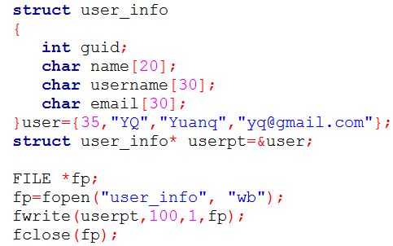
Binary serialization - example
Notes:
binary serialization ( C language )

Slide 16
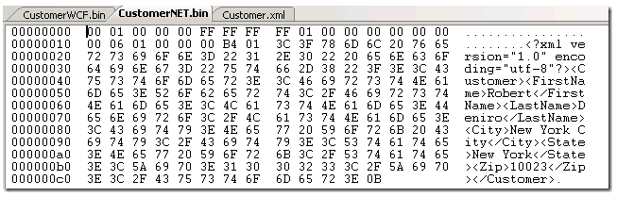
Binary serialization - example
Notes:
The feature of “unreadable”

Slide 17
Binary serialization - features
Fast
Multi-programming-language support
Not human-readable

Slide 18
data serialization - SQL
Back-up
data
data
SQL
Database
New database
Notes:
This is for sql, with example of mediawiki, table wiki_page, and the sql statement.

Slide 19
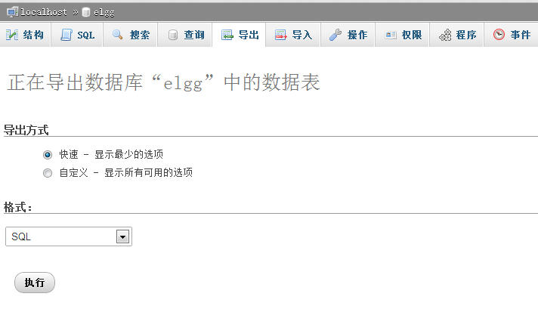

SQL - example

Slide 20
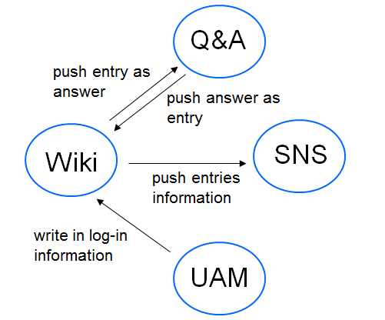
Multiple system
LWS
(Learning Workflow System)
Data transportation

Slide 21
?
Different format
<picture>
data serialization

Slide 22
History of XML
<Picture> Different format in different system
Document Structures
Different format
Standard format
GML

Slide 23
History of XML
GML
SGML
XML
IBM
Generalized
Markup Language
Complex
High cost
Standard Generalized
Markup Language
ISO
Extensible
Markup Language
W3C

Slide 24
Why use XML as a method of data serialization?
Advantage:
Maintainance
format control

Slide 25
A XML document—
A document with mark
What exactly it is——Definition
How to make the mark ——Syntax
How to control the format——Schema
Other function
——Knowledge of XML

Slide 26
Definition
XML
extensible Markup Language

Slide 27
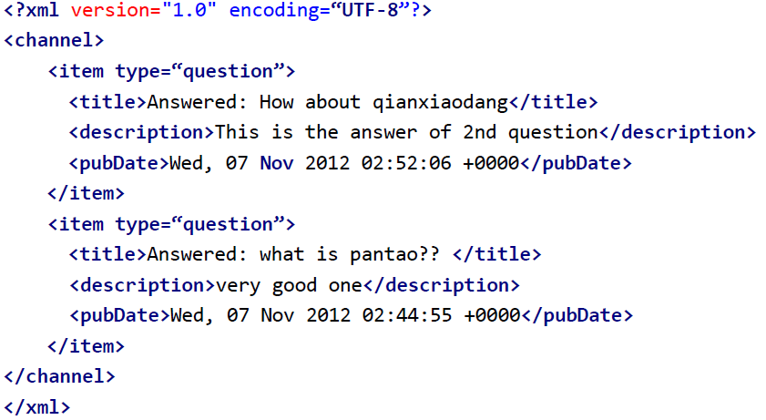
Syntax
tag
attribute
element

Slide 28
Tree structure

Slide 29
Root
channel
Element
title
Element
description
Element
pubDate
Element
item
Attribute
type
text
What is Pantao?
text
very good one
text
Wed,07 Nov 2012

Slide 30

Q&A
WIKI
XML
XML
Definition
Answer

Slide 31
DTD
—Document type definition:
The types of tags
<!ELEMENT title (#PCDATA)>
<!ELEMENT description (#PCDATA)>
<!ELEMENT pubDate (#PCDATA)>
<!ELEMENT item (title,description,pubDate)>
<!ELEMENT channel (item,item,item)>
<!ATTLIST item type CDATA #REQUIED>
The order of tags
The attribute
of tags

Slide 32
Disadvantage:
Poor expandability
Different syntax from XML
No specific data type
ELEMENT: text——#PCDATA
string
<!ELEMENT title (#PCDATA)>
<!ELEMENT description (#PCDATA)>
<!ELEMENT pubDate (#PCDATA)>
<!ELEMENT item (title,description,pubDate)>
<!ELEMENT channel (item,item,item)>
<!ATTLIST item type CDATA #REQUIED>
date

Slide 33
XSD—XML Schema Definition
more extensible
same syntax with XML
variety of data types
string
integer
boolean
date
…
more limitation
number of occurance
number range
…

Slide 34
XSD:XML Schema Definition
<?xml version=”1.0”>
<xs:schema xmlns:xs=”http://www.w3.org/2001/XMLSchema”>
<xs:element name=”item”>
<xs:complexType>
<xs:sequence>
<xs:element name=”title” type=”xs:string”/>
<xs:element name=”description” type=”xs:string”/>
<xs:element name=”pubDate” type=”xs:date”/>
</xs:sequence>
<xs:attribute name=”type” type=”xs:string”/>
</xs:complexType>
</xs:element>
</xs:schema>

Slide 35
XPath
XPath is a syntax for defining parts of an XML document.
XPath uses path expressions to navigate in XML documents.
similar to the expressions you see on a traditional computer file system.

Slide 36
XPath Nodes
<?xml version="1.0" encoding=“UTF-8"?> <channel> <item type=”question”> <title>Answered: How about qianxiaodang</title> <description>This is the answer of 2nd question</description> <pubDate>Wed, 07 Nov 2012 02:52:06 +0000</pubDate> </item> <item type=”question”> <title>Answered: what is pantao?? </title> <description>very good one</description> <pubDate>Wed, 07 Nov 2012 02:44:55 +0000</pubDate> </item>
</channel> </xml>

Slide 37
XPath Nodes
Tree structure
(7) namespace node
(1) Element node
(4) Processing-instruction node
(5) Document node
(6) comment node
(2) Attribute node
(3) text node
/
xml-stylesheet
channel
type=“question”
type=“question”
item
item
title
text
title
text
description
text
description
text
pubDate
text
pubDate
text

Slide 38
Xpath Syntax
/title
/ // . .. @
//title
../item[2]/pubData
/channel/item
Selecting Nodes:
/
xml-stylesheet
channel
type=“question”
type=“question”
item
item
item
item
title
text
title
text
title
title
description
text
description
text
text
pubDate
text
pubDate
pubDate

Slide 39
Xpath Syntax
//item[@type=‘question']
/channel/item[1]/title
Predicates:
/
xml-stylesheet
channel
type=“question”
type=“question”
item
item
item
item
title
text
title
text
title
description
text
description
text
pubDate
text
pubDate
text

Slide 40
Xpath Syntax
Selecting Unknown Nodes: /channel/item[1]/*
/
xml-stylesheet
channel
type=“question”
type=“question”
item
item
title
text
title
text
title
dexcription
text
description
text
description
pubDate
text
pubDate
text
pubDate

Slide 41
Xpath Syntax
Selecting Several Paths:
/
//item[1]/title | //item[2]/pubDate
xml-stylesheet
channel
type=“question”
type=“question”
item
item
title
text
title
text
title
description
text
description
text
text
pubDate
text
pubDate
pubDate

Slide 42
XPath Axes
Child /child::item[1]/child:: title
Descedent /channel/descendent::title
Parent /parent::node()/item[2]
Ancestor /channel/item[1]/description/
ancestor::*

Slide 43
XPath Operators & Functions
Operators
+ - * div mod > < and or |
Functions
position()
count()
last()
contains()

Slide 44
(There is a demonstration here.)

Slide 45
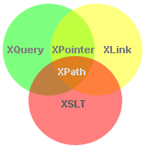
XQuery
The language for querying XML data
XQuery for XML is like SQL for databases
Built on XPath expressions

Slide 46

Xquery:FLOWR
for $x in doc(“rss.xml")/channel/item where $x/@type == “question” order by $x/title return $x/item
Result:

Slide 47



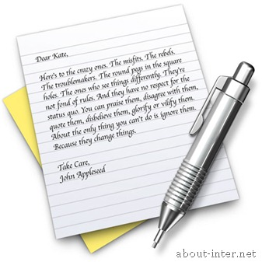

Application of XML
PROs of XML
Extensibility
Plain text
Exchange of data
XML

Slide 48
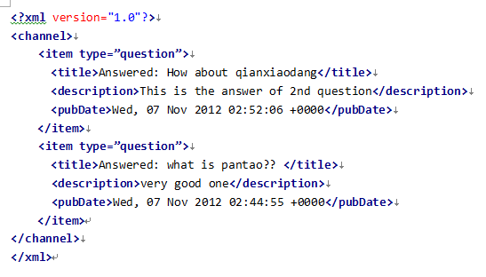


PROs of XML
Unicode(run the HTML with and without UTF-8)
Easy to read by human: self-documenting, tag and nest
”≥:Tè≥•ö¨H2z+qß”¨˘äÈeùT‚iß¢™±ä pdT Ha#¨Ë:b∞(2Pã‘òj"∏%$ímS\YuLùG+,9^ùLá
Wû≥/©gäkFLªM ÉD§0êWn Ú—pBH8·Ú÷N∂c¨ÈXÅmƒ˜+·S‘ŸÊ°+°e√ÕÀNV¢√
∏t£dí8 á»4rùtå:ﬁí›&P]ì* íÒ÷Ωd◊K)50c®†ÈÉ∆ ÙÿóÏÿﬂ‚ƒÖ]è,

Slide 49
CONs of XML
low efficiency
space(tag and tag)
time(compare to binary)(比较真实数据)

Slide 50
CONs of XML
So-called easy to read?
Read by human? How about this long
Debug by human? How about using tool
We don’t need this nowadays!!
So, what are we going to do with XML
High Extensibility
Highly structured
Efficiency doesn’t matter

Slide 51
So better use in:
Structured data store
Tree model of XML data(UI of andriod)
Exchange of Data
Format base on XML:RSS, eBXML,SVG,SMIL

Slide 52
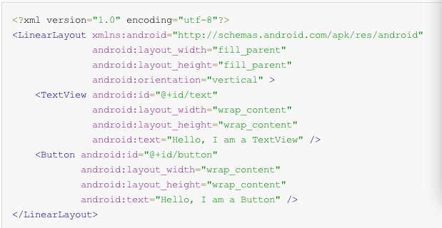


Application of XML
Structured data store
Tree model of XML data(UI of andriod)

Slide 53



Exchange of Data
Format base on XML:RSS, eBXML,SVG,SMIL

Slide 54
NEWs
Really Simple Syndication
Also called News feed
Media
Products
ME
Music
Novel
ADs

Slide 55
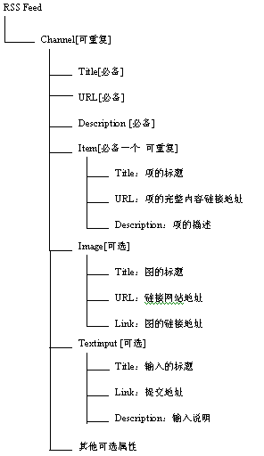
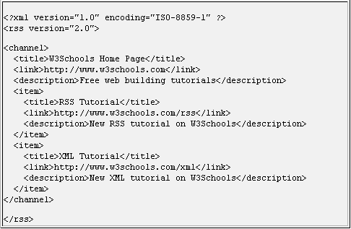

Slide 56

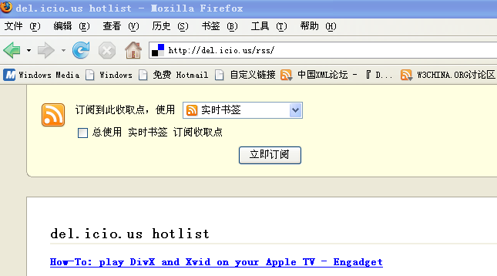
How we use on web: e.g. Google reader
How we use on our project?
Lets try it together!

Slide 57
JSON
A popular altenative to XML
with
Less Space & Faster Speed!

Slide 58
JSON Definition
JavaScript Object Notation
a lightweight data-interchange format
Less Space & Faster Speed

Slide 59
JSON structure
Question:
How do we store and access data in C/ C++ language?
Object : string God = “Pantao”
Array: char God_name = {‘P’, ‘a’, ‘n’, ‘t’, ‘a’, ‘o’}
Two basic structures of JSON:
Object
Array

Slide 60
Object (or data!)
——A collection of name/value pairs
{“Search”: [
{ “name”: “Li Donghui” , “gender” : “male”, “class”: “02”},
{ “name”: “Liu Jiayuan”, “gender” : “male”, “class”: “02”},
{ “name”: “Xu Tianyang”, “gender” : “male”, “class”: “02”},
{ “name”: “Yuan Quan”, “gender” : “male”, “class”: “02”},
{ “name”: “Fei Fei”, “gender” : “female”, “class”: “01”},
{ “name”: “Sun Jiankun”, “gender” : “female”, “class”: “02”},
{ “name”: “Chu Yi”, “gender” : “female”, “class”: “02”}
],
“Wiki”: [
{ “name”: “Li Zheran”, “gender” : “male”, “class”: “02”},
{ “name”: “Lei Chen”, “gender” : “female”, “class”: “02”},
{ “name”: “Yao Le”, “gender” : “female”, “class”: “02”}
]}
name/value
object

Slide 61
Array
——An ordered list of values
{“Search”: [
{ “name”: “Li Donghui” , “gender” : “male”, “class”: “02”},
{ “name”: “Liu Jiayuan”, “gender” : “male”, “class”: “02”},
{ “name”: “Xu Tianyang”, “gender” : “male”, “class”: “02”},
{ “name”: “Yuan Quan”, “gender” : “male”, “class”: “02”},
{ “name”: “Fei Fei”, “gender” : “female”, “class”: “01”},
{ “name”: “Sun Jiankun”, “gender” : “female”, “class”: “02”},
{ “name”: “Chu Yi”, “gender” : “female”, “class”: “02”}
],
“Wiki”: [
{ “name”: “Li Zheran”, “gender” : “male”, “class”: “02”},
{ “name”: “Lei Chen”, “gender” : “female”, “class”: “02”},
{ “name”: “Yao Le”, “gender” : “female”, “class”: “02”}
]}
Values
Array

Slide 62
Grammar (or rules)
Mapping : “:”
“name”: “Li Donghui”
Coordinate data: “,”
{ “name”: “Li Donghui” , “gender” : “male”}
Object: “{ }”
{ “name”: “Li Donghui” , “gender” : “male”}
Array: “[ ]”
[ { “name”: “Li Donghui” , “gender” : “male”},
{ “name”: “Liu Jiayuan”, “gender” : “male”} ]

Slide 63
Characteristics
Text format
Simple rules
Easy for humans to read and write
Easy for machines to parse and generate
(Why?)

Slide 64
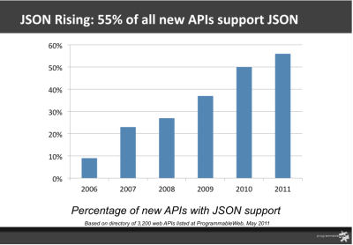
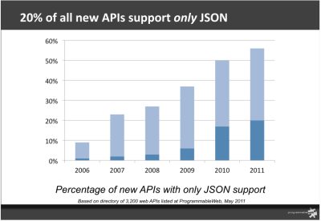
JSON VS XML
Advantages of JSON:
Less Space
Faster Speed

Slide 65
Less Space
XML file:
43 characters!
JSON file:
38 characters!
<?xml version="1.0" encoding=“UTF-8”?> <channel> <item type=“question”> <title>Answered: How about qianxiaodang</title> <description>This is the answer of 2nd question</description> <pubDate>Wed, 07 Nov 2012 02:52:06 +0000</pubDate> </item> <item type=“question”> <title>Answered: what is pantao?? </title> <description>very good one</description> <pubDate>Wed, 07 Nov 2012 02:44:55 +0000</pubDate> </item>
</channel> </xml>
Why?
{“question”:
[{“title”: “Answered: How about qianxiaodang”,
“description”: “This is the answer of 2nd question”,
“pubDate”: “Wed, 07 Nov 2012 02:52:06 +0000”},
{“title”: “Answered: what is pantao??”,
“description”: “very good one”,
“pubDate”: “Wed, 07 Nov 2012 02:44:55 +0000”}]
}
XML has a lot of tags!

Slide 66
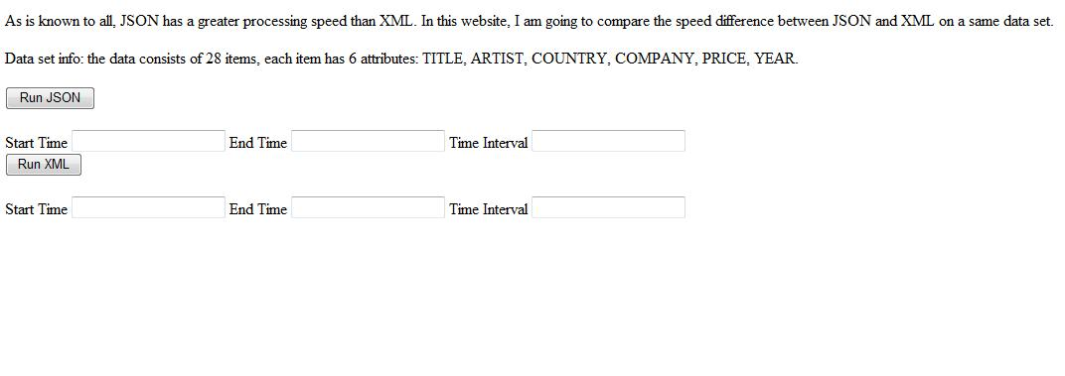
Faster Speed
现场演示。暂时自己的例子用php写一个简单网页显示两者解析速度，进行比较，但容易受网速影响，正在想办法解决
http://localhost/time.php

Slide 67
AJAX
Widely used in today’s website
Adding dynamic behavior to the webpage
Can improve user experience

Slide 68
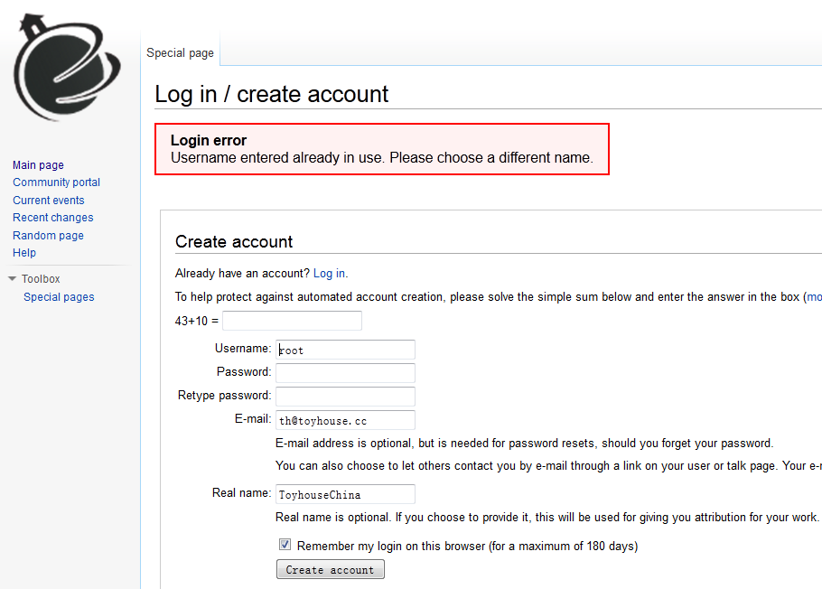
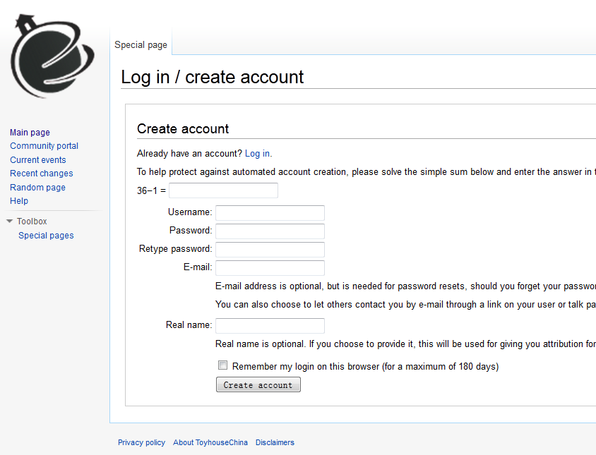
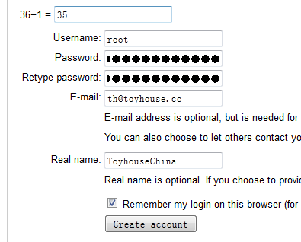
Some live examples
Scene 1: Sign up for an account

Slide 69
With AJAX, the situation will become much better

Slide 70
Scene 2: Search
By AJAX, google can load and build the result page when you are typing the keywords

Slide 72
AJAX
Asynchronous JavaScript and XML
Asynchronous: in the background
JavaScript
XML: Today JSON is often used instead

Slide 73

Workflow of AJAX
XML, JSON or other format
Webpage
Return the results
New content
JavaScript
Send/Request Data
Server
Browser

Slide 74
Demonstration
How to know whether a webpage is using AJAX and what format (XML/JSON) is used
Use AJAX to build a simple input suggestion function

Slide 75
Hack the search suggestion function of MediaWiki

Slide 76
Build a simple input suggestion function
Techniques
jQuery: A very popular JavaScript library
JSON
PHP

