Slide 1
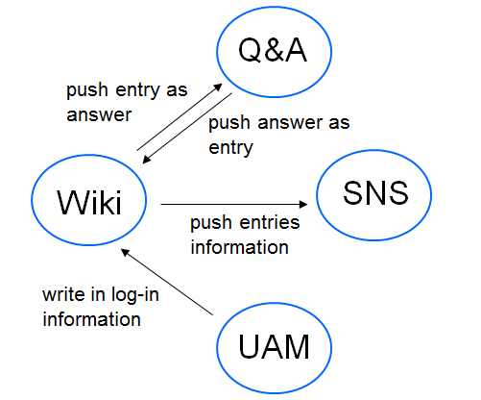
Multiple system
LWS
(Learning Workflow System)
Data transportation

Slide 2
?
Different format
<picture>
data serialization

Slide 3
History of XML
<Picture> Different format in different system
Document Structures
Different format
Standard format
GML

Slide 4
History of XML
GML
SGML
XML
IBM
Generalized
Markup Language
Complex
High cost
Standard Generalized
Markup Language
ISO
Extensible
Markup Language
W3C

Slide 5
Why use XML as a method of data serialization?
Advantage:
Maintainance
format control

Slide 6
A XML document—
A document with mark
What exactly it is——Definition
How to make the mark ——Syntax
How to control the format——Schema
Other function
——Knowledge of XML

Slide 7
Definition
XML
extensible Markup Language

Slide 8
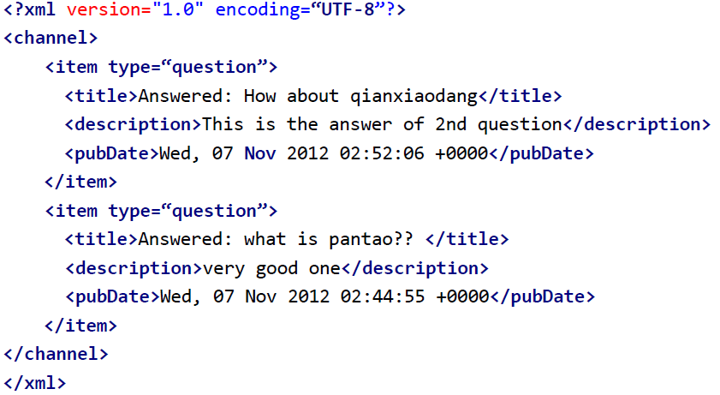
Syntax
tag
attribute
element

Slide 9
Tree structure

Slide 10
Root
channel
Element
title
Element
description
Element
pubDate
Element
item
Attribute
type
text
What is Pantao?
text
very good one
text
Wed,07 Nov 2012

Slide 11

Q&A
WIKI
XML
XML
Definition
Answer

Slide 12
DTD
—Document type definition:
The types of tags
<!ELEMENT title (#PCDATA)>
<!ELEMENT description (#PCDATA)>
<!ELEMENT pubDate (#PCDATA)>
<!ELEMENT item (title,description,pubDate)>
<!ELEMENT channel (item,item,item)>
<!ATTLIST item type CDATA #REQUIED>
The order of tags
The attribute
of tags

Slide 13
Disadvantage:
Poor expandability
Different syntax from XML
No specific data type
ELEMENT: text——#PCDATA
string
<!ELEMENT title (#PCDATA)>
<!ELEMENT description (#PCDATA)>
<!ELEMENT pubDate (#PCDATA)>
<!ELEMENT item (title,description,pubDate)>
<!ELEMENT channel (item,item,item)>
<!ATTLIST item type CDATA #REQUIED>
date

Slide 14
XSD—XML Schema Definition
more extensible
same syntax with XML
variety of data types
string
integer
boolean
date
…
more limitation
number of occurance
number range
…

Slide 15
XSD:XML Schema Definition
<?xml version=”1.0”>
<xs:schema xmlns:xs=”http://www.w3.org/2001/XMLSchema”>
<xs:element name=”item”>
<xs:complexType>
<xs:sequence>
<xs:element name=”title” type=”xs:string”/>
<xs:element name=”description” type=”xs:string”/>
<xs:element name=”pubDate” type=”xs:date”/>
</xs:sequence>
<xs:attribute name=”type” type=”xs:string”/>
</xs:complexType>
</xs:element>
</xs:schema>

