Slide 1

PART 1
PART 2
ADD YOUR TOPIC
PART 3
PART 4
ADD YOUR NAME AND INFORMATION
THE END

Slide 2
Functions
Federal Search
PART 2
USER
MEDIA
PART 3
PART 4
WIKI
NEWS
THE END
…
Q&A

Slide 3
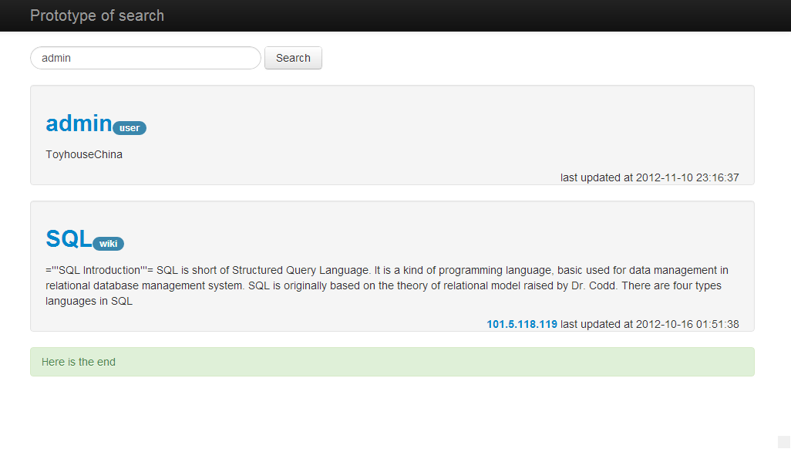
Functions
Federal Search
PART 2
PART 3
PART 4
THE END

Slide 4

Functions
Federal Search
Federal search
MEMA
SNS
WIKI
Q2A
PART 2
PART 3
PART 4
THE END

Slide 5
Functions
Federal Search
PART 2
PART 3
Federal search
PART 4
THE END
Search whatever you what!

Slide 6
Technology
View
• Convenient for coding
• Convenient for searching
2. Table—Index
• Efficiency
3. SQL
• Instant update
PART 2
PART 3
PART 4
THE END
Notes:
Convenient for coding
—— Similar searching method for different systems
Convenient for searching
——Searching in the collection of needed information

Slide 7
Functions
Filter
Create a search language
type:
author:
before: after:
PART 3
PART 4
THE END
PART 1

Slide 8
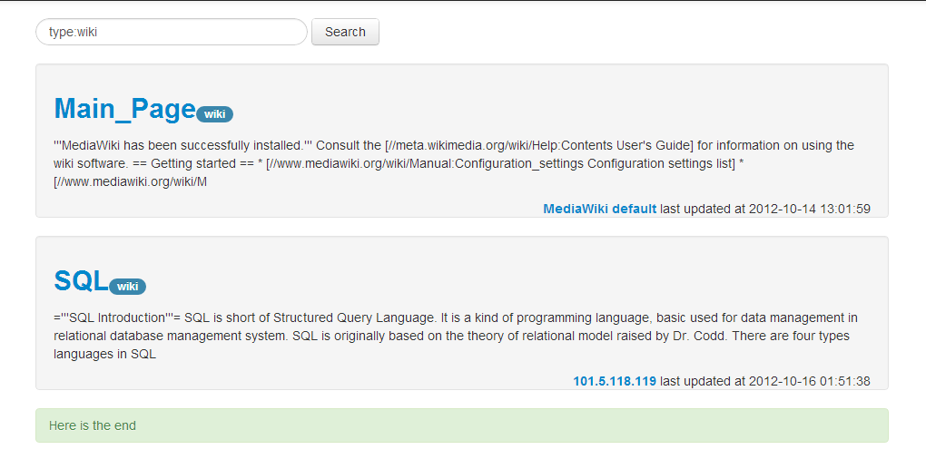
Functions
Filter
type: media
PART 4
THE END
PART 1

Slide 9
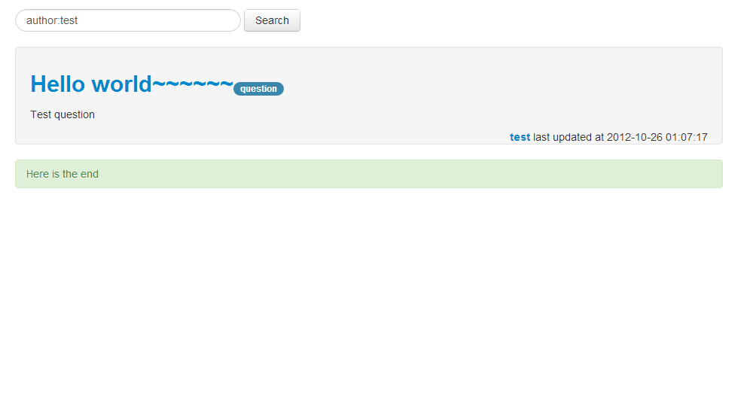
Functions
Filter
author: test
PART 4
THE END
PART 1

Slide 10
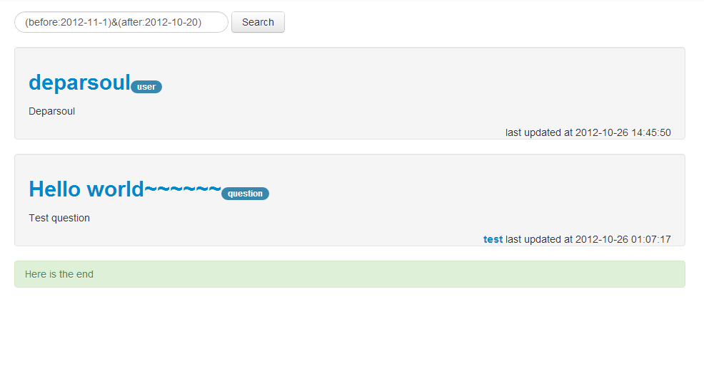
Functions
Filter
((before:2012-11-1)&(after:2012-10-20)

Slide 11
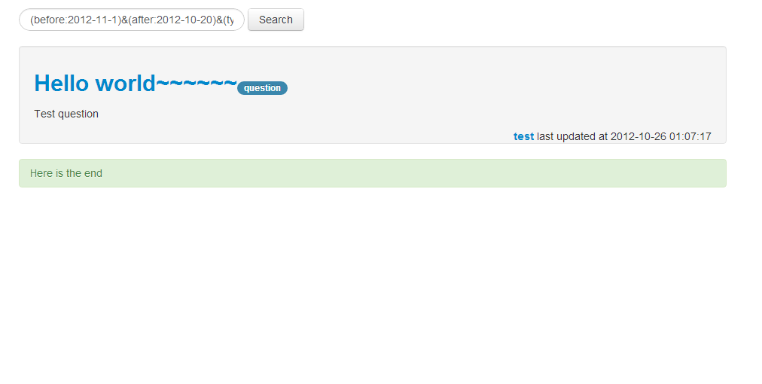
Functions
Filter
(before:2012-11-1)&(after:2012-10-20)&(type:question)

