Slide 1
JSON
A popular altenative to XML
with
Less Space & Faster Speed!

Slide 2
What is Json?
JavaScript Object Notation
a lightweight data-interchange format
Less Space & Faster Speed

Slide 3
JSON structure
Question:
How do we store and access data in C/ C++ language?
Object : string God = “Pantao”
Array: char God_name = {‘P’, ‘a’, ‘n’, ‘t’, ‘a’, ‘o’}
Two basic structures of JSON:
Object
Array

Slide 4
Object (or data!)
——A collection of name/value pairs
{“Search”: [
{ “name”: “Li Donghui” , “gender” : “male”, “class”: “02”},
{ “name”: “Liu Jiayuan”, “gender” : “male”, “class”: “02”},
{ “name”: “Xu Tianyang”, “gender” : “male”, “class”: “02”},
{ “name”: “Yuan Quan”, “gender” : “male”, “class”: “02”},
{ “name”: “Fei Fei”, “gender” : “female”, “class”: “01”},
{ “name”: “Sun Jiankun”, “gender” : “female”, “class”: “02”},
{ “name”: “Chu Yi”, “gender” : “female”, “class”: “02”}
],
“Wiki”: [
{ “name”: “Li Zheran”, “gender” : “male”, “class”: “02”},
{ “name”: “Lei Chen”, “gender” : “female”, “class”: “02”},
{ “name”: “Yao Le”, “gender” : “female”, “class”: “02”}
]}
name/value
Objects!

Slide 5
Array
——An ordered list of values
{“Search”: [
{ “name”: “Li Donghui” , “gender” : “male”, “class”: “02”},
{ “name”: “Liu Jiayuan”, “gender” : “male”, “class”: “02”},
{ “name”: “Xu Tianyang”, “gender” : “male”, “class”: “02”},
{ “name”: “Yuan Quan”, “gender” : “male”, “class”: “02”},
{ “name”: “Fei Fei”, “gender” : “female”, “class”: “01”},
{ “name”: “Sun Jiankun”, “gender” : “female”, “class”: “02”},
{ “name”: “Chu Yi”, “gender” : “female”, “class”: “02”}
],
“Wiki”: [
{ “name”: “Li Zheran”, “gender” : “male”, “class”: “02”},
{ “name”: “Lei Chen”, “gender” : “female”, “class”: “02”},
{ “name”: “Yao Le”, “gender” : “female”, “class”: “02”}
]}
Values
Array

Slide 6
Grammar (or rules)
Mapping : “:”
“name”: “Li Donghui”
Coordinate data: “,”
{ “name”: “Li Donghui” , “gender” : “male”}
Object: “{ }”
{ “name”: “Li Donghui” , “gender” : “male”}
Array: “[ ]”
[ { “name”: “Li Donghui” , “gender” : “male”},
{ “name”: “Liu Jiayuan”, “gender” : “male”} ]

Slide 7
Characteristics
Text format
Simple rules
Easy for humans to read and write
Easy for machines to parse and generate
(Why?)

Slide 8
JSON VS XML
Advantages of JSON:
Less Space
Faster Speed

Slide 9
Less Space
同样的内容用XML和JSON写，字符数量不同，例子最好沿用XML部分的，但是没来得及整合

Slide 10
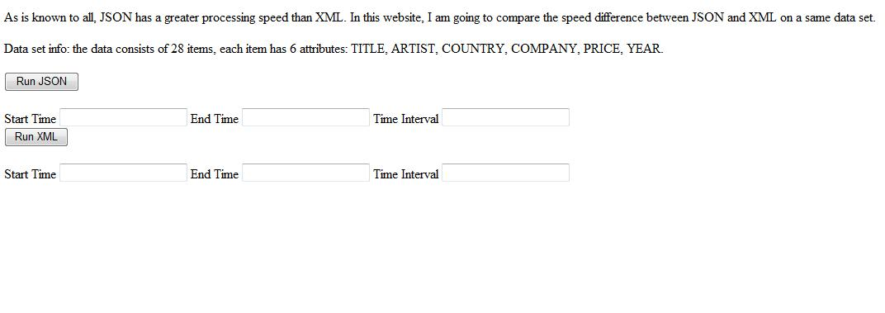
Faster Speed
暂时自己的例子
http://localhost/time.php

