Slide 1
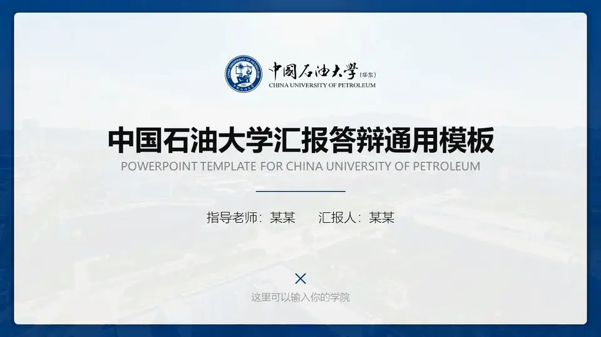

Parallel programming
Final project
Division of labor
Lin Wang
Tianyu Zhao
Kanglai Liu
Zihang Chen

Slide 2


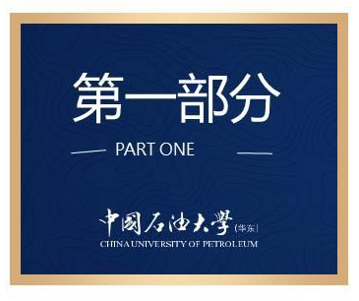
contents
contents
Algorithm design & Report Writing（Lin Wang）
Data Structure (Zihang Chen)
MPI(Kanglai Liu)
CUDA（Tianyu Zhao）

Slide 3
Algorithm design & Report Writing
At first, we need to design the algorithm. Here is the flow figure.
Input
matrix
(dense)
Input
matrix
(sparse)
MPI
Interface
CUDA
on
Cluster
Send
Initialize
Receive
output
After the results are obtained, the data and work are summarized to complete the report.

Slide 4
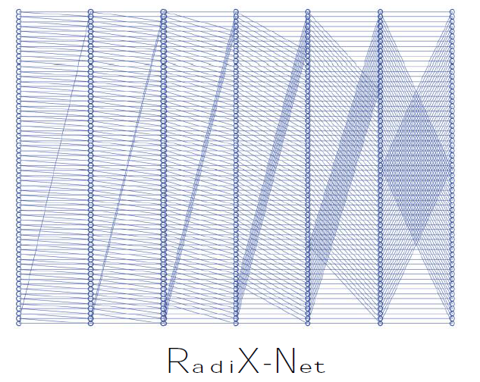
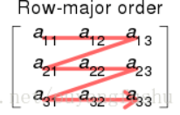
Data Structure
We need to transform the dense matrix into a sparse matrix and use CSR to store it
If we want better performance, GEMM is not a good idea.
SPARSE!
Notes:
1、DC analysis is the first step and basis of other analysis work. Hiw
how can we quickly and accurately get the DC solutions is a important problem.

Slide 5
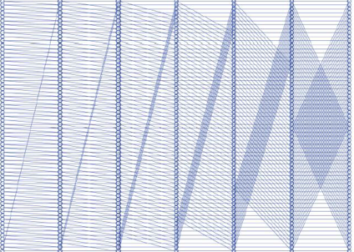
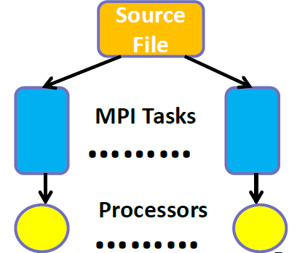
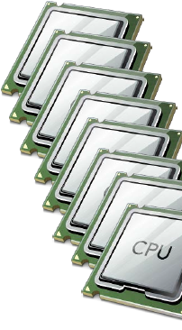
MPI
In MPI part, The MPI is responsible for each acting as the interface between the cluster and the data.
INTERFACE

Slide 6
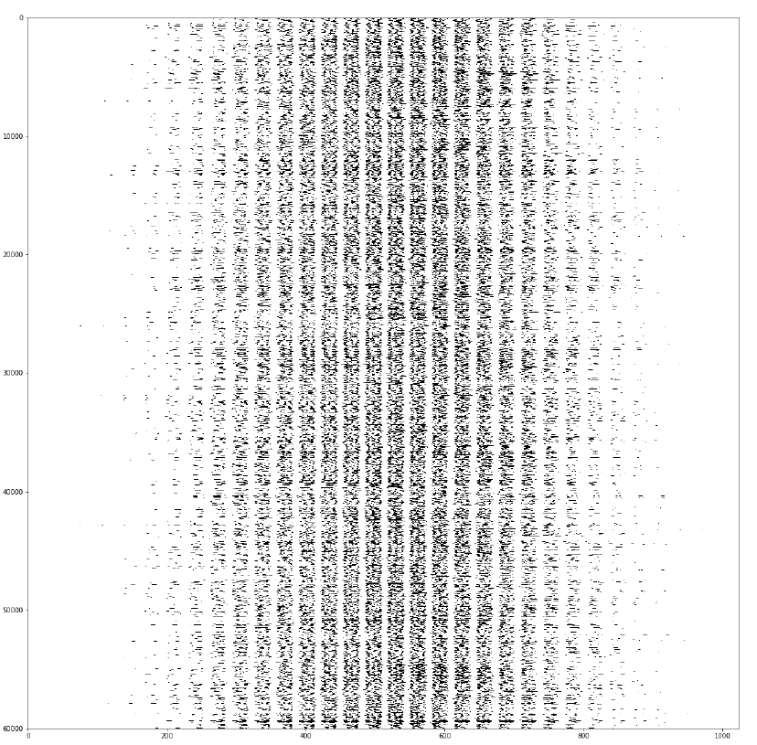
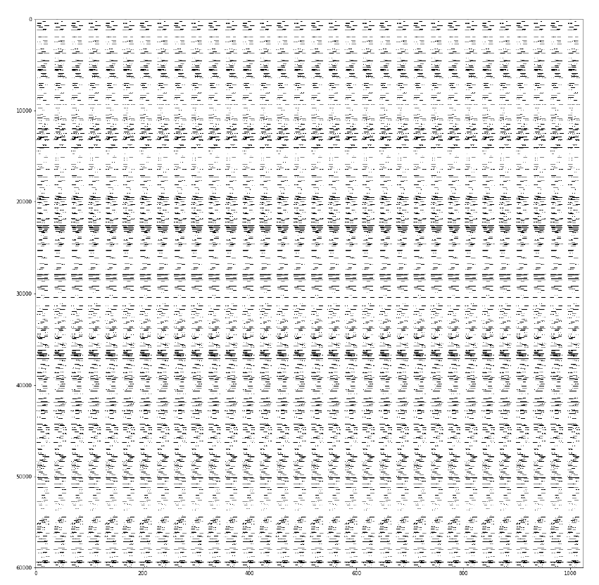
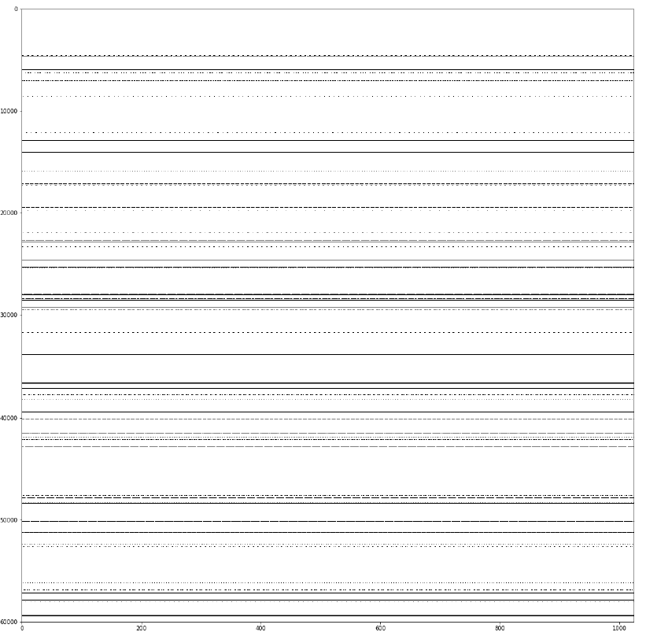
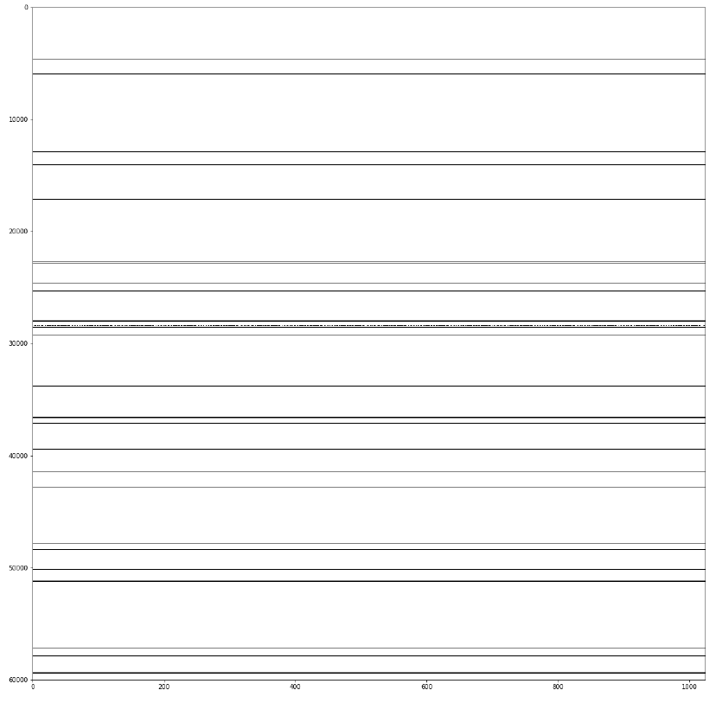
CUDA
The CUDA part completes the implement of the reasoning process on each device.
Matrix inference is implement through CUDA
Layer 1
Layer 3
Layer 6
Layer 9
…
…
…
These hidden layers are calculated by CUDA

Slide 7
Thanks for listening
Thank you

