Slide 1
Understanding spin-orbit torque domain wall logic devices
15 nm
3 nm
CoFeB
3 nm
HM

Slide 2
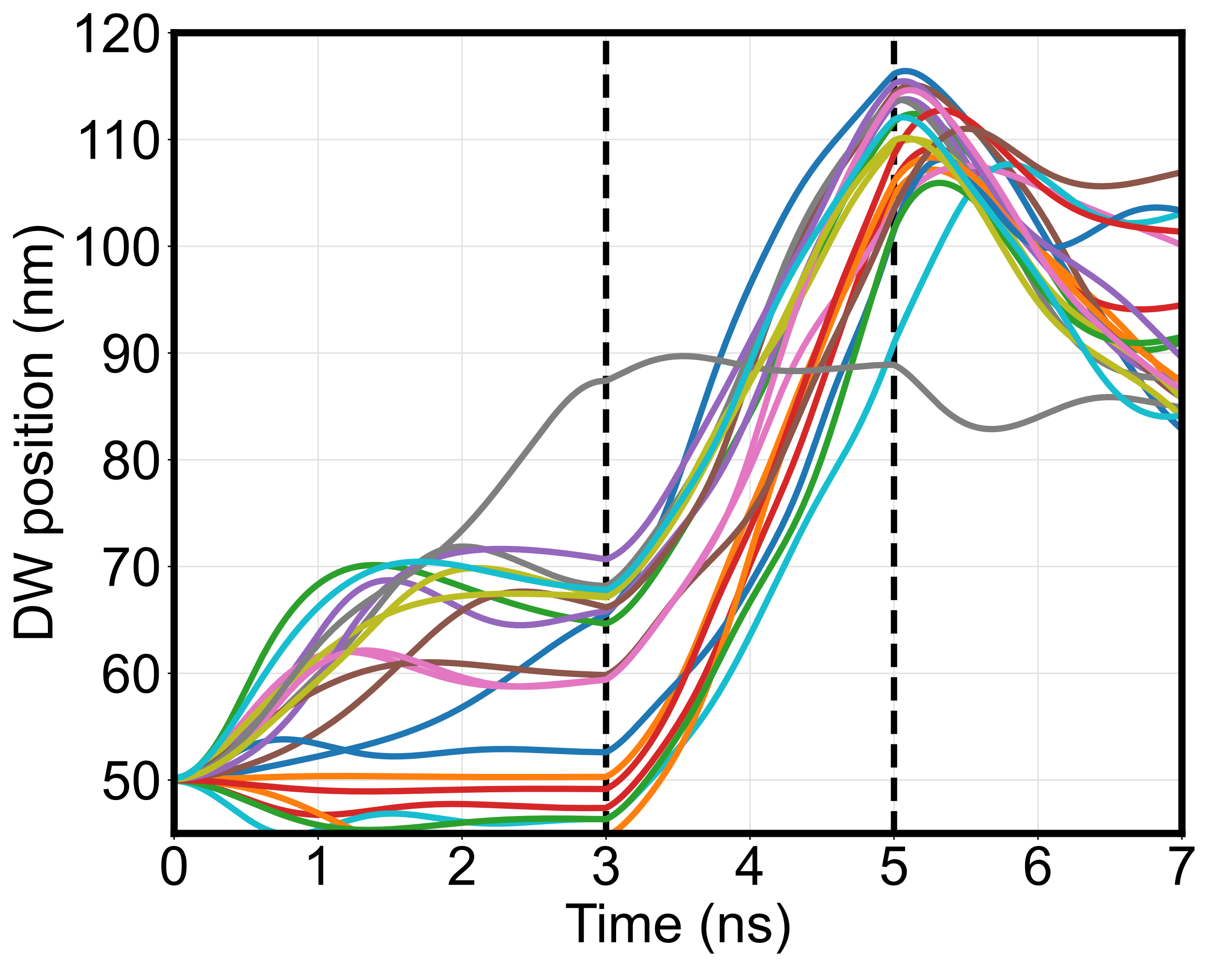
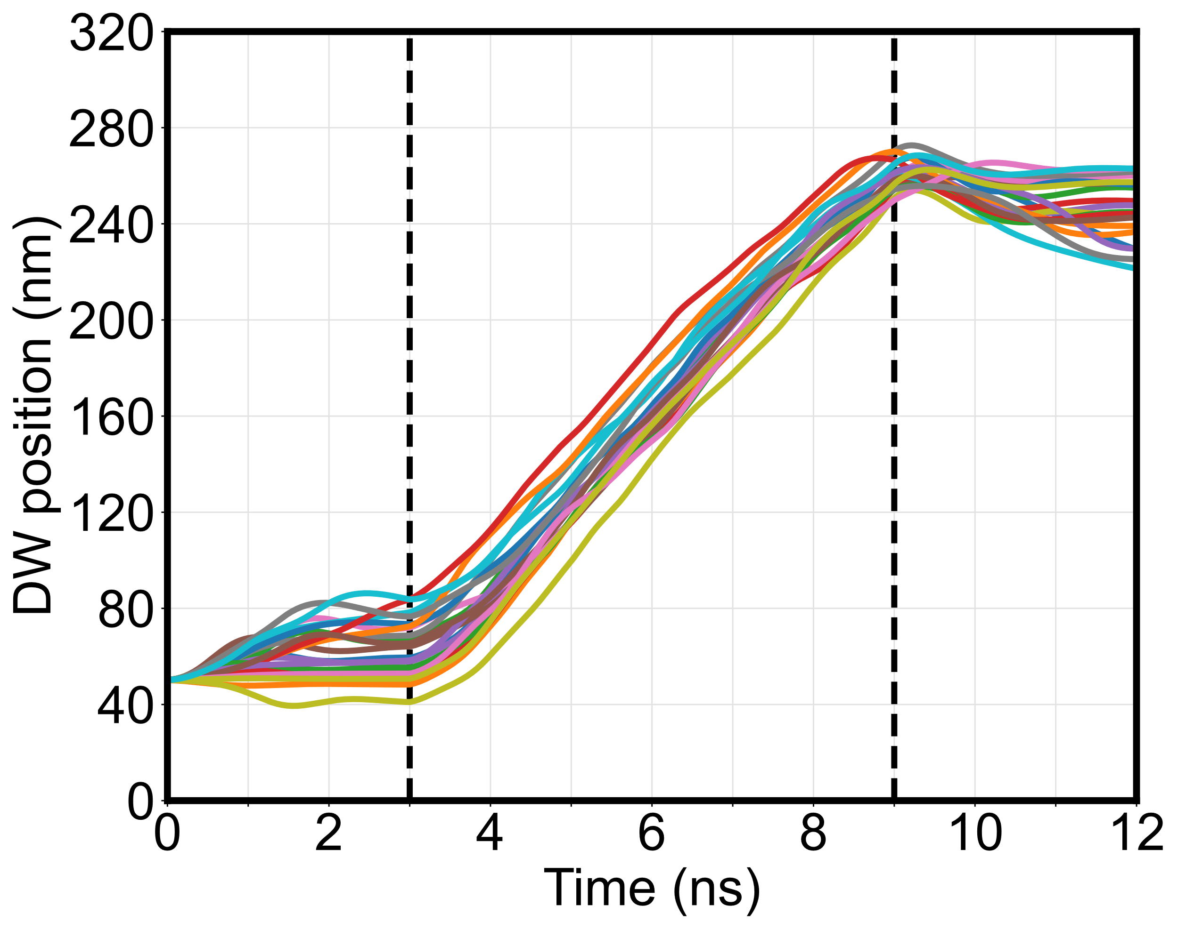
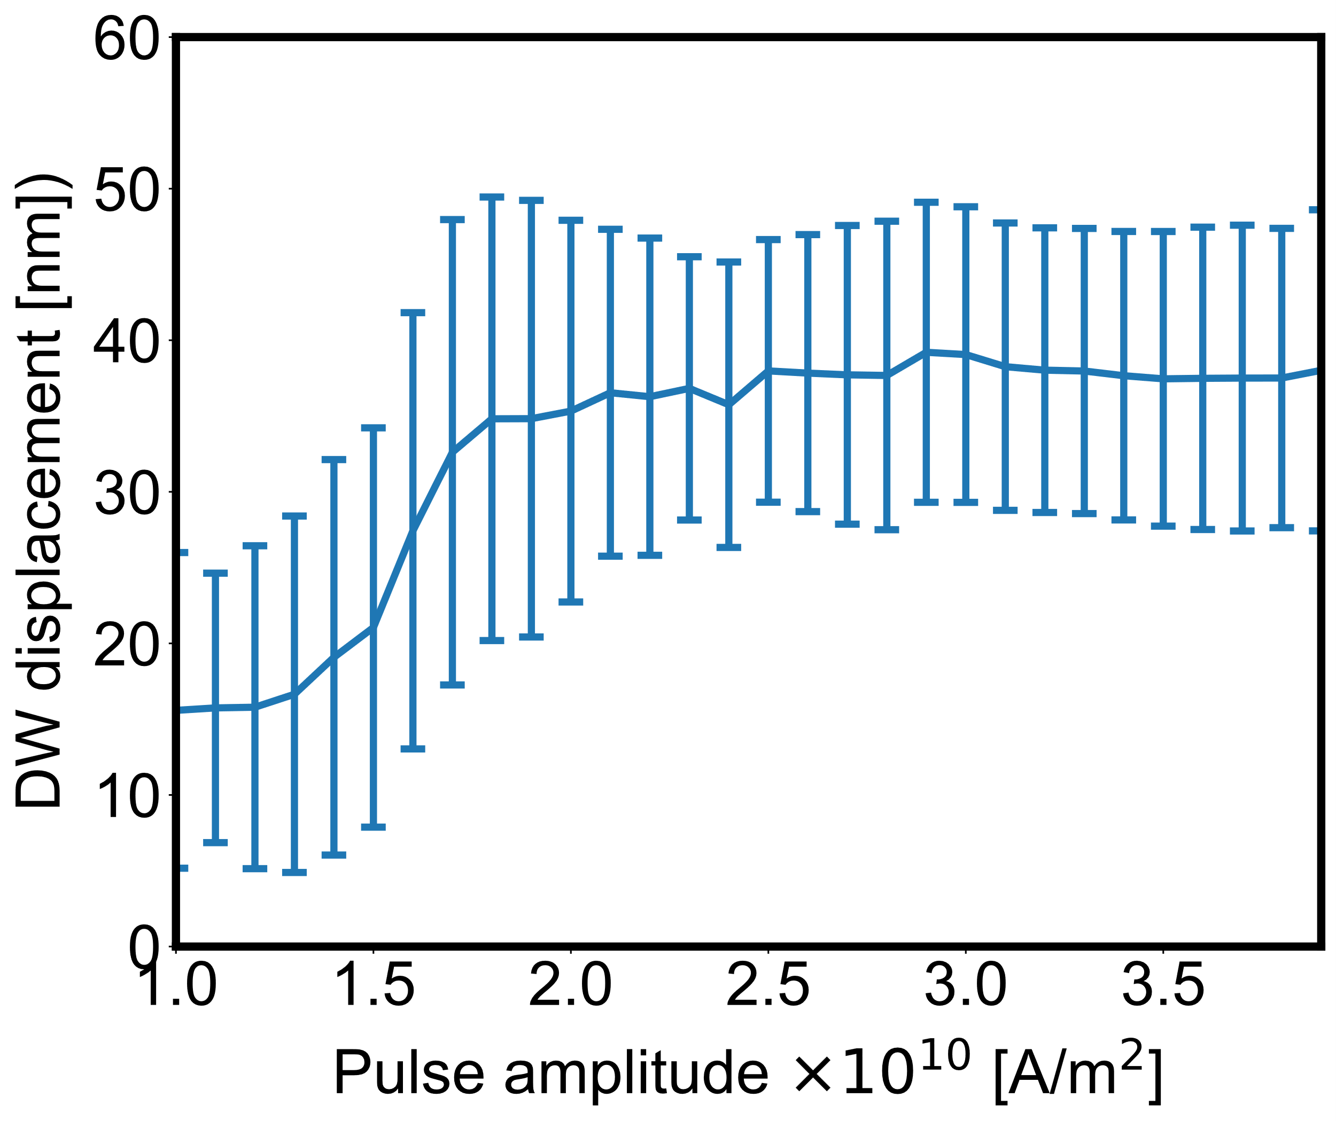
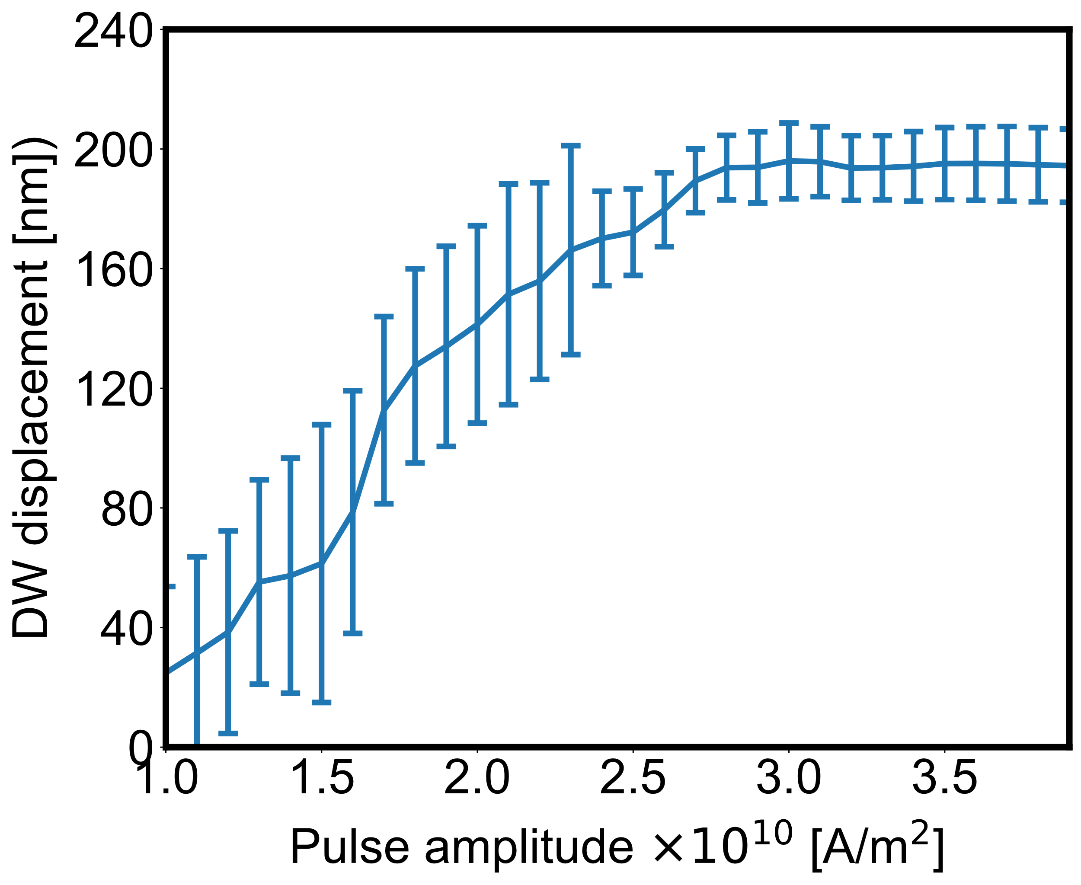
To reduce the DW depinning current, pin the DW on edge roughness
120nm track
320nm track
3×10¹⁰ A/m², 2 ns pulse
3×10¹⁰ A/m², 6 ns pulse
The DW settles to a band of positions for a given pulse width due to geometry variations, a longer track is needed to separate the states
2 ns pulse
6 ns pulse

Slide 3
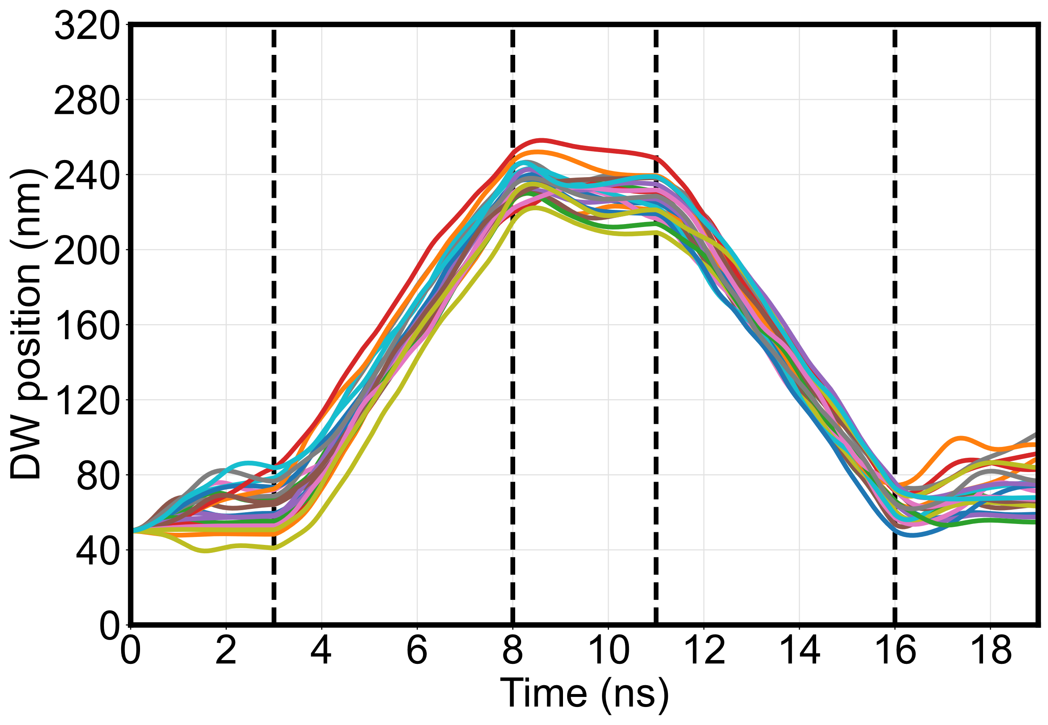
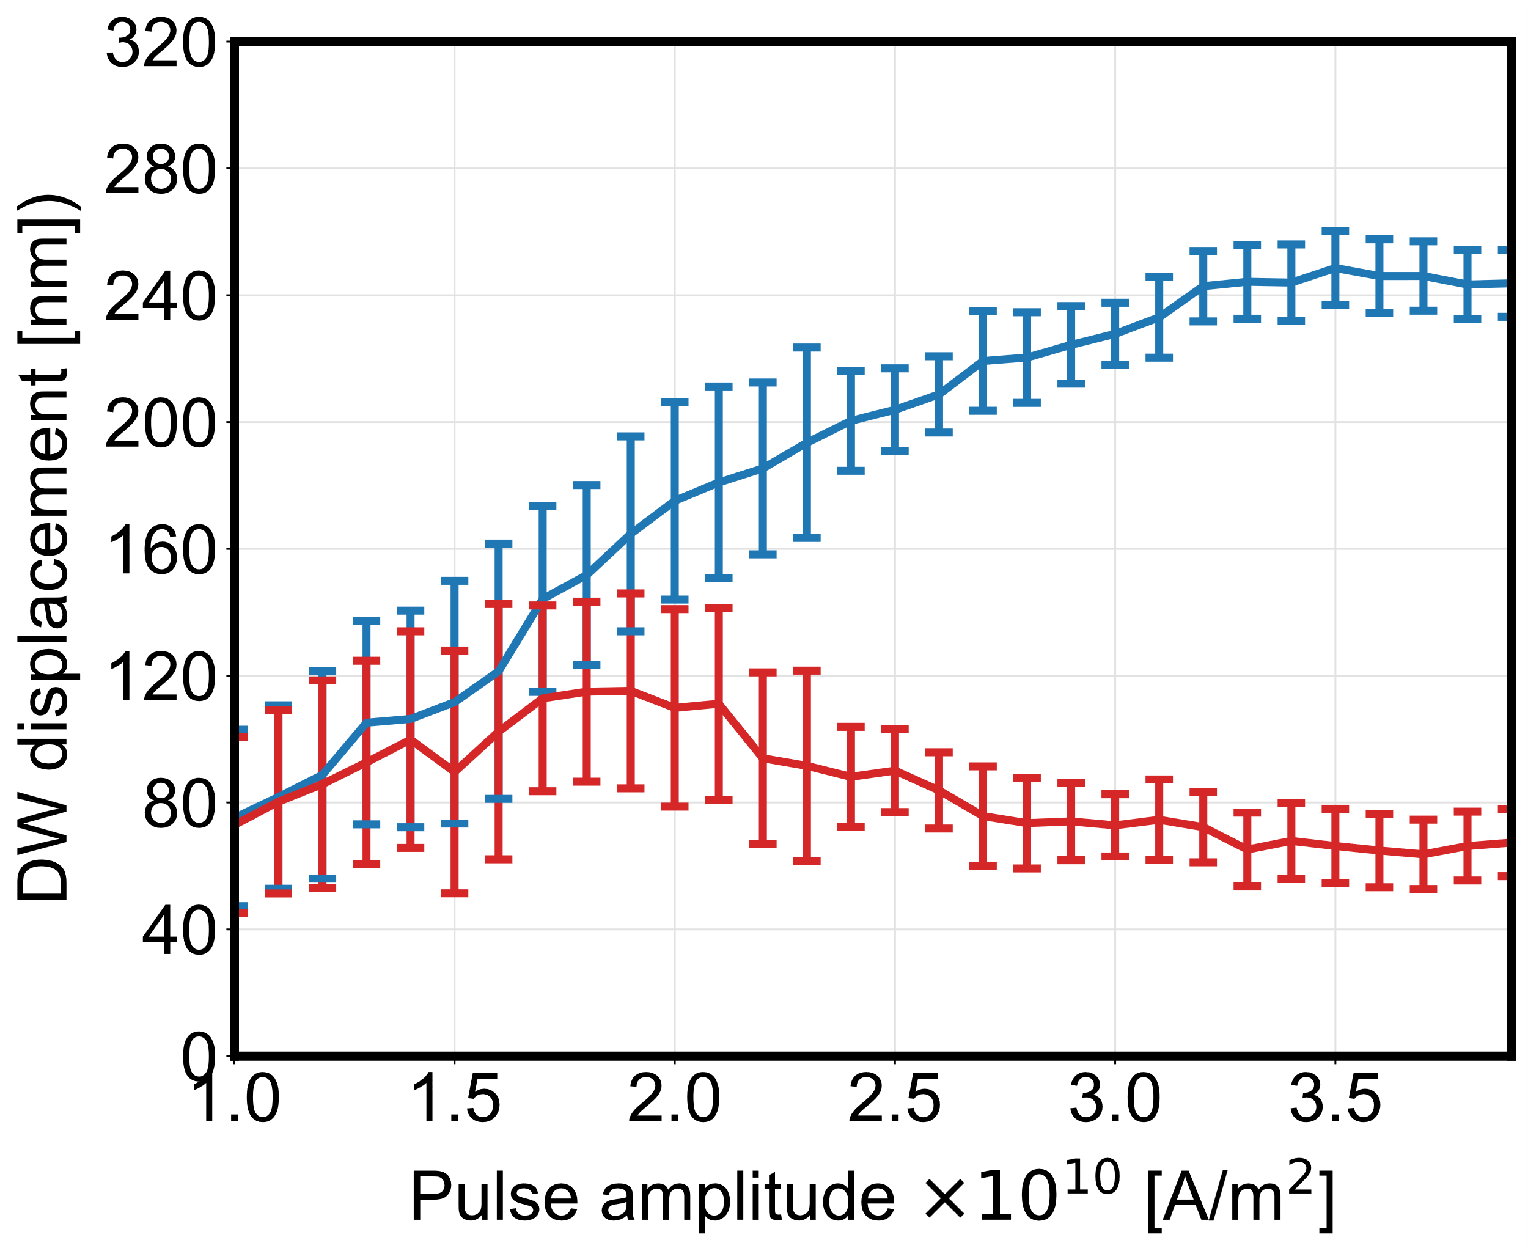
DW can be reliably driven back and forth with opposite polarity pulses
5 ns
5 ns
(+) pulse
(+) & (–) pulse

Slide 4
Strong reset is important regardless of device state
J_{low}
J_{high}
(+) pulse
State after input high
MTJ
(+) & (–) pulse
State after input low, before reset
State after reset

Slide 5
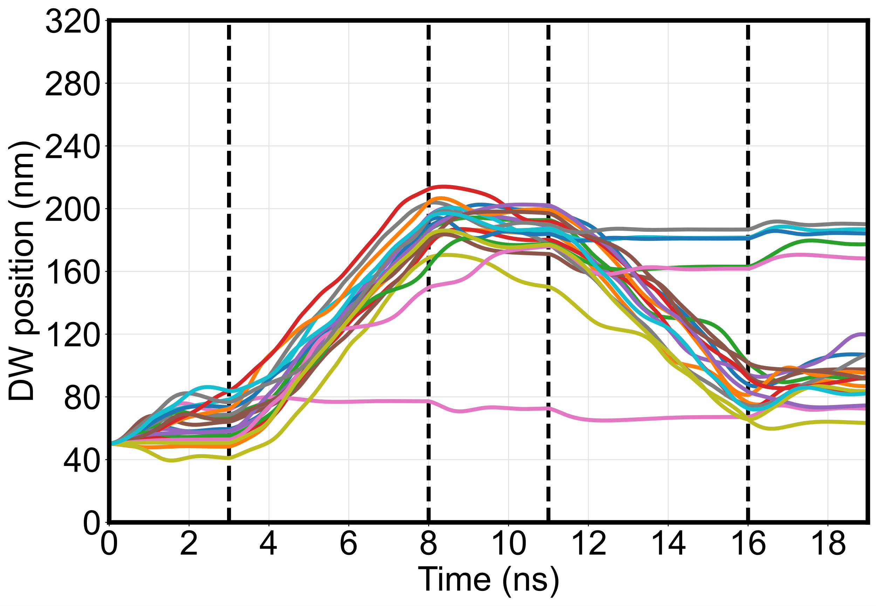
Inertia?
5 ns
5 ns
5 ns
5 ns

Slide 6
An approximate model of concatenation
J₁ does not vary across the track and is independent of MTJ state
J₂ does not affect DW
J₂
R_{MTJ}
J₁
V
J_{high} if x(t) > x_{R}
J_{high} / (1 + TMR) if x(t) < x_{L}
J₂ (t) =
1
x₁(t) – x_{L}
1 + TMR
x_{R} – x₁(t)
–1
+
if x_{L} < x(t) < x_{R}
J_{high}
x_{R} – x_{L}
J_{high}
x_{R} – x_{L}

Slide 7
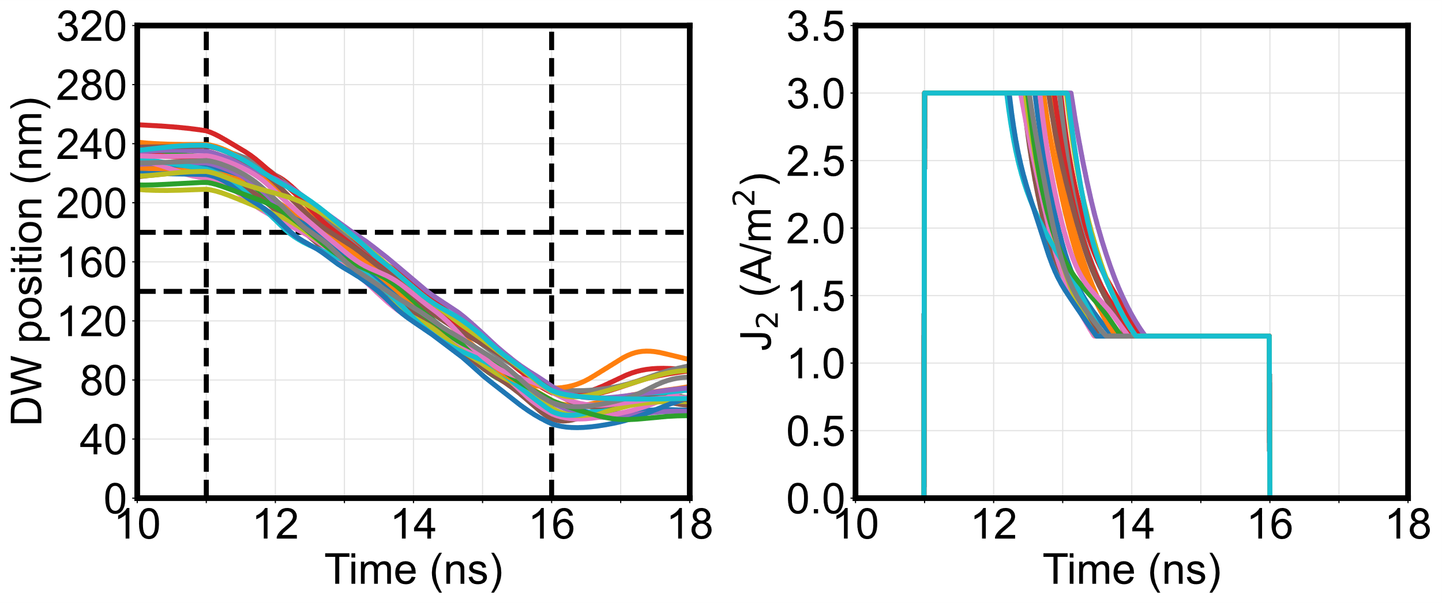
DW 1 reset
(constant J₁)
Current into DW 2

Slide 8
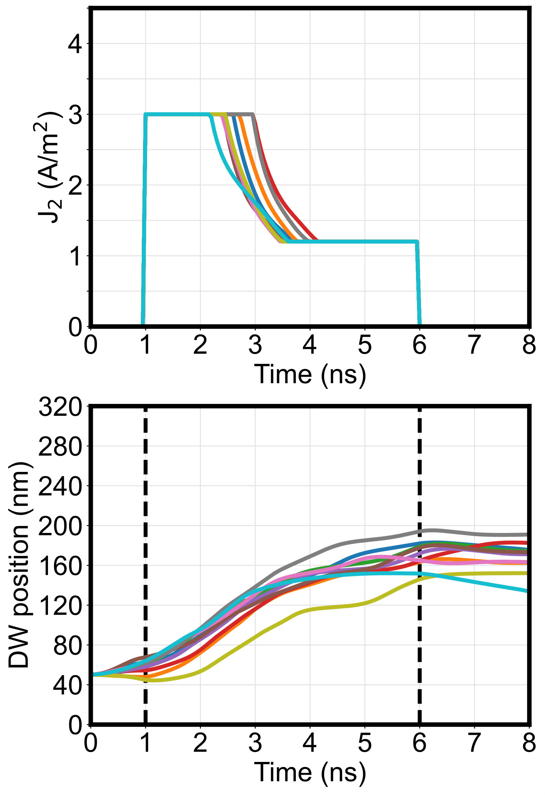
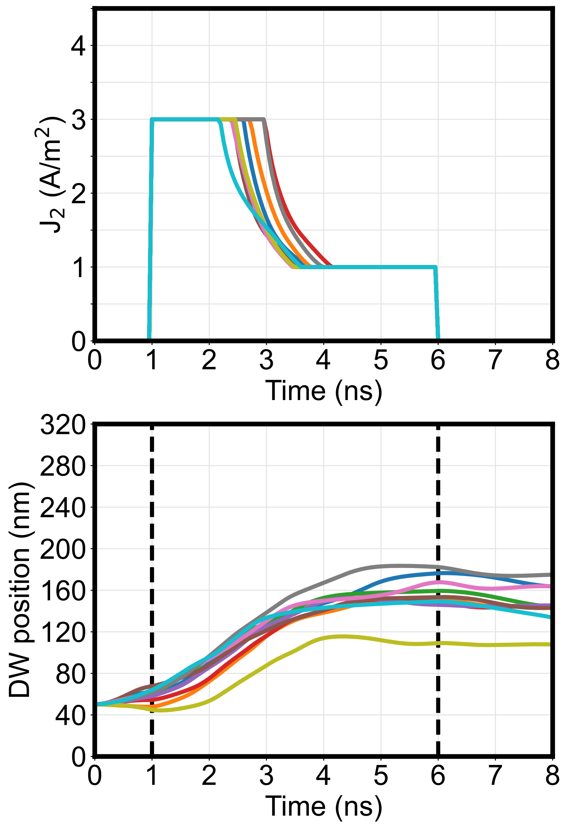
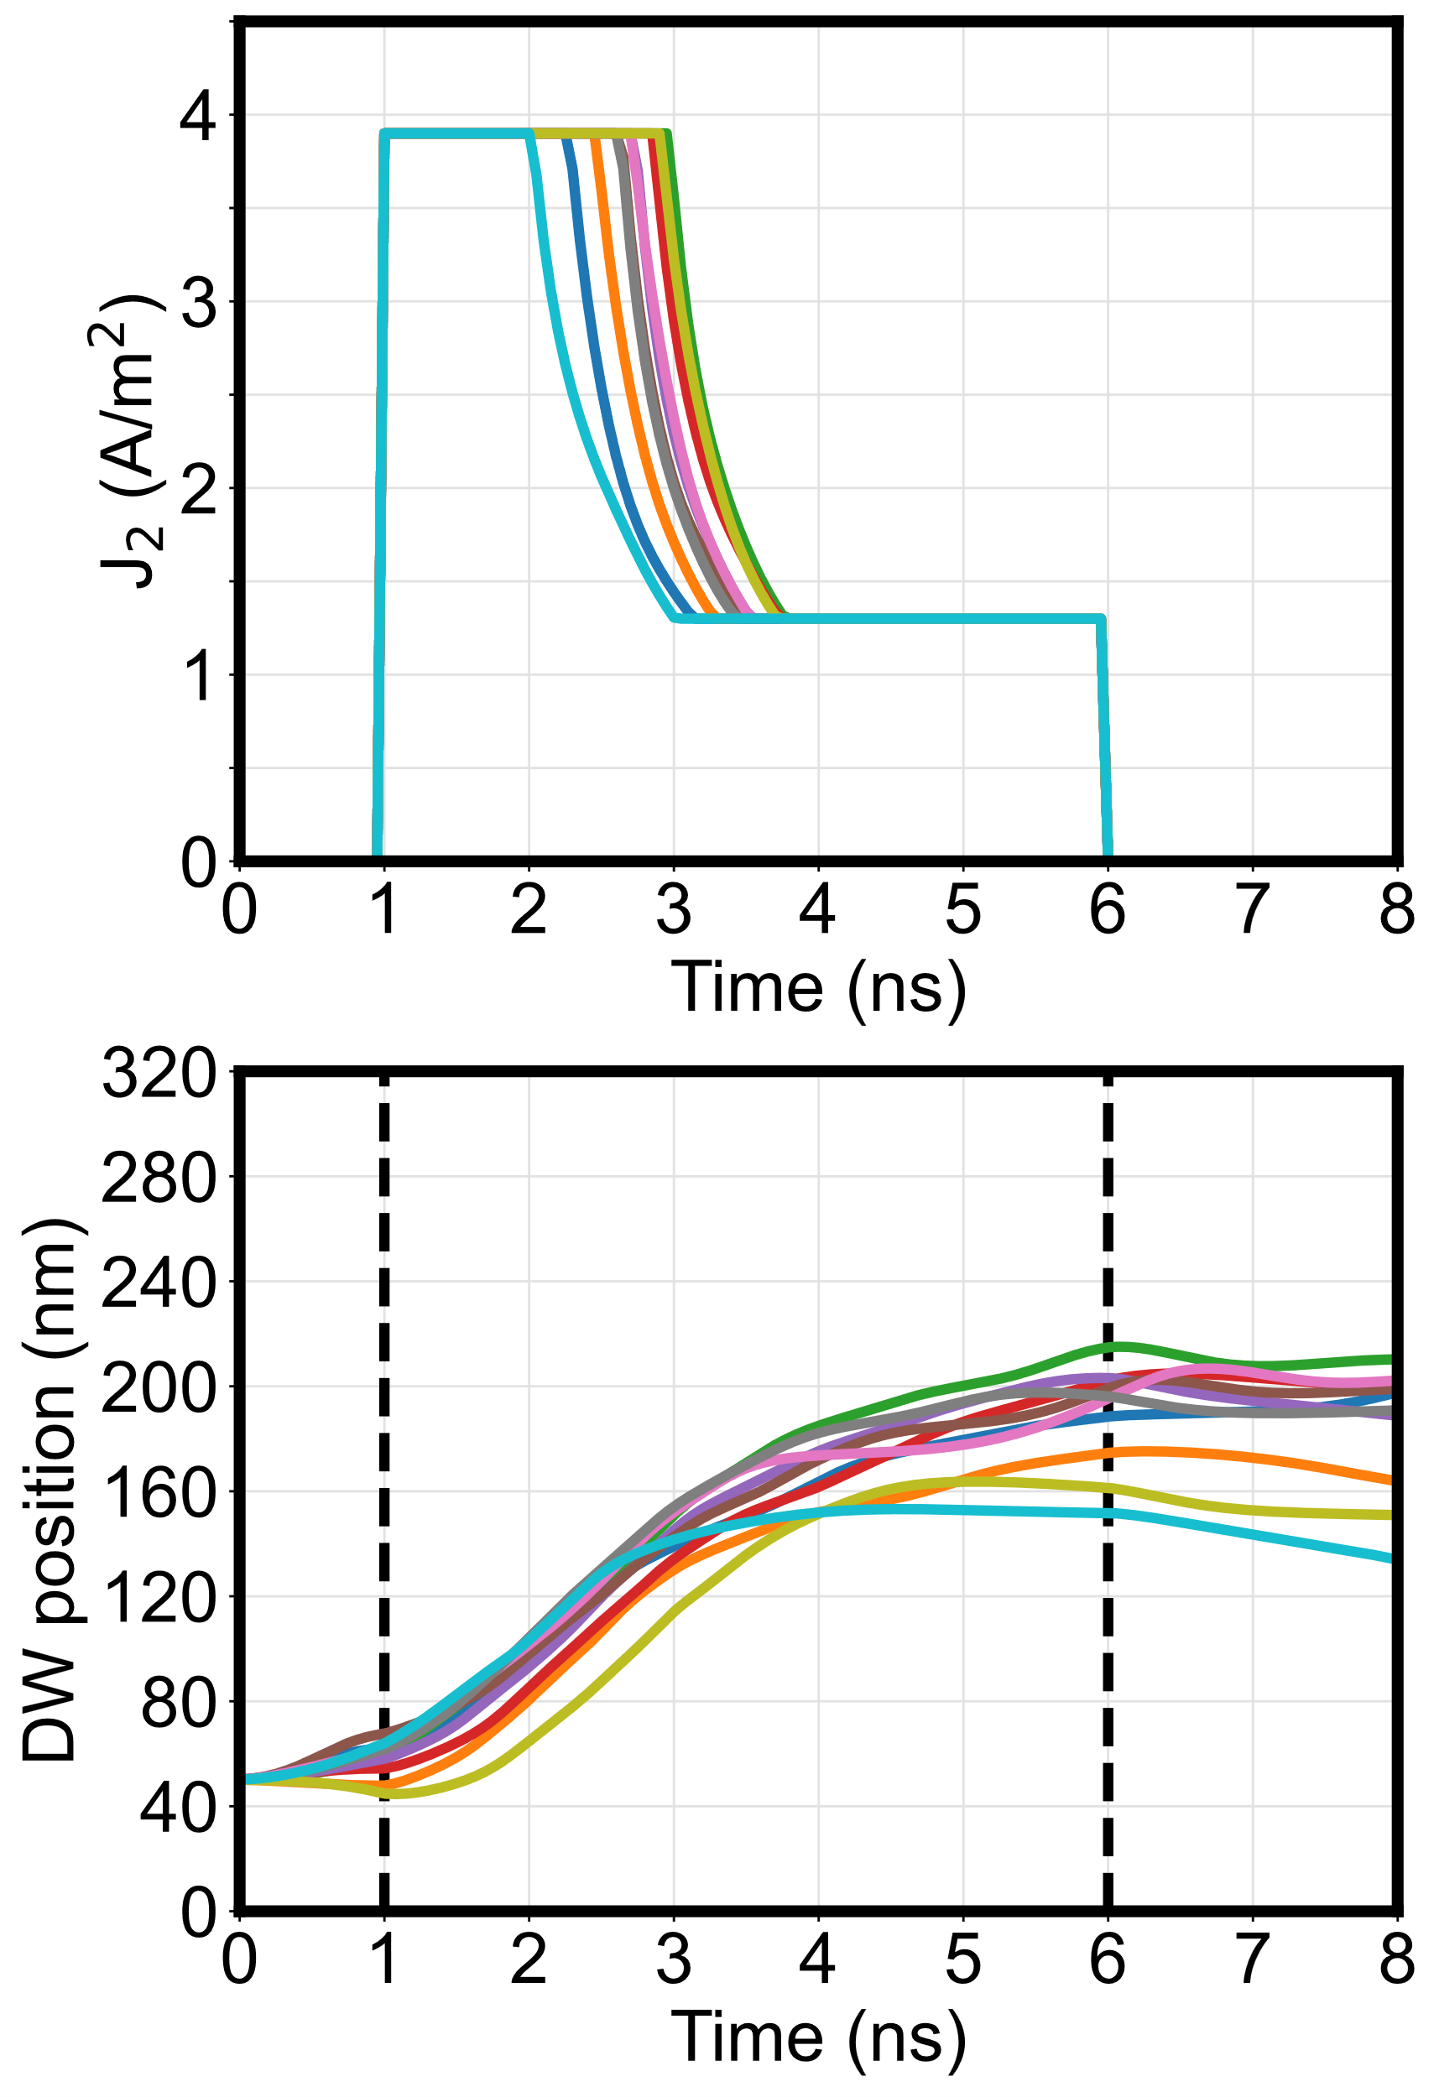
Time-varying current input
J_{high} = 3.0×10¹⁰
J_{low} = 1.2×10¹⁰
J_{high} = 3.0×10¹⁰
J_{low} = 1.0×10¹⁰
J_{high} = 3.9×10¹⁰
J_{low} = 1.3×10¹⁰
(TMR = 150%)
(TMR = 200%)
(TMR = 200%)
DW 2

Slide 9
The current input is large enough to move the DW at a moderate speed in the fat region
DW2 switches first
DW1 resets later

Slide 10
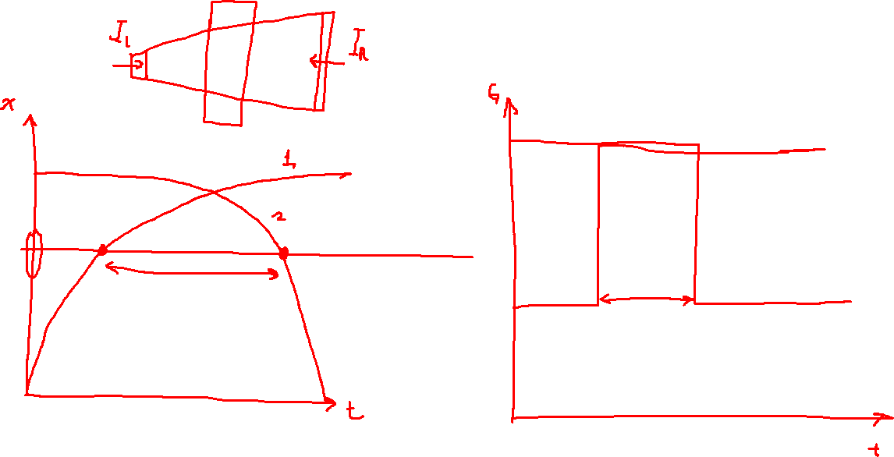

Slide 11
Other more obvious solutions (that don’t work)
Higher current to give DW 2 more speed
But DW 1 will move back faster, shortening the current pulse
Move MTJ to the left
DW 2 will clear the MTJ faster, but DW 1 will also be reset faster
Both DWs need to clear the MTJ with a large margin
Make second device narrower: limits cascade-ability
Are we under-estimating inertia? Is the amount of roughness too great?
The problem gets worse if we realistically model current division in the first device

Slide 12
Metal strip on the right side of track
DW2 switches first
DW1 resets later

Slide 13
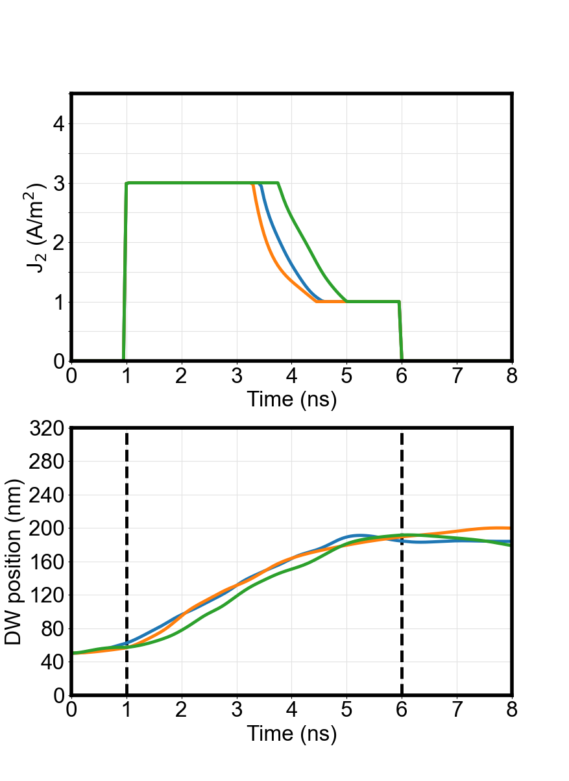
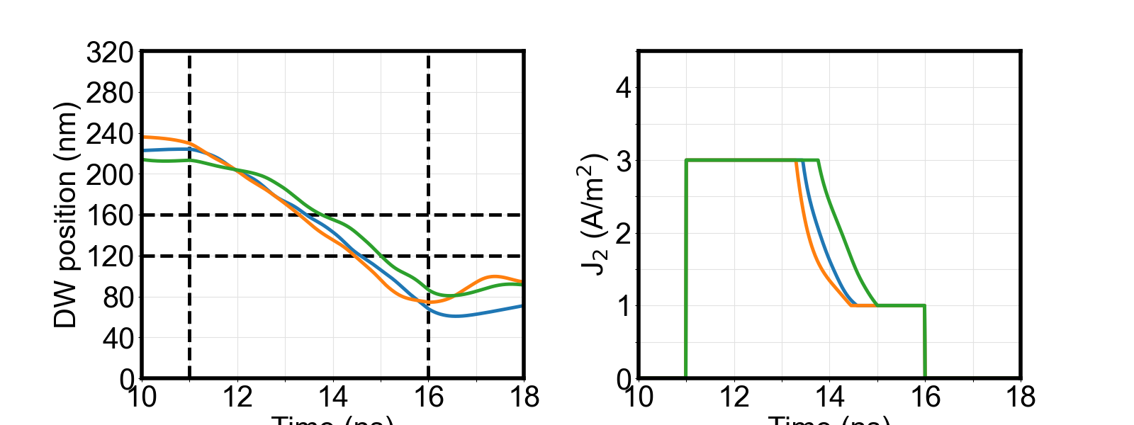
First shot – reduces current density in region by 25%

Slide 14
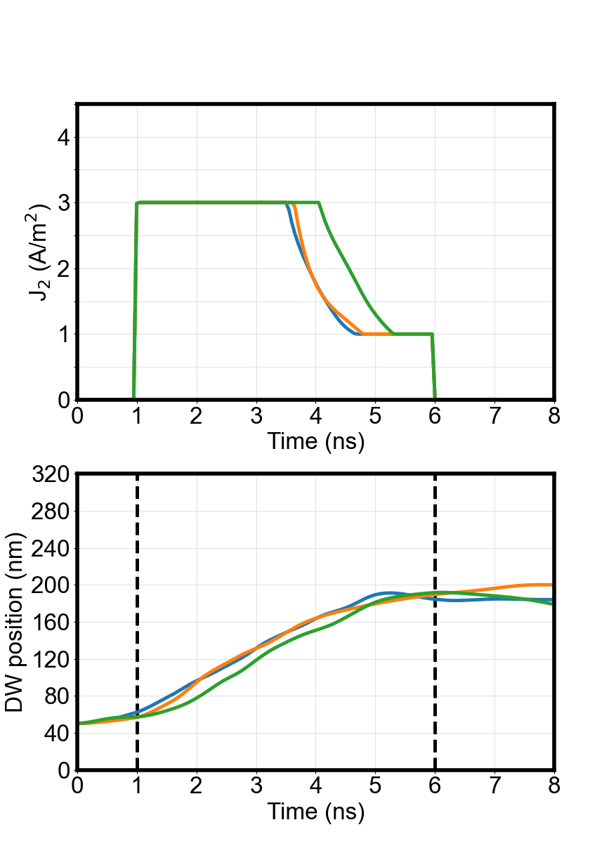
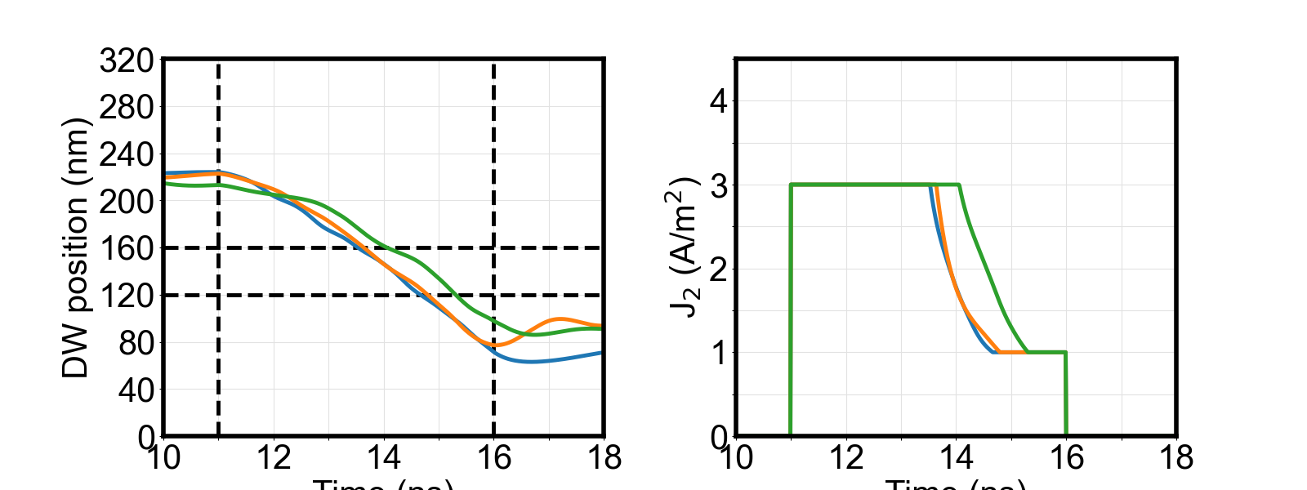
Second shot – reduces current density in region by 30%

Slide 15
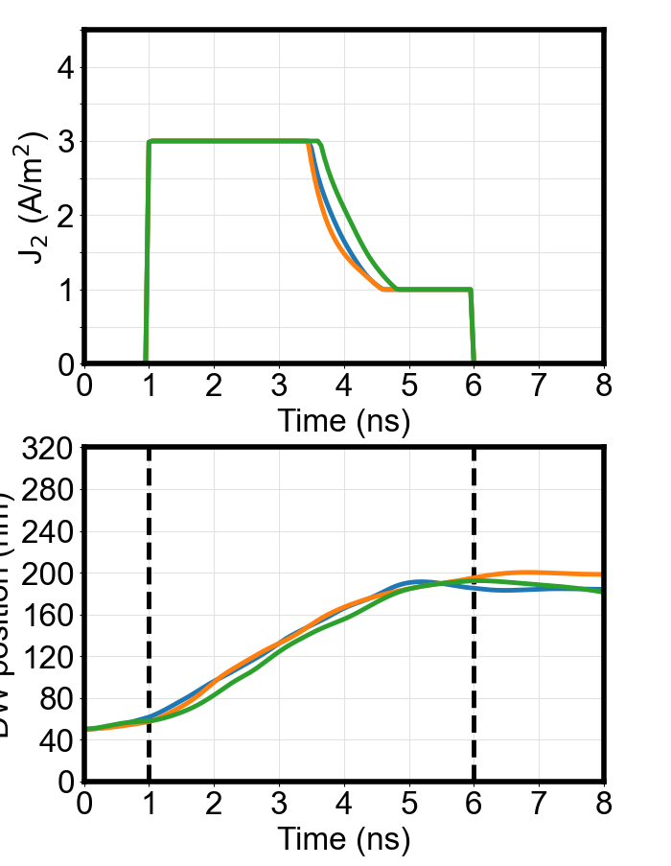
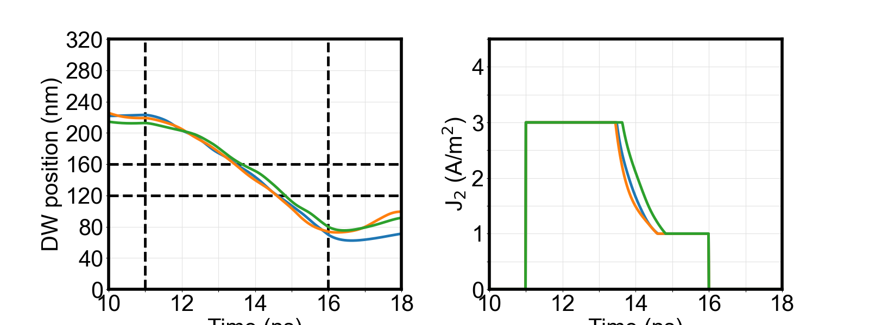
Third shot – reduces current density in region by 30%, anisotropy variation reduced

Slide 16
Potential idea for device: VCMA pinning
Use voltage- controlled pinning sites at ends of track, turn off when pulse is delivered, turn on when pulse ends
V_{pin}
J

Slide 17
To-do
Figure out geometry
Calculate electric field (electrostatics/Poisson)
Mumax3 simulations

