Slide 1
Monitoring Memory Behaviors and Mitigating NUMA Drawbacks on Tiered NVM Systems
S. Yang et al @ Sys-Inventor Lab
Sep. 2020

Slide 2
Executive Summary
Mitigating NUMA Drawbacks on Tiered NVM Systems
Problem: DAX-aware file system maintains the persistence of data in NVM, but it brings potential risks of remote access in NUMA.
Our Goal: Develop appropriate to improve the throughput and resource utilization while eliminate the risk of remote access
Observation:
OS will randomly select idle CPUs to start threads
Improper thread placement will cause remote access
Remote access of NVM can cause up to 3x the additional overhead
Solution: 1) Help OS realize that the phenomenon of remote access to NVM data is happening 2) Develop an appropriate process migration policy to determine the occasion of data migration
Results: 5.9% to 3.62x bandwidth improvement in the case where remote NVM accesses happen.

Slide 3
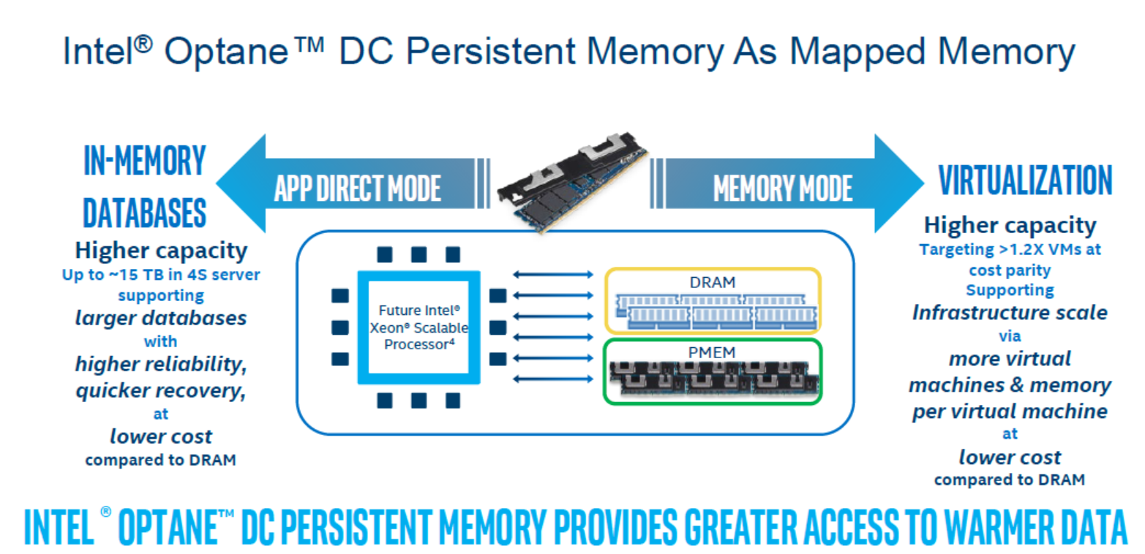
NVM's products- Intel Optane
This mode maintains the durability of NVM

Slide 4
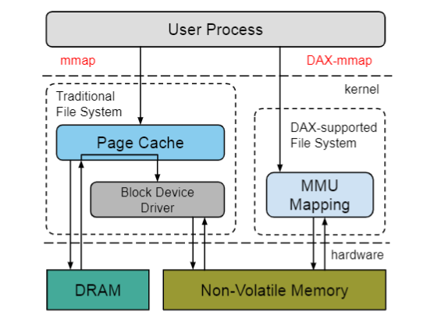
Memory access path in NVM
DAX-mmap (direct access) interface
Removes all of the on-demand paging overheads, CPU can directly access the data through the store/ load command.

Slide 5
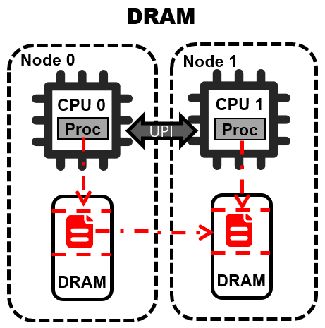
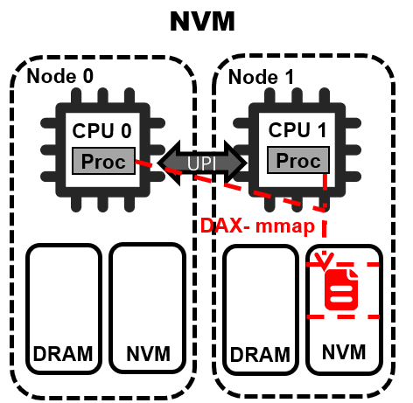
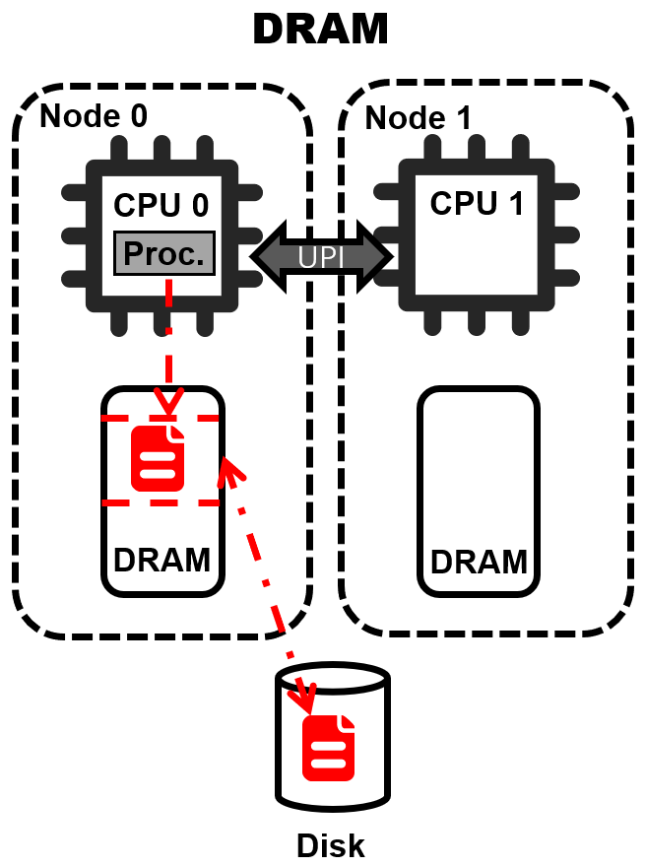
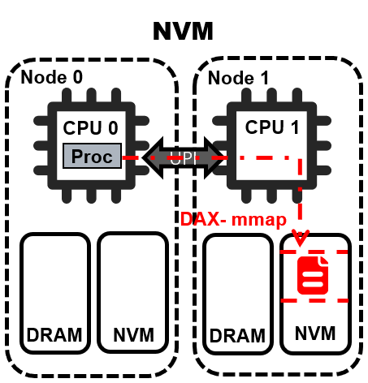
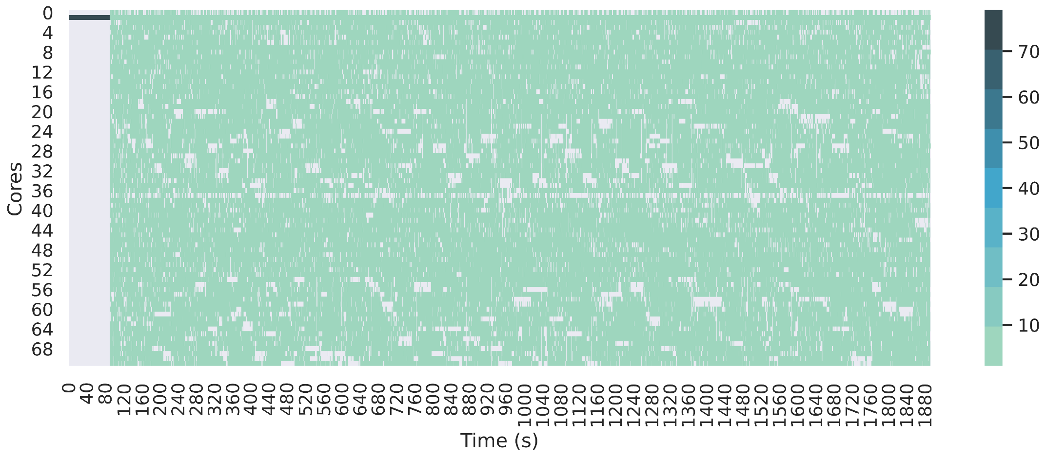

Remote access risk brought by DAX-mmap
Phenomenon - Remote write accesses to NVM incur serious overheads

Slide 6
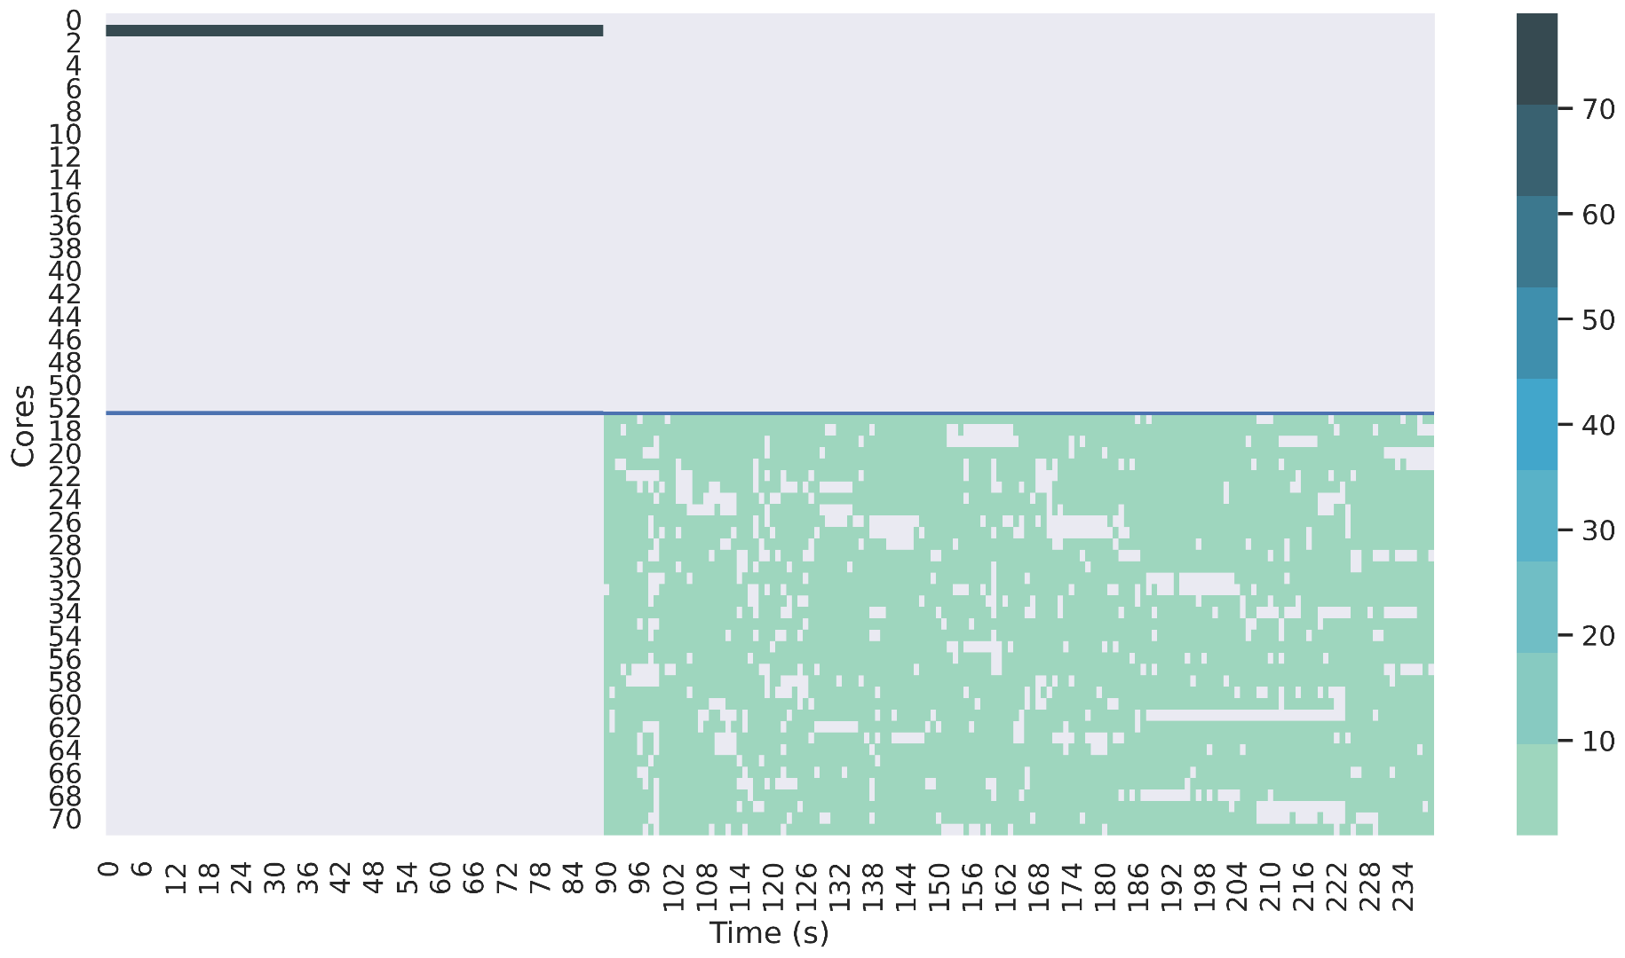
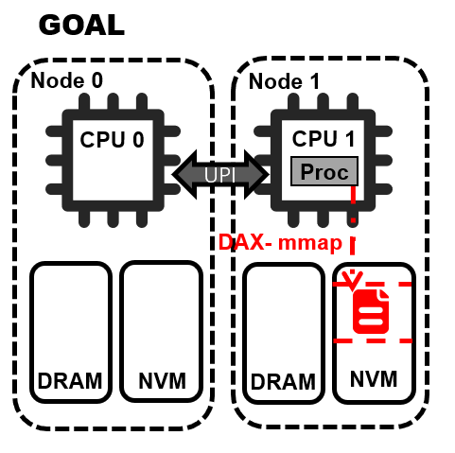
If the data cannot be moved, then we move the thread
Our Goal
node 0
node 1

Slide 7
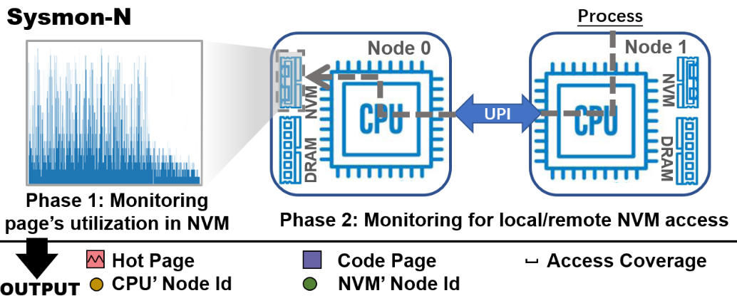
Sysmon-N: Monitoring NVM behavior
Sampling pages in NVM to collect the page hotness information while avoiding sampling pages in DRAM to narrow down the sampling space;
Checking whether remote access occurs and collecting related data access information

Slide 8
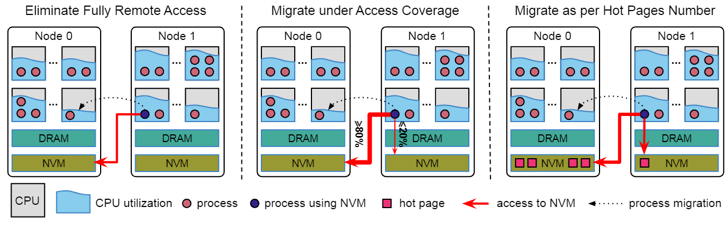
Conditional Migration Model of N-Policy
Three cases of thread migration：
100% remote access
remote access coverage ≥ 80%
remote access coverage is about 50%, but remote data is “hot”

Slide 9
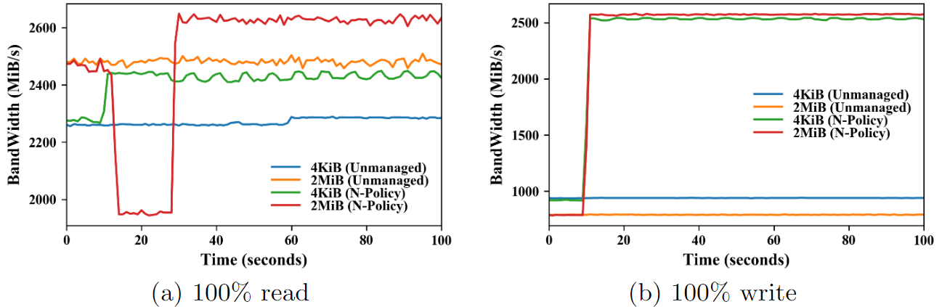
Evaluation
Our approach improves the read bandwidth by 6.94% and 5.90%, the write bandwidth by 2.71x and 3.26x in the case of 4KiB and 2MiB block sizes

Slide 10
Conclusion
Our approach takes advantage of the characteristics of NVM
Our approach includes:
SysMon-N, an OS-level sampling module, to obtain access information about NVM in low overhead
N-Policy utilize the data collected by SysMon-N to guide process migration

Slide 11
Thank You

