Slide 1

Going Vertical in Memory Management: Handling Multiplicity by Multi-policy
(ISCA’14 in MN)
Lei Liu
Sys-Inventor Lab, SKLCA, ICT, CAS

Slide 2
Executive Summary
Beginning: The Story of Memory Management in Multicore system.
Question: “Best-fit” Memory Allocating Policies?
Target: Efficient & Effective Memory Management mechanism in Multicore system.
- Reduction/Elimination of Memory Contentions.
- Meeting the diverse requirements of workloads.
- Exploiting the advantages of existing architecture.
- Improving the utilization of Memory Resource.

Slide 3
Background & Motivation

Slide 4
Optimizing Memory System through Operating System Approaches
Two “Philosophies” on Memory Optimization
“Horizontal” Partitioning in DRAM Banks
and Cache
-- Eliminating memory interferences
-- Improving overall system performance
(2) Random Interleaving approach
-- Reducing potential memory interferences
-- Benefitting system performance
Notes:
Since our work is an OS-based software approach, I may want to introduce the two typical approaches partitioning and interleaving.

Slide 5
“Horizontal” Cache Partitioning
Partitioning (Software-based Page-Coloring)
-- Cache [J.Lin, X.Zhang et al. HPCA-2008]
-- DARM Bank [L.Liu PACT-2012]
Physical address
00
Page Offset
Thread 1
01
Thread 2
10
Cache Set Bits
Thread 3
11
Thread 4
Notes:
Let each thread only use its own colored part of cache. Thus, the memory interferences in llc are eliminated, benefitting the overall system performance

Slide 6
“Horizontal” DRAM Partitioning
Partitioning (Software-based Page-Coloring)
-- Cache [J.Lin et al HPCA-2008]
-- DARM Bank [L.Liu PACT-2012]
Thread 1
Thread 2
Thread 3
Memory interferences are eliminated →
The overall system performance is improved
DRAM Banks

Slide 7
Random Interleaving
Random Interleaving [H. Park et al. ASPLOS-2013]
Thread 1
Thread 2
Thread 3
DRAM Banks
The more randomized,
the higher performance will be achieved
Notes:
Quite different with partitioning “idea” is random interleaving

Slide 8
Partitioning V.S. Random Interleaving
Partitioning [L.Liu PACT-2012]
-- Better for Multi-programmed workloads
-- Not suitable for Multi-threaded workloads
Random Interleaving
-- Better for some Multi-threaded workloads
How to integrate these approaches into one
system?
How to make Partitioning more effective?
Notes:
The existing researches show that ……

Slide 9
Study the Effectiveness of “Horizontal” Partitioning

Slide 10
“Horizontal” Partitioning: Cache VS. DRAM -- Programs are from SPECCPU2006
Whether the two horizontal approaches work cooperatively?

Slide 11
Architecture Features in Modern Multicore Systems
B-/C-/O-Bits in Address Mapping
The address Mapping of Intel i7-860 w/ 8GB Memory

Slide 12
“Vertical” Partitioning using O-Bits
Cache Set
Cache Line
T1 T2 T3 T4
Last Level Cache
DRAM Banks
Notes:
Using o-bits, we can vertically partition last cache and dram bank at the same time. We introduce the concept of vertical partitioning, since it can eliminate the memory interferences in both cache level and dram bank level at the same time.

Slide 13
Partitioning Space in Entire Memory Hierarchy
The address Mapping of Intel i7-860 w/ 8GB Memory
Notes:
B-vp uses one b-bit + two o-bits, and thus partitions bank level at a finer granularity.

Slide 14
The History of Page-Coloring
--Cross-layer Cooperative Vertical partitioning

Slide 15
The Performance Gains on Vertical Partitioning

Slide 16
They are in the quadrant ONE

Slide 17
“Best-Fit” Policy?

Slide 18
What affects Vertical Partitioning?
Cache sensitivity impacts VP
LLCH: Last Level Cache High Requirement LLCT: LLC Thrashing
LLCM: LLC Middle Requirement CCF: Core Cache Fitting
Notes:
We found cache sensitivity is a determing factor that impacts the performance of VP. Since vp adds the performance gains of Cache partitioning and Bank partitioning together.
Thus, to make right decision on selecting vertical partitioning, we classify application’s caching behavior into four catoegires, LLCH, LLCT, LLCM and CCF in terms of the cache requirement.
We collect the application's performance slowdown as the LLC capacity is decreasing from 8/8 quota to 1/8 quota. As we can see from the figure, LLCH are those with highest performance degradation. On the other extreme, LLCT shows negligible impact.

Slide 19
The Classification of SPECCPU2006
Diverse memory features on Cache and DRAM

Slide 20
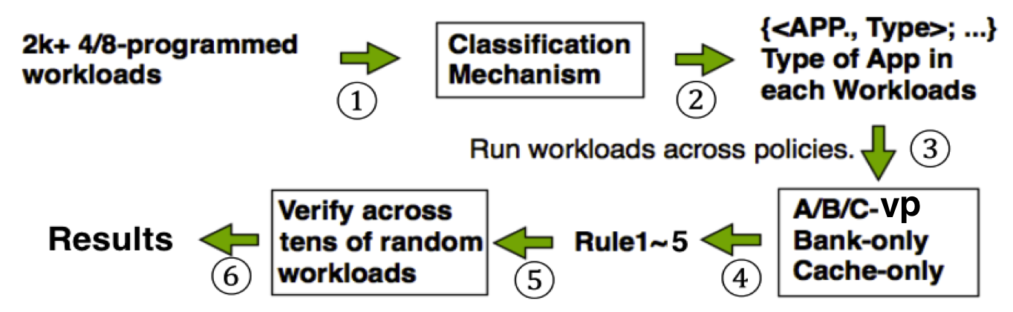
Data Mining: Classification → Best-Fit Partitioning
Algorithm: Using APRIORI algorithm to discover A → B
Modeling：{lib, mcf, bzip, hmmer} →
{<lib, LLCT>, <mcf, LLCH>, <bzip, LLCM>, <hmmer, CCF>}
→ <cache-only, x%>, <bank-only, y%>, <A/B/C-VP, z%>

Slide 21
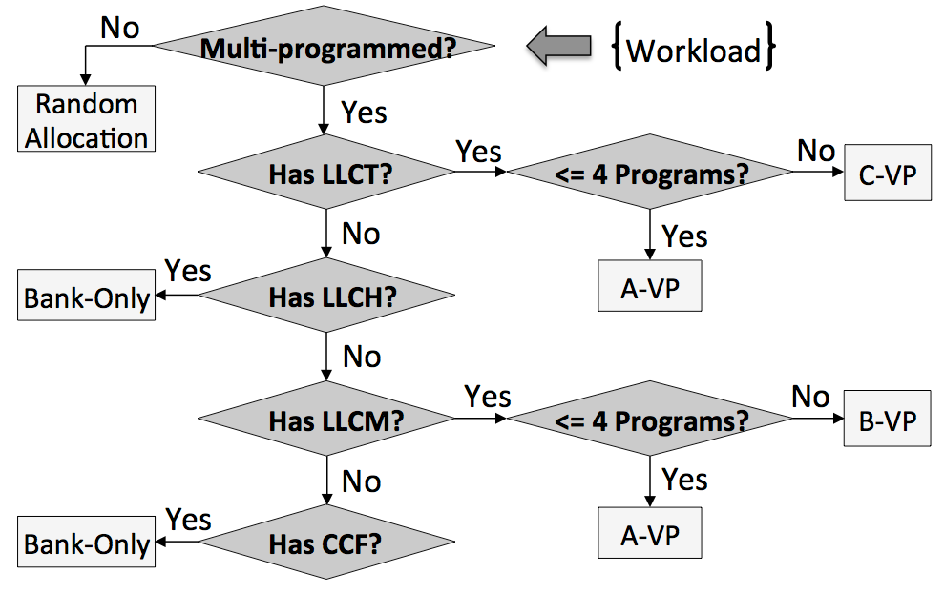
Handling Multiplicity by Multi-policy (1) -- Memory Policy Decision Tree
Who is “stronger”：LLCT > LLCH > LLCM > CCF

Slide 22
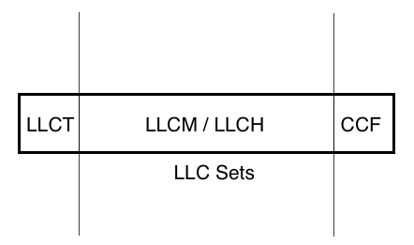
Handling Multiplicity by Multi-policy (2) -- Partitioning and Coalescing rules
Who is “stronger”：LLCT > LLCH > LLCM > CCF
Notes:
Another result from data mining is the Partitioning and Coalescing rules. They indicate that we should partition LLCT and CCF seperatively, and then leave more space for LLCM and LLCH

Slide 23
A-/B-/C-Vertical Partitioning “Best-Fit” memory policy Application-Architecture-Aware Memory Management

Slide 24
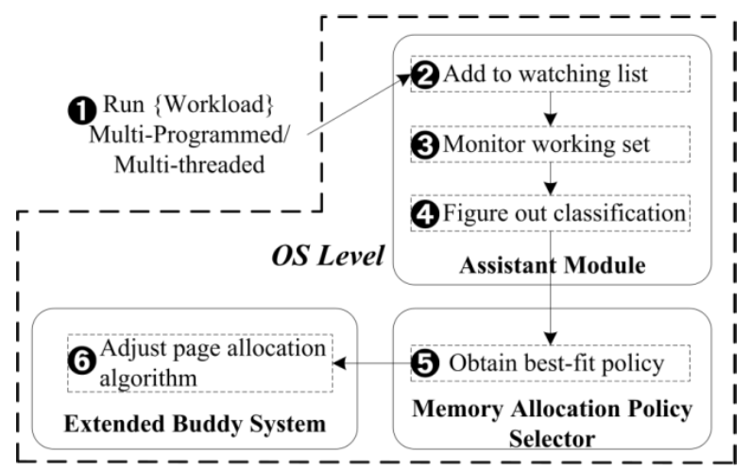
Let it Run On-the-Fly!

Slide 25
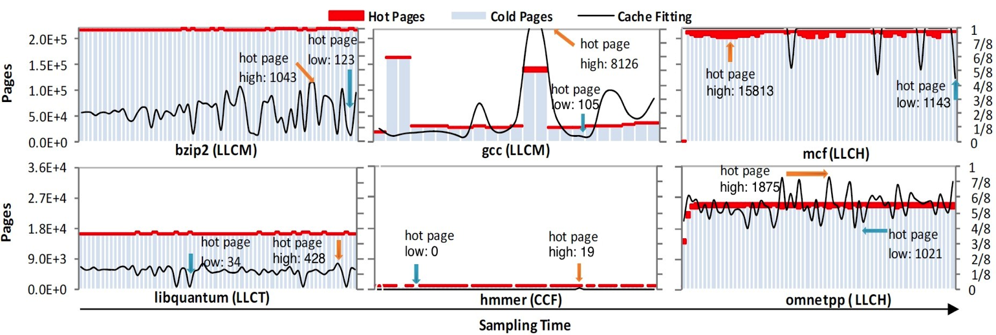
SysMon: Light-weighted OS level Monitoring Tool (1) ()
It detects __access_bit in PTE, and then distinguishes “cold” and “hot” pages.
It indicates the max requirements of Cache utility of one threads by counting the number of “hot” pages.

Slide 26
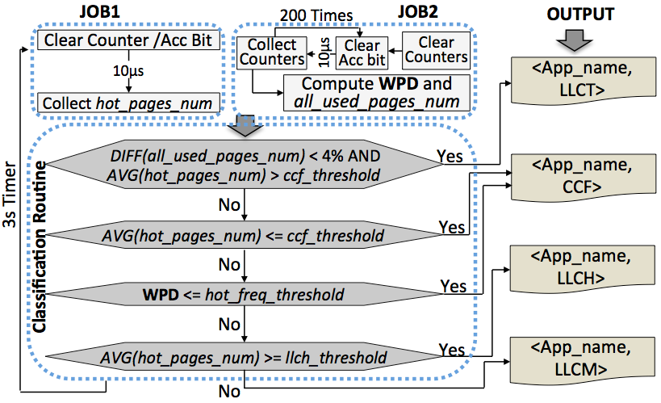
SysMon: Light-weighted OS level Monitoring Tool (2)
Weighted Page Distribution →“Locality”
WPD= (2xVH + 1.5xH +1xM + 0.5xL + 0.1xVL) / all_used_pages_num

Slide 27
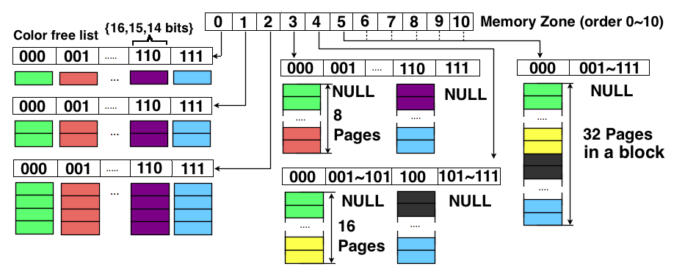
X-buddy: Supporting Multi-policy (1)
Sub-System A (O-bit 14,15,C-bit 16 bit)→A-/C-VP
Allocating physical pages in terms of colors

Slide 28
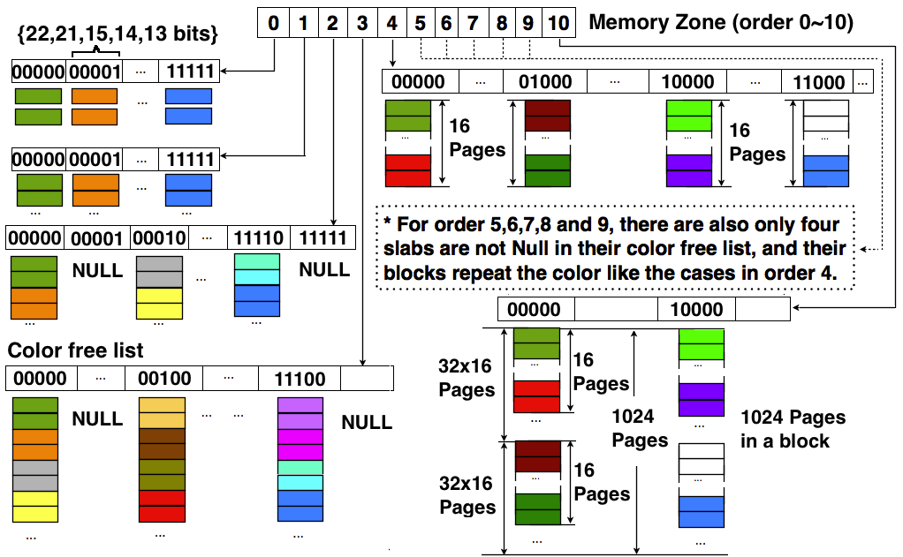
X-buddy: Supporting Multi-policy (2)
Sub-System B (O-bits 13,14,15,B-bits 21,22 bits)→Bank-Only/B-VP
Support interleaving by random or Round-Robin selecting pages in Order-1 list

Slide 29
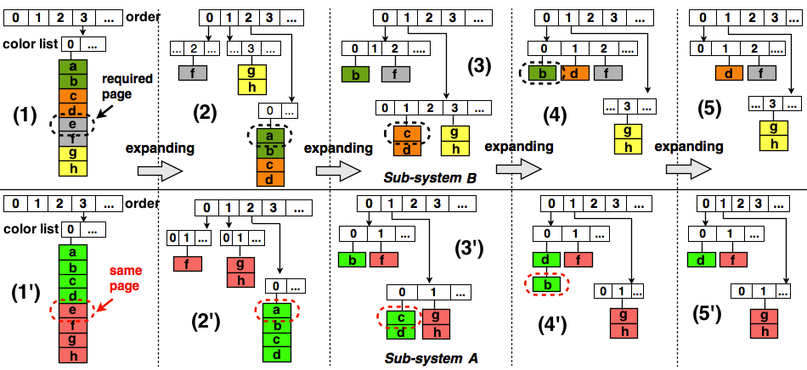
Sub-System A and B work together
We can get page with target color in O(1)

Slide 30
Experimental Results

Slide 31
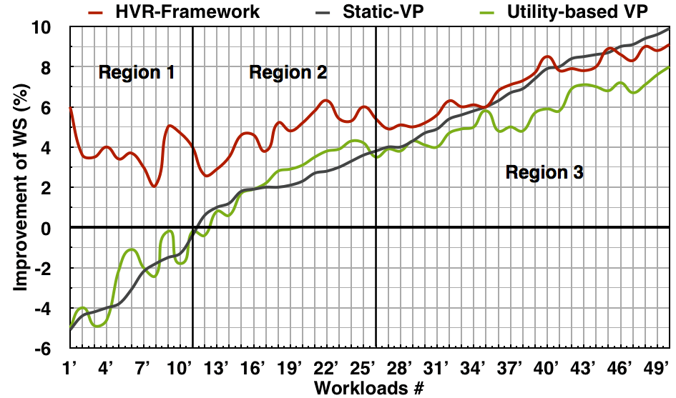
Horizontal Vertical Random Framework (1)
Get the proper memory allocating policy
Use the partitioning and coalescing
LLCM
A/B-VP
LLCH
Bank-Only
LLCT
A/C-VP
Notes:
For different workloads, Our framework can get the proper memory allocating policy in terms of application’s classification, and use the partitioning and coalescing for more performance. For example, in region 1, there are llch domanate workloads, so it use bank partitioning and thus avoid the performance lost.
In region 2, there are LLCT domaniate workloads, so the partitioning and coalescing rule will benefit the performance.

Slide 32
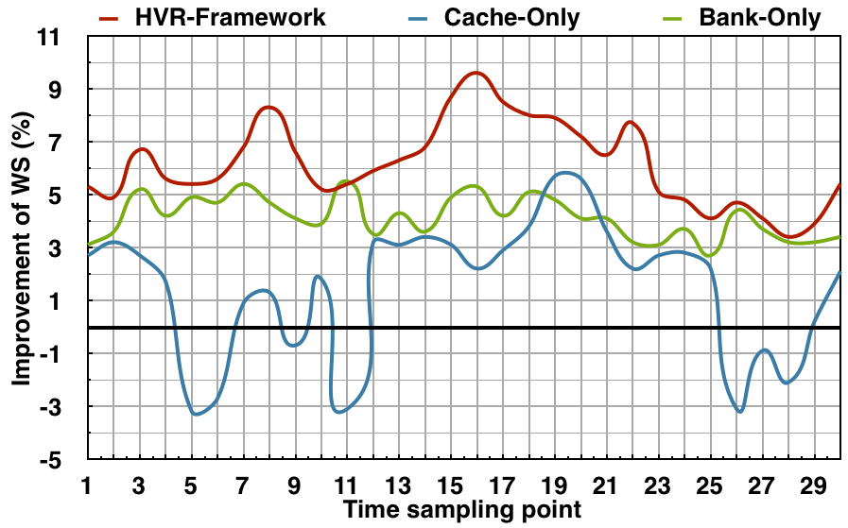
Horizontal Vertical Random Framework (2)
HVR outperforms the “Horizontal” Partitioning
Notes:
In the sampling point 16th, the system achieve higher performance, since our approach uses the vertical partitioning, and enable the coalescing policy for the applications with higher memory requirement.

Slide 33
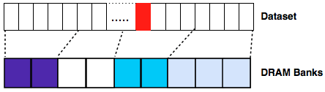
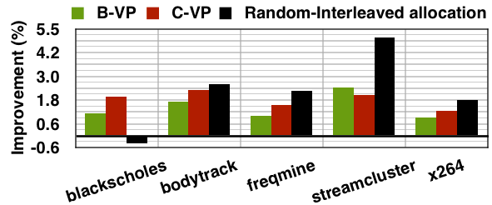
For Multi-Threaded workloads
Partitioning VS. Random

Slide 34
Conclusion
Vertical Partitioning
-- Brings up to 17% improvement
-- Outperforms the Horizontal partitioning
Closing the “gap” between arch. and OS
-- Makes OS take advantages of arch. Features
-- Application-Arch.-Aware Memory Management (HVR)
Memory optimization
-- We try to approach it from OS angle
-- Optimizes the memory allocating in the root

Slide 36
backup

Slide 37
Overhead
（1）Page-table based sampling
－ average 0.6％
－ randomly selecting pte in page table. Example, 5µs (povray) to 4.46ms (mcf)
－ sampling interval, grows with an increasing step once it collects sufficient information to complete the initial classification process, and thus its overhead is further reduced for long running workloads.
（2）x-Buddy
－ systime, ranging from 0.x sec to several sec
（3）Page migration and re-coloring
－ 30s (at most in our experiments)／90s (saved)
－ Lazy “migration”
－ “row-clone” [Micro-2013]

Slide 38
Throughput, Fairness and Bandwidth
AVG. 6% Improvements

Slide 39
Executive Summary
Beginning: The Story of Memory Management in Multicore system.
Question: “Best-fit” Memory Policies?
Target: Efficient & effective Memory Management mechanism in Multicore system.
- Reduction/Elimination of Memory Contentions.
- High utilization of Memory Resource.
- Exploiting the advantages of existing arch.
- Meeting the diverse requirements of workloads.

Slide 40
The Philosophy of Memory Management
Multiplicity: Partitioning VS. Randomizing
Multi-Programmed VS. Multi-Threaded
Multi-policy: Horizontal, Vertical, Random
- HVR: An uniform memory management framework
- Handling Multiplicity by Multi-policy
- Application-Arch.-Aware Memory Management
- Minimizing Memory “GAP” between Arch. & OS.

Slide 41
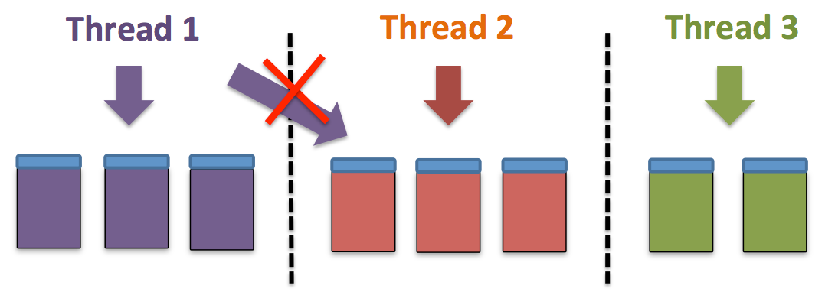
What will I talk?
DRAM Bank Partitioning

Slide 42
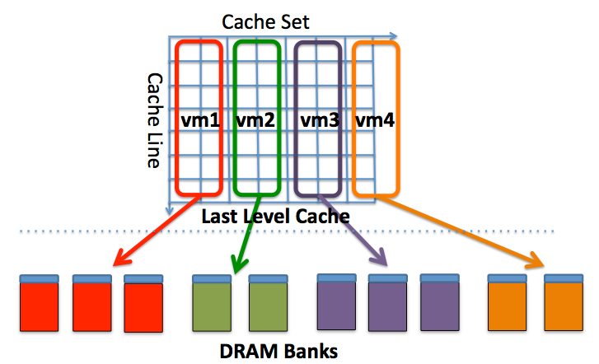
What will I talk?
Vertical Partitioning in memory hierarchy

Slide 43
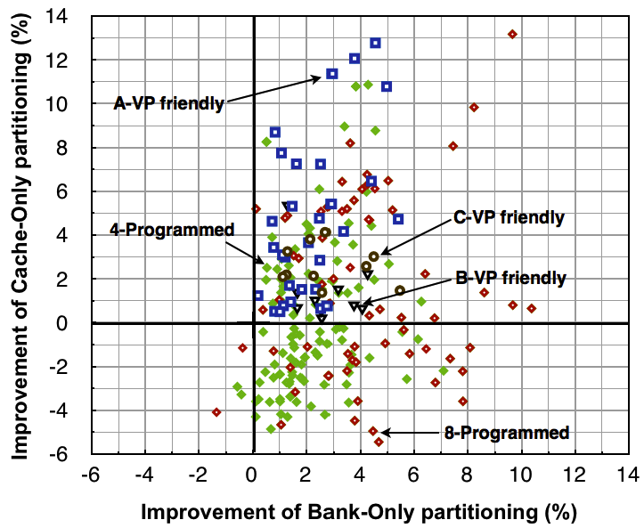
What will I talk?
App.-Arch.-Aware Memory Management
- SysMon: Light weight OS level Monitoring Tool
- Data Mining for finding Best-Fit Memory Policies
- X-Buddy System for supporting Multiplicity (HVR)

