Slide 1
A New Qubits Mapping Mechanism for Multi-programming Quantum Computing
Xinglei Dou, Lei Liu
Sys-Inventor Lab

Slide 2
Executive Summary
Multi-programming in quantum computers is proposed to improve the throughput and resource utilization
Problem: Multi-programming leads to degradation in fidelity and contention between concurrent quantum programs
Our Goal: Develop techniques to improve the throughput and resource utilization while ensuring the fidelity
Observation:
Community Detection Algorithm profiles the quantum chip
Inter-program SWAPs help to reduce compilation overheads
Solution: Community Detection Assisted Partition; X-SWAP scheme; Compilation task scheduler
Results: 12% improvement in fidelity and 11.1% reduction in compilation overheads

Slide 3
Outline
Introduction
Motivation
Designs
Evaluation
Conclusion

Slide 4
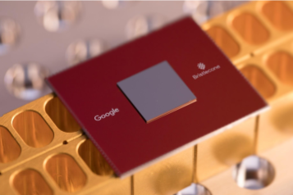


Quantum computing
Quantum computing is stepping into our view
Quantum computers are accessible via cloud
72-qubit chip of Google
53-qubit chip of IBM
49-qubit chip of Intel
Calibration data
Coupling graph
Probabilities (%)
Quantum cloud service
00
01
10
11
Quantum program
Compiler
State
Compiled program
Result histogram

Slide 5
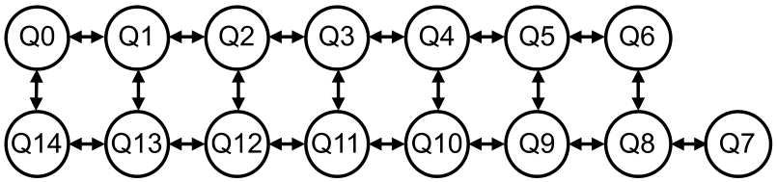
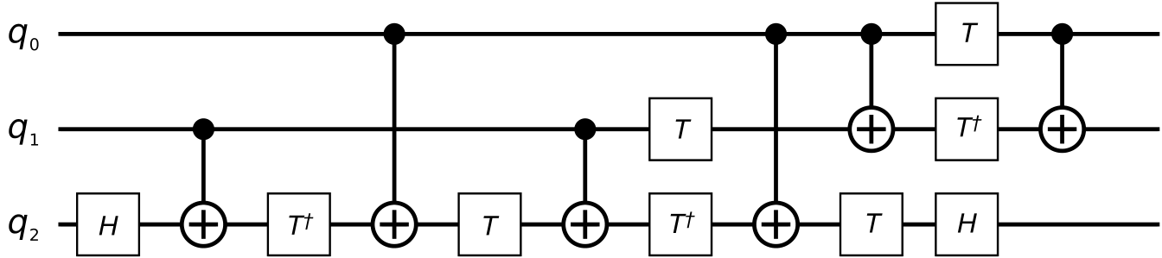
Quantum program compilation
Constrains
Each program qubit is allocated to a physical qubit
A quantum gate is executable when it has not unexecuted predecessors
A 2-qubit gate is executable when the two qubits involved are mapped physically adjacent
Compilation workflow
Initial mapping generation
Mapping transition by inserting SWAPs
IBMQ16 architecture
Decomposed Toffoli gate

Slide 6
Trends
Noise Intermediate Scale Quantum(NISQ)
QEC is too expensive to be implemented
Noise-aware quantum compilers
Multi-programming is needed
Contention for accessing quantum computers
Resource underutilization of quantum computers
Multi-programming proposes new challenges
Scarce robust resources
Cross-talk noise [Murali, ASPLOS’20]
Greater compilation overheads

Slide 7
Outline
Introduction
Motivation
Designs
Evaluation
Conclusion

Slide 8
Previous solution results in wastes
Fair and Reliable Partition in [Das, MICRO’19]
Programs to be mapped:
P1:5 qubits
P2:4 qubits
Unreliable qubit
P1 allocation
Available allocation for P2
Q0
2.5
Q1
1.6
Q2
3.0
Q3
1.8
Q4
2.2
Q5
5.5
Have to suffer an unreliable link
Q6
2.5
8.0
4.5
3.0
3.3
3.4
3.8
Q14
Q13
Q12
Q11
Q10
Q9
Q8
Q7
4.1
8.6
6.0
3.1
3.8
1.8
2.8
Can not support to map another quantum program
Q0
2.5
Q1
1.6
Q2
3.0
Q3
1.8
Q4
2.2
Q5
5.5
Avoids the unreliable link
Q6
2.5
8.0
4.5
3.0
3.3
3.4
3.8
Q14
Q13
Q12
Q11
Q10
Q9
Q8
Q7
4.1
8.6
6.0
3.1
3.8
1.8
2.8
A better solution can make full utilization of resources

Slide 9
Inter-program SWAPs reduce overheads
Inter-program SWAPs take shortcuts
P₁ allocation
q₃
q₄
q₅
P₂ allocation
q₂
q₉
q₈
Front Layer
CNOT q₁ q₅
……
q₁
q₆
q₇
Previous solution
(Intra-program SWAP) takes 3 steps
Inter-program SWAP takes 1 step

Slide 10
Inter-program SWAPs reduce overheads
An inter-program SWAP can replace two intra-program SWAPs
q₁
q₂
q₃
P1 Allocation
P1
g3
g1
g2
P2 Allocation
q₂
q₅
q₆
q₂
q₅
q₆
q₄
q₅
q₆
q₂
q₅
q₆
q₃
q₁
q₄
q₃
q₁
q₄
P2
g6
g4
g5
Previous solution takes 2 steps
Inter-program SWAP take 1 step
q₃
q₁
q₄
P1 and P2 are mapped on a 6-qubit chip

Slide 11
Outline
Introduction
Motivation
Designs
Community Detection Assisted Partition (CDAP)
X-SWAP Scheme
Compilation Task Scheduler
Evaluation
Conclusion

Slide 12



CDAP: For initial mapping generation
Outline
Hierarchy tree construction
Partition physical qubits according the hierarchy tree
Allocate quantum programs to the assigned regions
Concurrent Programs
Coupling Map
Calibration Data
Hierarchy Tree
Partition
Allocation

Slide 13
Hierarchy tree construction
Workflow
Each qubit forms a community
Merge two communities that can maximize the reward function F until there is only one community containing all qubits
Features:
Each node is a candidate set of qubits for initial mapping
Qubits in a node are tightly-connected
Qubits with lower error rates are preferentially merged
Q₀
Q₁
Q₂
{0,1,2,3,4}
1.4
0.5
3.5
1.2
3.3
{0,1,2}
{3,4}
Higher fidelity
1.0
Q₃
3.3
{0,1}
{2}
{3}
{4}
1.3
Q₄
3.0
{0}
{1}
IBM Q London architecture
Hierarchy tree
Hierarchy tree is a profile of the quantum chip and helps to locate robust resources on a quantum computer

Slide 14
Design Details
Reward Function: F=Q_{merged}-Q_{origin}+ωEV
For physical typology: Q_{merged}-Q_{origin} [Newman, 2014]
For error rates: ωEV
ω: a weight parameter
E: fidelity of edges connecting two communities
V: fidelity of readout operations on qubits connecting two communities
Q_{origin}
<
Q_{merged}

Slide 15
Partition and allocation
Partition
Prioritize programs with higher CNOT density (num. of CNOTs / num. of qubits)
Search the hierarchy from bottom to top to find available candidate set of physical qubits
The candidate with lowest error rate is assigned for initial mapping
{0,1,2,3,4}
{3,4}
Candidates
Higher
CNOT
density
P1(2 qubits,
2CNOTs)
{0,1,2}
{3,4}
Assigned to P2
{0,1,2}
Assigned to P1
{3,4}
{0,1,2,3,4}
P2(3 qubits,
6 CNOTs)
{0,1}
{2}
{3}
{4}
{0}
{1}
Programs are allocated to the assigned regions with Greatest Weighted Edge First strategy [Murali,ASPLOS’19]

Slide 16
Outline
Introduction
Motivation
Designs
Community Detection Assisted Partition
X-SWAP Scheme
Compilation Task Scheduler
Evaluation
Conclusion

Slide 17
Design of heuristic search space
Prioritize critical gates
Critical gates
g₁
= CNOT q_{a} q_{b}
g₁
= CNOT q_{c} q_{d}
F₁
g₃
g₂
q_{a}
6 possible
SWAPs
DAG₁
g₁
F₂
g₃
q_{b}
g₃
5 possible
SWAPs
DAG₂
q_{c}
q_{d}
Helps to reduce post-compilation depth

Slide 18
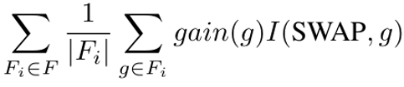
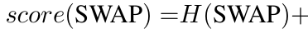
Design of heuristic cost function
Prioritize inter-program SWAPs
gain(g)=D[σ(g.q₁)][σ(g.q₂)] − D_{i} ′[σ(g.q₁)][σ(g.q₂)]
Nearest Neighbor Cost function [Li,2019]
Gain of inter-program SWAP
Indicates whether the SWAP is on the shortest path
P₁ allocation
q₃
q₄
q₅
D: Shortest path matrix for all physical qubits
D_{i}’ : Shortest path matrix of unmapped physical qubits and physical qubits on which P_{i} is mapped
P₂ allocation
Front Layer
q₂
q₉
q₈
CNOT q₁ q₅
……
q₁
q₆
q₇
D₁’[σ(q₁)][σ(q₅)]=4
D[σ(q₁)][σ(q₅)]=2
(shortest path)
SWAP q₁ q₉ is prioritized

Slide 19
Outline
Introduction
Motivation
Designs
Community Detection Assisted Partition
X-SWAP Scheme
Compilation Task Scheduler
Evaluation
Conclusion

Slide 20



Compilation task scheduler
Based on estimated fidelity
EPST violation = 1 – Co-located EPST/Independent EPST
Stops after N iterations
Incoming jobs
1
2
3
4
…
EPST violation < threshold ?
EPST violation < threshold ?
EPST violation < threshold ?
Current job set
Submit to the backend for execution
Stops after M programs’ co-location

Slide 21
Outline
Introduction
Motivation
Designs
Evaluation
Conclusion

Slide 22
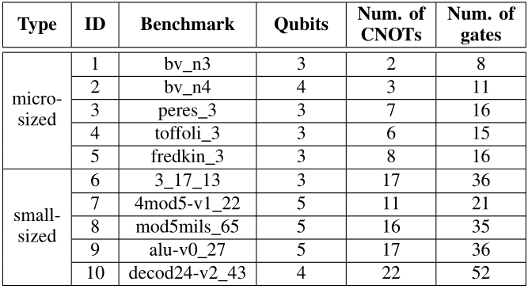
Metrics & Methodology
Metrics
Probability of a Successful Trial (PST): the fraction of trails that produce a correct result
Post-compilation gates number: especially CNOT gates
Trial Reduction Factor (TRF): the ratio of trails needed when programs are executed independently to the trails when multi-programming is enabled.
Methodology
Qiskit
Platforms: IBMQ16/Q20
Benchmarks:

Slide 23
Baseline
Independent execution [Li, ASPLOS’19] High fidelity, low throughput
Multi-programming baseline [DAS, MICRO’19] Low fidelity
Breakdown of our approach:
CDAP-only
X-SWAP-only
CDAP + X-SWAP

Slide 24
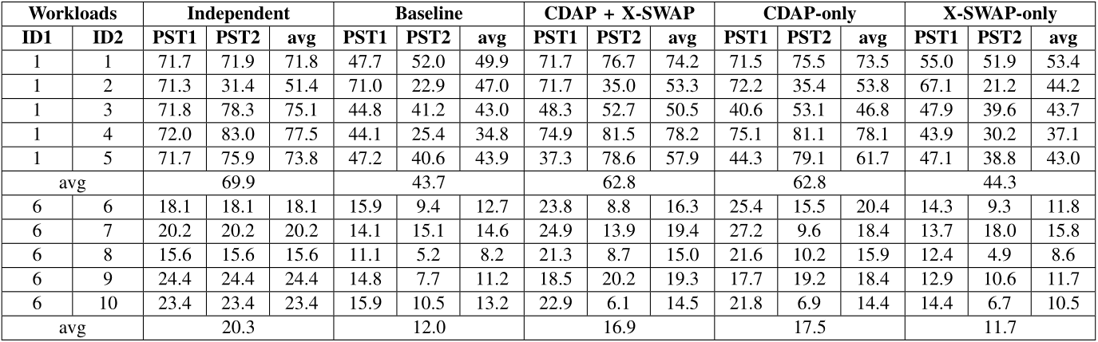
Evaluation of fidelity
Our approach outperforms Baseline by 12% and incurs only 5.25 % fidelity reduction compared with Independent cases.
The benefits mainly come from CDAP
Initial mapping has a major impact on reliability in small-sized benchmark combinations
Few SWAPs are needed to compile small-sized programs

Slide 25
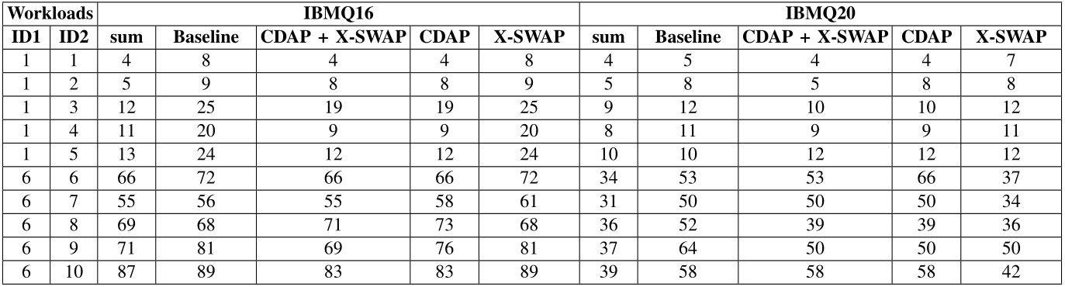
Evaluation of gates reduction
Our approach helps to save 12.4% post-compilation gates on IBMQ16 and 9.8% post-compilation gates on IBMQ20.
CDAP helps to reduce SWAP
costs by providing a better initial mapping
X-SWAP eliminate the adverse effects of
resource conflicts by providing more efficient SWAPs

Slide 26
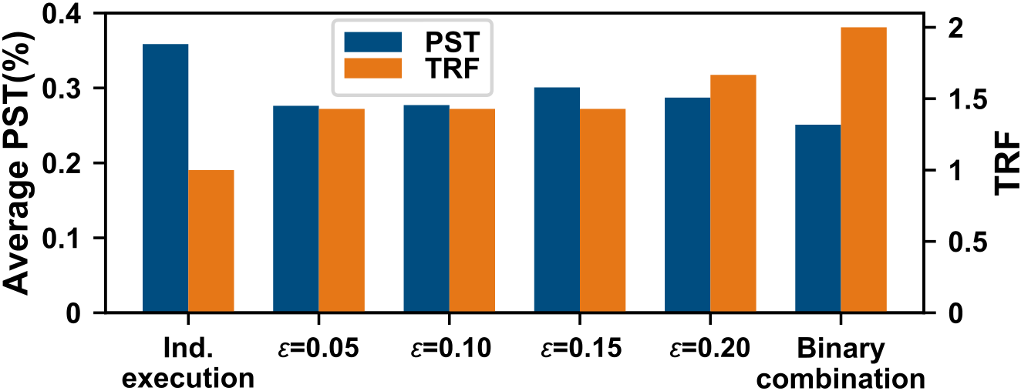
Evaluation of task scheduler
A task queue containing 10 tasks
ε: the threshold of EPST violation
Performs best with a fidelity reduction of 5.8% and improves the throughput by 43%
The scheduler trades off between fidelity and throughput

Slide 27
Outline
Introduction
Motivation
Designs
Evaluation
Conclusion

Slide 28
Conclusion
Our approach takes advantage of the characteristics of multi-programming
Our approach includes:
CDAP ➔ higher fidelity and less overheads
X-SWAP scheme ➔ less overheads
Compilation task scheduler ➔ fairness, trade-off between throughput and fidelity
Our approach helps reduces compilation overheads and incurs less fidelity reduction.

Slide 29
Thank You

