Slide 1

A Software Memory Partition Approach for Eliminating Bank-level Interference in Multicore Systems (PACT’12)
Lei Liu
Sys-Inventor Lab, SKLCA, ICT, CAS
Notes:
Good afternoon everyone, thank you for coming to my talk
Today I am going to present ……. This is work done by ………

Slide 2
Executive Summary
Observations:
-- Memory requests from different threads potentially interleave across all banks, which cause interferences
-- The necessary amount of banks one program requires is limited, and more banks cause more interferences
Problem: More unnecessary banks & Interleaving → more interferences → lower performance
Solution: Partitioning DRAM banks between threads
Result: Eliminating interferences on bank-level between threads, and saving energy
Notes:
The problem is, in many cases in multicore platform, all bank across interleaving will cause interferences that lead to lower performance than performance gain.
This work begins with the 2 key observations
We observe that on multicore platform, (1) (2)
It will raise a problem,
Our solution is …………
By this method, the interferences on banks can be eliminated at the root, which contribute the performance and energy saving.

Slide 3
Outline
Background & Motivation
Our Goal
BPM: Bank-level Partitioning Mechanism
Results
Conclusion
Notes:
Let me first go over some background on memory system and show our motivation.

Slide 4
Organization of shared memory system
Core 0
Core 1
Core 2
Core N
...
Shared Memory System
Shared Cache
Memory Controller
On-chip
Chip Boundary
Off-chip
DRAM
Bank 0
DRAM
Bank 1
DRAM Bank 2
...
DRAM Bank K
Notes:
In modern computer system, the core number in a single die is still increasing. They share last level cache and memory controller and the bandwidth. They are on-chip components,
Main memory system consists of server DRAM banks, and they are shared by all cores. The banks, shared last level cache resource and memory controller are called shared memory system.

Slide 5
Interleaved Memory Access
Two Level Interleaving: Channel, and Bank Interleaving
Bank1
Bank2
Cache Line
Cache Set
Channel 1
Main Memory
BW
Channel 2
Last Level Cache
Bank1
Bank2
Notes:
Here, let us go over the interleaving schema, which is widely used to improve the bandwidth utility.
The successive requested block in banks are interleaved across two or more channels. We call it channel level interleaving.
And the consecutive physical pages are mapped to different DRAM banks. We call it bank level interleaving.
In multicore platform, when multiple threads are running together, interleaving will cause the interference problem.
------------
Channel level interleaving maps successive memory requests to diff. channel, <show begin>. As shown here, consecutive blocks be of 64B are from diff. channel. It is a good way of improve the utility of banks.</>
Physical pages are mapped across diff. bank. <show begin> </>
But does interleaving always deliver good performance in any cases?

Slide 6
Memory accessing of diff. threads
Stream
Random
Row-Buffer
Row-Buffer
Row-Buffer
Row-Buffer
Bank1
Bank2
Bank3
Bank4
Notes:
Modern computer run A wide variety of workloads. Different threads show diff. memory accessing behavior. For example, the stream and random threads are entire different.
<show>
Stream like thread has good potential row-buffer locality, while the other threads such as random threads go to many different banks and show poor row-buffer locality.
Threads will interfere each other when they are running together.

Slide 7
Interferences on DRAM Banks --Unfairness
Stream
Random
Unfairness
1.1X vs. 11X+
4X latency
Row-Buffer
Row-Buffer
Row-Buffer
Row-Buffer
Bank1
Bank2
Bank3
Bank4
Random Threads always suffer
an unfairness problem
Notes:
Let us re-view this example, and show how interferences will lead to lower system throughput.
While the stream thread’s memory requests go to bank1 and the enjoy the row-buffer locality, the random one’s request has to suffer a 4x latency. But the other requests to other banks will be served parallel. As a result, random like thread will suffer unfairness problem. This is phenomenon is common in today’s computing environment.
Some recent studies have shown that random threads

Slide 8
Interferences on DRAM Banks -- Conflicts
Row-Buffer Conflicts
-- More serious in multi-core platforms
-- Thrashing in row-buffer degrades performance
-- Hardly to be eliminated at the root
Row-Buffer
2 times Thrashing of Row 1: increases latency
Bank
Notes:
<begin>
In the interleaving cases, Interference on banks is always a problem.
If memory requests go to the different row in the same bank, they have to be moved to the row-buffer one by one, and served one after another. This is so called row-buffer conflicts.
</>
1….2….3…

Slide 9
Previous Solutions
Most previous studies focus on memory scheduling algorithms.
Few researchers realize the phenomenon that all banks are shared by all cores by interleaving
Leading to more interferences between threads
Causing more serious conflicts on multicore platform
Can we propose a practical approach to
eliminate Row-Buffer conflicts between threads?
Notes:
This inter-application interference degrades system performance. And designing a good memory scheduling algorithm can mitigate the problem…
<click>
Although scheduling is an effective method, it always use a complex scheduling logic, and additional modifications to exists memory controller.
<click>
Few researchers realize that on multi-core platform, all banks are shared by all cores will leading to more interferences than performance gains.
<click>
We raise a question, can we ……

Slide 10
Our Goal
A practical software approach for eliminating Bank-level Interferences
-- Without any hardware modification to MC
-- Could be deployed on real system easily
-- Improves both fairness and system throughput
-- Saves energy consumption of memory system
Notes:
Our goal is to ……
To this end,

Slide 11
Outline
Background & Motivation
Our Goal
BPM: Bank-level Partitioning Mechanism
Results
Conclusion
Notes:
So far I have talked about the background and our goal/
Now, I will talk about our observations

Slide 12
Page-Coloring Partitioning Approach
Page-coloring technique has been proposed to partition cache.
Four-way Associativity
Physical address
00
Frame No.
Page Offset
Thread 1
01
Thread 2
Cache Sets
10
Cache Set Bits
Thread 3
11
Thread 4
Notes:
We come up with page-coloring partitioning approach. Actually, page coloring technique is not new. It has been used for partition cache.
Let me show you how it works. Given a physical address, processor can use it to lookup in cache by the cache index bits. OS can also use it to indentify a physical page by frame number, and do page allocation. So there are two bits overlapped between cache index and page frame number. These two bits are considered as color-bits. We can use it to partition both physical pages and the cache into four color groups so that one physical page can only go into its corresponding cache sets with the same color.
The idea is pretty nice, using software to partition hardware. But can we use this idea to partition DRAM banks?

Slide 13
Bank bits in PFN
Some bits in page frame number (pfn) denotes the bank address
We could extend page-coloring to partition banks
DRAM Banks
Notes:
The same reason, there are also some bits denote the bank address. So that it inspire us that we could extend page-coloring to partition DRAM banks.
To this end, we have made 2 key observations that lead to our new mechanism design

Slide 14
Partitioning banks into groups
Banks are colored into diff. groups
Thread 1
Thread 2
Thread 3
DRAM Banks
Reducing the available amount of banks that one thread can access
Notes:
By this partitioning approach, banks are divided into diff. colored groups. Thread can only access its corresponding colored banks, which are assigned at the beginning.
It is forbidden to banks be of other color, which do not belong to it. Apparently, we forbid the all banks across interleaving. It will raise another question, will the limited number of banks impact the overall system performance?
---------
To this end, we have made 2 key observations that lead to our new mechanism design

Slide 15
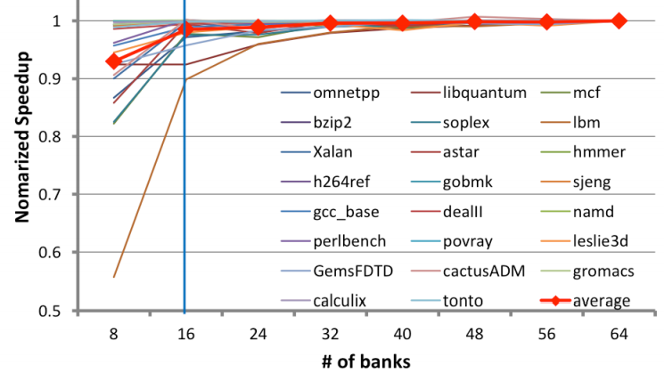
The necessary bank amount
Will this influence performance?
The necessary amount of banks one program
requires is limited
Notes:
But doing exclusively mapping would reduce the available bank amount for one thread. So we need to know whether it would affect application’s performance.
We did experiments on an Intel machine with 64 banks to investigate the correlation between bank number and applications’ performance. Surprisingly, we found that 16 banks are enough for most applications. They can achieve over 95% of performance compared to 64 banks.
So it is feasible to partition banks into several groups and exclusively map bank groups to specific threads.
But how?

Slide 16
Address Mapping Challenges
The idea is straightforward, but in practice the mapping from physical address to DRAM banks is not fixed.
Challenge: How to figure out accurate bank bits?
-- MC always supports various address mapping
-- Vendors’ manuals offer infor.
-- Diff. DRAM hardware determines diff. mapping

Slide 17
Bank-level Partition Mechanism (BPM)
Implementation: adopt page-coloring base BPM in Linux kernel 2.6.32 by modify its buddy system.
group free pages into 32 colors.
Adjust the page allocation algorithm in OS.
Notes:
……
We make change to buddy system in operating system very serious, and we adapt a efficient … algorithm, by which one thread can get its corresponding colored pages effectively.
and adjust the page allocation algorithm so that the thread can get the page with corresponding color efficiently and
effectively.
--------------------
So far, we’ve addressed the mapping challenge. Next, we implement the page-coloring based bank partition mechanism into a Linux kernel.
We modify the buddy system which manages free physical pages in kernel. We make the buddy system group free pages into 32 colors and use a new algorithm for page allocation.
We perform experiments on an Intel machine with 8GB DRAM and 64 banks. The benchmark is SPECCPU 2006 and PARSEC.

Slide 18
Overview of Our Mechanism

Slide 19
Outline
Background & Motivation
Our Goal
BPM: Bank-level Partitioning Mechanism
Results
Conclusion
Notes:
Let us see the experimental results.

Slide 20
Experiment environment
System Configuration
-- 4-core/8-thread Intel Core i7-860 CPU 2.8GHz
-- LLC: 8MB/16 ways of associativity
Memory Configuration
-- Micron DDR3-1333
-- 2 Channel, 8 Ranks, 64 Banks
Workloads
-- 23 benchmarks from SPEC CPU 2006 (Multi-Program)
-- PARSEC (Multi-Thread)
Notes:
We use real machine that has i7-860 2.8GHz and 8MB last level cache. The memory system is ddr3 dram with 2 channels, 8 ranks, and 64 banks in total.
We use spec 2006 for the multi-programmed workloads. And parsec for multi-threaded workloads.

Slide 21
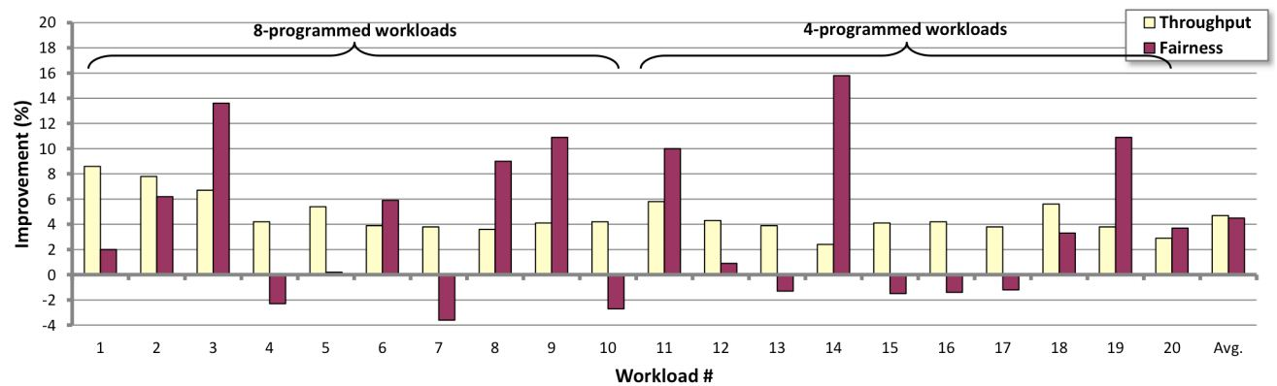
Experimental Results
System throughput : 4.7%↑ (up to 8.6%)
Maximum slowdown: 4.5%↓ (up to 15.8%)
Memory Power : 5.2% ↓
Notes:
Here are the overall results.
By using the software partition approach, we can achieve system throughput improvement by 4.7% on average and up to 8.6%. The maximum slowdown decreases by 4.5% and up to 15.8%. The approach can also save some memory power.
So this is our software bank-level partition work.

Slide 22
Row-buffer miss rate
Reduced row buffer miss by BPM depends on workloads’ features (5%~10%)

Slide 23
What affects the BPM?
Average(RBL)
Sum(BW)
Stdev(RBL)
Sum(BW)*Stdev(RBL)
Sum(BW)*Stdev(RBL) works well as a predictor
of the effectiveness of BPM
Notes:
This metric indicates that memory interference is positively correlated to the memory access intensity and the divergence of applications' locality.

Slide 24
BPM and Per-core Bandwidth
BPM is promising for future multi-/many-core platforms that have even less per-core bandwidth

Slide 25
BPM for Multi-threaded
Streamcluster from Parsec 2.0
Partition the input data by a straightforward way
The improvement is less than Multi-Programmed
-- 1.7% and 2.3% on 4/8-threaded separately
-- Because there are too much shared data
Our future work will study these issues

Slide 26
Conclusion
Observations:
-- Serious Interferences in multi-core platform
-- The necessary amount of banks is limited
Problem: Interferences cause lower performance
BPM: Partitioning banks between threads
-- Easily implemented and deployed in reality
-- Without any modifications to hardware
-- Benefits various of workloads
Result: Improving overall system performance and saving energy
Notes:
This work begins with the 2 key observations
We observe that on multicore platform, (1) (2)
It will raise a problem,
Our solution is …………
By this method, the interferences on banks can be eliminated at the root, which contribute the performance and energy saving.

Slide 27
A Software Memory Partition Approach for Eliminating Bank-level Interference in Multicore Systems
Lei Liu, Zehan Cui, Mingjie Xing,
Yungang Bao, Mingyu Chen, Chengyong Wu
Notes:
Good afternoon everyone, thank you for coming to my talk
Today I am going to present ……. This is work done by ………

Slide 29
Open-page w/ BPM VS. Close-page
Upper to 11%
AVG. 6.2%
Close-Page
w/o BPM
BPM revives Open-page on Multicore platforms
Notes:
Some studies show that we have to use close-page on multi-core platform, because the row-buffer locality is decreased to a lower level, which is caused by mutual interference on banks.
But,the advantage of BPM is to eliminate the interferences between threads, so that it can perhaps revive the open-page on multicore platforms, which is more suitable for locality.
To maintain a better row-buffer locality.
Our experiment shows that we can get 6.2% and upper to 11% improvement.

Slide 30
BPM VS. Only cache partitioning

Slide 31
Observation 2
Some bits in address mapping method of memory controller denotes the bank address
We could extend page-coloring to Partition banks
DRAM Banks
Notes:
To this end, we have made 2 key observations that lead to our new mechanism design

Slide 32
Overview of Our Mechanism
CMD
A
R
P
A
R
P
A
R
DATA
D
D
D
CMD
A
R
A
R
R
DATA
D
D
D
A: Active
R: Read
P: Precharge
D: Data
Saved Cycles
Row-Buffer
Row-Buffer
Row-Buffer
Row-Buffer thrashing
x2 times
Bank1
Bank1
Bank2
Notes:
Let me show you the overview of our mechanism.
Suppose there is a memory request go to bank1 and row2. It firstly active the row, and read the data block. After the operation, pre-charge cmd will be issued and the row will be write back. The second memory request comes after the first one, it active another row and repeat the operations on banks. The third request re-active the second row. lots of the time are spent on the row-buffer thrashing problem.
But, our mechanism maps the diff. threads’ requests to diff. banks, We can eliminate the interferences between threads on banks, and minimize the negative effects of row-buffer conflicts.
This is saved cycles.
This is our mechanism.

