Slide 1
QuCloud: A New Qubit Mapping Mechanism for Multi-programming Quantum Computing in Cloud Environment
Lei Liu, Xinglei Dou (Speaker)
Sys-Inventor Lab, SKLCA, ICT, CAS
IEEE HPCA-2021 (Session 2B)

Slide 2
Executive Summary
Multi-programming in quantum computing cloud services has been proposed to improve the throughput and resource utilization
Challenge: Multi-programming leads to degradation in fidelity and contention between concurrent quantum programs
Goal: To improve throughput and resource utilization while ensuring fidelity
Solutions:
Community Detection Assisted Partition (CDAP): Locate the robust resources for initial mapping
X-SWAP: Enable inter-program SWAPs for reducing compilation overheads
Compilation task scheduler: Fairness, trade-off between throughput and fidelity
Results: 9.7% improvement in fidelity; 11.6% reduction in compilation overheads

Slide 3
Outline
Introduction
Motivation
Designs
Evaluation
Conclusion

Slide 4




Quantum Computing
Quantum Computing (QC) can solve conventionally hard problems
Quantum computers are accessible via cloud
Machine learning
[Biamonte et al., Nature’2017]
Chemistry simulation
[Kandala et al., Nature’2017]
Database search
[Grover, STOC’1996]
Chip error rates
Problem
Chip topology
Quantum
Cloud Service
Probability (%)
Quantum program
Local
Compiler
00
01
10
11
Compiled program
Output
Result

Slide 5


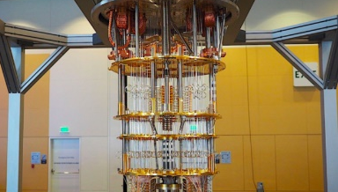
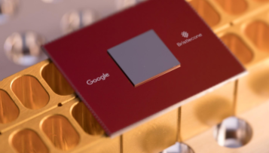
Why Multi-programming is Needed?
Contention in accessing a quantum computer
Resource under-utilization
…
Users
QC
cloud service
Quantum computer
Task queue
Allocated qubits
Idle qubits
Only small circuits
can be executed reliably
Q0
Q1
Q2
Q3
Q4
Q5
Q6
Q7
Q8
Q9
Q10
Q11
Q12
Q13
Q14
Q15
Q16
Q1 7
Q18
Q19
IBM, 50 qubits
Q20
Q21
Q22
Q23
Q24
Q25
Q26
Q27
Q28
Q29
Q30
Q31
Q32
Q33
Q34
Q35
Q36
Q37
Q38
Q39
Q40
Q41
Q42
Q43
Q44
Q45
Q46
Q47
Q48
Q49
Google, 72 qubits
NISQ computers with tens of physical qubits
Qubits are underutilized

Slide 6
One Step to explore Quantum OS - QuOS
Noise Intermediate Scale Quantum (NISQ) era
Quantum Error Correction (QEC) is too expensive to be implemented
Noise-aware quantum compilers
Algorithms
(Grover search, Shor factoring,…)
High-level languages
(QASM, Scaffold,…)
Our work
Quantum Software Stack (Compiler, OS)
(initial mapping, mapping transition)
Quantum architecture
(qubits, gates,…)
Quantum Error Correction & Control pulses
(surface code,...)
Physical implementation
(superconducting, ion-trap, photonic,…)
Quantum Computing technology stack
[Chong et al., Nature’2017]

Slide 7
Qubit Mapping Problem
Compilation workflow
Initial mapping generation: Map each logical qubit onto a physical qubit
Q0
Q1
Q2
q1
q1
q2
q3
Q3
Q4
Q5
Q6
q2
...
Q14
Q13
Q12
Q11
q3
Q7
Q10
Q9
Q8
H
T†
IBMQ16
Quantum program

Slide 8
Qubit Mapping Problem
Compilation workflow
Initial mapping generation: Map each logical qubit onto a physical qubit
Mapping transition: Making all gates executable by inserting SWAPs
CNOT q1 q3 can not be executed directly
Q0
Q1
Q2
q1
q1
q2
q3
Q3
Q4
Q5
Q6
q2
...
Q14
Q13
Q12
Q11
q3
Q7
Q10
Q9
Q8
H
T†
IBMQ16
Quantum program

Slide 9
Qubit Mapping Problem
Compilation workflow
Initial mapping generation: Map each logical qubit onto a physical qubit
Mapping transition: Making all gates executable by inserting SWAPs
SWAP q1 q2 is inserted to make
q1 and q3 physically adjacent.
Q0
Q1
Q2
Q3
q1
q1
q2
q3
q2
Q4
Q5
Q6
...
Q14
Q13
Q12
Q11
q3
Q7
Q10
Q9
Q8
H
T†
IBMQ16
Quantum program

Slide 10
Qubit Mapping Problem
Compilation workflow
Initial mapping generation: Map each logical qubit onto a physical qubit
Mapping transition: Making all gates executable by inserting SWAPs
Multi-programming
Mapping multiple quantum programs simultaneously onto a quantum chip
Optimization Goals
Fidelity; throughput; number of additional SWAPs
SWAP q1 q2 is inserted to make
q1 and q3 physically adjacent.
Q0
Q1
Q2
Q3
q1
q1
q2
q3
q2
Q4
Q5
Q6
...
Q14
Q13
Q12
Q11
q3
Q7
Q10
Q9
Q8
H
T†
IBMQ16
Quantum program

Slide 11
Outline
Introduction
Motivation
Designs
Evaluation
Conclusion

Slide 12
Previous solution results in wastes
Two programs to be mapped: P1(5 qubits), P2(4 qubits)
Fair and Reliable Partition [Das et al., MICRO’19]
P1 allocation
Q0
2.5%
Q1
1.6%
Q2
3.0%
Q3
1.8%
Q4
2.2%
5.5%
Q4
Q5
Q6
Q3
Q5
2.5%
8.0%
4.5%
3.0%
3.3%
3.4%
3.8%
Q14
Q13
Q12
Q11
Q10
Q9
Q10
Q9
Q8
Q7
4.1%
8.6%
6.0%
3.1%
3.8%
1.8%
2.8%
Unreliable
physical qubit
Unreliable
link

Slide 13
Previous solution results in wastes
Two programs to be mapped: P1(5 qubits), P2(4 qubits)
Fair and Reliable Partition [Das et al., MICRO’19]
P1 allocation
Q0
2.5%
Q1
1.6%
Q2
3.0%
Q3
1.8%
Q4
2.2%
5.5%
Q4
Q5
Q6
Q3
Q5
2.5%
8.0%
4.5%
3.0%
3.3%
3.4%
3.8%
Q14
Q13
Q12
Q11
Q10
Q9
Q10
Q9
Q8
Q7
4.1%
8.6%
6.0%
3.1%
3.8%
1.8%
2.8%
Can not find a reliable root with enough reliable neighbors for P2
3 qubits are not enough for P2
P2 can not be mapped

Slide 14
Previous solution results in wastes
Two programs to be mapped: P1(5 qubits), P2(4 qubits)
P1 allocation
Available allocation for P2
Q0
2.5%
Q1
1.6%
Q2
3.0%
Q3
1.8%
Q4
2.2%
5.5%
Q4
Q5
Q6
Q3
Q5
2.5%
8.0%
4.5%
3.0%
3.3%
3.4%
3.8%
Q14
Q13
Q12
Q11
Q10
Q9
Q10
Q9
Q8
Q7
4.1%
8.6%
6.0%
3.1%
3.8%
1.8%
2.8%
A better solution can provide higher qubit utilization

Slide 15
Inter-program SWAPs reduce overheads
Inter-program SWAPs are not enabled in previous solution
Inter-program SWAPs take shortcuts
Previous solution takes 3 steps
P1 allocation
q3
q4
q5
P2 allocation
Code:
q2
q9
q8
CNOT q1 q5
……
q1
q6
q7
Inter-program SWAP takes 1 step

Slide 16
Inter-program SWAPs reduce overheads
An inter-program SWAP can replace two intra-program SWAPs
P1 Allocation
P2 Allocation
q1
q2
q3
P1
g3
g1
g2
q2
q5
q6
q2
q5
q6
q2
q5
q6
q4
q5
q6
q3
q1
q4
q3
q1
q4
q3
q1
q4
P2
g6
g4
g5
g3 and g6 can not be executed directly
2 Intra-program SWAPs
1 Inter-program
SWAP

Slide 17
Arbitrarily selected workloads are harmful
P1 depth:40
Strong interference on P2
instant measurement
P2 depth:170
measurement
Start
Severe coherence error for P1
P1 depth:40
delayed measurement
P2 depth:170
Start

Slide 18
Outline
Introduction
Motivation
Designs
Community Detection Assisted Partition
X-SWAP Scheme
Compilation Task Scheduler
Evaluation
Conclusion

Slide 19



CDAP: Improving resource utilization
Community Detection Assisted Partition (CDAP)
Outline
Hierarchy tree construction
Partition physical qubits according to the hierarchy tree and concurrent programs
Map quantum programs to the assigned regions
Coupling Map
Concurrent Programs
Calibration
Data
Qubits
Dendrogram
Partition
Allocation

Slide 20
CDAP: Improving resource utilization
Hierarchy tree construction
Each qubit forms a community
Merge two communities that can maximize the reward function
Q₀
Q₁
Q₂
{0,1,2,3,4}
Features of the tree:
Each node is a candidate set of qubits for initial mapping
Qubits in a node are tightly-connected
Qubits with lower error rates are preferentially merged
1.4
0.5
3.5
1.2
3.3
{0,1,2}
{3,4}
More reliable
1.0
Q₃
3.3
{0,1}
{2}
{3}
{4}
1.3
Q₄
3.0
{0}
{1}
IBM Q London architecture
Hierarchy tree

Slide 21
CDAP: Improving resource utilization
Partition and allocation
Prioritize programs with higher CNOT density (num. of CNOTs / num. of qubits)
Search available candidate set of physical qubits from bottom to top
Select the candidate with lowest error rate for initial mapping
{0,1,2,3,4}
P1
(2 CNOTs, 2 qubits)
Candidates
Sort by
CNOT
density
{0,1,2}
{3,4}
{0,1,2}
Assigned to P2
P2
(6 CNOTs, 3 qubits)
{0,1,2,3,4}
{0,1}
{2}
{3}
{4}
{0}
{1}

Slide 22
CDAP: Improving resource utilization
Partition and allocation
Prioritize programs with higher CNOT density (num. of CNOTs / num. of qubits)
Search available candidate set of physical qubits from bottom to top
Select the candidate with lowest error rate for initial mapping
{3,4}
Candidates
Sort by
CNOT
density
{3,4}
{3,4}
Assigned to P1
P1
(2 CNOTs, 2 qubits)
{3}
{4}
Allocate qubits to selected region with
Greatest Weighted Edge First strategy [Murali et al.,ASPLOS’19]

Slide 23
Outline
Introduction
Motivation
Designs
Community Detection Assisted Partition
X-SWAP Scheme
Compilation Task Scheduler
Evaluation
Conclusion

Slide 24
X-SWAP: Reducing compilation overheads
Mapping transition: Insert SWAPs to make all 2-qubit gates executable
Single-qubit gates are not considered during mapping transition
SWAP based heuristic search [Li et al., ASPLOS’19]
g₁
g₃
g₄
g₅
q₁
q₂
q₃
q₄
q₅
g₁
g₃
Front Layer
g₄
g₂
g₅
g₂
l₁(F)
l₂
l₃
l₄
Quantum Circuit
Directed Acyclic Graph (DAG)

Slide 25
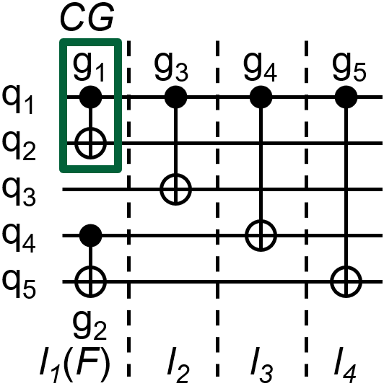
X-SWAP: Reducing compilation overheads
Search SWAPs associated with critical gates
= CNOT
Critical gates
g₁
q_{a}
q_{b}
= CNOT
g₁
g₃
q_{c}
q_{d}
F₁
q_{a}
g₂
DAG₁
q_{b}
F₂
g₃
q_{c}
q_{d}
Critical gates have subsequent CNOTs in the second layer
DAG₂
11 possible SWAPs

Slide 26
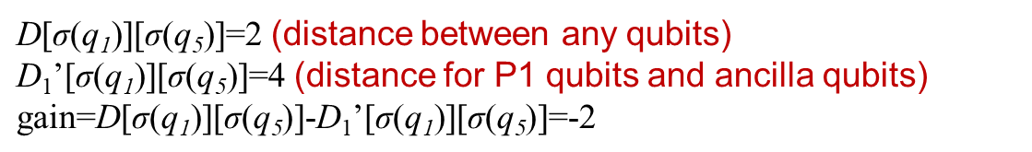
X-SWAP: Reducing compilation overheads
Nearest Neighbor Cost (NNC) function
Prioritize inter-program SWAPs on the shortest path
P1 allocation
q3
q4
q5
P2 allocation
CNOTs on path q1-q9-q5 are prioritized
Code:
q2
q9
q8
CNOT q1 q5
……
q1
q6
q7
$\text{D}\text{[}\text{σ}\text{(}\text{q}\text{1}\text{)][}\text{σ}\text{(}\text{q}\text{5}\text{)]=2 }$(distance between any qubits)
$\text{D}\text{1}\text{’[}\text{σ}\text{(}\text{q}\text{1}\text{)}\text{][}\text{σ}\text{(}\text{q}\text{5}\text{)}\text{]=4 }$(distance for P1 qubits and ancilla qubits)
$$\text{gain}\text{=}\text{D}\text{[}\text{σ}\text{(}\text{q}\text{1}\text{)][}\text{σ}\text{(}\text{q}\text{5}\text{)]-}\text{D}\text{1}\text{’[}\text{σ}\text{(}\text{q}\text{1}\text{)][}\text{σ}\text{(}\text{q}\text{5}\text{)}\text{]=-2}$$

Slide 27
Outline
Introduction
Motivation
Designs
Community Detection Assisted Partition
X-SWAP Scheme
Compilation Task Scheduler
Evaluation
Conclusion

Slide 28


Compilation task scheduler: Trade-off
Selecting workloads for co-location
Based on estimated fidelity (EPST)
Trade-off between throughput and fidelity
Stops
after N iterations
after M programs’ co-location
1
2
1
Add one job to current job set
Submit for execution
2
3
3
4
4
Quantum cloud service
…
Current job set
Incoming jobs
For each job
EPST violation acceptable?
Keep it in the current job set
Remove the job

Slide 29
Outline
Introduction
Motivation
Designs
Evaluation
Conclusion

Slide 30
Metrics
Probability of a Successful Trial (PST): the fraction of trails that produce a correct result
Post-compilation gates number: especially CNOT gates
Trial Reduction Factor (TRF): the ratio of trails needed when programs are executed separately to the trails when multi-programming is enabled.

Slide 31
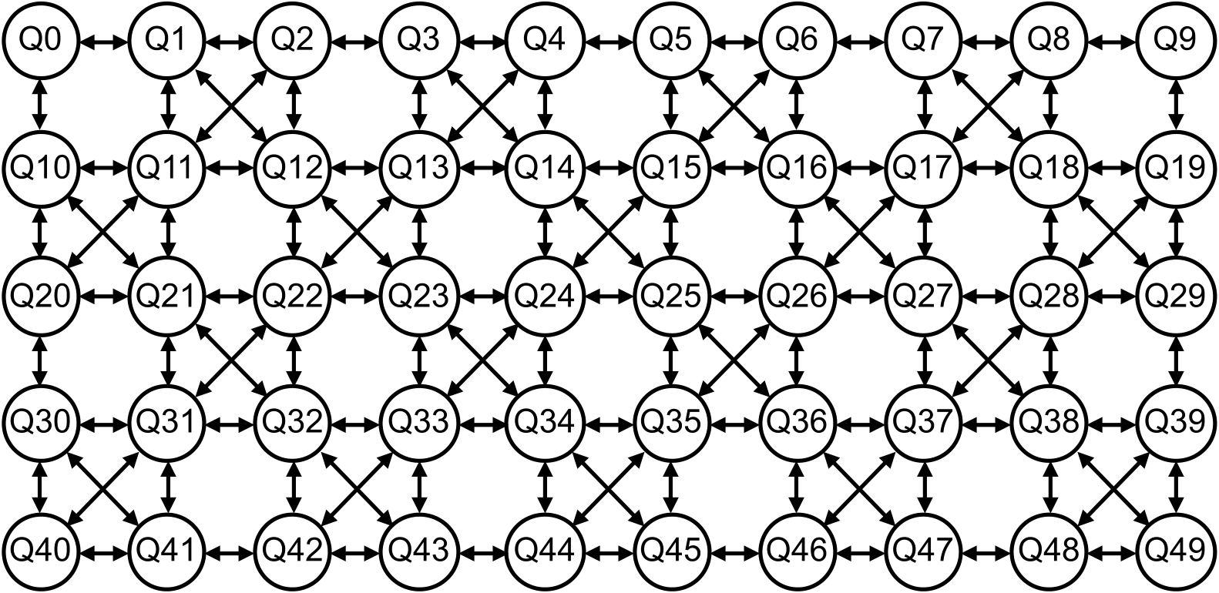
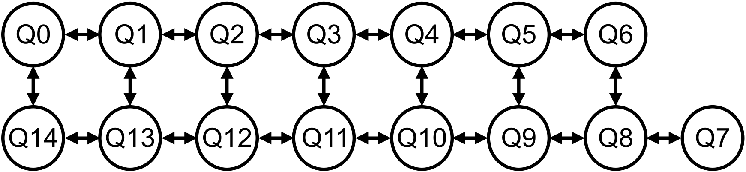
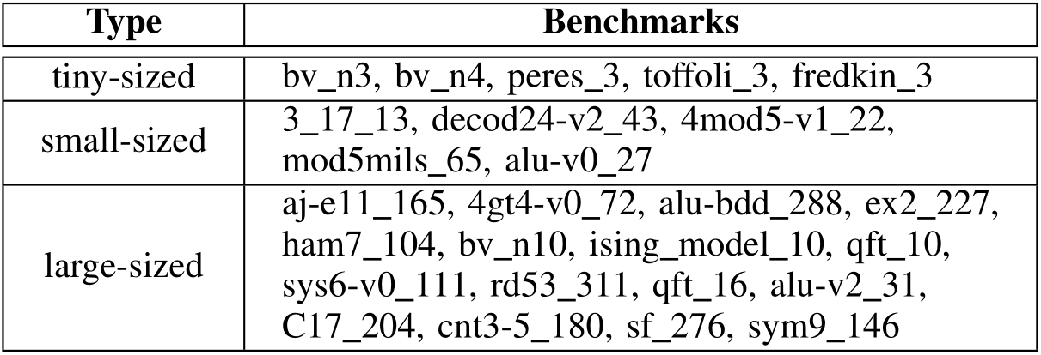
Methodology
Methodology
Platforms
Benchmarks
IBMQ16: For fidelity evaluation
IBMQ50: For compilation overheads evaluation
For fidelity evaluation
For compilation overheads evaluation

Slide 32
Baseline
Separate execution
Multi-programming baseline [Das et al., MICRO’19]
SABRE [Li et al., ASPLOS’19]
Breakdown of our approach:
CDAP-only
X-SWAP-only
CDAP + X-SWAP

Slide 33
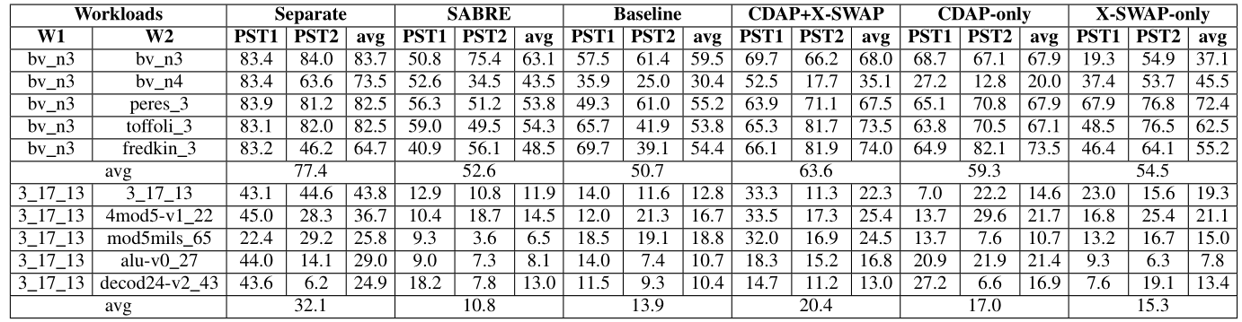
Results
Improved fidelity
Improving fidelity by 10.3% and 9.7% compared with SABRE and baseline on IBMQ16, respectively.

Slide 34
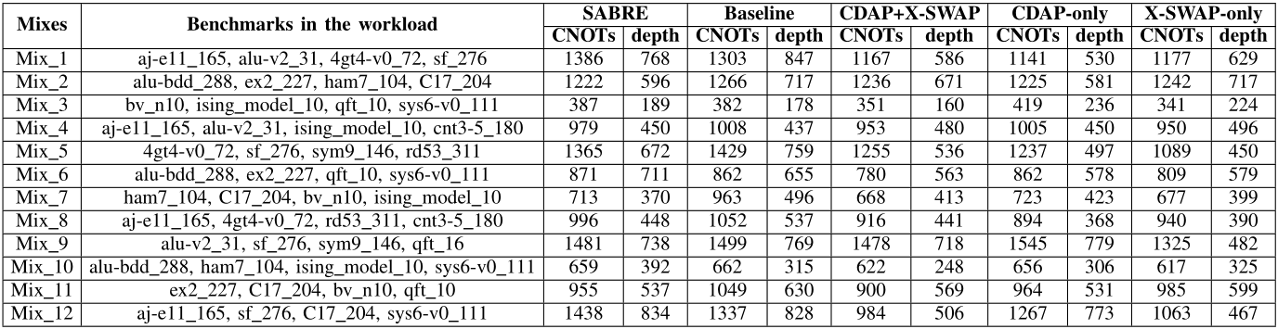
Results
Reduced compilation overheads
Reducing the number of post-compilation gates by 8.6% and 11.6% compared with SABRE and baseline on IBMQ50, respectively.

Slide 35
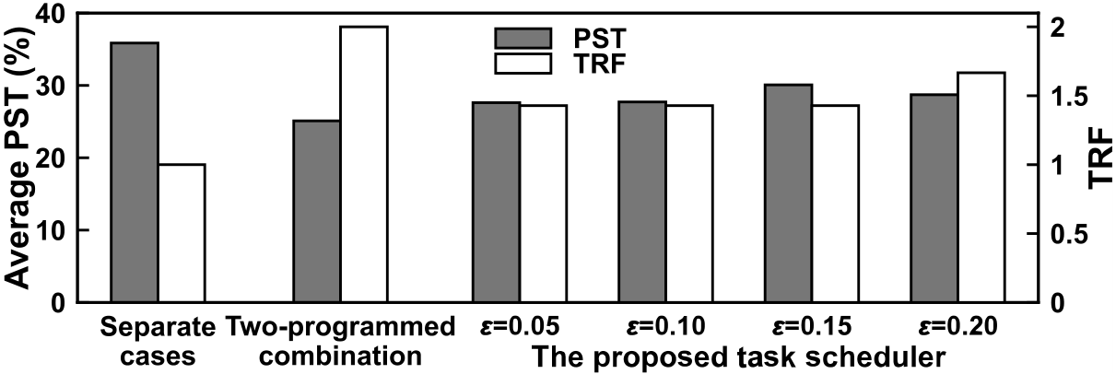
Results
Trade-off achieved between throughput and fidelity
Improving TRF by 42.9% compared to separate execution cases
Improving fidelity by 5.0% compared to randomly selected workloads

Slide 36
Outline
Introduction
Motivation
Designs
Evaluation
Conclusion

Slide 37
Conclusion
Our work tackles the qubit mapping problem for multi-programing quantum computing
Our approach includes:
CDAP ➔ higher resource utilization, higher fidelity
X-SWAP ➔ less overheads
Compilation task scheduler ➔ fairness, trade-off between throughput and fidelity

Slide 38
Thank You
Lei Liu, Xinglei Dou
Sys-Inventor Lab, SKLCA, ICT, CAS
This presentation and recording belong to the authors.
No distribution is allowed without the authors' permission.

