Slide 1

COMM
Find the Right Place at the Right Time

Slide 2
Hi, I’m Joe

Slide 3
I got 99 problems

Slide 4
But finding a place to live is #1

Slide 5
Problem
People have a hard time finding areas to live in because:
Unfamiliar with city
Lack information about factors that matter
Existing applications are cluttered

Slide 6

Motivation
Recommendation
Community
Income

Slide 7

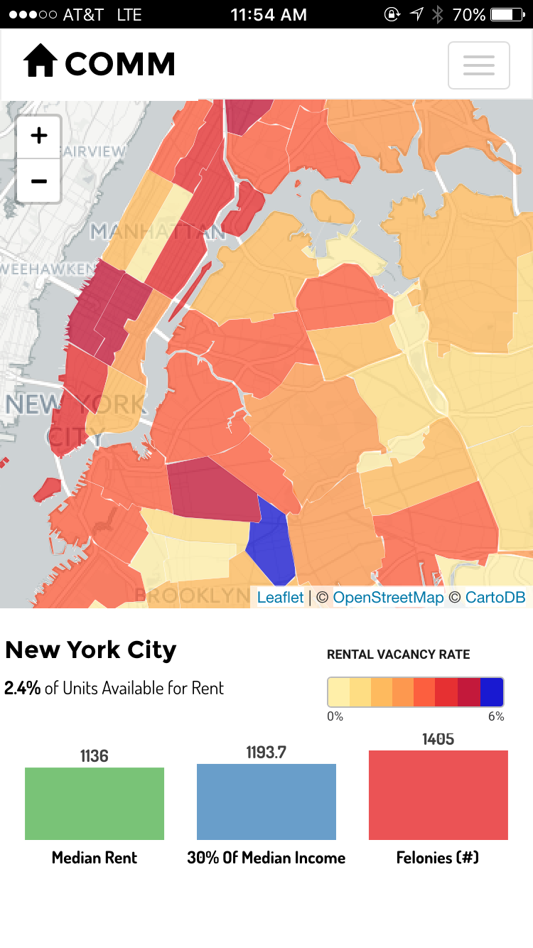
Solution
Comm is a mobile app that helps users:
Identify the perfect location to live in based on:
Income
Rent
Crime
Get personalized recommendation from app of best area for YOU.

Slide 8

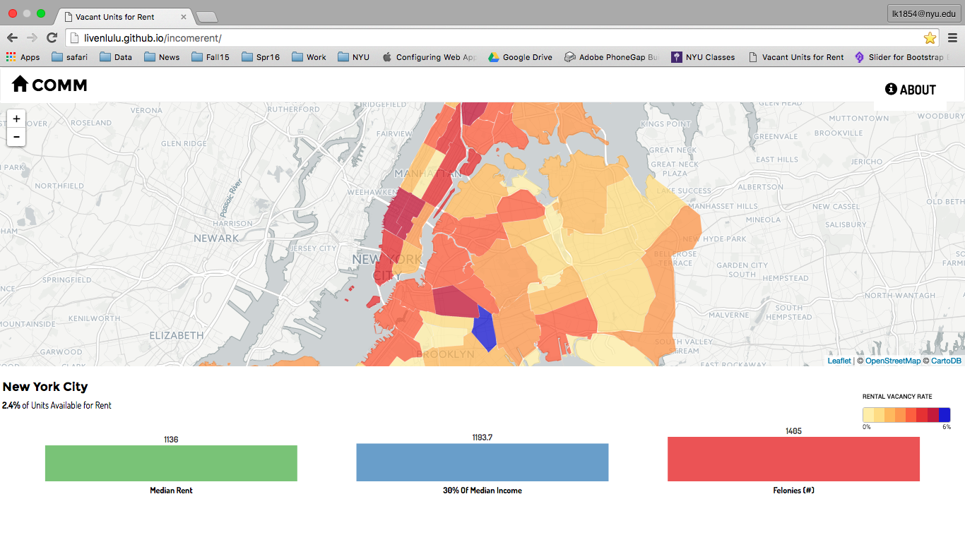
Overview of App

Slide 9
Market Analysis
Industry: Internet Publishing, Broadcasting & Search Portals
Companies in this industry publish content on the internet to help people find content online
Advertising sales account for over 50% of US industry revenue
Industry forecasted to grow at annual rate of 9% between 2016 and 2020
Top competitors for COMM:
Trulia
Streeteasy
Source: http://subscriber.hoovers.com/H/industry360/overview.html?industryId=1904

Slide 10
Competitor Analysis - Trulia
Description:
Website/app to help people through the home and rental search process
Strengths:
Has strong brand
Allows users to search for homes/apartments
Shows information on schools and amenities
Weaknesses:
User has to do all the work
Doesn’t provide personalized recommendation
Users may feel overwhelmed with complexity of site

Slide 11
Competitor Analysis - Streeteasy
Description:
Website/app to help people through the home and rental search process
Strengths:
Has a lot of filters
Allows users to search for homes/apartments
Weaknesses:
Map isn’t useful/hard to browse
Complex

Slide 12

Target Audience
People moving into NYC for the first time
Age 21 - 35
Young professionals/rely on tech
Are not familiar with the area
Don’t have time/want to do all the hard work

Slide 13
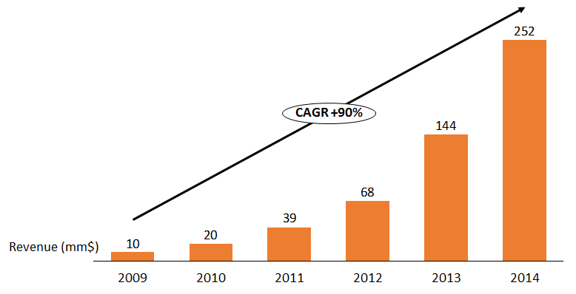
Market Analysis - Opportunity
Trulia’s historical revenue growth
 | In N.Y. | In U.S.
Renter-occupied households | 3,148,067 | 43,267,432
% of Total | 51% | 37%
Source: US Census, MNHC, Capital IQ

Slide 14

Monetization/Growth Strategy
Monetization Strategies
Advertising
Partner real estate listings
Local business partnership

Slide 15


Revenue stream 1 - Advertising
We can embed ads in our application
Amazon and Google provide easy API access for ads display
Floating add sample

Slide 16

Revenue stream 2 - real estate listing
We can show apartment vacancies on the map
Charge fees by traffic direction

Slide 17
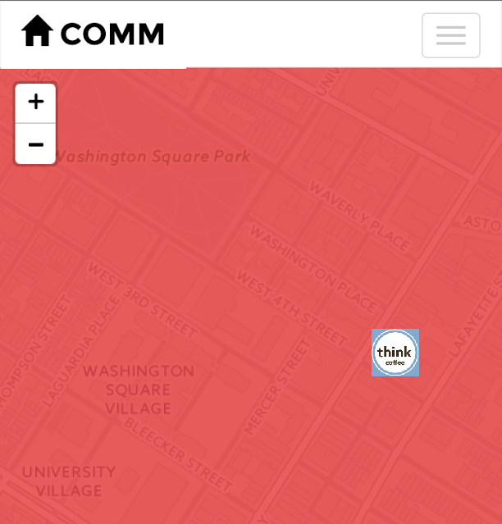
Revenue stream 3 - Business partners
Local business partners can show up on the map to promote their brands
Potentially get rebates from from their incremental revenues

Slide 18
Data
Attributes about each location are written into GeoJSON Objects
Based on user input, the application filter the attributes
Suitable objects are displayed on the map
Your Dream Home

Slide 19
Approach
HTML, CSS, Javascript, JQuery
Data
Map
Filter
Recommend
Notes:
So how did we actually build the app?
We used html, css, javascript and jquery for all the coding. We also used some other features bootstrap, nvd3 charts and leaflet maps.
There’s 4 components to our app, how we gather the data, put it on a map then filter some options so we can give our customers recommendations on places to live.
Now im going over each of them so you get the concept of how our app works.

Slide 20
Methodology
Data
Map
Filter
Recommend
Data: Aggregate all data to Community Districts and convert to GeoJSON format
Median Income
Median Rent
No. of Felonies
Vacancy Rate
Joined by Community Districts
GeoJSON
Notes:
So first we have all the data, in order for all those data to be linked we had to aggregate and joined by community districts. I believe there are 59 of them so on the map it should show 59 polygons, then we convert everything to geojson format with latitude and longitude to show it on a map.

Slide 21
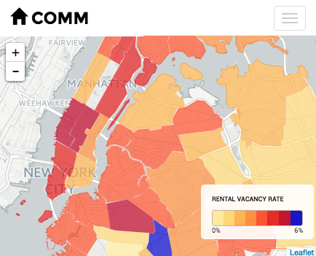
Methodology
Data
Map
Filter
Recommend
Map: Show % of vacant units on Leaflet map and using JQuery to match data attributes
Notes:
THis map was made using leaflet which is a opensource map library
We chose to show % of vacant apartments available because we want to inform users these are places they can live in, we dont want to suggest a neighborhood that has no apartments for rent.

Slide 22
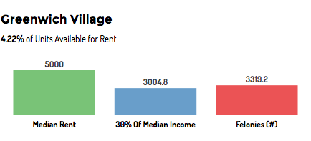
Methodology
Data
Map
Filter
Recommend
Interactive: NVD3 Chart to show background dynamics on neighborhood
Notes:
Our goal is to try to make it as much user friendly and interactive as possible so a user can touch the screen on a neightborhood and shows them dynamics of each community, we’re showing that by using nvd3 bar chart. The dynamics include median rent, income and crime rate. So lets say you’re looking into greenwich village, the median rent is 5000$ and by thumb of rule, you’re not suppose to pay 30% of you income for rent, that’ll be rent burden. We have an option on the bar chart showing 30% of the median income and that how much an average person makes in this neighborhood, and it seems like people that live in this area pay way more rent than they should. So with this function u can easily compare each of the communitys.

Slide 23
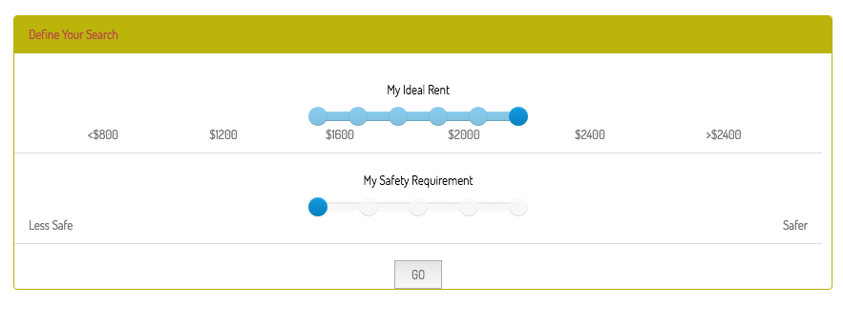
Methodology
Data
Map
Filter
Recommend
Filter: User can indicate their own preferences on ideal rent price and safety requirement
Notes:
We have filter options on our app, so we ask our users just 2 simple questions like how much rent are you willing to pay, and do you have any safety requirements, so this was linked by the felonies data and rent data that was shown earlier. We decided to use a slider with minimum on the left and maximum and provided 5 ranges for them to choose from, we first had select options but we figure this is much easier to use and functions better. this was a bootstrap component on github. We calculate based on the users preference using the GET form in javascript, and then...

Slide 24
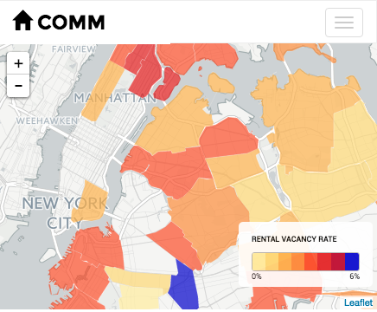
Methodology
Data
Map
Filter
Recommend
Recommend: we provide recommendations based on their criteria needs
Notes:
We give them a recommendation based on their needs. So you can see only the communitys we recommend that show on the map.

Slide 25
Problems Encountered
Tap function on mobile
Linking the data to show attributes on d3 charts (JQuery)
Styling of map / grid size
Notes:
There were a lot of technical difficulties like the tap function of the map, and how linking the data for each attributes was a difficult considering
none of us are coders it was hard to code in jquery, Styling of map: fixing the height of the map was harder than it seemed. We spent a lot of unnecessary time on that which was only 1 line of code.

Slide 26
Next Steps
Real-time data
More add-on features with more data attributes
Add user sign up/log-in profile information
Partner up with real estate agencies to show actual apartments available on app
Notes:
For future steps, we’d like to work with real-time data, this was all just 2015.
Signup login so a user can save their information.

