Slide 1
Knowledge-Embedded Representation Learning for Fine-Grained Image Recognition
Visual Understanding meets Knowledge Reasoning
Tianshui Chen, Liang Lin*,
Riquan Chen, Yang Wu, Xiaonan Luo
Notes:
Nowadays, how to boost the visual understanding with human knowledge has bocame a hot topic.
And I will introudce a paper of our Lab, "Knowledge-Embedded Representation Learning for Fine-Grained Image Recognition "

Slide 2
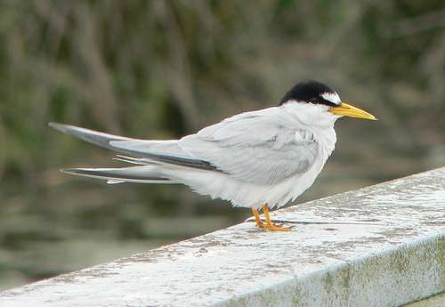
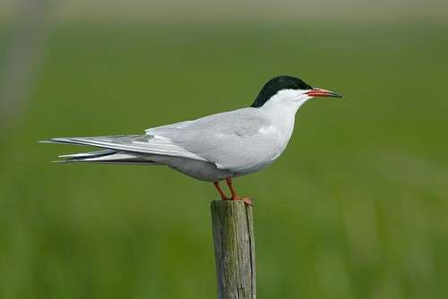
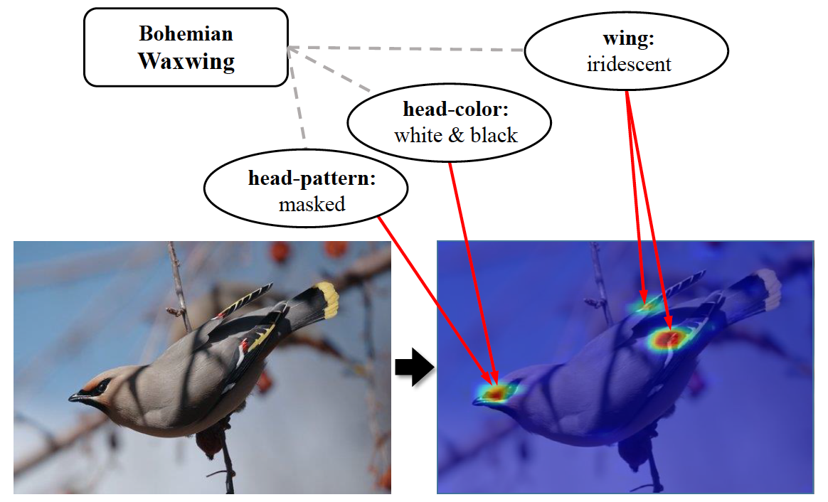
Fine-Grained Image Classification
Objective: Distinguish sub-categories under a basic category.
Least Tern
Common Tern
Motivation: Understanding image with the aid of professional knowledge
Correlations between category labels and part-based attributes can be served as extra guidance for fine grained image recognition.
Notes:
That is a very challenging classification task. It aim to distinguish the sub-categories under a basic category. For example, to predict the category label of these two birds.
The motivation of this paper is to utilize the humnan professional knowledge to help the image understanding.
%
For example, an expert may tell you: the head color of Bohemian Waxwing is white and black, its wing is iridescent.
%
Then, given a bird image, you will look through its head and wing part, and distinguish whether it is an Bohemian Waxwing or not.
%
So, the correlations between category labels and part-based attributes can be served as extra guidance for fine grained image recognition

Slide 3
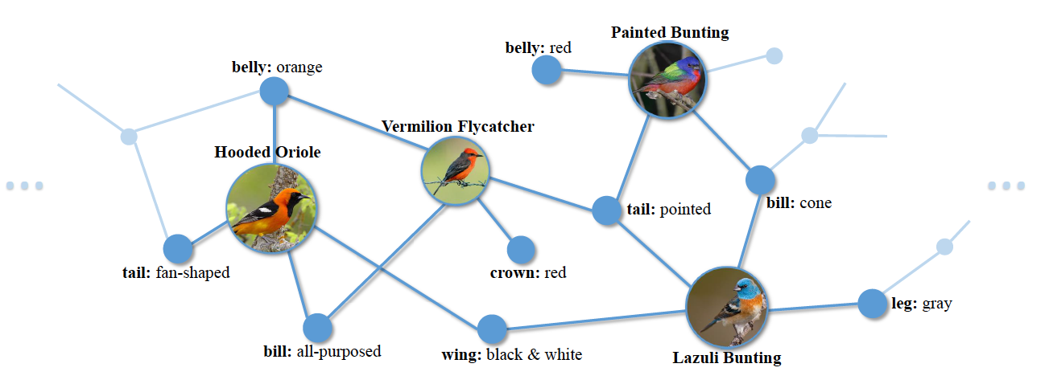
Knowledge graph
The knowledge graph refers to the correlations between categories and attributes
Nodes: the category labels and attributes.
Edges: the correlations between corresponding labels and attributes
Construct a Category-Attributes Knowledge Graph for the whole dataset
Encoding it with Gated Graph Neural Networks (GGNN) [1]
GGNN learns features for graph-structured dataset via recurrent message propagation
[1] Li, Yujia, Daniel Tarlow, Marc Brockschmidt, and Richard Zemel. “Gated graph sequence neural networks”, arxiv 2015

Slide 4
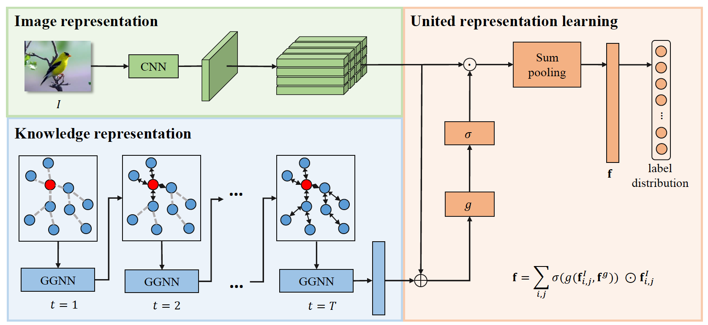

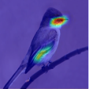
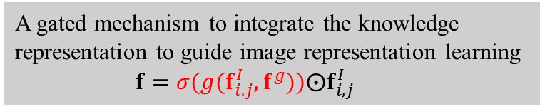
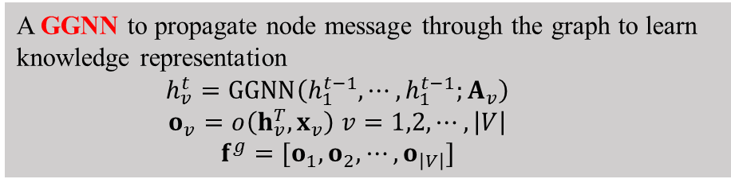
Knowledge Embedded Representation Learning
A GGNN to propagate node message through the graph to learn knowledge representation
$$h_{v}^{t}=GGNN\left(h_{1}^{t−1},⋯,h_{1}^{t−1};A_{v}\right)$$
$$o_{v}=o\left(h_{v}^{T},x_{v}\right) v=1,2,⋯,\left|V\right|$$
$$f^{g}=[o_{1},o_{2},⋯,o_{\left|V\right|}]$$
Image feature extraction
Knowledge representation learning
United representation learning
A gated mechanism to integrate the knowledge representation to guide image representation learning
$$f=σ(g(f_{i.j}^{I},f^{g}))⨀f_{i,j}^{I}$$
Notes:
g (): attention function

Slide 5
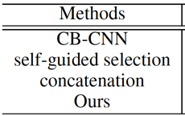
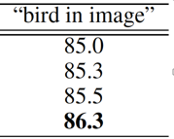

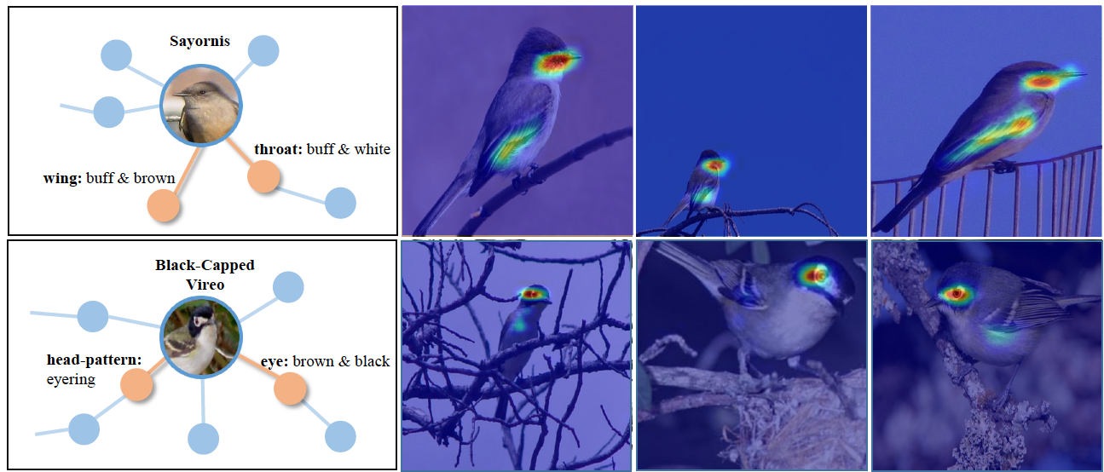
Experiment on Caltech-UCSD bird dataset
200 categories, 5,994 images for training and 5,794 images for test
CB-CNN: compact bilinear model
Self-guided selection: remove the knowledge representation during the gated selection of image features
Concatenation: Simply concatenate the image feature and knowledge representation for recognition.
Explicitly associating specific attributes with image representations

