Slide 1
并行程序设计
Lecture 1: Introduction
谷守珍
2018年3月2日

Slide 2

课程信息
时间： 周五上午10:00-11:40 （1~18周）
地点：教书院120
课本：“An Introduction to Parallel Programming,” Peter Pacheco, Morgan-Kaufmann Publishers, 2011.
课程考核：
  平时成绩：50%（练习30％+编程项目20%）
  期末考试：50%（闭卷）
先修课程：
  C语言、计算机组成原理、操作系统
Email: szgu@sei.ecnu.edu.cn
Tel：021-62224020
办公室：数学馆东213

Slide 3
课堂须知
每堂课不定时会有小测试~！
请不要带笔记本电脑
禁止抄袭作业！
禁止从网上抄袭编程代码！

Slide 4
课程目标
学习怎样编写并行程序
  了解计算机的并行架构
  用并行的思想考虑问题
  编写正确的并行程序
了解目前主流的并行计算相关知识
  为什么学习这门课
  目前流行的并行编程模型与结构
  今后的发展趋势

Slide 5
Why Parallel Computing?

Slide 6
Parallel and Distributed Computing
Parallel computing (processing):
  the use of two or more processors (computers), usually within a single system, working simultaneously to solve a single problem.
Distributed computing (processing):
  any computing that involves multiple computers remote from each other that each have a role in a computation problem or information processing.
Parallel programming:
  the human process of developing programs that express what computations should be executed in parallel.

Slide 7
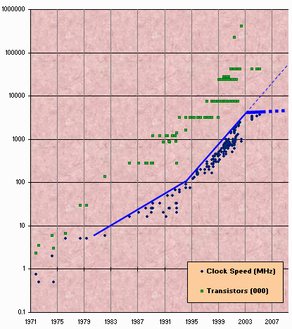
Technology Trends: Microprocessor Capacity
Transistor count still rising
Clock speed flattening sharply
Slide source: Maurice Herlihy

Slide 8
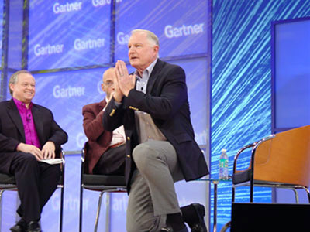
Technology Trends
Moore’s Law: Gordon Moore (co-founder of Intel) predicted in 1965 that the transistor density of semiconductor chips would double roughly every 18 months.
Microprocessor performance increases 50% per year
  Where does the performance gain from? Clock Rate and Capacity
  Clock Rate increases 30% per year
  Transistor count grows much faster than clock rate. Increase 40% per year
2004年, Intel CEO贝瑞特曾为奔腾4处理器无法突破4GHz大关而下跪道歉。2011年Intel终于攻克4GHz大关，发布了一款双核Xeon处理器，其默认主频高达4.4GHz

Slide 9
The Multi-Core or Many-Core Paradigm Shift
What to do with all these transistors?
Key ideas:
  Movement away from increasingly complex processor design and faster clocks
  Replicated functionality (i.e., parallel) is simpler to design
  Resources more efficiently utilized
  Huge power management advantages
All Computers are Parallel Computers.

Slide 10

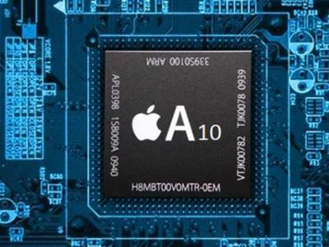
Smartphones
2 billion transistors
2 CPU
4 GPU

Slide 11


Gaming Console
5 billion transistors
AMD 8 Core CPU
768 Shader Cores

Slide 12

The fastest computer in 2013
天河2号，Tianhe-2 has 16,000 nodes, each with two Intel Xeon IvyBridge processors and three Xeon Phi processors for a combined total of 3,120,000 computing cores.
33.86 petaflops, 12.4PB hard disk,1.4PB main memory

Slide 13
Software Challenge
The chip industry's move to multicore processors, like Sun's Niagara chip has caught software developers flat-footed.
"We really don't know how to write software in this new model," David Patterson notes. "It's absolutely critical for the future of IT in the United States and around the world that we figure it out."
From IEEE Spectrum

Slide 14
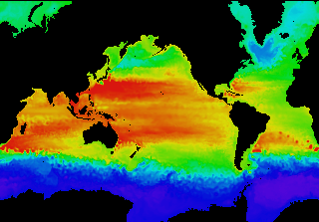
Example: Global Climate Modeling Problem
Problem is to compute:
  f(latitude, longitude, elevation, time) →
  temperature, pressure, humidity, wind velocity
Approach:
  Discretize the domain, e.g., a measurement point every 10 km
  Devise an algorithm to predict weather at time t+δt given t
Uses:
  Predict major events, e.g., El Nino
  Use in setting air emissions standards
Source: http://www.epm.ornl.gov/chammp/chammp.html

Slide 15
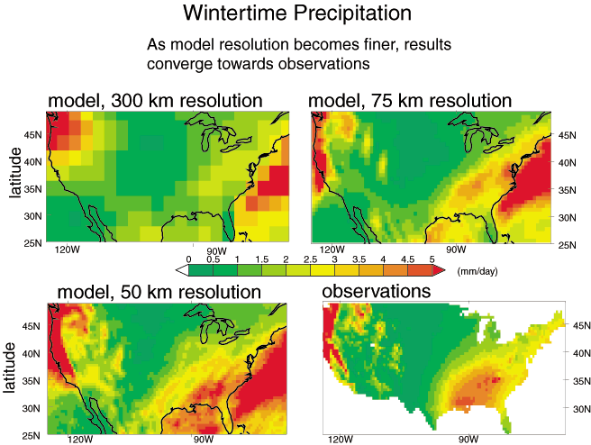
Example: Global Climate Modeling Problem
High Resolution Climate Modeling on NERSC-3 – P. Duffy, et al., LLNL

Slide 16
Some Characteristics of Scientific Simulation
Discretize physical or conceptual space into a grid
  Simpler if regular, may be more representative if adaptive
Perform local computations on grid
  Given yesterday’s temperature and weather pattern, what is today’s expected temperature?
Communicate partial results between grids
  Contribute local weather result to understand global weather pattern.
Repeat for a set of time steps
Possibly perform other calculations with results
  Given weather model, what area should evacuate for a hurricane?

Slide 17
Example of Discretizing a Domain
One processor
computes this part
Another processor
computes this part in
parallel
Processors in adjacent blocks in the grid communicate their result.

Slide 18
Finding Enough Parallelism
Suppose only part of an application seems parallel
Amdahl’s law
  let s be the fraction of work done sequentially, so (1-s) is fraction parallelizable
  P = number of processors
Speedup(P) = Time(1)/Time(P)
<= 1/(s + (1-s)/P)
<= 1/s
Even if the parallel part speeds up perfectly
performance is limited by the sequential part

Slide 19
Overhead of Parallelism
Given enough parallel work, this is the biggest barrier to getting desired speedup
Parallelism overheads include:
  cost of starting a thread or process
  cost of communicating shared data
  cost of synchronizing
  extra (redundant) computation
Each of these can be in the range of milliseconds (=millions of flops) on some systems
Tradeoff: Algorithm needs sufficiently large units of work to run fast in parallel (I.e. large granularity), but not so large that there is not enough parallel work

Slide 20
Locality and Parallelism
Conventional
Storage
Hierarchy
Proc
Proc
Proc
Cache
Cache
Cache
L2 Cache
L2 Cache
L2 Cache
L3 Cache
L3 Cache
L3 Cache
potential
interconnects
Memory
Memory
Memory
Large memories are slow, fast memories are small
Program should do most work on local data

Slide 21
Load Imbalance
Load imbalance is the time that some processors in the system are idle due to
  insufficient parallelism (during that phase)某一阶段
  unequal size tasks 任务划分不平等
Examples of the latter
  adapting to “interesting parts of a domain”
  tree-structured computations
  fundamentally unstructured problems
Algorithm needs to balance load
Good
Bad

Slide 22
Summary of Lecture
Solving the “Parallel Programming Problem”
  Key technical challenge facing today’s computing industry, government agencies and scientists
Scientific simulation discretizes some space into a grid
  Perform local computations on grid
  Communicate partial results between grids
  Repeat for a set of time steps
  Possibly perform other calculations with results
Commodity parallel programming can draw from this history and move forward in a new direction
Writing fast parallel programs is difficult
  Amdahl’s Law ➔Must parallelize most of computation串行比例越小越好
  Data Locality 额外开销
  Communication and Synchronization 额外开销
  Load Imbalance

