Slide 1
并行程序设计
Lecture 10:
MPI: Collective Communications
Shouzhen Gu

Slide 2
Today’s Lecture
  3.4 Collective communication
  MPI_Reduce and MPI_Allreduce
  Broadcast
  Data distributions
  Scatter
  Gather
  Allgather

Slide 3
Collective communication
Collective communication is defined as communication that involves a group or groups of processes.
Several collective routines such as broadcast and gather have a single originating or receiving process. Such a process is called the root.
The type-matching conditions for the collective operations are more strict than the corresponding conditions between sender and receiver in point-to-point.
Collective communication calls may use the same communicators as point-to-point communication.
The key concept of the collective functions is to have a group or groups of participating processes.
There are two types of communicators: intra-communicators and inter-communicators.
Notes:
An intracommunicator can be thought of as an identifier for a single group of processes linked with a context.
An intercommunicator identifies two distinct groups of processes linked with a context.

Slide 4
Collective vs. Point-to-Point Communications
All the processes in the communicator must call the same collective function. For example, a program that attempts to match a call to MPI_Reduce on one process with a call to MPI_Recv on another process is erroneous, and, in all likelihood, the program will hang or crash.
The arguments passed by each process to an MPI collective communication must be “compatible.” For example, if one process passes in 0 as the dest_process and another passes in 1, then the outcome of a call to MPI_Reduce is erroneous, and, once again, the program is likely to hang or crash.
Notes:
通信器里所有的进程，必须调用同一个集合体函数。

Slide 5
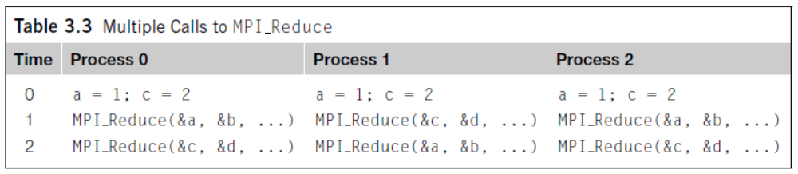
Collective vs. Point-to-Point Communications
The output_data_p argument is only used on dest_process. However, all of the processes still need to pass in an actual argument corresponding to output_data_p, even if it’s just NULL.
Point-to-point communications are matched on the basis of tags and communicators. Collective communications don’t use tags. They’re matched solely on the basis of the communicator and the order in which they’re called.
Notes:
指向接收消息的内存块的指针，这个参数只在目的进程中用。

Slide 6
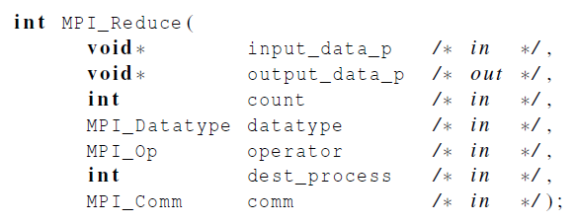
MPI_Reduce
All processes provide input buffers of the same length, with elements of the same type as the output buffer at the root.
The operator is always assumed to be associative.
Notes:
int MPI_Reduce(
void *input_data, /*指向发送消息的内存块的指针 */
void *output_data, /*指向接收（输出）消息的内存块的指针 */
int count，/*数据量*/
MPI_Datatype datatype,/*数据类型*/
MPI_Op operator,/*规约操作*/
int dest，/*要接收（输出）消息的进程的进程号*/
MPI_Comm comm);/*通信器，指定通信范围*/

Slide 7
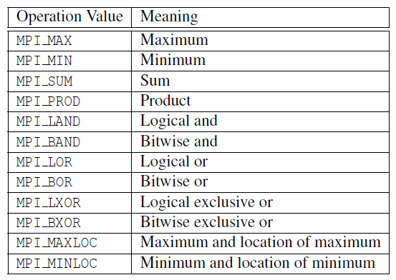
Predefined reduction operators in MPI

Slide 8
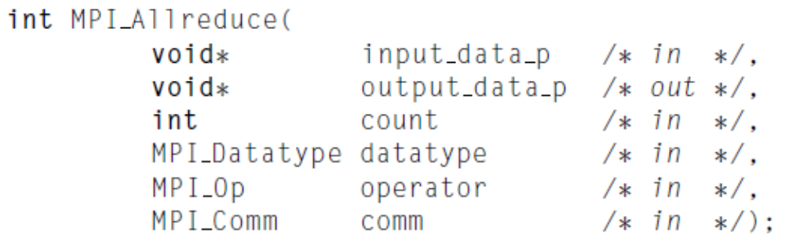
MPI_Allreduce
MPI_Allreduce behaves the same as MPI_Reduce except that the result appears in the receive buffer of all the processes.

Slide 9
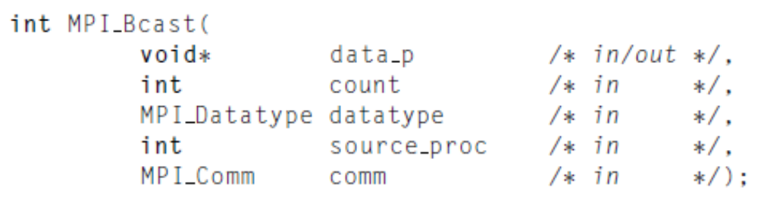
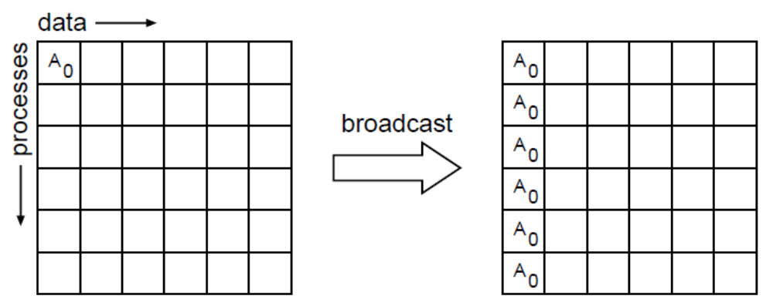
Broadcast
p0
p1
p2
p3
p4
p5
Notes:
When broadcasting, Root is included

Slide 10
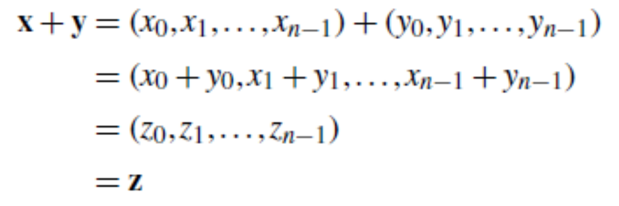
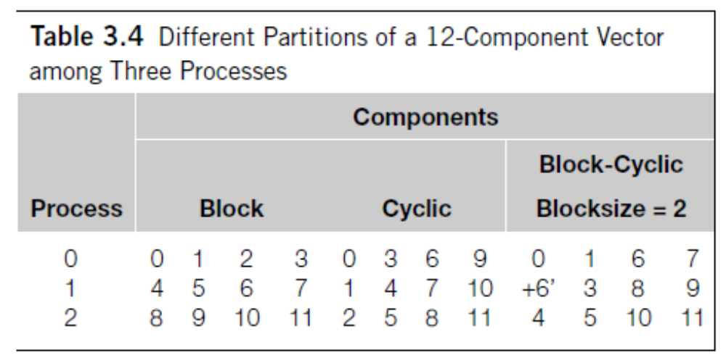
Data distributions
n=12, Comm_sz=3

Slide 11
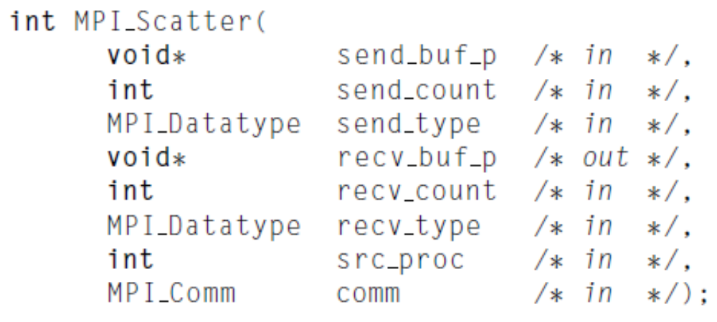
Scatter
the number of items it sends to each process
This message is split into n equal segments, the i-th segment is sent to the i-th process

Slide 12
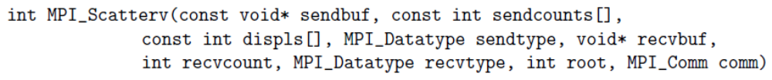
MPI_Scatterv
non-negative integer array (of length group size) containing
the number of elements that are sent to each process.
The data sent to process j is placed into sendbuf of the root process beginning at offset displs[j] elements .

Slide 13
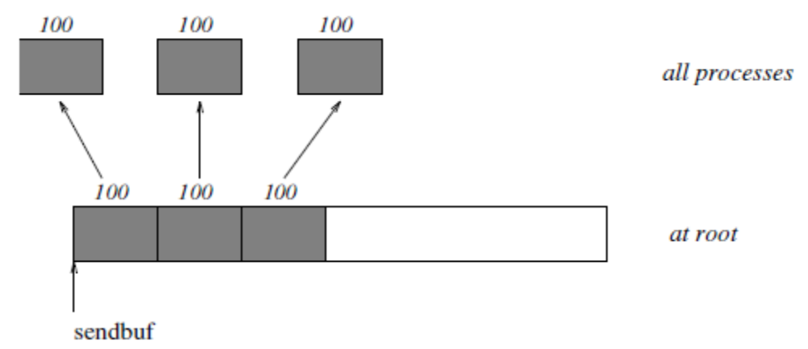
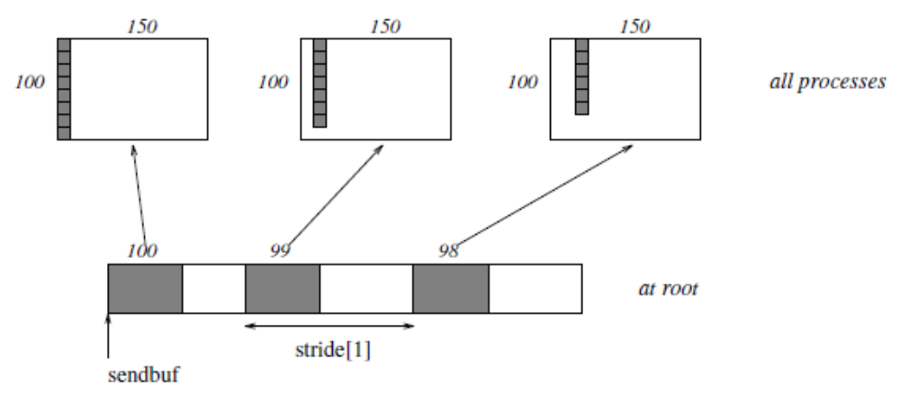
MPI_Scatter vs. MPI_Scatterv

Slide 14
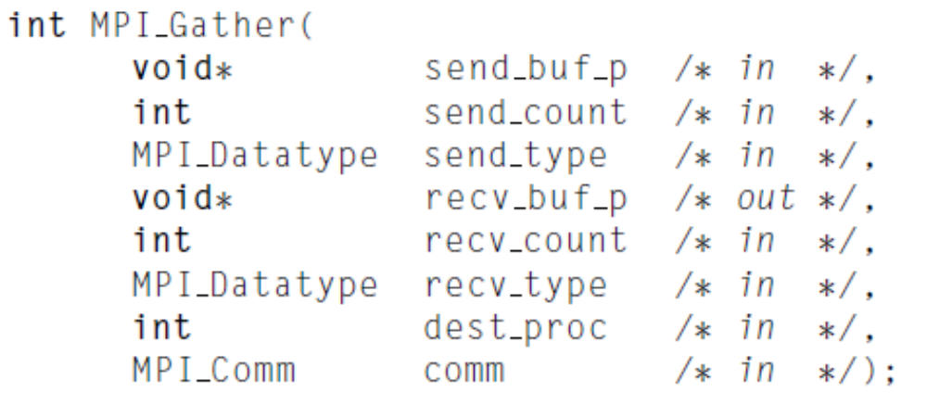
Gather
the number of items it receives from each process
All processes execute：
MPI_Send(sendbuf, sendcount, sendtype, root , ...),
The root execute:
MPI_Recv(recvbuf+i·recvcount·extent(recvtype), recvcount, recvtype, i,...),
Notes:
When gathering, Root is included

Slide 15
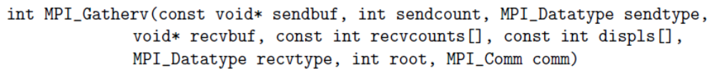
MPI_Gatherv
non-negative integer array (of length group size) containing
the number of elements that are received from each process (significant only at root)
The data received from process j is placed into recvbuf of the root process beginning at offset displs[j] elements (in terms of the recvtype).

Slide 16
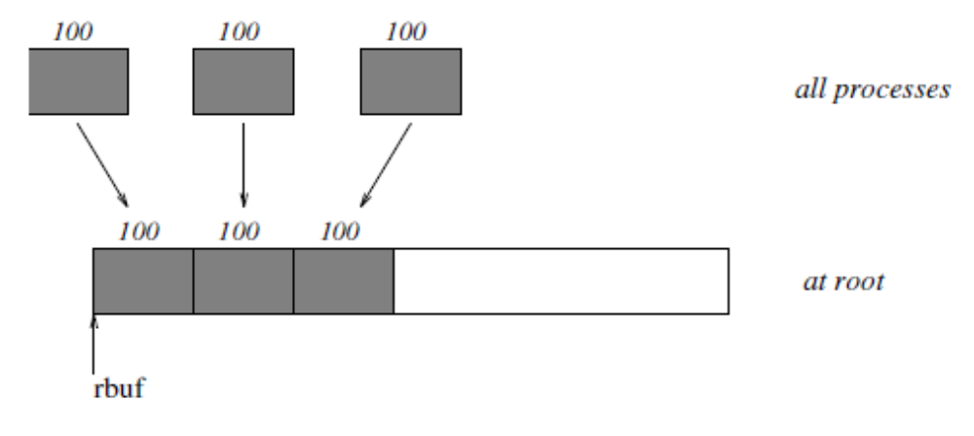
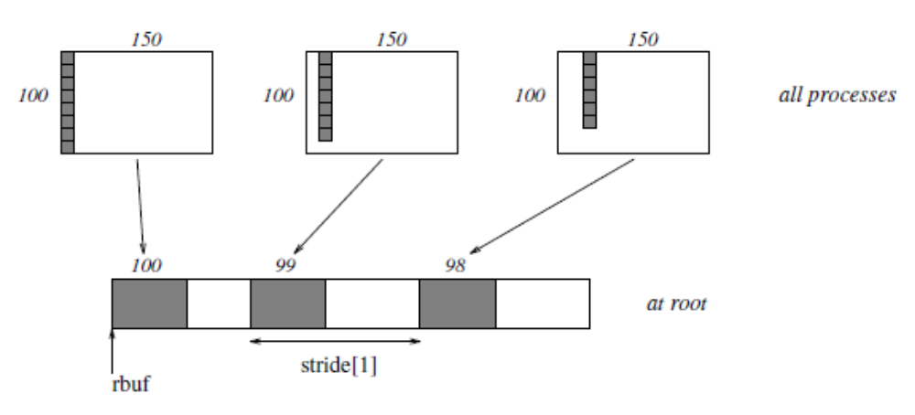
MPI_Gather vs. MPI_Gatherv

Slide 17
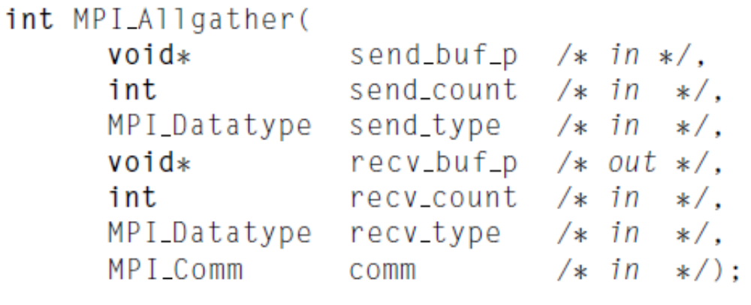
Allgather
MPI_Allgather can be thought of as MPI_Gather, but where all processes receive the result, instead of just the root.
The block of data sent from the j-th process is received by every process and placed in the j-th block of the buffer recv_buf_p.

Slide 18
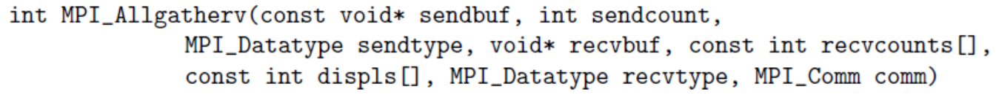
MPI_Allgatherv
MPI_ALLGATHERV can be thought of as MPI_GATHERV, but where all processes receive the result, instead of just the root.
The block of data sent from the j-th process is received by every process and placed in the j-th block of the buffer recvbuf.
These blocks need not all be the same size.

Slide 19
Program2
Matrix-Matrix multiplication
Assuming there are two matrix m×n A and n×k B (where m, n, k can be 1,2,3,…,1000). If C equals to A×B, then C is an m×k matrix. Please write a program with MPI to realize matrix-matrix multiplication. Note that, matrix A and B, int m, int n, and int k should be obtained from I/O. And the number of processes t can be arbitrary positive integer.
Deadline: 20:00 pm, May 22
Email:51164500273@stu.ecnu.edu.cn

