Slide 1
并行程序设计
Lecture 11:
MPI: Communicators and Groups
Shouzhen Gu

Slide 2
Today’s Lecture
  MPI Derived Datatypes
  Pack and unpack
  MPI’s Support for Libraries

Slide 3

The Path of a Message
A blocking send visits 4 address spaces
Besides being time-consuming, it locks processors together quite tightly
the cost of sending a fixed amount of data in multiple messages is usually much greater than the cost of sending a single message with the same amount of data

Slide 4
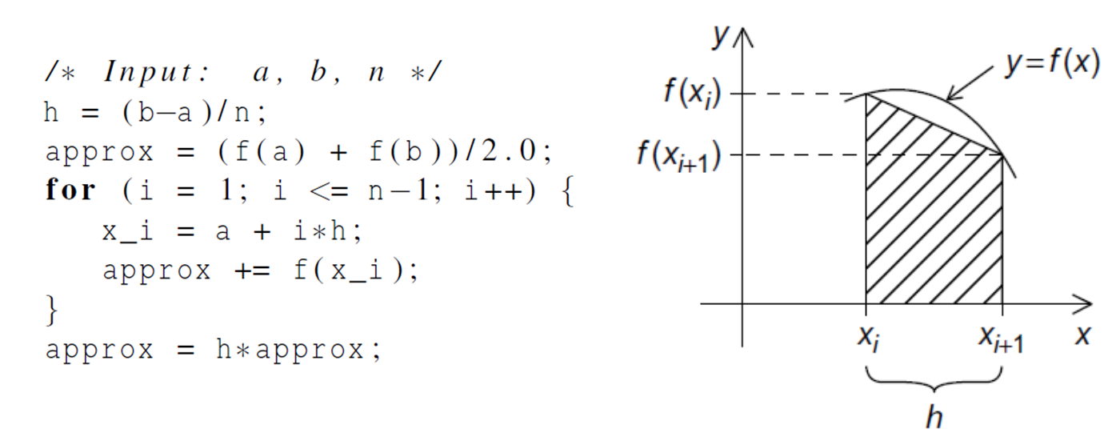
Approaches to Consolidating data
the count argument: can be used to group contiguous array elements into a single message
Derived datatypes: can be used to represent any collection of data items in memory by storing both the types of the items and their relative locations in memory.
MPI Pack/Unpack: Packs data of a given datatype into contiguous memory and communicate.

Slide 5
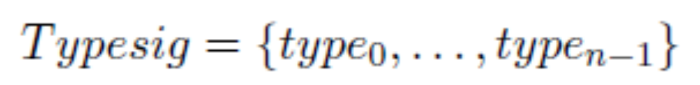
MPI Derived Datatypes
One often wants to pass messages that contain values with different datatypes (e.g., an integer count, followed by a sequence of real numbers)
One often wants to send noncontiguous data (e.g., a sub-block of a matrix).
A derived datatype consists of two parts:
  A sequence of basic datatypes
  A sequence of integer (byte) displacements
Type map: a sequence of pairs {(type₀, disp₀),…,(type_{n-1},disp_{n-1})}, where type_{i} are basic types, and disp_{i} are displacements.
Type signature of the datatype: the sequence of basic datatypes (displacements ignored)

Slide 6
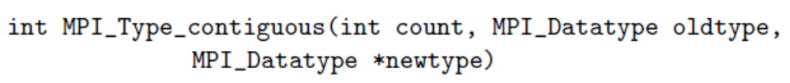
MPI_Type_contiguous
For example:
Let oldtype have type map
MPI_Type_contiguous(3,oldtype,newtype)
Notes:
return a newType consisting of the replication of a datatype into contiguous location

Slide 7
MPI_Type_vector
MPI_Type_vector is a more general constructor that allows replication of a datatype into locations that consist of equally spaced blocks.
For example, let oldtype has type map
Then, MPI_Type_vector(2,3,4,oldtype,newtype)

Slide 8
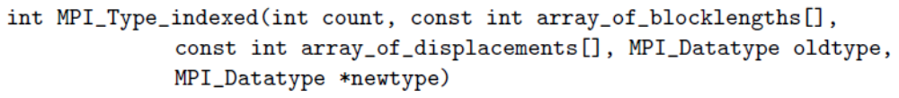
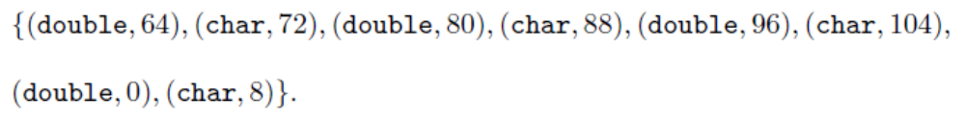
MPI_Type_indexed
MPI_Type_indexed allows replication of an old datatype into a sequence of blocks (each block is a concatenation of the old datatype), where each block can contain a different number of copies and have a different displacement.
For example, let oldtype has type map
Let B=(3,1) and D=(4,0).
Then, MPI_Type_indexed(2,B,D,oldtype,newtype)

Slide 9
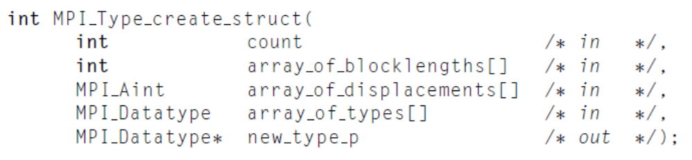
MPI_Type_create_struct
We can use MPI_Type_create_struct to build a derived datatype that consists of individual elements that have different basic types
For example, let type1 has type map
Then, MPI_Type_create_struct(3,B,D,T,newtype)

Slide 10
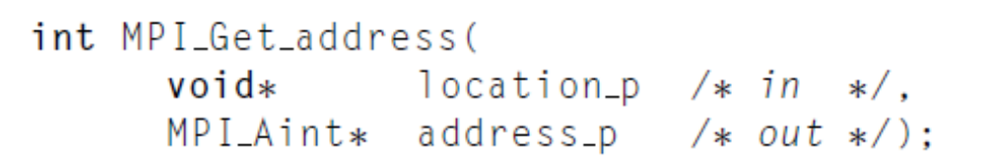
Address and Size Functions
MPI_Bottom: indicate the initial address zero of address space.
MPI_Get_address: find the the address of a location in memory.
MPI_Aint_add: produces a new MPI_Aint value that is equivalent to the sum of the base and disp arguments.
MPI_Aint_diff: produces a new MPI_Aint value that is equivalent to the difference between addr1 and addr2 arguments.
MPI_Type_size: set the value of size to the total size, in
bytes, of the entries in the type signature associated with datatype.

Slide 11
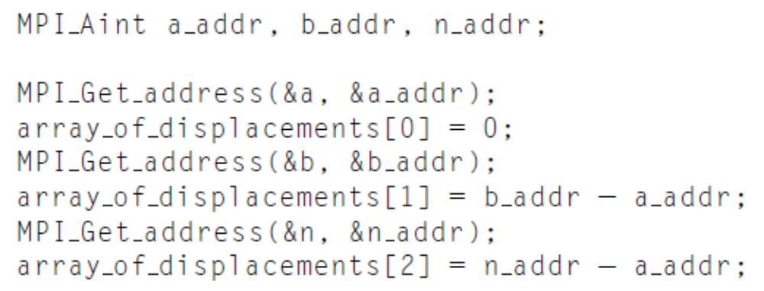
Get displacements
MPI_Aint a_addr, b_addr, n_addr;
MPI_Get_address(&a, &a_addr);
MPI_Get_address(&b, &b_addr);
MPI_Get_address(&n, &n_addr);
array_of_displacements[0]=0;
array_of_displacements[1]=MPI_Aint_diff(&b_addr,&a_addr);
array_of_displacements[2]=MPI_Aint_diff(&n_addr,&a_addr);

Slide 12
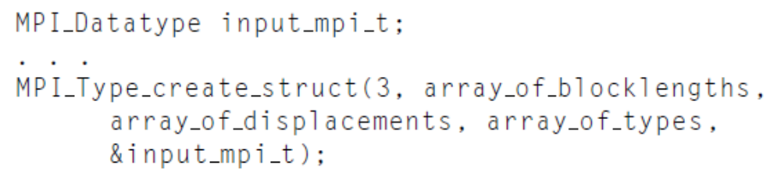
Commit and Free
MPI_Type_commit: A datatype object has to be committed before it can be used in a communication. The commit operation commits the datatype, that is, the formal description of a communication buffer, not the content of that buffer.
MPI_Type_free: Marks the datatype object associated with datatype for deallocation and sets datatype to MPI_DATATYPE_NULL.

Slide 13
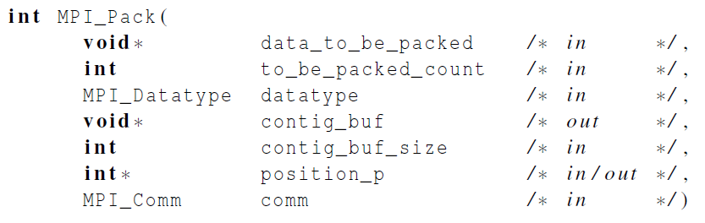

Packing data into a buffer of contiguous memory
Packs the message in the send buffer specified by data_to_be_packed, to_be_paced_count, datatype into the buffer space specified by contig_buf and contig_buf_size.
The output buffer is a contiguous storage area containing contig_buf_size bytes, starting at the address contig_buf.
Notes:
The input value of position is the first location in the output buffer to be used for
packing. position is incremented by the size of the packed message, and the output value
of position is the first location in the output buffer following the locations occupied by the
packed message.

Slide 14
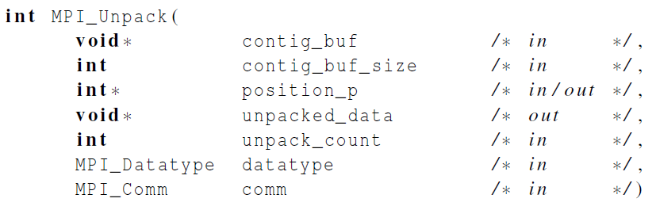

Unpacking data from a buffer of contiguous memory
Unpacks a message into the receive buffer specified by unpacked_data, unpack_count, datatype from the buffer space specified by contig_buf and contig_buf_size. The output buffer can be any communication buffer allowed in MPI_RECV.

Slide 15
MPI’s Support for Libraries
Contexts of communication: a property of communicators that allows partitioning of the communication space; provide the ability to have separate safe “universes" of message-passing in MPI;
Groups of processes: define an ordered collection of processes, each with a rank, and it is this group that defines the low-level names for inter-process communication;
Virtual topologies: defines a special mapping of the ranks in a group to and from a topology;
Attribute caching: Communicators provide a “caching" mechanism that allows one to associate new attributes with communicators, on par with MPI built-in features;
Communicators: encapsulate all of these ideas in order to provide the appropriate scope for all communication operations in MPI;

Slide 16
Intra-Communicators
Intra-communicators bring together the concepts of group and context.
MPI communication operations reference communicators to determine the scope and the “communication universe" in which a point-to-point or collective operation is to operate.
Each communicator contains a group of valid participants; this group always includes the local process.
For collective communication, the intra-communicator specifies the set of processes that participate in the collective operation (and their order, when significant)
An initial intra-communicator MPI_COMM_WORLD of all processes the local process can communicate with after initialization (itself included) is defined once MPI_INIT or MPI_INIT_THREAD has been called.

Slide 17
Inter-Communicators
An inter-communication is a point-to-point communication between processes in different groups. a summary of the properties of inter-communication and inter-communicators:
The syntax of point-to-point and collective communication is the same for both inter- and intra-communication. The same communicator can be used both for send and for receive operations;
A target process is addressed by its rank in the remote group, both for sends and for receives;
Communications using an inter-communicator are guaranteed not to conflict with any communications that use a different communicator.
A communicator will provide either intra- or inter-communication, never both.

Slide 18
Group Mnagement
Group Accessors:
Group Constructors: Group constructors are used to subset and superset existing groups.
Notes:
The function MPI_GROUP_INCL creates a group newgroup that consists of the
n processes in group with ranks ranks[0],: : :, ranks[n-1]

Slide 19
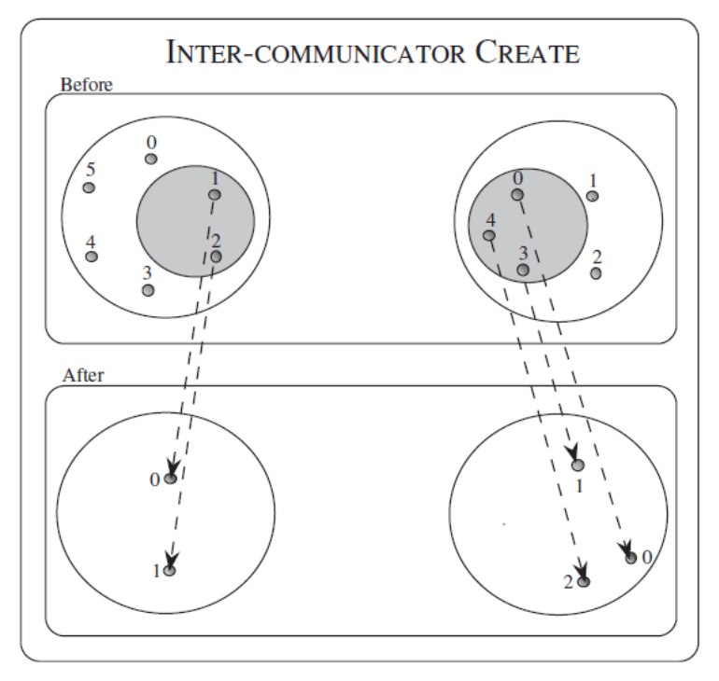
Communicator Management
Communicator Accessors:
Communicator Constructors:

Slide 20
MPI Basic (Blocking) Send
A(10)
B(20)
MPI_Send( A, 10, MPI_DOUBLE, 1, …)
MPI_Recv( B, 20, MPI_DOUBLE, 0, … )
MPI_SEND(start, count, datatype, dest, tag, comm)
The message buffer is described by (start, count, datatype).
The target process is specified by dest, which is the rank of the target process in the communicator specified by comm.
When this function returns, the data has been delivered to the system and the buffer can be reused. The message may not have been received by the target process.

Slide 21
MPI Basic (Blocking) Receive
A(10)
B(20)
MPI_Send( A, 10, MPI_DOUBLE, 1, …)
MPI_Recv( B, 20, MPI_DOUBLE, 0, … )
MPI_RECV(start, count, datatype, source, tag, comm, status)
Waits until a matching (both source and tag) message is received from the system, and the buffer can be used
source is rank in communicator specified by comm, or MPI_ANY_SOURCE
tag is a tag to be matched on or MPI_ANY_TAG
receiving fewer than count occurrences of datatype is OK, but receiving more is an error
status contains further information (e.g. size of message)

Slide 22
Non-Blocking Communication
The programmer must ensure semantics of the send and receive.
This class of non-blocking protocols returns from the send or receive operation before it is semantically safe to do so.
Non-blocking operations are generally accompanied by a check-status operation.
When used correctly, these primitives are capable of overlapping communication overheads with useful computations.
Message passing libraries typically provide both blocking and non-blocking primitives.

Slide 23
Non-Blocking Communication
To overlap communication with computation, MPI provides a pair of functions for performing non-blocking send and receive operations (“I” stands for “Immediate”):
int MPI_Isend(void *buf, int count, MPI_Datatype datatype, int dest, int tag, MPI_Comm comm, MPI_Request *request)
int MPI_Irecv(void *buf, int count, MPI_Datatype datatype, int source, int tag, MPI_Comm comm, MPI_Request *request)
These operations return before the operations have been completed.
Function MPI_Test tests whether or not the non- blocking send or receive operation identified by its request has finished.
int MPI_Test(MPI_Request *request, int *flag, MPI_Status *status)
MPI_Wait waits for the operation to complete.
int MPI_Wait(MPI_Request *request, MPI_Status *status)

