Slide 1
并行程序设计
Lecture 12:
MPI
Shouzhen Gu

Slide 2
Today’s Lecture
  Performance Evaluation of MPI Program
  Parallel odd-even transposition sort

Slide 3
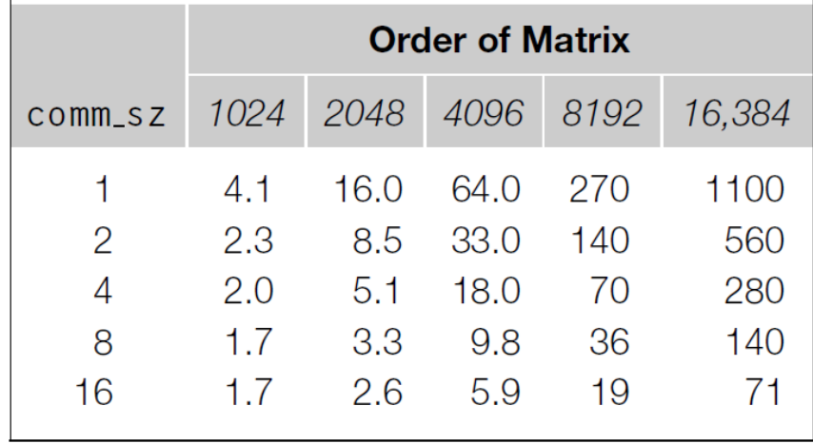
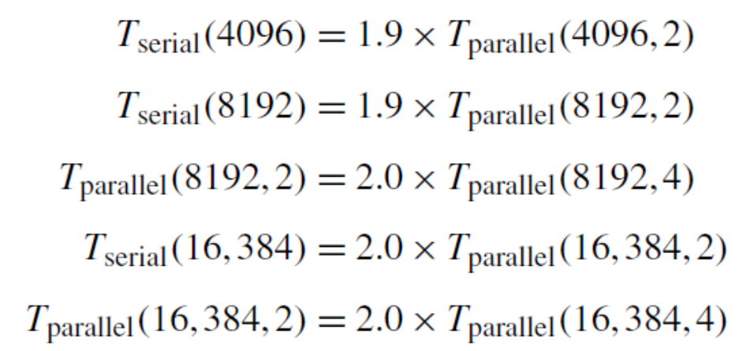
Performance Evaluation of MPI Program
parallel run-time
serial run-time
overhead time
T_{parallel}(n,p)=T_{serial}(n)/p+T_{overhead}
size of the input
the number of processes
Doubling p roughly halves the overall run-time.

Slide 4
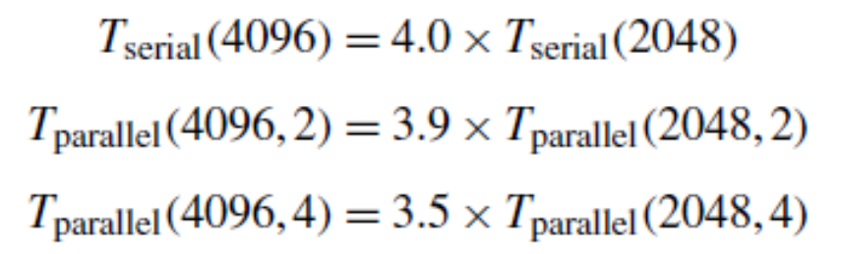
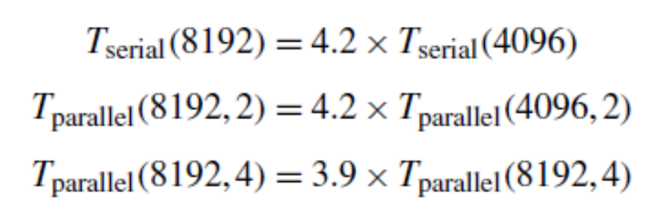
Performance Evaluation of MPI Program
If we fix p at a small value, then increasing n seems to have approximately the same effect as increasing n for the serial program.
For small p, the overhead run-time has little effect on the performance.

Slide 5
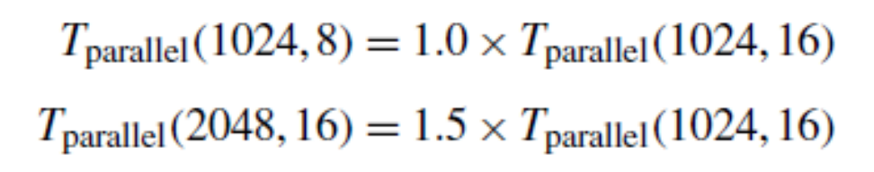
Performance Evaluation of MPI Program
For small n and large p, the dominant term for T_{parallel} is T_{overhead}
Notes:
数据项少，进程多，杀鸡焉用宰牛刀，额外开销很大

Slide 6
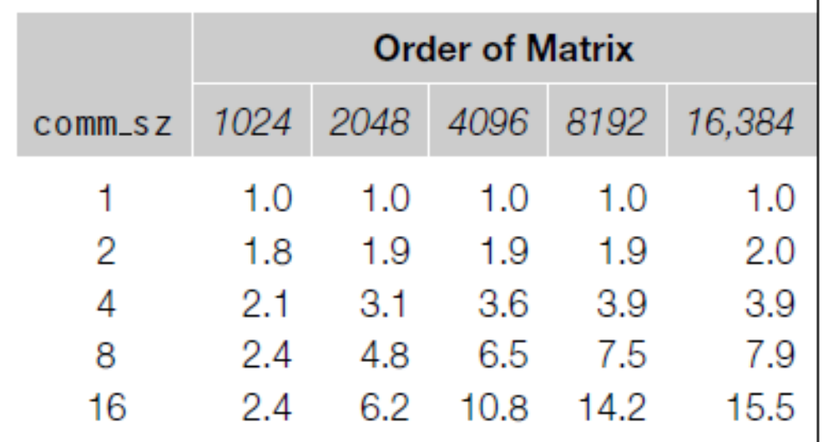
Speedup
S(n,p)=T_{serial}(n)/T_{parallel}(n,p)
For small p and large n, the speedup is near linear.
For small n and large p, the speedup was considerably less than p.

Slide 7
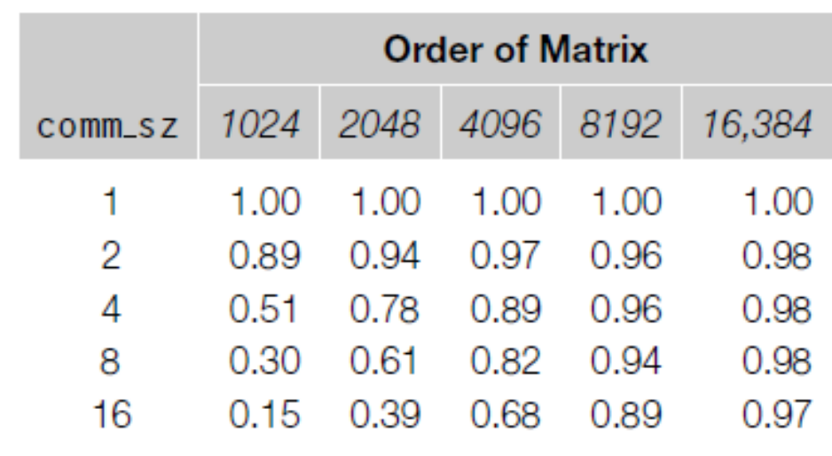
Efficiency
E(n,p)=S(n,p)/p= T_{serial}(n)/(T_{parallel}(n,p)×p)
per process speedup
For small p and large n, the parallel efficiencies are near linear.
For small n and large p, the parallel efficiencies are far from linear.

Slide 8
Scalability
A program is scalable if the problem size can be increased at a rate so that the efficiency doesn’t decrease as the number of processes increase.
Strongly scalable: can maintain constant efficiency without increasing the problem size.
Weakly scalable: can maintain a constant efficiency if the problem size increases at the same rate as the number of processes.
E(n,p)=S(n,p)/p
the problem size
the number of processes

Slide 9
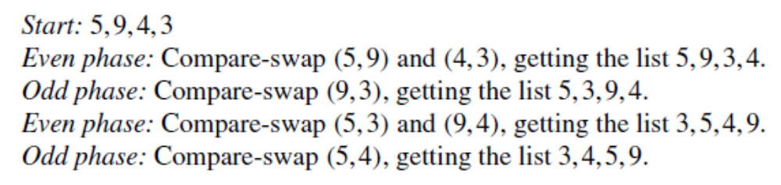
Parallel odd-even transposition sort
Even phases:
Odd phases:

Slide 10
Serial odd-even transposition sort
1 void Odd even sort(
2 int a[] /* in/out* /,
3 int n /* in */) {
4 int phase, i, temp;
5
6 for (phase = 0; phase < n; phase++)
7 if (phase % 2 == 0) { / *Even phase */
8 for (i = 1; i < n; i += 2)
9 if (a[i-1] > a[i]) {
10 temp = a[i];
11 a[i] = a[i-1];
12 a[i-1] = temp;
13 }
14 } else {/ *Odd phase */
15 for (i = 1; i < n-1; i += 2)
16 if (a[i] > a[i+1]) f
17 temp = a[i];
18 a[i] = a[i+1];
19 a[i+1] = temp;
20 }
21 }
22 } / Odd even sort /

Slide 11
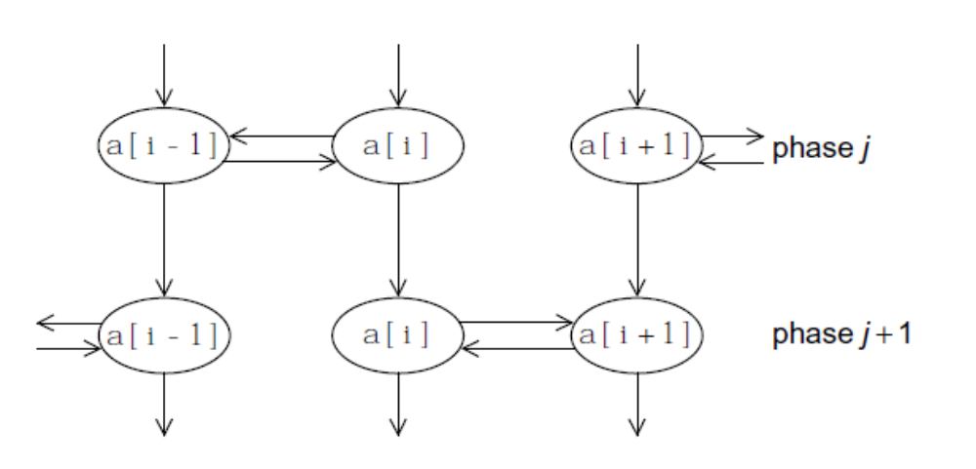
Parallel odd-even transposition sort
Tasks: Determine the value of a[i] at the end of phase j.
Communications: the task needs to communicate with either the task determining the value of a[i-1] or a[i+1]. Also the value of a[i] at the end of phase j needs to be available for determining the value of a[i] at the end of phase j+1.

Slide 12
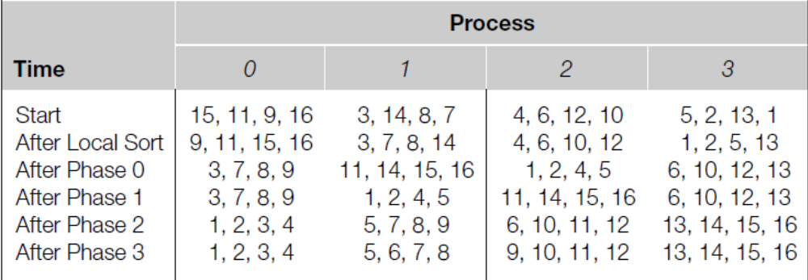
Parallel odd-even transposition sort
Phase0: process 0 and 1 exchange elements. Process 0 keep the four smaller elements and process 1 keep the larger. Process 2 and 3 exchange elements, similarly, process 2 keep the smaller and process 3 keep the larger. (even phase)
Phase1: process 1 and 2 exchange elements, process 1 keep the smaller and process 2 keep the larger. (odd phase)
Notes:
How to decide whether the process is idle

Slide 13
Parallel odd-even transposition sort
Sort local keys;
for (phase = 0; phase < comm sz; phase++) {
partner = Compute partner(phase, my rank);
if (I’m not idle) {
Send my keys to partner;
Receive keys from partner;
if (my rank < partner)
Keep smaller keys;
else
Keep larger keys;从小到大排序
}
}
how do we compute the partner rank?
And what is the partner rank when a process is idle?
if my rank = 0 or my rank = comm_sz-1, the partner rank can be -1 or comm_sz.

Slide 14
Compute Partner
if (phase % 2 == 0) / *Even phase */
if (my rank % 2 != 0) /* Odd rank */
partner = my_rank-1;
else /*Even rank */
partner = my_rank + 1;
else /*Odd phase*/
if (my rank % 2 != 0) /*Odd rank */
partner = my rank + 1;
else /*Even rank*/
partner = my rank 􀀀 1;
if (partner == -1 || partner == comm_sz)
partner = MPI_PROC_NULL;
MPI_PROC_NULL is a constant defined by MPI.

Slide 15
Safety in MPI programs
Deadlock: If the MPI_Send executed by each process blocks, no process will be able to start executing a call to MPI_Recv, and the program will hang or deadlock, that is, each process is blocked waiting for an event that will never happen.
Unsafe program: A program that relies on MPI-provided buffering.
In general, how can we tell if a program is safe?
How can we modify the communication in the parallel odd-even sort program so that it is safe?

Slide 16
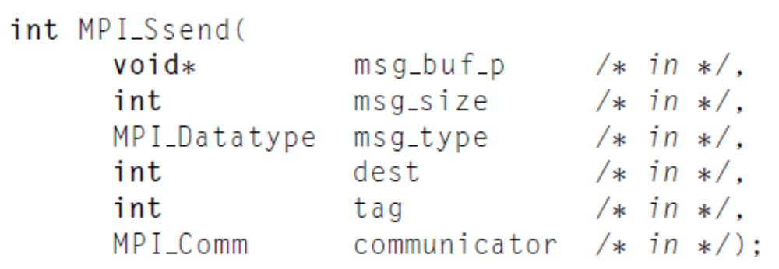
Synchronous mode
The send will complete successfully only if a matching receive is posted, and the receive operation has started to receive the message sent by the synchronous send.
MPI_Ssend is guaranteed to block until the matching receive starts. So, we can check whether a program is safe.

Slide 17
Communication modes
MPI_Bsend: A buffered mode send operation can be started whether or not a matching receive has been posted. If a send is executed and no matching receive is posted, then MPI must buffer the outgoing message.
MPI_Ssend: A synchronous mode send operation can be started whether or not a matching receive was posted. However, the send will complete successfully only if a matching receive is posted.
MPI_Rsend: A send that uses the ready communication mode may be started only if the matching receive is already posted.

Slide 18
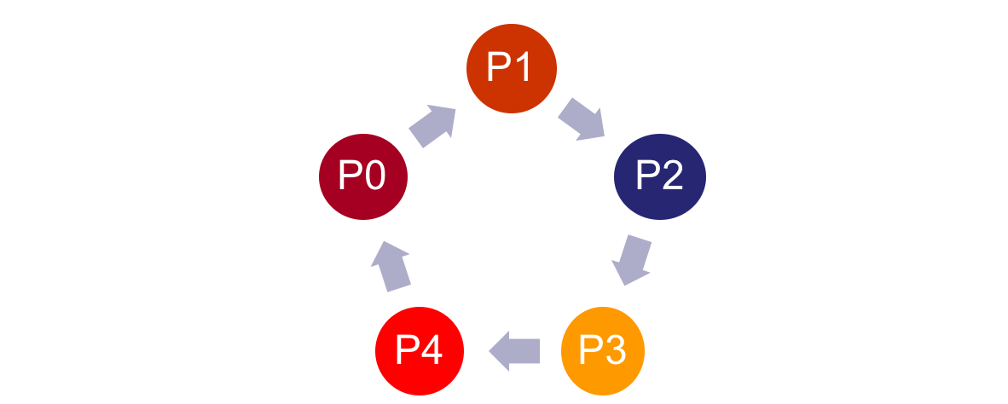
Ring Pass
send
send
send
send
send
if (my rank % 2 == 0) {
MPI_Send(msg, size, MPI_INT, (my rank+1) % comm_sz, 0, comm);
MPI_Recv(new_msg, size, MPI_INT, (my_rank+comm_sz-1) % comm_sz,
0, comm, MPI_STATUS_IGNORE).
} else {
MPI_Recv(new_msg, size, MPI_INT, (my_rank+comm_sz-1) % comm_sz,
0, comm, MPI_STATUS_IGNORE).
MPI_Send(msg, size, MPI_INT, (my_rank+1) % comm_sz, 0, comm);
}

Slide 19
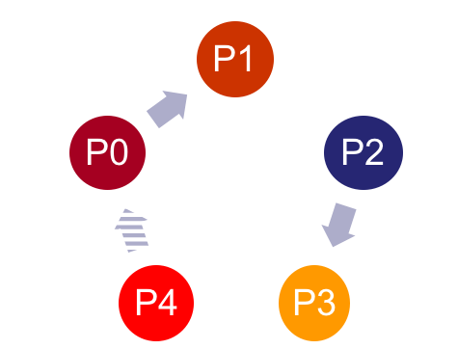
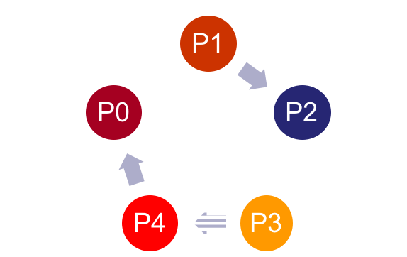
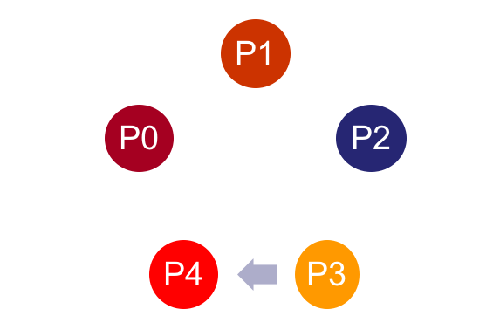
Ring Pass
this will work if comm_sz is even.
It’s not clear if comm_sz is odd.
Time0
Time1
Time2

Slide 20
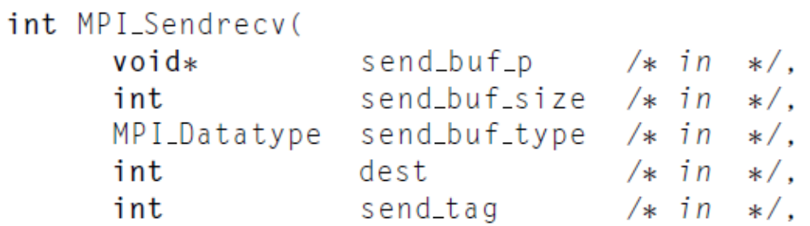
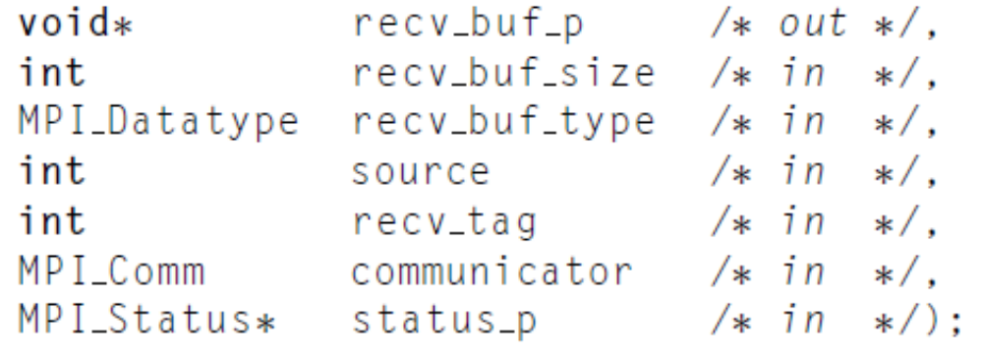
Send-receive
This function carries out a blocking send and a receive in a single call.
The dest and the source can be the same or different.
MPI implementation schedules the communications so that the program won’t hang or crash.
Notes:
The most common cause of an unsafe program is multiple processes simultaneously first sending to each other and then receiving.
Another example is ring pass.

Slide 21
Homework 2: merge sort
Homework2: Parallel merge sort (MPI)
Starts with n/comm_sz keys assigned to each process. It ends with all the keys stored on process 0 in non-decreasing order. Process 0 should read in n and broadcast it to the other processes. Each process should use a random number generator to create a local list of n/comm_sz ints. Each process should then sort its local list, and process 0 should gather and print the local lists. Then the processes should use tree-structured communication to merge the global list onto process 0, which prints the result.
Deadline: 17:00 pm, May 8
Email:735968414@qq.com（助教刘新韬邮箱）

Slide 22
Summary of MPI
In MPI a communicator is a collection of processes that can send messages to each other.
MPI_Init does the setup needed to run MPI. It should be called before other MPI functions are called. When you’re done using MPI, you should call MPI_Finalize.
Message passing libraries typically provide both blocking and non-blocking primitives.
There are two types of communications in MPI, Collective communications and point-to-point communications.
For ordinary vectors and arrays, we could use block partitioning, cyclic partitioning, or block-cyclic partitioning to partition global data structures among the processes.
MPI provides three methods for reducing the number of messages sent: the count argument to communication functions, derived datatypes, and MPI Pack/Unpack.
Speedup, efficiency and scalability can be use to evaluate the program performance.
Prevent from deadlock or hang. An unsafe MPI program can be made safe in several ways.

