Slide 1
并行程序设计
Lecture 13:
Introduction to OpenMP
Shouzhen Gu

Slide 2
Today’s Lecture
  OpenMP
  Programming Model of OpenMP
  Compiling and running OpenMP programs
  The trapezoidal rule
  The reduction clause

Slide 3
Programming with Threads
Pthreads are based on OS features
  Can be used from multiple languages (need appropriate header)
  Familiar language for most programmers
  Ability to shared data is convenient
Pitfalls
  Data races are difficult to find because they can be intermittent
  Deadlocks are usually easier, but can also be intermittent
OpenMP is commonly used today as a simpler alternative, but it is more restrictive
  OpenMP can parallelize many serial programs with relatively few annotations that specify parallelism and independence
Notes:
OpenMP支持的编程语言包括C、C++和Fortran；而支持OpenMp的编译器包括Sun Compiler，GNU Compiler和Intel Compiler等。
OpenMp提供了对并行算法的高层的抽象描述，程序员通过在源代码中加入专用的pragma来指明自己的意图，由此编译器可以自动将程序进行并行化，并在必要之处加入同步互斥以及通信。当选择忽略这些pragma，或者编译器不支持OpenMp时，程序又可退化为通常的程序(一般为串行) 。

Slide 4
OpenMP: Prevailing Shared Memory Programming Approach
Model for shared-memory parallel programming
Portable across shared-memory architectures
Scalable (on shared-memory platforms)
Incremental parallelization
  Parallelize individual computations in a program while leaving the rest of the program sequential
Compiler based
  Compiler generates thread program and synchronization
Extensions to existing programming languages (Fortran, C and C++)
  mainly by directives
  a few library routines
Notes:
OpenMP提供的这种对于并行描述的高层抽象降低了并行编程的难度和复杂度，这样程序员可以把更多的精力投入到并行算法本身，而非其具体实现细节。

Slide 5
A Programmer’s View of OpenMP
OpenMP is a portable, threaded, shared-memory programming specification with “light” syntax
  Exact behavior depends on OpenMP implementation!
  Requires compiler support (C/C++ or Fortran)
OpenMP will:
  Allow a programmer to separate a program into serial regions and parallel regions, rather than concurrently-executing threads.
  Hide stack management
  Provide synchronization constructs
OpenMP will not:
  Parallelize automatically
  Guarantee speedup
  Provide freedom from data races

Slide 6
OpenMP Execution Model
Fork-join model of parallel execution
Begin execution as a single process (master thread)
Start of a parallel construct:
  Master thread creates team of threads (worker threads)
Completion of a parallel construct:
  Threads in the team synchronize -- implicit barrier
Only master thread continues execution
Implementation optimization:
  Worker threads spin waiting on next fork

Slide 7
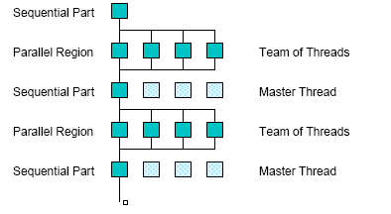
OpenMP Execution Model
fork
join
Notes:
串行zhuxiancheng
并行 工作线程

Slide 8
OpenMP parallel region construct
Block of code to be executed by multiple threads in parallel
Each thread executes the same code redundantly (SPMD)
  Work within work-sharing constructs is distributed among the threads in a team
Example with C/C++ syntax
#pragma omp parallel [ clause [ clause ] ... ] new-line
structured-block
clause can include the following:
  private (list)
  shared (list)
  num_threads(int)
  reduction(operator:list)
Notes:
in OpenMP: a program without a parallel construct will be executed sequentially
omp_get_thread_num()

Slide 9
Programming Model – Data Sharing
Parallel programs often employ two types of data
  Shared data, visible to all threads, similarly named
  Private data, visible to a single thread (often stack-allocated)
// shared, globals
int bigdata[1024];
void* foo(void* bar) {
// private, stack
int tid;
/* Calculation goes
here */
}
int bigdata[1024];
void* foo(void* bar) {
int tid;
#pragma omp parallel \
shared ( bigdata ) \
private ( tid )
{
/* Calc. here */
}
}
PThreads:
  Global-scoped variables are shared
  Stack-allocated variables are private
OpenMP:
  shared variables are shared
  private variables are private
  Default is shared
  Loop index is private

Slide 10
OpenMP uses Pragmas
Pragmas are special preprocessor instructions.
Typically added to a system to allow behaviors that aren’t part of the basic C specification.
Compilers that don’t support the pragmas ignore them.
The interpretation of OpenMP pragmas
  They modify the statement immediately following the pragma
  This could be a compound statement such as a loop
#pragma omp …

Slide 11
OpenMP directive format C
(also Fortran and C++ bindings)
Pragmas, format
#pragma omp directive_name [ clause [ clause ] ... ] new-line
Conditional compilation
#ifdef _OPENMP
  block,
  e.g., printf(“%d avail.processors\n”,omp_get_num_threads());
#endif
Case sensitive
Include file for library routines
#ifdef _OPENMP
#include <omp.h>
#endif

Slide 12
OpenMP runtime library, Query Functions
omp_get_num_threads:
Returns the number of threads currently in the team executing the parallel region from which it is called
int omp_get_num_threads(void);进程数量
omp_get_thread_num:
Returns the thread number, within the team, that lies between 0 and omp_get_num_threads()-1, inclusive. The master thread of the team is thread 0 进程号
int omp_get_thread_num(void);

Slide 13
Hello World in OpenMP
Let’s start with a parallel region construct
Things to think about
  As before, number of threads is read from command line
  Code should be correct without the pragmas and library calls
Differences from Pthreads
  More of the required code is managed by the compiler and runtime (so shorter)
  There is an implicit thread identifier
$ gcc -g –Wall −fopenmp -o …
Notes:
ggwfo

Slide 14
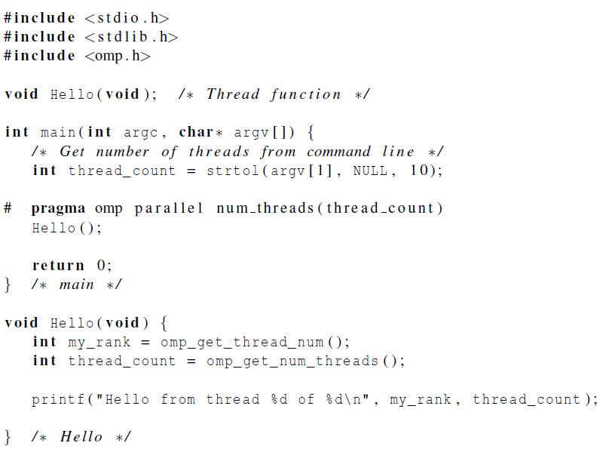
Hello World in OpenMP
Programmer specify
But not guarantee
Notes:
There may be system-defined limitations on the number of thread. Usually, it hundreds or thousands of threads.
# pragma omp parallel

Slide 15
In case the compiler doesn’t support OpenMP
# include <omp.h>
#ifdef _OPENMP
# include <omp.h>
#endif
Notes:
#ifdef_openmp
＃include <omp.h>
#endif

Slide 16
In case the compiler doesn’t support OpenMP
# ifdef _OPENMP
int my_rank = omp_get_thread_num ( );
int thread_count = omp_get_num_threads ( );
# e l s e
int my_rank = 0;
int thread_count = 1;
# endif

Slide 17
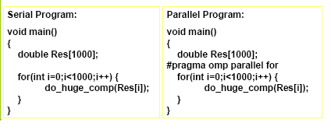
OpenMP Data Parallel Construct: Parallel Loop
All pragmas begin: #pragma
Compiler calculates loop bounds for each thread directly from serial source (computation decomposition)
Compiler also manages data partitioning of Res
Synchronization also automatic (barrier)
Notes:
The structured block following parallel for must be a for loop.

Slide 18
Limitations and Semantics
Not all “element-wise” loops can be parallelized
#pragma omp parallel for
for (i=0; i < numPixels; i++) {}
  Loop index: signed integer
  Termination Test: <,<=,>,=> with loop invariant int
  Incr/Decr by loop invariant int; change each iteration
  Count up for <,<=; count down for >,>=
  Basic block body: no control in/out except at top
Threads are created and iterations divvied up; requirements ensure iteration count is predictable
Notes:
循环次数不可知的不能并行
带break语句的不能并行
每次迭代时有data dependence的不能得到正确结果。

Slide 19
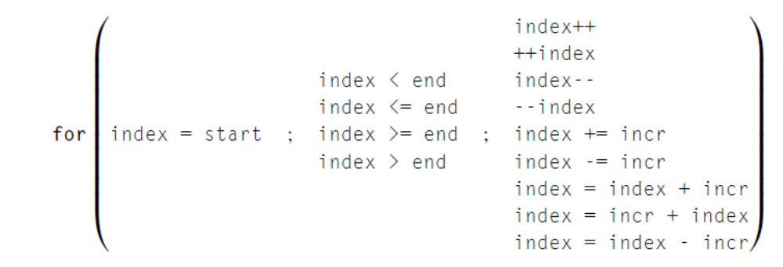
Legal Forms
The variable index must have integer or pointer type (e.g., it can’t be a float).
The expressions start, end, and incr must have a compatible type. For example, if index is a pointer, then incr must have integer type.
The expressions start, end, and incr must not change during execution of the loop.
During execution of the loop, the variable index can only be modified by the “increment expression” in the for statement.

Slide 20
Data Dependences
Serial code:
fibo[0] = fibo[1] = 1;
for (i = 2; i < n; i++)
fibo[i] = fibo[i-1] + fibo[i-2];
Parallel code:
fibo[0] = fibo[1] = 1;
#pragma omp parallel for num_threads(thread count)
for (i = 2; i < n; i++)
fibo[i] = fibo[i-1] + fibo[i-2];
OpenMP compilers don’t check for dependences among iterations in a loop that’s being parallelized with a parallel for directive. It’s up to us, the programmers, to identify these dependences.
A loop in which the results of one or more iterations depend on other iterations cannot, in general, be correctly parallelized by OpenMP.

Slide 21
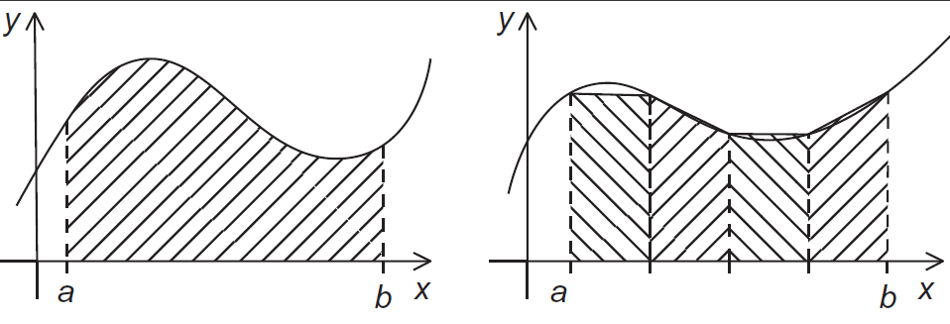
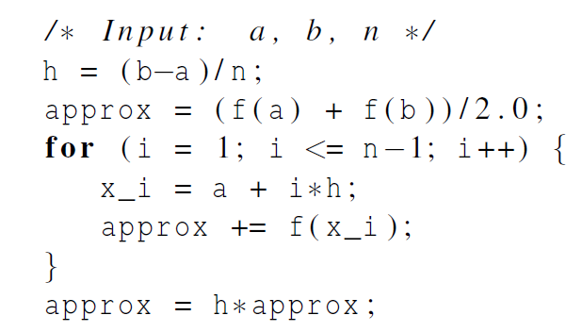
The trapezoidal rule

Slide 22
OpenMP critical directive
Enclosed code
– executed by all threads, but
– restricted to only one thread at a time
#pragma omp critical [ ( name ) ] new-line
structured-block
A thread waits at the beginning of a critical region until no other thread in the team is executing a critical region with the same name.
All unnamed critical directives map to the same unspecified name.

Slide 23
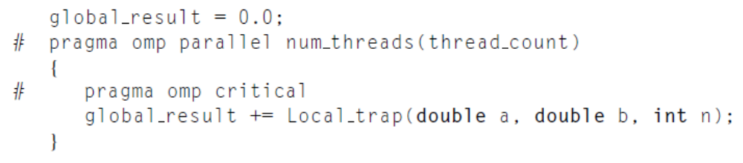
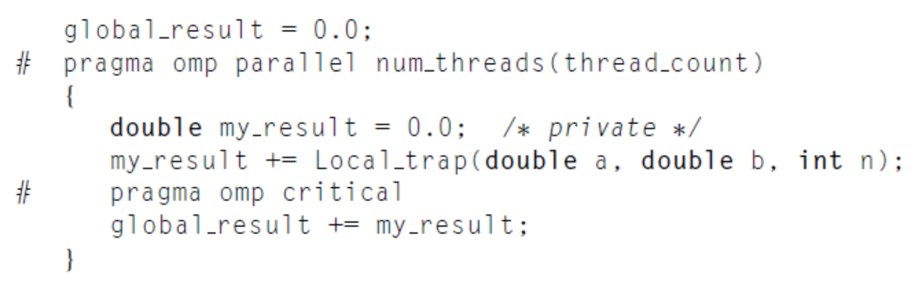
Critical Section
1.
The result is correct. However, the call to Local_trap is executed by one thread at a time.
2.

Slide 24
OpenMP Reductions
OpenMP has reduce operation
sum = 0;
#pragma omp parallel for reduction(+:sum)
for (i=0; i < 100; i++) {
sum += array[i];
}
Reduce ops and init() values (C and C++):
+ 0 bitwise & ~0 logical & 1
- 0 bitwise | 0 logical | 0
* 1 bitwise ^ 0
FORTRAN also supports min and max reductions

Slide 25
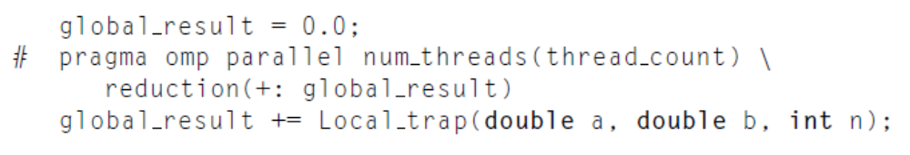
OpenMP Reductions
global_result is shared. However, a private variable is created for each thread in the team.

Slide 26
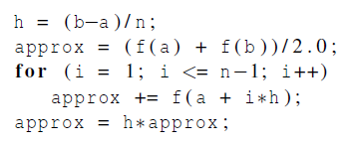
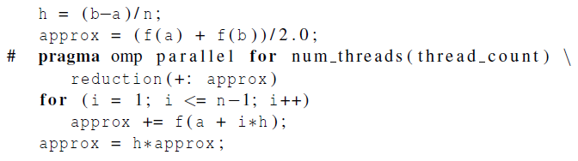
OpenMP trapezoidal rule program

Slide 27
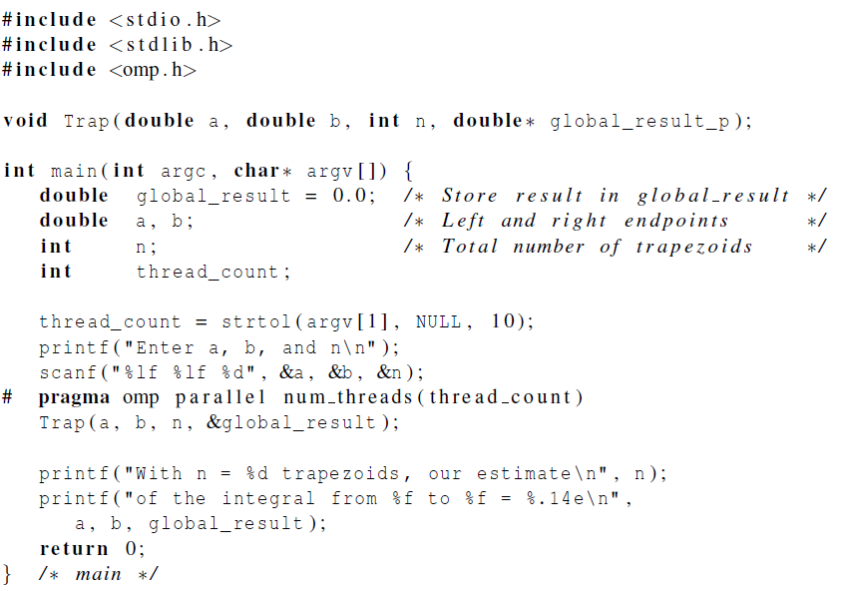
Notes:
Global_result_p的值要被改变，所以传指针

Slide 28
